Slide 1
MINING BIG DATA IN MANUFACTURING: REQUIREMENT ANALYSIS, TOOLS AND TECHNIQUES
2022311382 김원중
시스템설계

Slide 2
Brief introduction
Review paper
Old (2014)
Neural Network is popular yet
Methodologies are changed lots(some of them are no longer existed)

Slide 3
1. Introduction
Era of big-data
Deal with data should changed
Challenge
Previous: Store, aggregate etc…
Changed: Combine, use etc…
Data mining methodologies are important

Slide 4
2. Data mining tools and techniques: a review
Several tasks required
1. exploratory data analysis
Without any prior knowledge
2. descriptive modeling
Describes the general characteristics
3. predictive modeling
Performs inference on the available data
4. discovering patterns and rules
Finds hidden patterns
5. retrieval by content
Retrieve patterns

Slide 5
2.1 Data Mining Techniques
Association Rule Mining
discovering interesting relationships among variables
Clustering Analysis
Cluster objects with similar characteristics
Classification
Identifying categories
Regression
Determining relationships between variables
Notes:
1. 서로 다른 variables간에

Slide 6
2.2 Data Mining Tools
Ramamohan
Traditional data mining tools
Dashboards(gui)
Text-mining
Mikut and Reischl
Data mining suites
Business Intelligence packages(basic data mining)
Mathematical packages(algorithms)
Integration packages(integrate different open-source)
EXT(small add-one)
Data mining libraries(data mining algorithms into libraries)
Specialties(implement only one special family of data)
RES(new and innovative data mining algorithms)
Solutions(domain-specific applications)

Slide 7
3 DATA MINING IN SELECTIVE MANUFACTURING DOMAINS: REQUIREMENT ANALYSIS, TOOLS AND TECHNIQUES

Slide 8
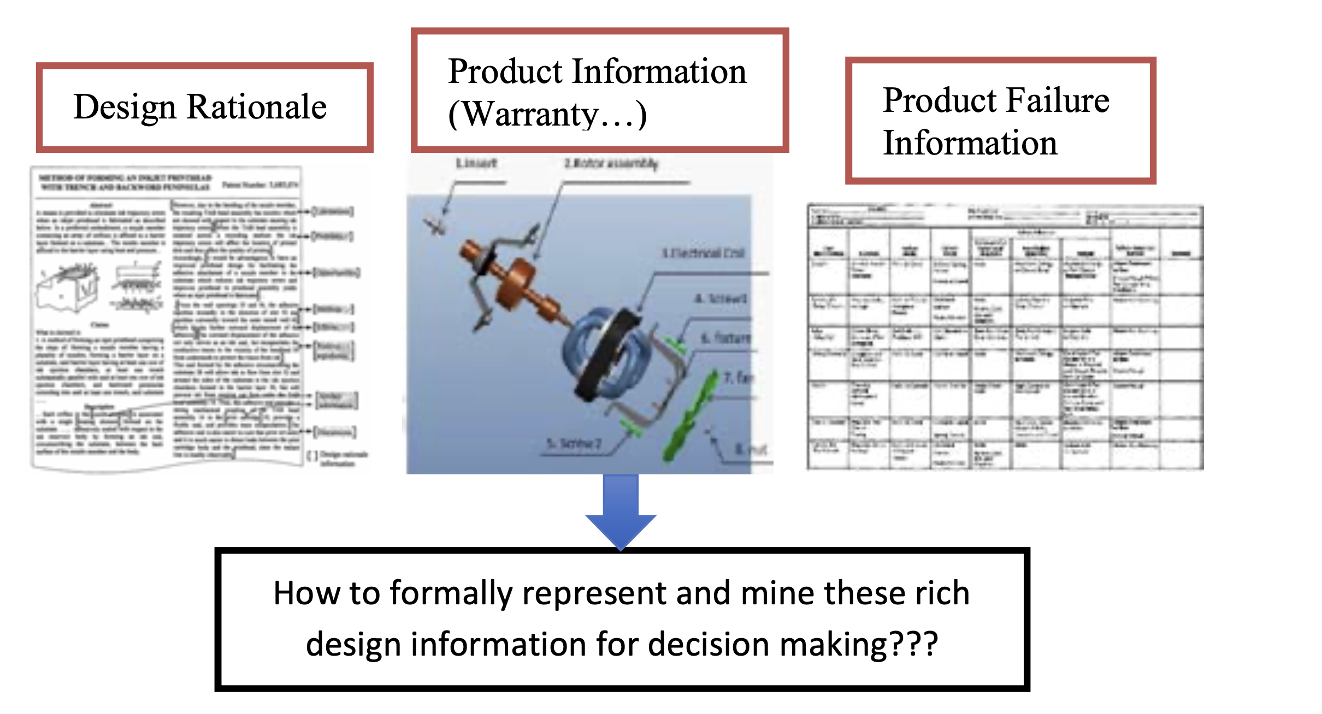
3.1 Data Mining In The “Design Intent” Retrieval Process For Manufacturing
3.1.1 Requirement Description
Information from computer-aided systems(CAD, CAM …) are available
But different data sources to extract knowledge is needed
3.1.2 Techniques
Understanding relationships between internal and external factors
Understanding → designers’ judgments are important

Slide 9
3.1.3 Tools
Text mining tools
SAS
Discovering patterns
Trends from the extracted data
GATE(General Architecture for Text Engineering)
KNIME
Audio mining tools
Burgsys
CallMiner
…

Slide 10
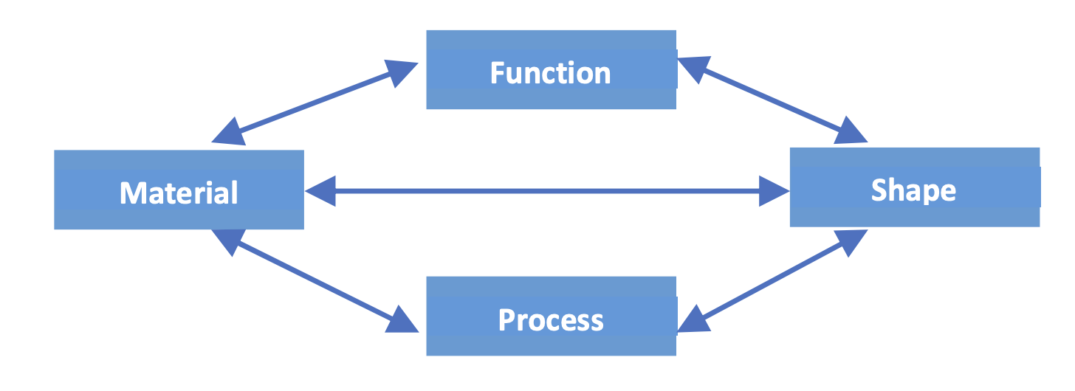
3.2 Data Mining For Material Selection
3.2.1 Requirement Description
Material sections highly depends on information
Function
Shape
Materials
Processes

Slide 11
3.2.2 Tools
DBMiner
Interactive mining
Wide range of data
Multi-level knowledge in large relational databases
Microsoft SQL Server
Own mining tools(SSDT, SQL Server Data Tools)

Slide 12
3.3 Data Mining For Process Design And Operation Management
Requirement description
Analyze process maps
Physical flows
Operational dashboards
Techniques
GA(Genetic Algorithm)
ANN(Artificial Neural Network)
Tools
KPI(Key Performance Indicators)
BOARD(commercial dashboards)
Panorama Necto …

Slide 13
3.4 Data Mining For Product Inspection, And After-Sales Services (Repair and Maintenance)
Requirement Description
Two data types
On manufacturing
After manufacturing
Two datas are different, data mining is needed
Techniques
CMM(Coordinate Measuring Machine)
CSG/B-REP(solid modeling technique)
SVM(Support Vector Machine)

Slide 14
4 INDUSTRIAL EFFORTS TO ADDRESS “BIG DATA” PROBLEMS USING DATA MINING

Slide 15
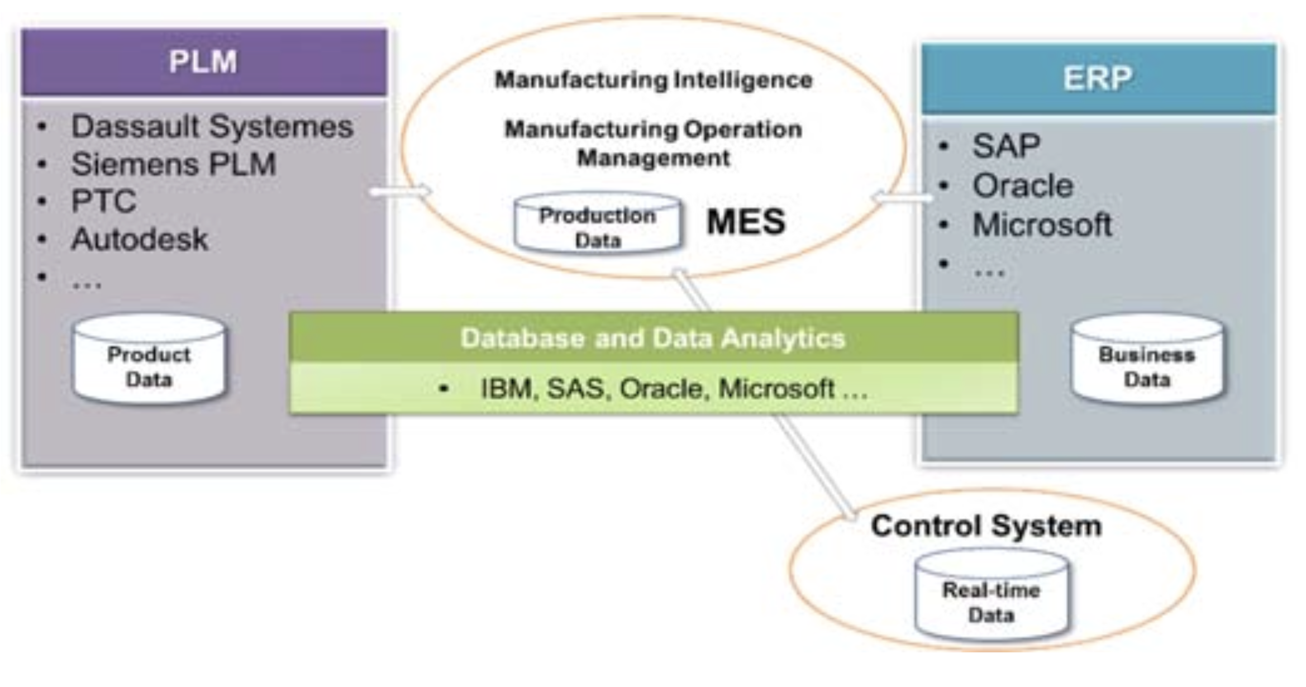
4.1 Requirement Description
Two major information systems
PLM(Product Life Cycle Management)
ERP(Enterprise Resource Planning)
And another two systems
MES(Manufacturing Execution systems)
SCADA(Supervisory Control and Data Acquisition)
Using legacy data reach limitation for the current method
Too big data and almost impossible to sort
Machine learning and data mining technologies emerged
Previous method cannot deal with by economical reasons

Slide 16
4.2 Tools and Techniques
IBM PAO(Predictive Asset Optimization)
Dassault System’s Exalead Cloudview
Siemens PLM Software Active Workspace

Slide 17
5 UNCERTAINTY AND INTEROPERABILITY ISSUES
Handle uncertain and non-interoperable data regarding data mining

Slide 18
5.1 Data Mining For Uncertain Data
Requirement Description
Hardware issues or Software issues, errors occurred
As we cannot 100% eliminate the errors, we should deal with them
Techniques
Probability-based
stochastic approach, large number theory
Fuzzy logic-based
Deduce imprecision of facts

Slide 19
5.2 Interoperability Issues Of The Data Collected From Different Sources
Requirement Description
PLM, ERP, and MES needed data
Without data-mining, only a scratch of data could get. Semantic(deep) data is needed
Techniques
Standards-Based approach(SBA)
Model Driven Approaches(MDA)
Ontology-Driven approaches

