Slide 1
SD P-P Presentation(2)
2022311382 김원중

Slide 2

ONSHAPE
Web-based CAD
PTC-CREO
FREE

Slide 3
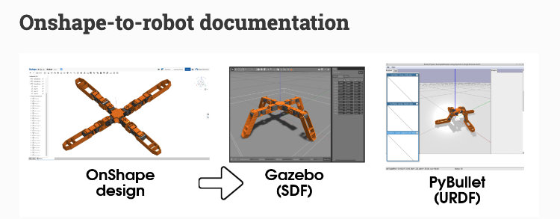
Onshape-to-robot

Slide 4
procedures
Design at ONSHAPE
Using onshape-to-robot to generate urdf
Check urdf file in mujoco.app

Slide 5
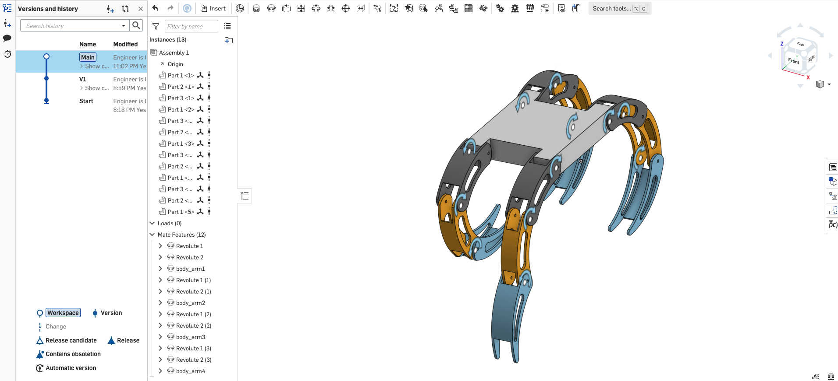
Design at ONSHAPE
Motors ➔

Slide 6
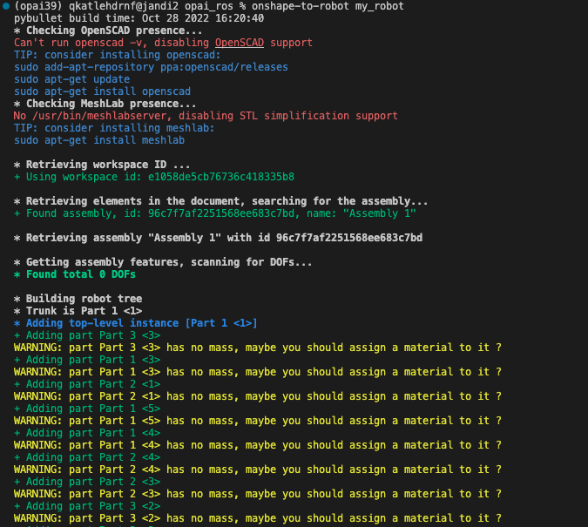
Export as urdf by python

Slide 7
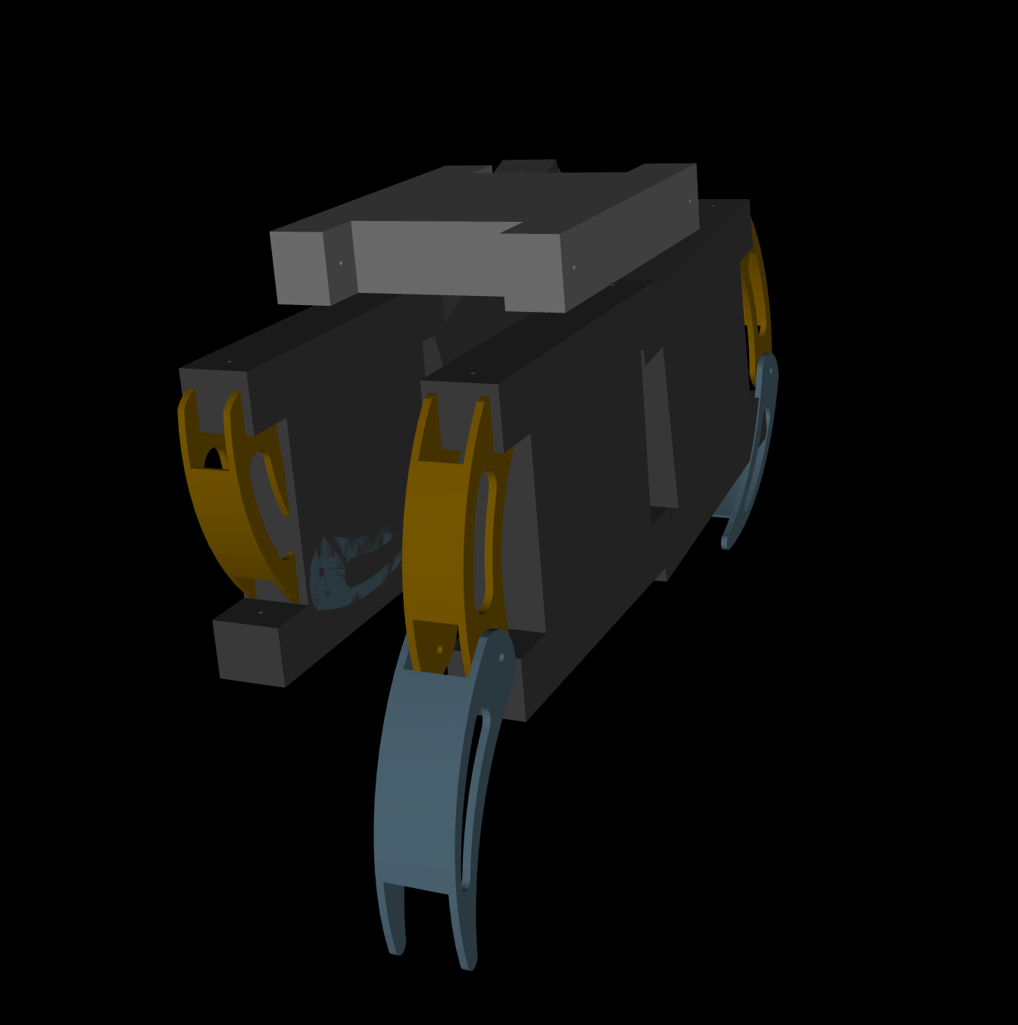
Results

Slide 8
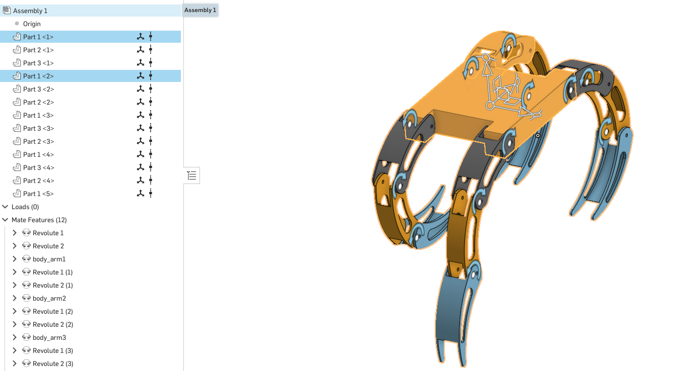
Reason of problem
Same name?

Slide 9
roadmap
1 | Single arm model on mujoco
2 | Multi arm or joint design
3 | Bug fix and learn how to move

