Slide 1
GNN needs attention too
2022311382 김원중
기계학습소개

Slide 2
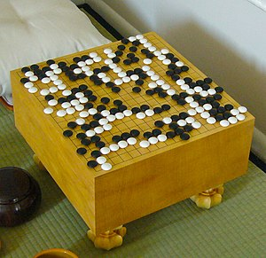
Baduk(game of go)
361!/200!
1.54E+610

Slide 3
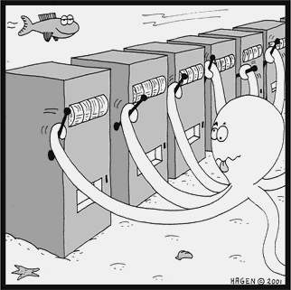
Multi Armed Bandit
Upper Confidence Bound(UCB)
Not solely random
Highly depends on Exploitation
See before move

Slide 4
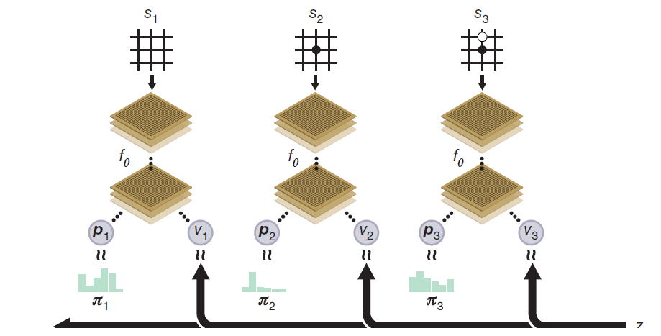
2017 Alphago zero, Mechanism
S: State
V: Winning possibility when s
P: Probability distribution over moves
DQN
Reward: number of rocks on the board

Slide 5
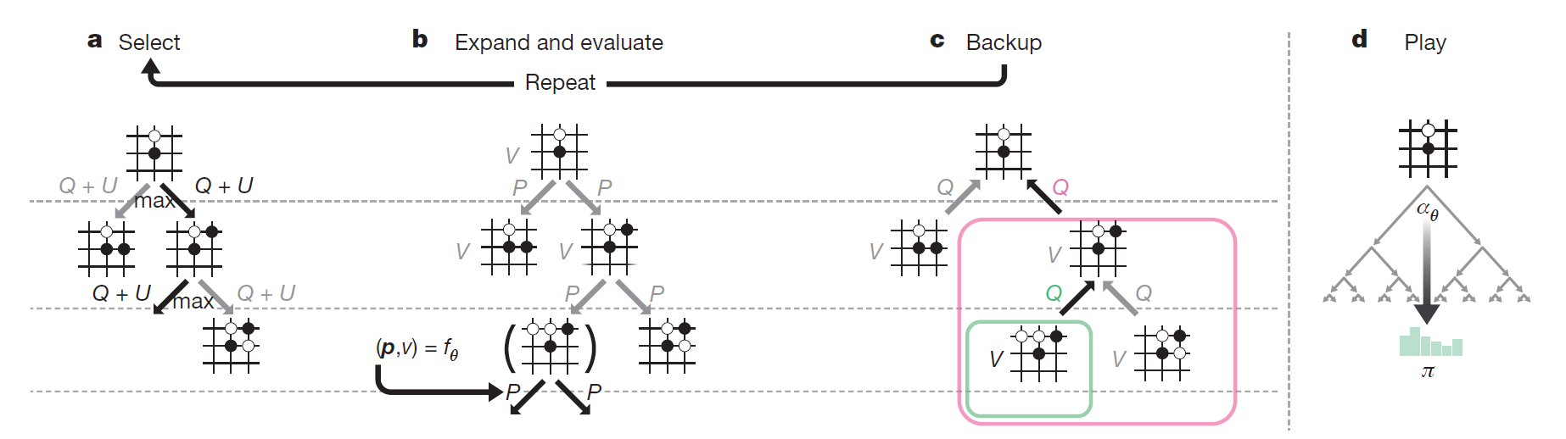
Previous models’ problem
Wasted?

Slide 6
Baduk is more like graph
S(1)
S(2,1)
S(2,2)
…
…
S(3)

Slide 7
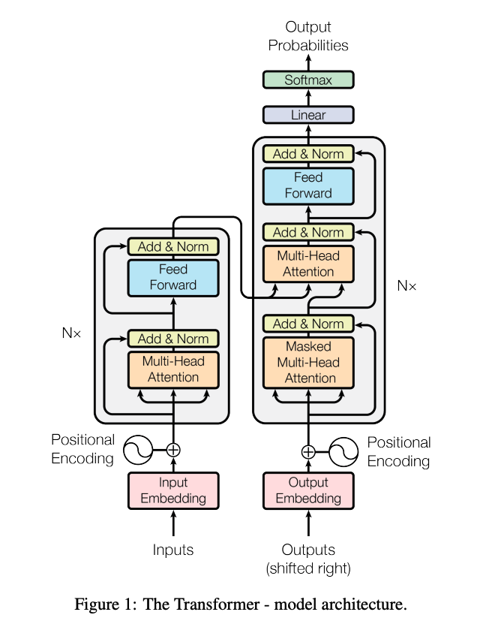
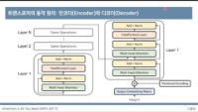
Attention mechanism

Slide 8
GNN[CNN] Block
Softmax, S(t+1)
N(1,1)
N(64,1)
State Information
Attention Value
S(t)
N(1,2)
N(64,2)
… …
……
……
Hidden vector
N(1,32)
N(64, possible place)

Slide 9
GNN networks
GNN Blocks S(t+1, 1)
0.05
Attention Value
GNN Blocks S(t+2, 1)
GNN Blocks S(t+2, 2)
GNN Blocks S(t)
0.2
Position vector
GNN Blocks S(t+1, 2)
0.75

Slide 10
Summary
Why GNN?
Baduk is not one-way calculation. But MCTS is.
GNN can make bi-direction calculation
Why transformer?
At S(t), it is helpful to know if previous calculation is passed

Slide 11
Limitations
Good at Reinforcement learning?
No
Good at GNN?
No
Good at transformer?
No…

Slide 12
Plan to mid
Make system for baduk
It can count the stone(for reward)
Know basic rule for baduk(kill it when surrounded)
Apply DQN algorithm
By solely CNN and DQN algorithm, make it playable

