Slide 1
SD P-P Presentation(1)
2022311382 김원중

Slide 2
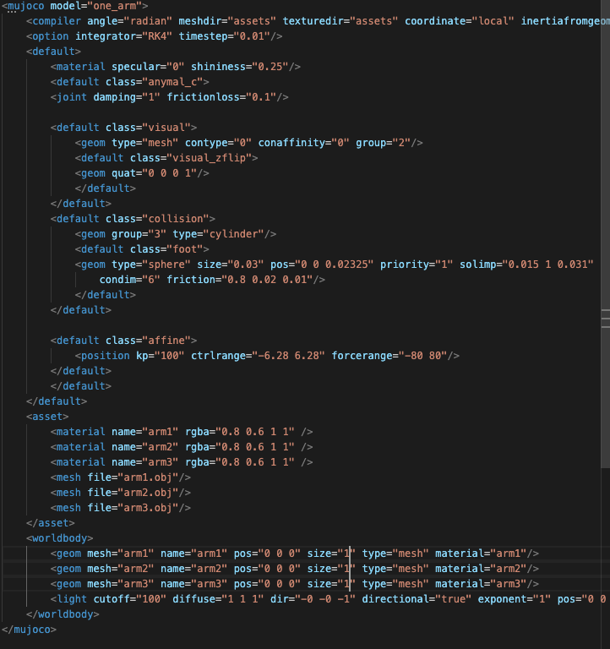
Mujoco XML
https://mujoco.readthedocs.io/en/latest/XMLreference.html

Slide 3
procedures
Prt file → obj file
Load obj file from xml file
xml file→ mjcf(urdf available) file
Load mjcf file from mujoco simulator

Slide 4

CAD file

Slide 5
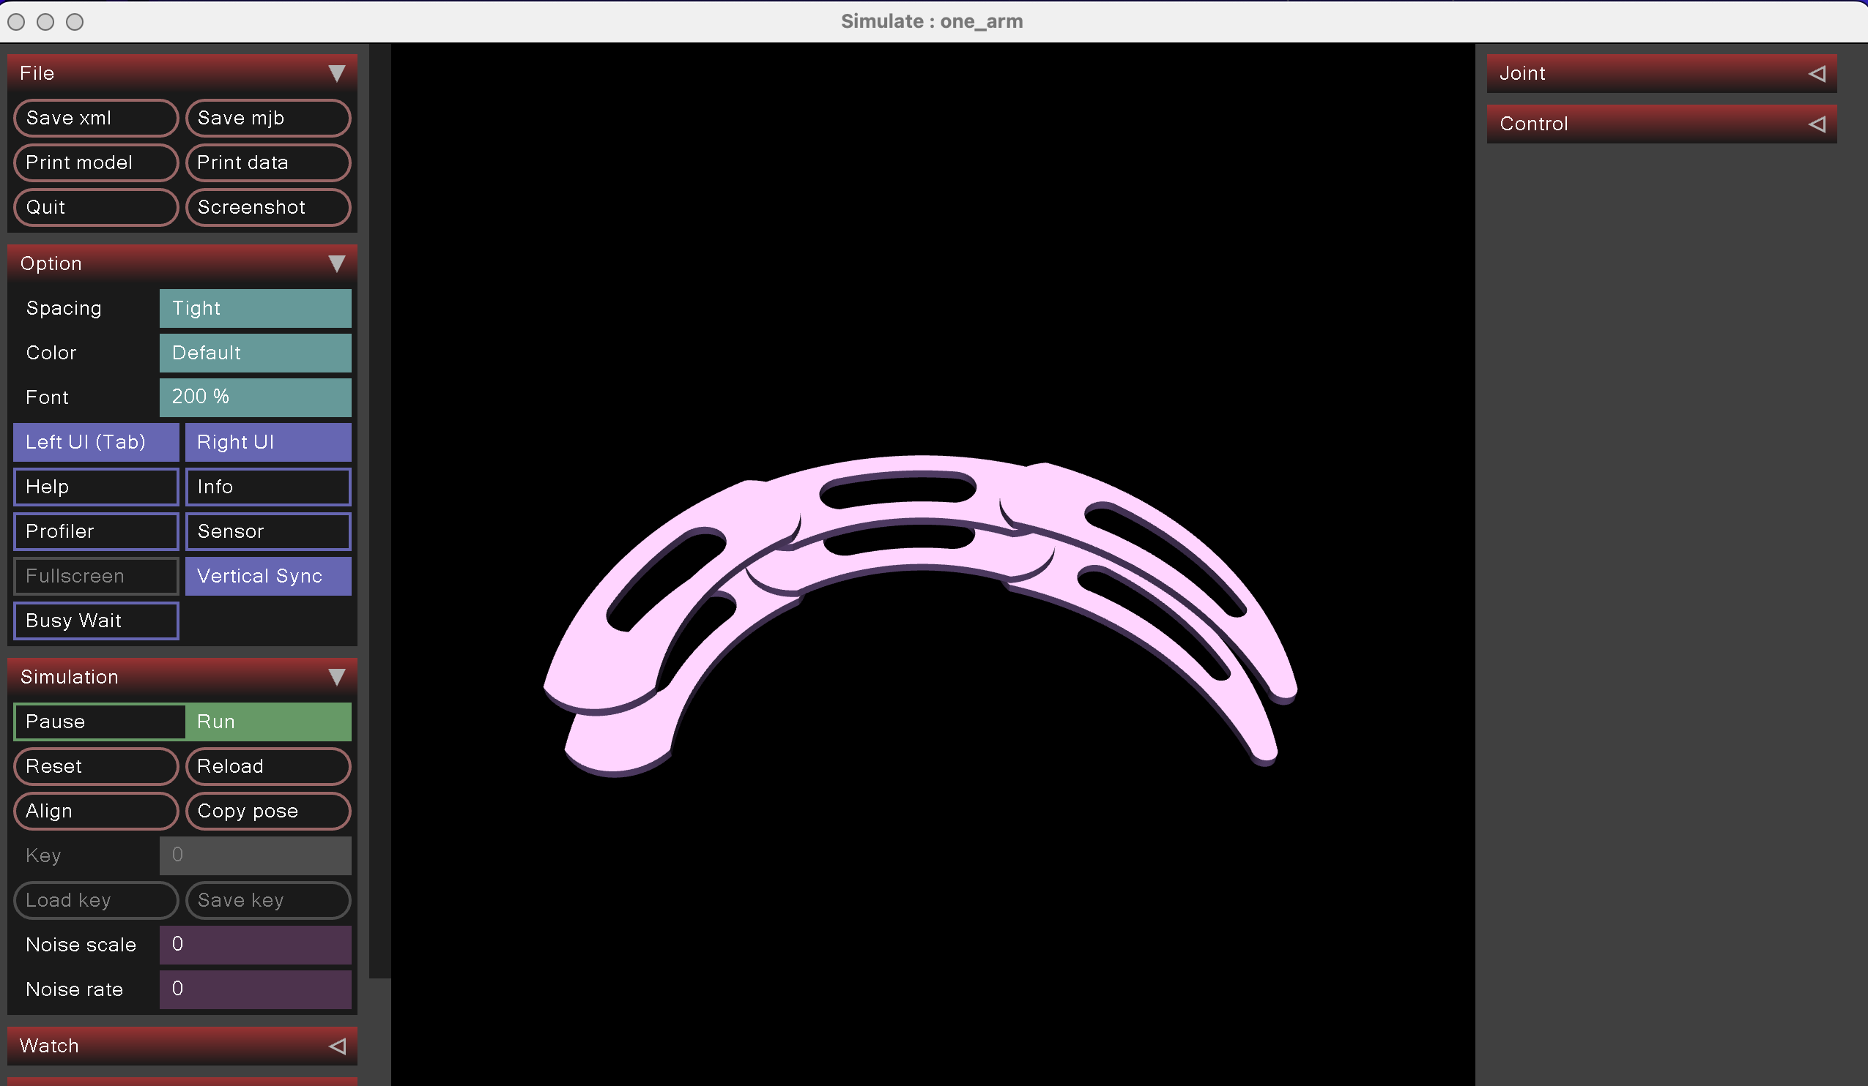
On mujoco application

Slide 6
roadmap
1 | Single arm model on mujoco
2 | Multi arm or joint design

