Slide 1
Robotic system design evaluation with open-ai gym
System Design Project Proposal
2022311382

Slide 2

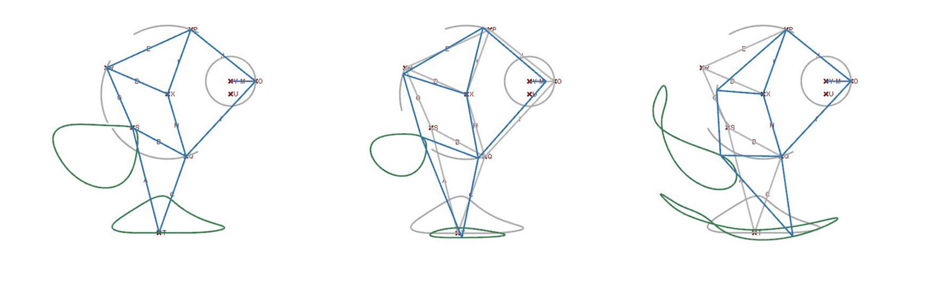
Problem Statement

Slide 3
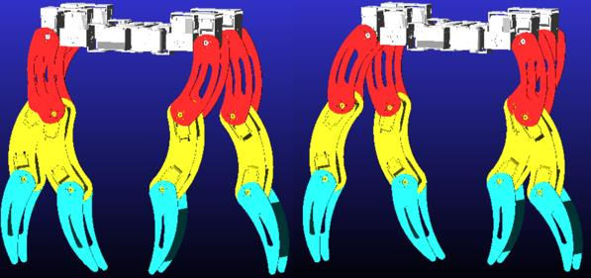
Problem Statement
x 3 x 4

Slide 4
Problem Statement
With reinforcement learning
https://youtu.be/G6fMV1UPzkg?t=8
https://youtu.be/-BqNl3AtPVw?t=10

Slide 5
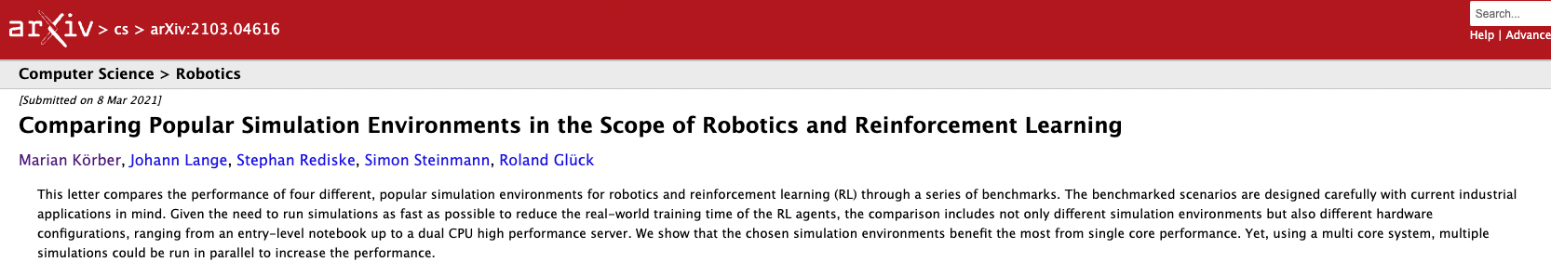
Simulator
 | Python app | RL type | famous | Easy to build
CoppeliaSim | x | x | o | o
OpenAI GYM (MuJoCo) | o | oo | o | o | Use this
Brax | o | o | x | o

Slide 6
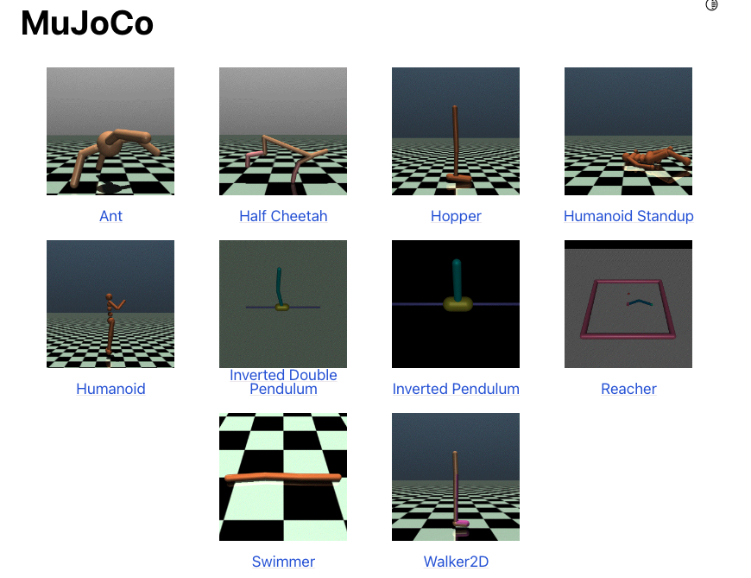
Methods
Make Environment
&
DQN

Slide 7
Discussion/Conclusion
Python based S/W ➔ worth it?
How to simulate real world?

Slide 8

Results

Slide 9
reference
https://pidexplained.com/pid-controller-explained/
지능형 제어 멀티 모드 로봇 기구 설계 및 작동 타당성 분석에 관한 연구(sun xiaotian)
Comparing Popular Simulation Environments in the Scope of Robotics and Reinforcement Learning(Marian Körber)
https://www.gymlibrary.dev/environments/mujoco/

Slide 10
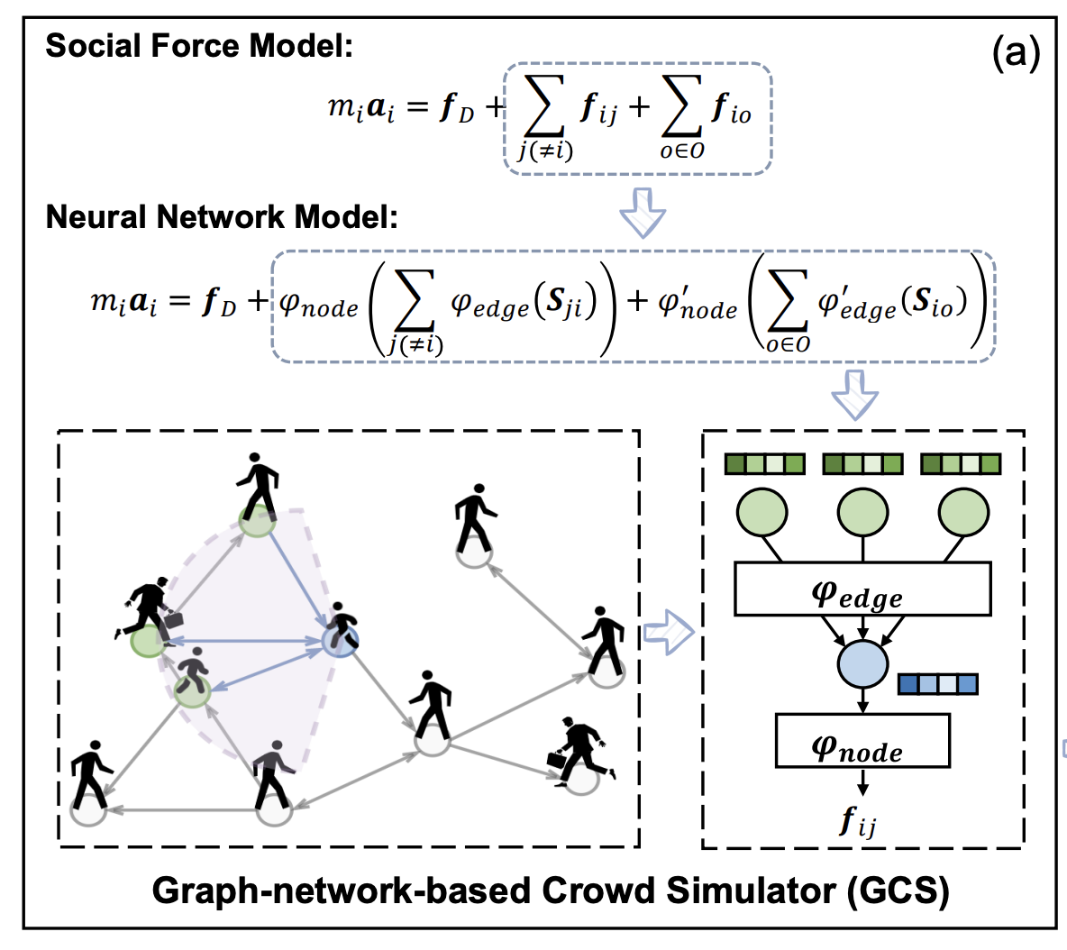
2nd Proposal, Crowd Simulation by GNNc

