Slide 1

MULTIMEDIA WEB DESIGN
Presentation
MULTIMEDIA WEB DESIGN
Presentation
Starting in…

Slide 2

1
4
5
2
3

Slide 3
Techlink
Techlink
Techlink

Slide 4
Techlink
Proudly Presents
Proudly Presents
Condominium Freestyle

Slide 5
Techlink
T
e
c
h
l
i
n
k

Slide 6
Introduction
Sketch
Flash
T
e
c
h
l
i
n
k

Slide 7
Introduction
Sketch
Flash
T
e
c
h
l
i
n
k

Slide 8
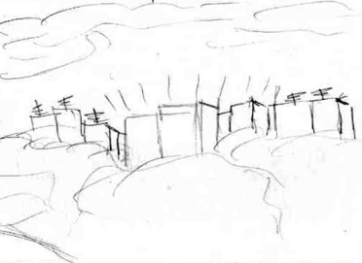
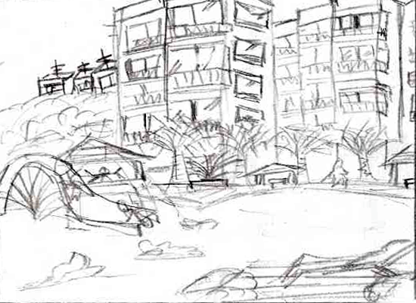
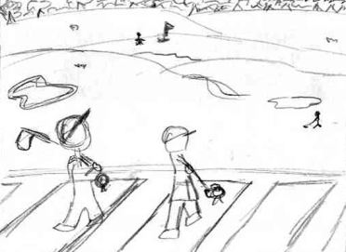
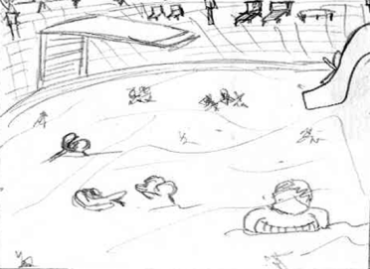
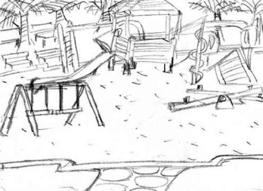
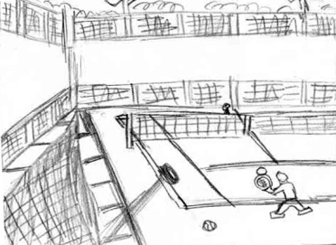
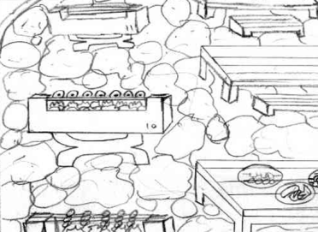
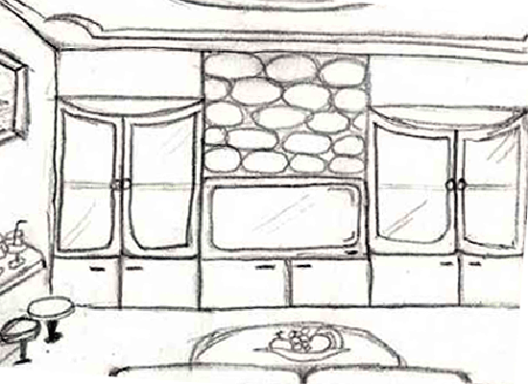
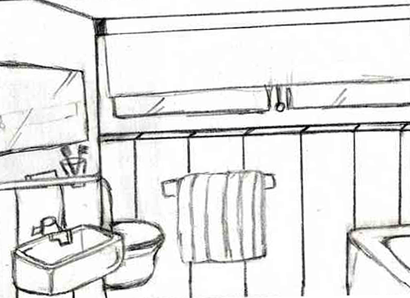
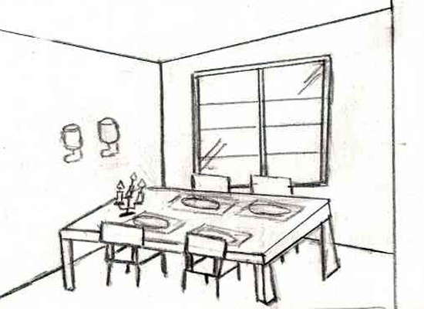
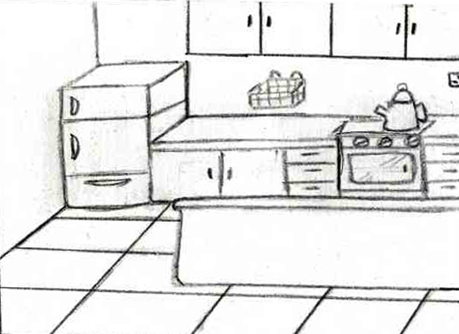
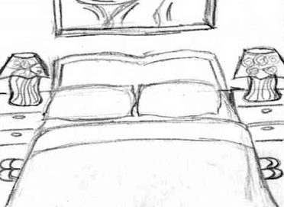
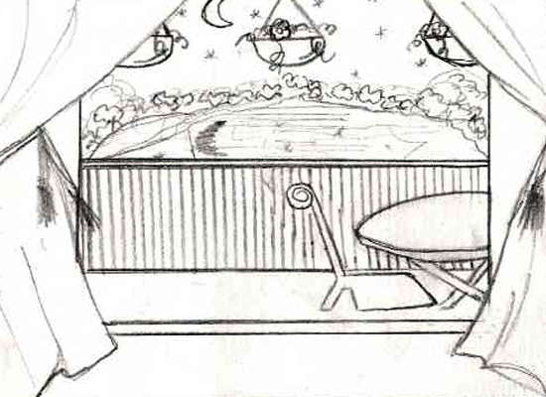
Opening
Close-up View
Golf Club
Pool
Playground
Introduction
Sketch
Flash
Tennis Court
BBQ (replaced)
Living Room
Washroom
Dining Room
Kitchen
Bedroom
Balcony
T
e
c
h
l
i
n
k

Slide 9
Introduction
Planning
Storyboarding
Organising
Closing
Introduction
Theme
Sketch
Delegation
Finalise
1
2
3
4
Sketch
National Day
History of Singapore
Car
Condominium
Involves in:
Drafting
Designing
Finalising in
Illustrator
Arrangement of scenes
Distribution of tasks
Compilation of scenes
Final amendment for errors
Flash
T
e
c
h
l
i
n
k

Slide 10
Introduction
Sketch
Flash
T
e
c
h
l
i
n
k

Slide 11
Introduction
Do you want to play the flash file?
2
Sketch
Yes
No
Flash
T
e
c
h
l
i
n
k

Slide 12
T
e
c
h
l
i
n
k

Slide 13
Flash file has been removed. Please press the ‘Esc’ key to exit.
Techlink Condominium Showcase
Techlink Condominium Showcase

Slide 14
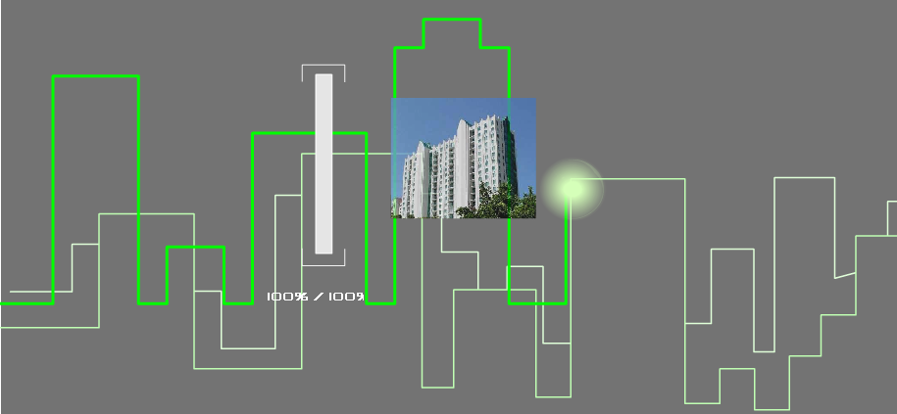

PreLoading
Opening
Close-up View
Golf Club
Pool
Playground
Tennis Court
BBQ (replaced)
Living Room
Washroom
Dining Room
Kitchen
Bedroom
Balcony
*Most of the pictures have
been taken out to reduce file size
T
e
c
h
l
i
n
k

Slide 15
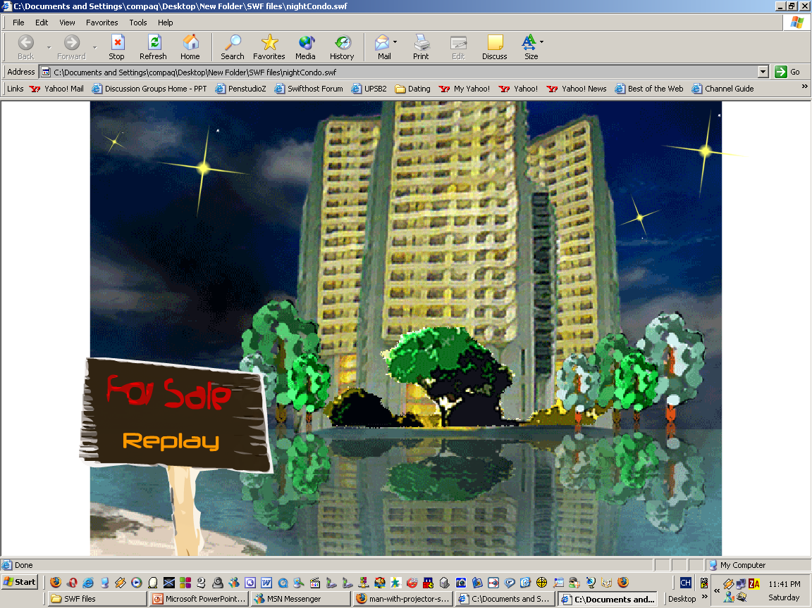
PreLoading
Ending
*Most of the pictures have
been taken out to reduce file size
T
e
c
h
l
i
n
k

Slide 16







PPT宝藏致力于优秀的ppt分享
PPT模板下载 http://www.pptbz.com/
PPT素材下载 http://www.pptbz.com/pptshucai/
PPT背景图片 http://www.pptbz.com/pptpic/
PPT课件下载 http://www.pptbz.com/kejian/
更多精美ppt下载请点击：ppt宝藏_www.pptbz.com

