Slide 1


航院徐博制作整理上传

Slide 2
a
Here’s
funny thing
航院徐博制作整理上传

Slide 3
Of
B2B
companies surveyed
stated
PowerPoint
was their
most
important
important
sales tool
航院徐博制作整理上传

Slide 4
Yet
72%
of companies
do not
regularly review
their
presentations
航院徐博制作整理上传

Slide 5
We at
Eyeful
find this
rather
worrying
航院徐博制作整理上传

Slide 6
Why
are we so
worried
?
航院徐博制作整理上传

Slide 7
Because
the
PowerPoint
is the culmination of
a lot of
work!
Final Sales Presentation
Marketing Spend
People Spend
Product Development
航院徐博制作整理上传

Slide 8
Product Development
Spend
Development
Protection
Research
Licensing
Branding
航院徐博制作整理上传

Slide 9
People
Spend
航院徐博制作整理上传

Slide 10
Website
Marketing
Advertising
PR
Brochures
Direct Mail
Viral Marketing
Spend
航院徐博制作整理上传

Slide 11
Homegrown presentation!
Lack of structure
Poor
design
Final Sales
Credibility Crumbles
Presentation
航院徐博制作整理上传

Slide 12
Got you
thinking?
We haven’t finished yet
航院徐博制作整理上传

Slide 13
Are you really
supporting
sales
?
航院徐博制作整理上传

Slide 14
How are you holding up
against the
competition?
Your
competition
Your
business
航院徐博制作整理上传

Slide 15
Time to
act!
How can we
help?
航院徐博制作整理上传

Slide 16
Presentation
Health Check
Find out just how well your PowerPoint presentation is performing
航院徐博制作整理上传

Slide 17
Presentation
Audit
Conduct an on-site review & evaluation of your company’s key presentations
航院徐博制作整理上传

Slide 18
How do we know these work?
We
listen
to our customers...
We’re now working PowerPoint much harder
First Data
航院徐博制作整理上传

Slide 19
How do we know these work?
We
listen
to our customers...
Our presentation is now not only more visually appealing, it’s more effective
Software AG
航院徐博制作整理上传

Slide 20
How do we know these work?
We
listen
to our customers...
We didn’t know you could
do this in PowerPoint!
Microsoft
航院徐博制作整理上传

Slide 21
Contact
Eyeful
0845 056 8528
info@eyefulpresentations.co.uk
www.eyefulpresentations.co.uk
航院徐博制作整理上传

Slide 22
航院徐博制作整理上传

Slide 23
The UK’s
leading
presentation consultancy
航院徐博制作整理上传

Slide 24



Click
on the area of interest
航院徐博制作整理上传
Click
to finish

Slide 25
航院徐博制作整理上传

Slide 26

of B2B companies
see PowerPoint as their primary sales tool.
Yet…
of companies do not regularly review their presentations.
航院徐博制作整理上传

Slide 27

BUY ME!
..PLEASE?
Product Dev
spend
People
spend
Marketing
spend
Final sales
presentation
Research
Development
Licensing
Protection
Branding
Recruitment
Training
Salaries
Bonuses
Car
Equipment
Website
Brochures
PR
Direct Mail
Advertising
Exhibitions
Homegrown presentation!
Lack of structure
Poor design
No consistency
Credibility crumbles
航院徐博制作整理上传

Slide 28
Fact:
Companies who invest in professional
sales tools are more successful
Your
competition
Your
business
How are you holding up
against the
competition?
航院徐博制作整理上传

Slide 29
航院徐博制作整理上传

Slide 30
航院徐博制作整理上传

Slide 31
We make presentations
more effective
…not just
prettier
航院徐博制作整理上传

Slide 32





…through
presentation optimisation
Focus
Through an onsite review, we identify the audience led messages required in the presentation
Storyboard
Workshop techniques to identify and develop the key building blocks of your story
Flexibility
Developing a user friendly interface for maximum impact and ease of use
Look & Feel
Working with your brand, creation of a visually compelling and engaging presentation
Training
Developing and delivering a bespoke training and presentation accreditation programme
航院徐博制作整理上传

Slide 33
Focus
Through an onsite review, we identify the audience led messages required in the presentation
Storyboard
Workshop techniques to identify and develop the key building blocks of your story
Flexibility
Developing a user friendly interface for maximum impact and ease of use
Look & Feel
Working with your brand, creation of a visually compelling and engaging presentation
Training
Developing and delivering a bespoke training and presentation accreditation programme
How we
work
Presentation Consultants
Project Management
Artwork Team
Training & Coaching
航院徐博制作整理上传
Click
on the area of interest

Slide 34

Board level experience in sales, communication and launch programming
B2B focus
Experts in storyboarding and proposition
creation techniques
Thought leaders in presentation development
Regular industry speaking engagements
and journal contributions
All consultants members of Chartered Institute
of Marketing
How we
work
Back
Presentation Consultants
Project Management
Artwork Team
Training & Coaching
航院徐博制作整理上传

Slide 35
World class experienced project management team
Time critical project planning processes
Working to published and agreed project plans
Investment in proactive CRM and project management systems
Published client market charter
How we
work
Back
Presentation Consultants
Project Management
Artwork Team
Training & Coaching
航院徐博制作整理上传

Slide 36
Leading edge commercial design team
Specialists in advanced PowerPoint applications
Wide experience from multinationals
through to SMEs
Latest design software and applications
Microsoft MVP
(Most Valued Professional) status
How we
work
Back
Presentation Consultants
Project Management
Artwork Team
Training & Coaching
航院徐博制作整理上传

Slide 37
Over 25 years experience in providing presentation, sales & technical skills training
Collaborative training approach – ensuring you get the most from our training
Bespoke course design tailored to your needs
How we
work
Back
Presentation Consultants
Project Management
Artwork Team
Training & Coaching
航院徐博制作整理上传

Slide 38



What our customers say
“The workshop helped us determine a strong strategic direction for the whole project”
Source
“Working with Eyeful was one of the best business decisions we made in the last 12 months”
Action Coach
“We have a new phrase in our business. If we need a persuasive and visually compelling PowerPoint, we “Eyeful” it!”
FTC Kaplan
航院徐博制作整理上传

Slide 39
Software & IT
Business Services
Manufacturing
Financial Services
Construction
& Building Services
Who we
work with
航院徐博制作整理上传

Slide 40




Software & IT
Business Services
Manufacturing
Financial Services
Construction
& Building Services
Who we
work with
航院徐博制作整理上传

Slide 41




Software & IT
Business Services
Manufacturing
Financial Services
Construction
& Building Services
Who we
work with
航院徐博制作整理上传

Slide 42





Software & IT
Business Services
Manufacturing
Financial Services
Construction
& Building Services
Who we
work with
航院徐博制作整理上传

Slide 43



Software & IT
Business Services
Manufacturing
Financial Services
Construction
& Building Services
Who we
work with
航院徐博制作整理上传

Slide 44





Software & IT
Business Services
Manufacturing
Financial Services
Construction
& Building Services
Who we
work with
航院徐博制作整理上传

Slide 45
航院徐博制作整理上传

Slide 46
航院徐博制作整理上传

Slide 47





Software & IT
Eyeful
works across
a wide range of business sectors
Business Services
Click on the sector of interest
Manufacturing
Financial Services
Construction
& Building Services
航院徐博制作整理上传

Slide 48
Software & IT
Eyeful
works across
a wide range of business sectors
Business Services
Click on the sector of interest
Manufacturing
Financial Services
Construction
& Building Services
航院徐博制作整理上传

Slide 49
航院徐博制作整理上传

Slide 50




Click for more info
Click for more info
Back
Click for more info
航院徐博制作整理上传

Slide 51
Software & IT
Eyeful
works across
a wide range of business sectors
Business Services
Click on the sector of interest
Manufacturing
Financial Services
Construction
& Building Services
航院徐博制作整理上传

Slide 52






Project Brief
Production of a visually appealing & persuasive credentials presentation
Process
Onsite workshop
Storyboard developed
Template & content redesign
Advanced animation techniques
Software
PowerPoint 2003
Back
航院徐博制作整理上传

Slide 53
Project Brief
Production of a visually appealing & persuasive credentials presentation
Process
Onsite workshop
Storyboard developed
Template & content redesign
Advanced animation techniques
Software
PowerPoint 2003
航院徐博制作整理上传

Slide 54
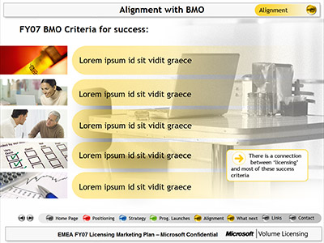
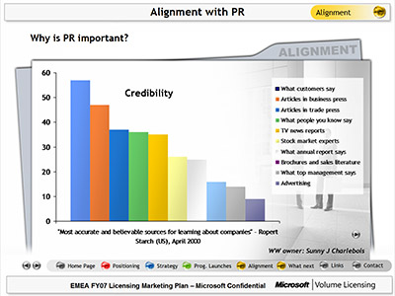

Project Brief
Production of an interactive presentation for circulation across the business
Process
Storyboard developed
Template & content redesign
Advanced custom show programming & animation
Software
PowerPoint 2003
Back
航院徐博制作整理上传

Slide 55
Project Brief
Production of an interactive presentation for circulation across the business
Process
Storyboard developed
Template & content redesign
Advanced custom show programming & animation
Software
PowerPoint 2003
航院徐博制作整理上传

Slide 56



Project Brief
Production of a high impact AGM presentation. Subsequently used in sales & training environments
Process
Onsite workshop
Storyboard developed
Template & content design
Advanced animation & audio production
Software
PowerPoint 2003
Back
航院徐博制作整理上传

Slide 57
Project Brief
Production of a high impact AGM presentation. Subsequently used in sales & training environments
Process
Onsite workshop
Storyboard developed
Template & content design
Advanced animation & audio production
Software
PowerPoint 2003
航院徐博制作整理上传

Slide 58
Software & IT
Eyeful
works across
a wide range of business sectors
Business Services
Click on the sector of interest
Manufacturing
Financial Services
Construction
& Building Services
航院徐博制作整理上传

Slide 59
航院徐博制作整理上传

Slide 60

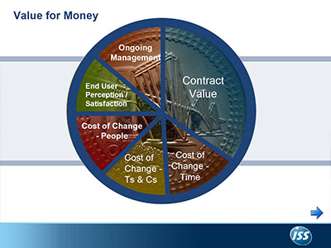

Click for more info
Click for more info
Back
Click for more info
航院徐博制作整理上传

Slide 61
Software & IT
Eyeful
works across
a wide range of business sectors
Business Services
Click on the sector of interest
Manufacturing
Financial Services
Construction
& Building Services
航院徐博制作整理上传

Slide 62
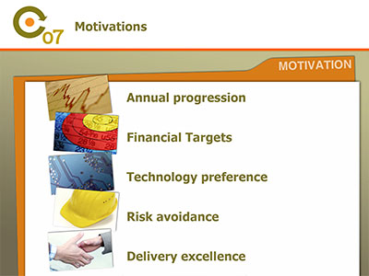


Project Brief
Production of a high end training presentation for global sales conference.
Deadline of 3 working days
Process
Telephone workshop
Storyboard developed
Content design
Animation & interactivity programming
Software
PowerPoint 2003
Back
航院徐博制作整理上传

Slide 63
Project Brief
Production of a high end training presentation for global sales conference.
Deadline of 3 working days
Process
Telephone workshop
Storyboard developed
Content design
Animation & interactivity programming
Software
PowerPoint 2003
航院徐博制作整理上传

Slide 64


Project Brief
Production of pitch presentation for key prospect.
Quick turnaround required
Process
Onsite workshop
Storyboard developed
Content design
High end animation & interactivity programming
Software
PowerPoint 2003
Back
航院徐博制作整理上传

Slide 65
Project Brief
Production of pitch presentation for key prospect.
Quick turnaround required
Process
Onsite workshop
Storyboard developed
Content design
High end animation & interactivity programming
Software
PowerPoint 2003
航院徐博制作整理上传

Slide 66

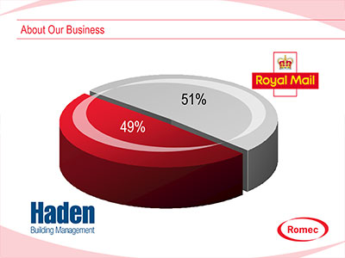
Project Brief
Production of group credentials presentation
Process
Onsite workshop for 30 delegates (split into two focus groups)
Storyboard developed
Template & content design
Animation & interactivity programming
Software
PowerPoint 2003
Back
航院徐博制作整理上传

Slide 67
Project Brief
Production of group credentials presentation
Process
Onsite workshop for 30 delegates (split into two focus groups)
Storyboard developed
Template & content design
Animation & interactivity programming
Software
PowerPoint 2003
航院徐博制作整理上传

Slide 68
Software & IT
Eyeful
works across
a wide range of business sectors
Business Services
Click on the sector of interest
Manufacturing
Financial Services
Construction
& Building Services
航院徐博制作整理上传

Slide 69
航院徐博制作整理上传

Slide 70


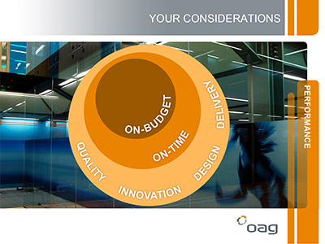
Click for more info
Back
Click for more info
Click for more info
航院徐博制作整理上传

Slide 71
Software & IT
Eyeful
works across
a wide range of business sectors
Business Services
Click on the sector of interest
Manufacturing
Financial Services
Construction
& Building Services
航院徐博制作整理上传

Slide 72


Project Brief
Production of annual conference presentations
Process
Telephone interviews with all speakers & stakeholders
Storyboards developed
Template & content design
High end animation & audio production
Software
PowerPoint 2003
Back
航院徐博制作整理上传

Slide 73
Project Brief
Production of annual conference presentations
Process
Telephone interviews with all speakers & stakeholders
Storyboards developed
Template & content design
High end animation & audio production
Software
PowerPoint 2003
航院徐博制作整理上传

Slide 74



Project Brief
Production of exhibition rolling presentations. Subsequent projects include credentials & training presentations.
Process
Onsite workshop
Storyboards developed
Template & content design
High end animation & audio production
Software
PowerPoint 2003
Back
航院徐博制作整理上传

Slide 75
Project Brief
Production of exhibition rolling presentations. Subsequent projects include credentials & training presentations.
Process
Onsite workshop
Storyboards developed
Template & content design
High end animation & audio production
Software
PowerPoint 2003
航院徐博制作整理上传

Slide 76



Project Brief
Production of visually appealing and persuasive sales presentation
Process
Onsite workshop
Storyboard developed
Template & content design
High end animation & interactivity programming
Software
PowerPoint 2003
Back
航院徐博制作整理上传

Slide 77
Project Brief
Production of visually appealing and persuasive sales presentation
Process
Onsite workshop
Storyboard developed
Template & content design
High end animation & interactivity programming
Software
PowerPoint 2003
航院徐博制作整理上传

Slide 78
Software & IT
Eyeful
works across
a wide range of business sectors
Business Services
Click on the sector of interest
Manufacturing
Financial Services
Construction
& Building Services
航院徐博制作整理上传

Slide 79
航院徐博制作整理上传

Slide 80



Click for more info
Back
Click for more info
Click for more info
航院徐博制作整理上传

Slide 81
Software & IT
Eyeful
works across
a wide range of business sectors
Business Services
Click on the sector of interest
Manufacturing
Financial Services
Construction
& Building Services
航院徐博制作整理上传

Slide 82


Project Brief
Production of highly interactive & intuitive sales toolkit presentation
Process
Series of onsite & telephone consultations
Structure & content developed/validated
Content design
High end animation & interactivity programming
Software
PowerPoint 2003
Back
航院徐博制作整理上传

Slide 83
Project Brief
Production of highly interactive & intuitive sales toolkit presentation
Process
Series of onsite & telephone consultations
Structure & content developed/validated
Content design
High end animation & interactivity programming
Software
PowerPoint 2003
航院徐博制作整理上传

Slide 84


Project Brief
Production of high impact, visually appealing reception presentation
Process
Onsite consultation
Storyboard developed
Content design
High end animation
User refresher training
Software
PowerPoint 2003
Back
航院徐博制作整理上传

Slide 85
Project Brief
Production of high impact, visually appealing reception presentation
Process
Onsite consultation
Storyboard developed
Content design
High end animation
User refresher training
Software
PowerPoint 2003
航院徐博制作整理上传

Slide 86

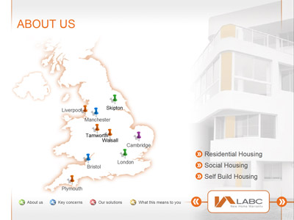

Project Brief
Production of high impact & persuasive credentials presentation
Process
Onsite workshop
Storyboard developed
Template & content design
High end animation & interactivity programming
User training & accreditation
Software
PowerPoint 2003
Back
航院徐博制作整理上传

Slide 87
Project Brief
Production of high impact & persuasive credentials presentation
Process
Onsite workshop
Storyboard developed
Template & content design
High end animation & interactivity programming
User training & accreditation
Software
PowerPoint 2003
航院徐博制作整理上传

Slide 88
Software & IT
Eyeful
works across
a wide range of business sectors
Business Services
Click on the sector of interest
Manufacturing
Financial Services
Construction
& Building Services
航院徐博制作整理上传

Slide 89
航院徐博制作整理上传

Slide 90

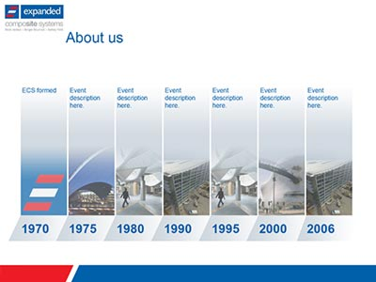
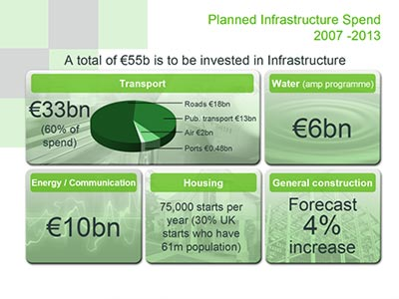
Click for more info
Click for more info
Back
Click for more info
航院徐博制作整理上传

Slide 91
Software & IT
Eyeful
works across
a wide range of business sectors
Business Services
Click on the sector of interest
Manufacturing
Financial Services
Construction
& Building Services
航院徐博制作整理上传

Slide 92
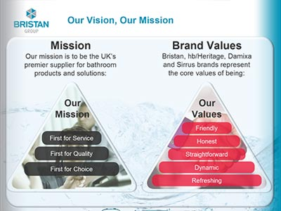
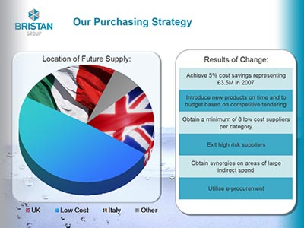

Project Brief
Production of persuasive credentials presentation. Followed by conference & pitch specific presentations
Process
Onsite workshop
Storyboard developed
Template & content design
High end animation & interactivity programming
User training & accreditation
Software
PowerPoint 2003
Back
航院徐博制作整理上传

Slide 93
Project Brief
Production of persuasive credentials presentation. Followed by conference & pitch specific presentations
Process
Onsite workshop
Storyboard developed
Template & content design
High end animation & interactivity programming
User training & accreditation
Software
PowerPoint 2003
航院徐博制作整理上传

Slide 94
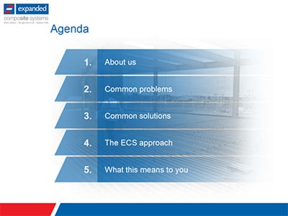


Project Brief
Production of new product sales presentation. Combining messaging of consortium of partners
Process
Onsite workshop
Storyboard developed
Template & content design
Animation programming
Software
PowerPoint 2003
Back
航院徐博制作整理上传

Slide 95
Project Brief
Production of new product sales presentation. Combining messaging of consortium of partners
Process
Onsite workshop
Storyboard developed
Template & content design
Animation programming
Software
PowerPoint 2003
航院徐博制作整理上传

Slide 96



Project Brief
Production of high impact sales conference presentation
Process
Onsite workshop
Messaging validated
Storyboard developed
Template & content design
Animation programming
Software
PowerPoint 2003
Back
航院徐博制作整理上传

Slide 97
Project Brief
Production of high impact sales conference presentation
Process
Onsite workshop
Messaging validated
Storyboard developed
Template & content design
Animation programming
Software
PowerPoint 2003
航院徐博制作整理上传

Slide 98




航院徐博制作整理上传

Slide 99
Contact
Eyeful
0845 056 8528
info@eyefulpresentations.co.uk
www.eyefulpresentations.co.uk
航院徐博制作整理上传

