Slide 2
The UK’s
leading
presentation consultancy

Slide 3



Click
on the area of interest
Click
to finish

Slide 5

of B2B companies
see PowerPoint as their primary sales tool.
Yet…
of companies do not regularly review their presentations.

Slide 6

BUY ME!
..PLEASE?
Product Dev
spend
People
spend
Marketing
spend
Final sales
presentation
Research
Development
Licensing
Protection
Branding
Recruitment
Training
Salaries
Bonuses
Car
Equipment
Website
Brochures
PR
Direct Mail
Advertising
Exhibitions
Homegrown presentation!
Lack of structure
Poor design
No consistency
Credibility crumbles

Slide 7
Fact:
Companies who invest in professional
sales tools are more successful
Your
competition
Your
business
How are you holding up
against the
competition?

Slide 10
We make presentations
more effective
…not just
prettier

Slide 11





…through
presentation optimisation
Focus
Through an onsite review, we identify the audience led messages required in the presentation
Storyboard
Workshop techniques to identify and develop the key building blocks of your story
Flexibility
Developing a user friendly interface for maximum impact and ease of use
Look & Feel
Working with your brand, creation of a visually compelling and engaging presentation
Training
Developing and delivering a bespoke training and presentation accreditation programme

Slide 12
Focus
Through an onsite review, we identify the audience led messages required in the presentation
Storyboard
Workshop techniques to identify and develop the key building blocks of your story
Flexibility
Developing a user friendly interface for maximum impact and ease of use
Look & Feel
Working with your brand, creation of a visually compelling and engaging presentation
Training
Developing and delivering a bespoke training and presentation accreditation programme
How we
work
Presentation Consultants
Project Management
Artwork Team
Training & Coaching
Click
on the area of interest

Slide 13

Board level experience in sales, communication and launch programming
B2B focus
Experts in storyboarding and proposition
creation techniques
Thought leaders in presentation development
Regular industry speaking engagements
and journal contributions
All consultants members of Chartered Institute
of Marketing
How we
work
Back
Presentation Consultants
Project Management
Artwork Team
Training & Coaching

Slide 14
World class experienced project management team
Time critical project planning processes
Working to published and agreed project plans
Investment in proactive CRM and project management systems
Published client market charter
How we
work
Back
Presentation Consultants
Project Management
Artwork Team
Training & Coaching

Slide 15
Leading edge commercial design team
Specialists in advanced PowerPoint applications
Wide experience from multinationals
through to SMEs
Latest design software and applications
Microsoft MVP
(Most Valued Professional) status
How we
work
Back
Presentation Consultants
Project Management
Artwork Team
Training & Coaching

Slide 16
Over 25 years experience in providing presentation, sales & technical skills training
Collaborative training approach – ensuring you get the most from our training
Bespoke course design tailored to your needs
How we
work
Back
Presentation Consultants
Project Management
Artwork Team
Training & Coaching

Slide 17



What our customers say
“The workshop helped us determine a strong strategic direction for the whole project”
Source
“Working with Eyeful was one of the best business decisions we made in the last 12 months”
Action Coach
“We have a new phrase in our business. If we need a persuasive and visually compelling PowerPoint, we “Eyeful” it!”
FTC Kaplan

Slide 18
Software & IT
Business Services
Manufacturing
Financial Services
Construction
& Building Services
Who we
work with

Slide 19




Software & IT
Business Services
Manufacturing
Financial Services
Construction
& Building Services
Who we
work with

Slide 20




Software & IT
Business Services
Manufacturing
Financial Services
Construction
& Building Services
Who we
work with

Slide 21





Software & IT
Business Services
Manufacturing
Financial Services
Construction
& Building Services
Who we
work with

Slide 22



Software & IT
Business Services
Manufacturing
Financial Services
Construction
& Building Services
Who we
work with

Slide 23





Software & IT
Business Services
Manufacturing
Financial Services
Construction
& Building Services
Who we
work with

Slide 26





Software & IT
Eyeful
works across
a wide range of business sectors
Business Services
Click on the sector of interest
Manufacturing
Financial Services
Construction
& Building Services

Slide 27
Software & IT
Eyeful
works across
a wide range of business sectors
Business Services
Click on the sector of interest
Manufacturing
Financial Services
Construction
& Building Services

Slide 29




Click for more info
Click for more info
Back
Click for more info

Slide 30
Software & IT
Eyeful
works across
a wide range of business sectors
Business Services
Click on the sector of interest
Manufacturing
Financial Services
Construction
& Building Services

Slide 31






Project Brief
Production of a visually appealing & persuasive credentials presentation
Process
Onsite workshop
Storyboard developed
Template & content redesign
Advanced animation techniques
Software
PowerPoint 2003
Back

Slide 32
Project Brief
Production of a visually appealing & persuasive credentials presentation
Process
Onsite workshop
Storyboard developed
Template & content redesign
Advanced animation techniques
Software
PowerPoint 2003

Slide 33
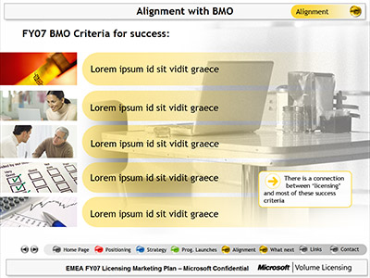
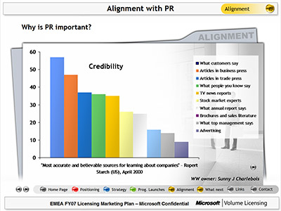

Project Brief
Production of an interactive presentation for circulation across the business
Process
Storyboard developed
Template & content redesign
Advanced custom show programming & animation
Software
PowerPoint 2003
Back

Slide 34
Project Brief
Production of an interactive presentation for circulation across the business
Process
Storyboard developed
Template & content redesign
Advanced custom show programming & animation
Software
PowerPoint 2003

Slide 35



Project Brief
Production of a high impact AGM presentation. Subsequently used in sales & training environments
Process
Onsite workshop
Storyboard developed
Template & content design
Advanced animation & audio production
Software
PowerPoint 2003
Back

Slide 36
Project Brief
Production of a high impact AGM presentation. Subsequently used in sales & training environments
Process
Onsite workshop
Storyboard developed
Template & content design
Advanced animation & audio production
Software
PowerPoint 2003

Slide 37
Software & IT
Eyeful
works across
a wide range of business sectors
Business Services
Click on the sector of interest
Manufacturing
Financial Services
Construction
& Building Services

Slide 39

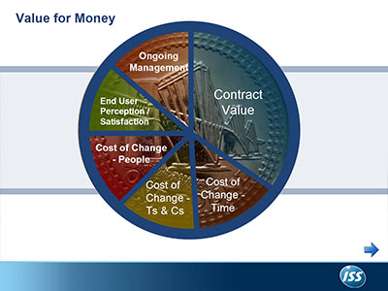

Click for more info
Click for more info
Back
Click for more info

Slide 40
Software & IT
Eyeful
works across
a wide range of business sectors
Business Services
Click on the sector of interest
Manufacturing
Financial Services
Construction
& Building Services

Slide 41
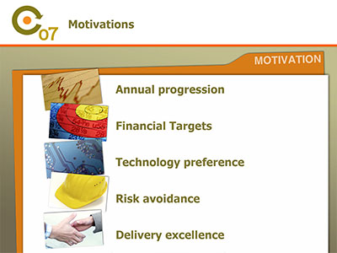


Project Brief
Production of a high end training presentation for global sales conference.
Deadline of 3 working days
Process
Telephone workshop
Storyboard developed
Content design
Animation & interactivity programming
Software
PowerPoint 2003
Back

Slide 42
Project Brief
Production of a high end training presentation for global sales conference.
Deadline of 3 working days
Process
Telephone workshop
Storyboard developed
Content design
Animation & interactivity programming
Software
PowerPoint 2003

Slide 43


Project Brief
Production of pitch presentation for key prospect.
Quick turnaround required
Process
Onsite workshop
Storyboard developed
Content design
High end animation & interactivity programming
Software
PowerPoint 2003
Back

Slide 44
Project Brief
Production of pitch presentation for key prospect.
Quick turnaround required
Process
Onsite workshop
Storyboard developed
Content design
High end animation & interactivity programming
Software
PowerPoint 2003

Slide 45

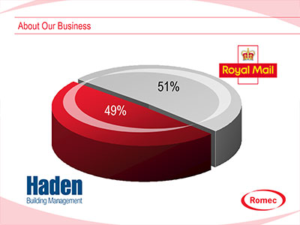
Project Brief
Production of group credentials presentation
Process
Onsite workshop for 30 delegates (split into two focus groups)
Storyboard developed
Template & content design
Animation & interactivity programming
Software
PowerPoint 2003
Back

Slide 46
Project Brief
Production of group credentials presentation
Process
Onsite workshop for 30 delegates (split into two focus groups)
Storyboard developed
Template & content design
Animation & interactivity programming
Software
PowerPoint 2003

Slide 47
Software & IT
Eyeful
works across
a wide range of business sectors
Business Services
Click on the sector of interest
Manufacturing
Financial Services
Construction
& Building Services

Slide 49

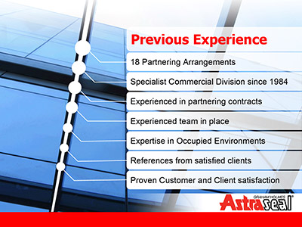
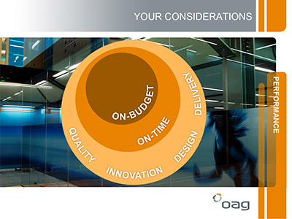
Click for more info
Back
Click for more info
Click for more info

Slide 50
Software & IT
Eyeful
works across
a wide range of business sectors
Business Services
Click on the sector of interest
Manufacturing
Financial Services
Construction
& Building Services

Slide 51


Project Brief
Production of annual conference presentations
Process
Telephone interviews with all speakers & stakeholders
Storyboards developed
Template & content design
High end animation & audio production
Software
PowerPoint 2003
Back

Slide 52
Project Brief
Production of annual conference presentations
Process
Telephone interviews with all speakers & stakeholders
Storyboards developed
Template & content design
High end animation & audio production
Software
PowerPoint 2003

Slide 53



Project Brief
Production of exhibition rolling presentations. Subsequent projects include credentials & training presentations.
Process
Onsite workshop
Storyboards developed
Template & content design
High end animation & audio production
Software
PowerPoint 2003
Back

Slide 54
Project Brief
Production of exhibition rolling presentations. Subsequent projects include credentials & training presentations.
Process
Onsite workshop
Storyboards developed
Template & content design
High end animation & audio production
Software
PowerPoint 2003

Slide 55



Project Brief
Production of visually appealing and persuasive sales presentation
Process
Onsite workshop
Storyboard developed
Template & content design
High end animation & interactivity programming
Software
PowerPoint 2003
Back

Slide 56
Project Brief
Production of visually appealing and persuasive sales presentation
Process
Onsite workshop
Storyboard developed
Template & content design
High end animation & interactivity programming
Software
PowerPoint 2003

Slide 57
Software & IT
Eyeful
works across
a wide range of business sectors
Business Services
Click on the sector of interest
Manufacturing
Financial Services
Construction
& Building Services

Slide 59



Click for more info
Back
Click for more info
Click for more info

Slide 60
Software & IT
Eyeful
works across
a wide range of business sectors
Business Services
Click on the sector of interest
Manufacturing
Financial Services
Construction
& Building Services

Slide 61


Project Brief
Production of highly interactive & intuitive sales toolkit presentation
Process
Series of onsite & telephone consultations
Structure & content developed/validated
Content design
High end animation & interactivity programming
Software
PowerPoint 2003
Back

Slide 62
Project Brief
Production of highly interactive & intuitive sales toolkit presentation
Process
Series of onsite & telephone consultations
Structure & content developed/validated
Content design
High end animation & interactivity programming
Software
PowerPoint 2003

Slide 63


Project Brief
Production of high impact, visually appealing reception presentation
Process
Onsite consultation
Storyboard developed
Content design
High end animation
User refresher training
Software
PowerPoint 2003
Back

Slide 64
Project Brief
Production of high impact, visually appealing reception presentation
Process
Onsite consultation
Storyboard developed
Content design
High end animation
User refresher training
Software
PowerPoint 2003

Slide 65

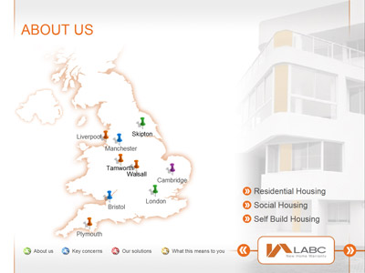

Project Brief
Production of high impact & persuasive credentials presentation
Process
Onsite workshop
Storyboard developed
Template & content design
High end animation & interactivity programming
User training & accreditation
Software
PowerPoint 2003
Back

Slide 66
Project Brief
Production of high impact & persuasive credentials presentation
Process
Onsite workshop
Storyboard developed
Template & content design
High end animation & interactivity programming
User training & accreditation
Software
PowerPoint 2003

Slide 67
Software & IT
Eyeful
works across
a wide range of business sectors
Business Services
Click on the sector of interest
Manufacturing
Financial Services
Construction
& Building Services

Slide 69

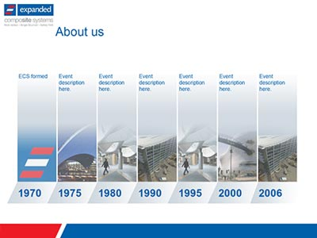
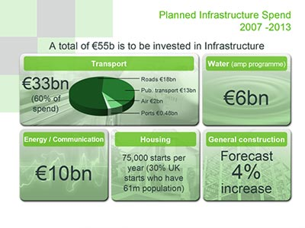
Click for more info
Click for more info
Back
Click for more info

Slide 70
Software & IT
Eyeful
works across
a wide range of business sectors
Business Services
Click on the sector of interest
Manufacturing
Financial Services
Construction
& Building Services

Slide 71
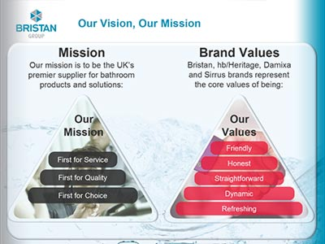
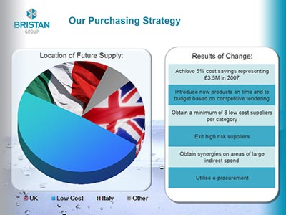

Project Brief
Production of persuasive credentials presentation. Followed by conference & pitch specific presentations
Process
Onsite workshop
Storyboard developed
Template & content design
High end animation & interactivity programming
User training & accreditation
Software
PowerPoint 2003
Back

Slide 72
Project Brief
Production of persuasive credentials presentation. Followed by conference & pitch specific presentations
Process
Onsite workshop
Storyboard developed
Template & content design
High end animation & interactivity programming
User training & accreditation
Software
PowerPoint 2003

Slide 73
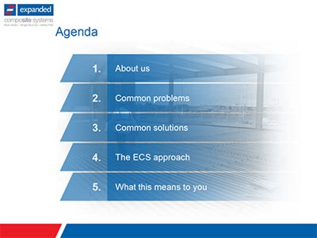
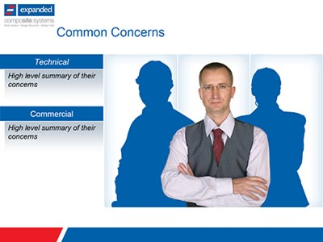

Project Brief
Production of new product sales presentation. Combining messaging of consortium of partners
Process
Onsite workshop
Storyboard developed
Template & content design
Animation programming
Software
PowerPoint 2003
Back

Slide 74
Project Brief
Production of new product sales presentation. Combining messaging of consortium of partners
Process
Onsite workshop
Storyboard developed
Template & content design
Animation programming
Software
PowerPoint 2003

Slide 75



Project Brief
Production of high impact sales conference presentation
Process
Onsite workshop
Messaging validated
Storyboard developed
Template & content design
Animation programming
Software
PowerPoint 2003
Back

Slide 76
Project Brief
Production of high impact sales conference presentation
Process
Onsite workshop
Messaging validated
Storyboard developed
Template & content design
Animation programming
Software
PowerPoint 2003

Slide 77





Slide 78
Contact
Eyeful
0845 056 8528
info@eyefulpresentations.co.uk
www.eyefulpresentations.co.uk

