Slide 1
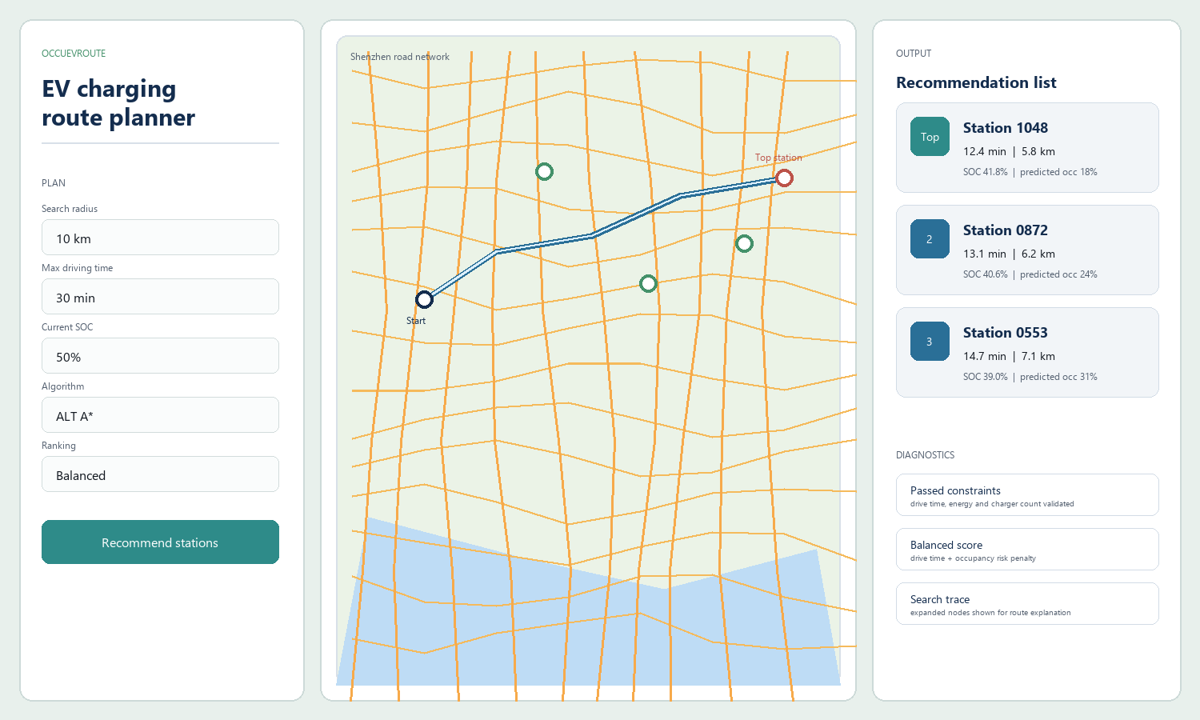
OccuEVRoute
EV charging route planning and congestion-aware recommendation for Shenzhen
Route search + battery feasibility + ML occupancy prediction
- Input: user location, vehicle state, search constraints
- Output: ranked charging stations, routes, SOC, predicted occupancy, diagnostics
- Goal: explainable course-demo system, not a production navigation product
OccuEVRoute | DI22001 Algorithms and AI
1

Slide 2
Problem Definition
Why this is more than finding the nearest charging station
Travel cost
EV feasibility
Congestion risk
Nearest or shortest-distance stations are not always optimal by road travel time.
Recommendations must satisfy max drive time, energy consumption, minimum arrival SOC, and charger count.
Predicted occupancy is used as a station-crowding risk signal. It is not waiting time.
Computable objective
- Find feasible candidate stations
- Compute real road-network route metrics
- Rank feasible stations by user-selected metric
Default balanced ranking: drive_time_min / max_drive_time_min + predicted_occupancy_rate
Lower score is better. Travel time is normalized; occupancy remains a congestion-risk term.
OccuEVRoute | DI22001 Algorithms and AI
2

Slide 3
Recommendation Workflow
Pre-check narrows the search; post-check validates the actual route
User input
Candidates
Pre-check
Route search
Post-check
ML + rank
location, SOC, constraints
nearby charging stations
static feasibility filters
road-network algorithms
time, energy, SOC
occupancy risk sorting
Frontend
Backend API
Domain modules
Map click, vehicle inputs, ranking metric, result panels
Request validation, response shaping, diagnostics
Route search, CSP checks, occupancy prediction, sorting
OccuEVRoute | DI22001 Algorithms and AI
3

Slide 4
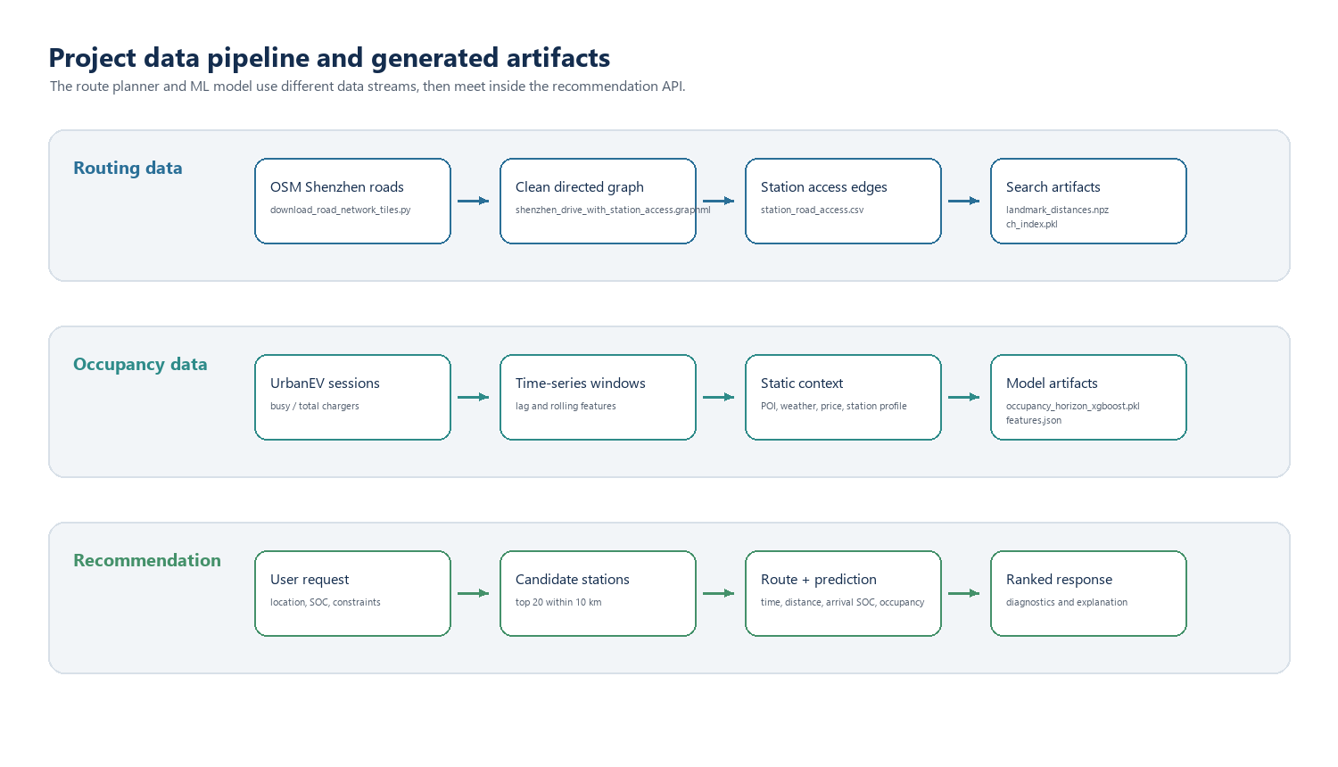
Dataset
Data is split into routing data and occupancy-prediction data
OccuEVRoute | DI22001 Algorithms and AI
4

Slide 5
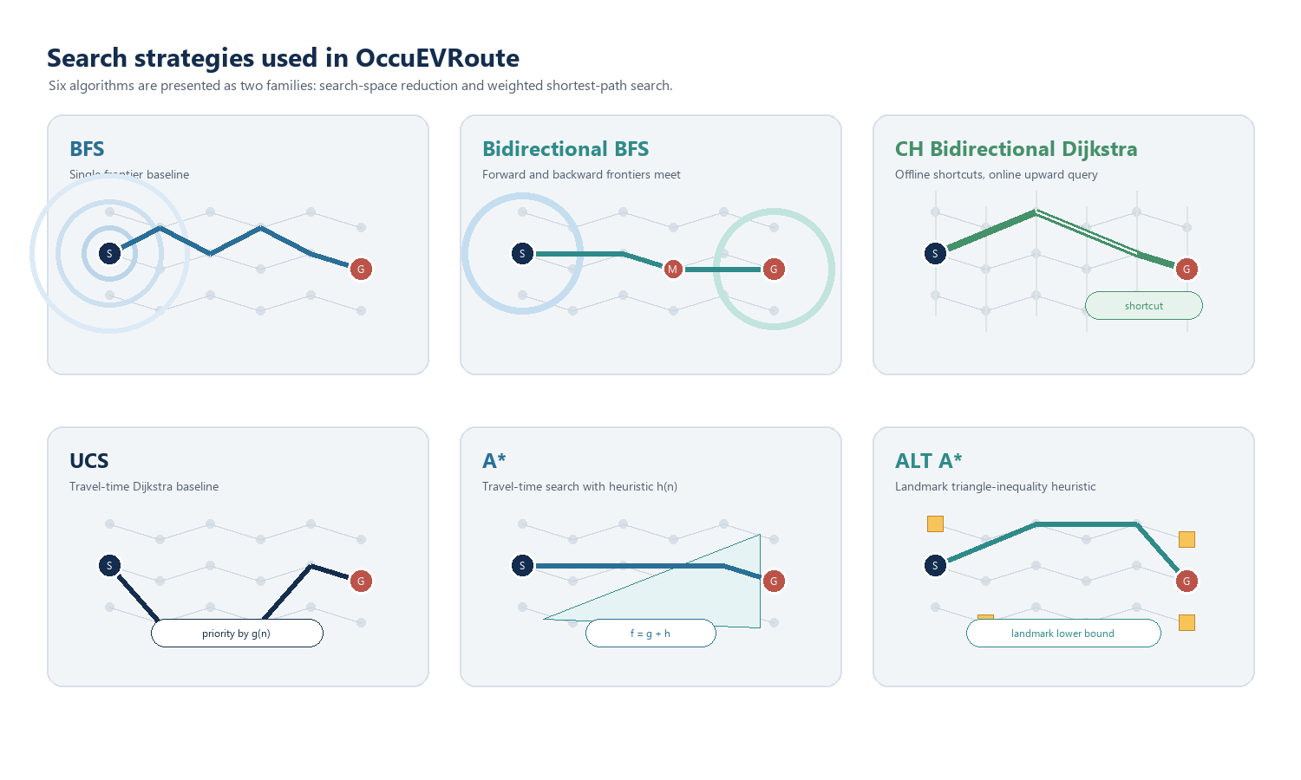
Search Strategy
Six algorithms, two comparison axes
OccuEVRoute | DI22001 Algorithms and AI
5

Slide 6
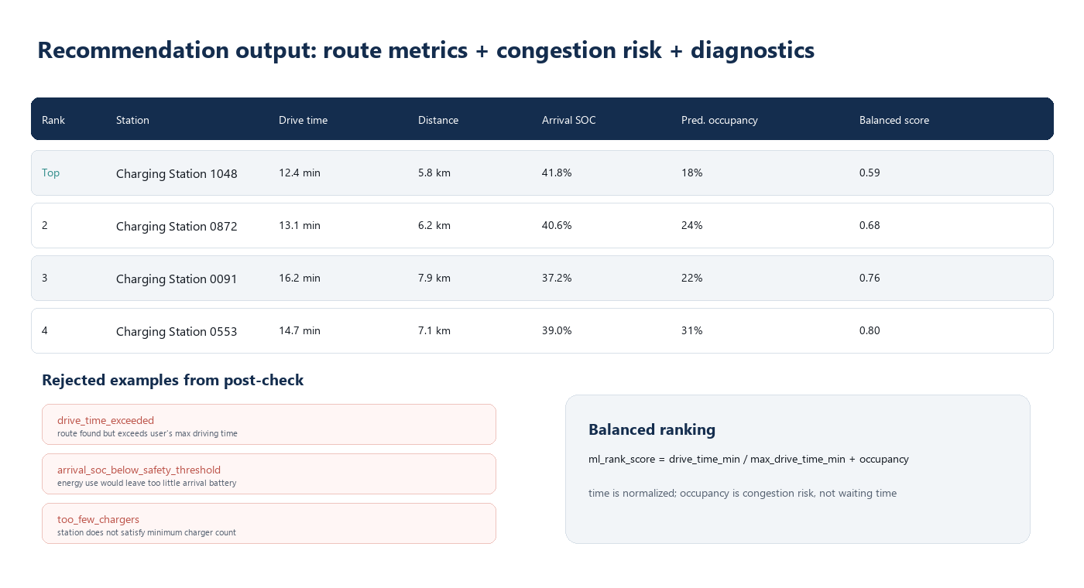
Constraints and Ranking
Feasibility is checked before ranking; occupancy is only a risk signal
Pre-check
Post-check
Ranking
Before graph search: search radius, charger count, road access distance.
After graph search: path found, drive time, energy use, arrival SOC.
Feasible stations are sorted by selected metric; balanced uses occupancy as risk.
OccuEVRoute | DI22001 Algorithms and AI
6

Slide 7
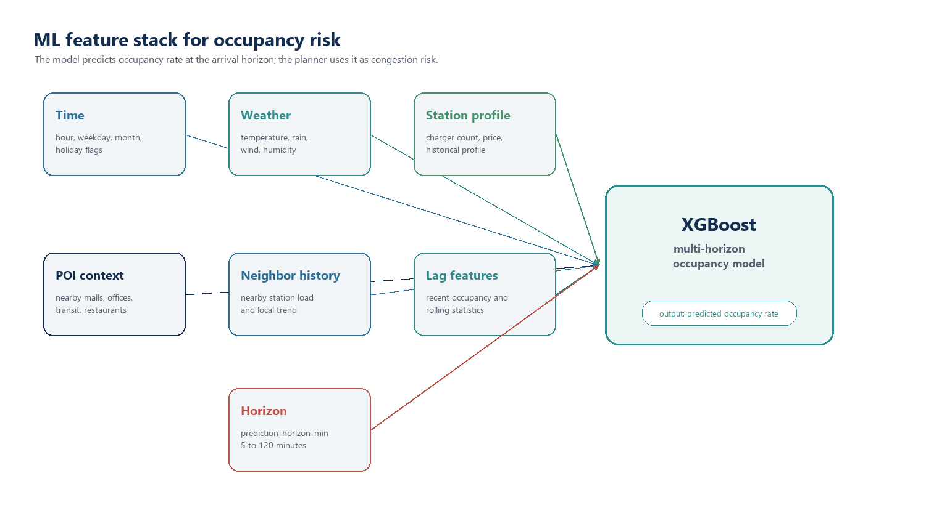
Machine Learning Model
XGBoost predicts future occupancy rate for the station arrival horizon
OccuEVRoute | DI22001 Algorithms and AI
7

Slide 8
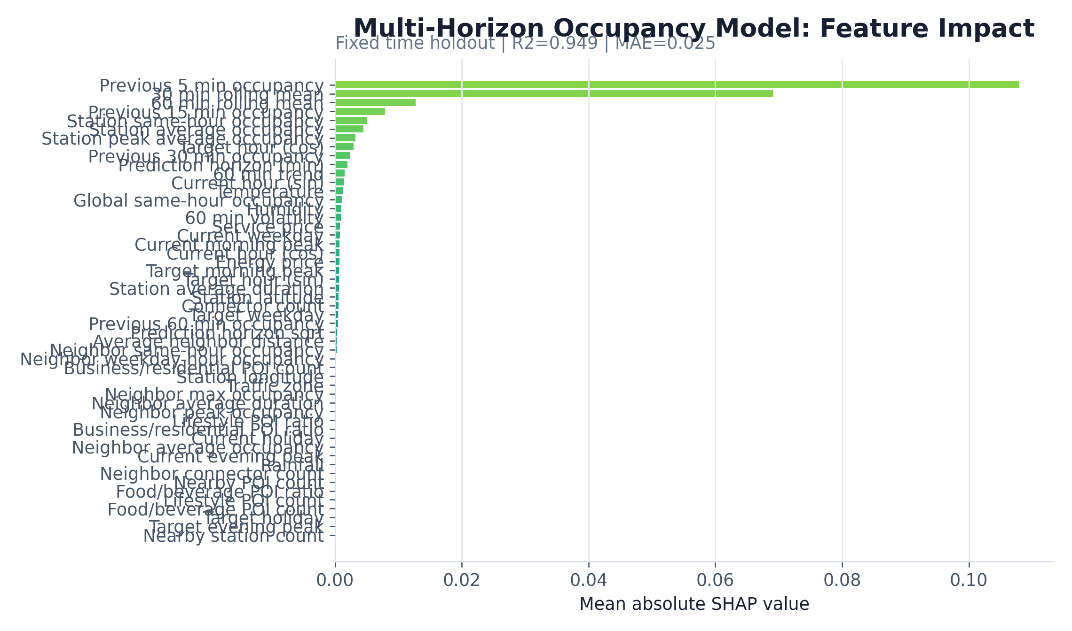
ML Results
Time-split evaluation shows strong occupancy prediction performance
Overall R2
Overall MAE
5 min R2
120 min R2
0.948742
0.024937, around 2.5 percentage points.
0.9790, strongest at short horizon.
0.8894, lower but still useful.
Interpretation
- Shorter horizons are more accurate
- Lag and historical station profiles are important
- MAE should be explained in occupancy-rate units, not only as a model score
R2 by prediction horizon
0.99
0.88
5 min
120 min
OccuEVRoute | DI22001 Algorithms and AI
8

Slide 9
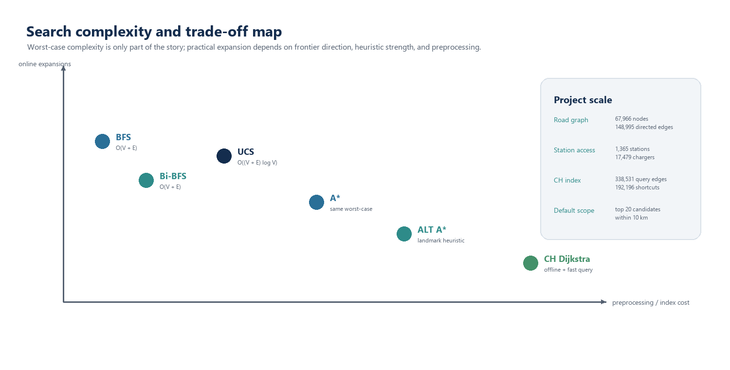
Performance and Complexity
Results should be explained together with algorithmic trade-offs
Counting: expanded_nodes means popped / settled nodes; bidirectional methods count both frontiers; CH counts upward-graph settled nodes.
OccuEVRoute | DI22001 Algorithms and AI
9

Slide 10
Limitations and Conclusion
A clear scope makes the project easier to defend
Limitations
Future work
No real waiting-time labels; occupancy is only congestion risk. No real-time traffic, live queue state, or charger-power dynamics.
Tune the congestion-risk weight, add live operational signals, and evaluate ranking behavior with user preference or real charging outcomes.
Conclusion
OccuEVRoute integrates graph search, EV feasibility constraints, ML occupancy prediction, and explainable ranking into a coherent course-demo route planning system.
Q&A reminders: occupancy is not waiting time; ranking is heuristic and explainable; CH is an acceleration method, not a new objective function.
OccuEVRoute | DI22001 Algorithms and AI
10

