Slide 1

Unsupervised Anomaly Detection with Generative Adversarial Networks to Guide Marker Discovery
Hansung University
Department of Computer Engineering
Bada Kim
Schlegl, Thomas, et al.
International Conference on Information Processing in Medical Imaging. Springer, Cham, 2017.

Slide 2
CONTENTS.
Introduction
Related works
AnoGAN
4. Experiments
Conclusion

Slide 3





Introduction
Anomaly Detection
What is the anomaly detection?
Normally data
Anomaly data
It is important to find anomaly for medical
  diagnosis
  monitoring of disease progression
  treatment response
Notes:
치료반응

Slide 4
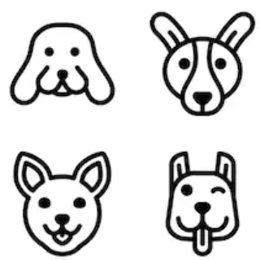


Introduction
Anomaly Detection
Why hard to anomaly detection?
  Fundamental anomaly problem
?
(Anomaly data)
Input
Model
Predicted
output

Slide 5




Introduction
Anomaly Detection
Why hard to anomaly detection?
  Impossible supervised learning for anomaly data
A number of Anomaly
Model
。 。 。

Slide 6
Introduction
Anomaly Detection
How will we anomaly detection?
  Distinguish to anomaly data
  Able to unsupervised learning
  Marked anomaly area
How use we anomaly detection?
  Using GAN(Generative Adversarial Networks)

Slide 7


Introduction
What’s GAN?
GAN(Generative Adversarial Networks)
  Generating a fake as if like a real.
Contents of GANs
VS
Generator
Discriminator

Slide 8
2. Related Works

Slide 9
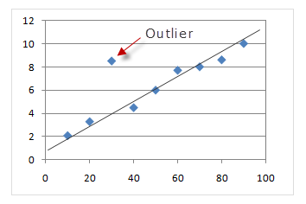
2. Related works
Typical method
Typical method for anomaly detection
  Outliers based

Slide 10

2. Related works
Typical method
Carrera et al. [3]
  Separately learning filters for anomaly detection.
Learning
[3] Detecting anomalous structures by convolutional sparse models.
In: 2015 International Joint Conference on Neural Networks (IJCNN), IEEE (2015) pp1-8

Slide 11
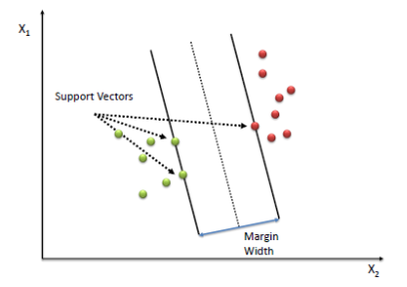
2. Related works
Typical method
Erfani et al. [4]
  Using SVM (Support Vector Machine)
[4] High-dimensional and large-scale anomaly detection using a linear one-class SVM with deep learning. Pattern Recognition 58 (2016) 121-134

Slide 12
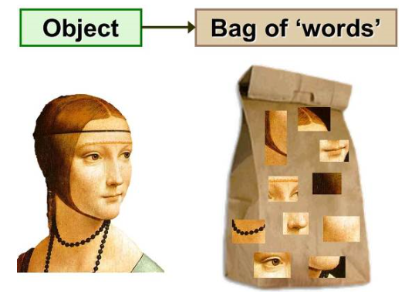
2. Related works
Typical method
Pimentel et al. [5]
  Using Bag-of-word
[5] A review of novelty detection." Signal Processing 99 (2014): 215-249.

Slide 13
3. anoGAN

Slide 14


3. anoGAN
Our proposal
Discriminator
VS
Generator
Discriminator
Searching Latent space and defining an anomaly score
Latent
space
and
score
Normal
data
Anomaly
data
Distinguish to score based anomaly data

Slide 15
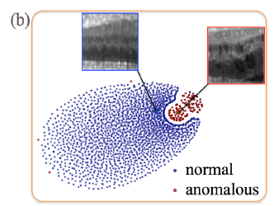
3. anoGAN
Data set
Using medical image set
  Retina fluid
Training set
  Normal data
Test set
  Normal data
  Anomaly data
Notes:
망막 액

Slide 16



3. anoGAN
Mapping function
Generator loss
Discriminator loss
Minimize

Slide 17
4. Experiments

Slide 18
4. Experiments
Standard
Training set : extracted 1,000,000 2D retina fluid at randomly
Test set : 8192 retina fluid data for normal and anomaly
performance: only evaluate discriminator
Comparison target
  AnoGAN
  GAN
  aCAE[16]
Evaluation standard
  ROC (sensitivity, specicity, precision, and recall)
[16] Pathak at al, “Context encoders:
Feature learning by inpainting.” CoRR abs/1604.07379 (2016)

Slide 19
4. Experiments
Implementation
AnoGAN
layer : 4 (512, 256, 128, 64)
Filter size : 5x5
RGB channel: Gray scale
Epoch : 20
Step: 500
Loss function: Stochastic gradient descent
Optimizer : adam
Language : python 2.7
Deep Learning: tensorflow

Slide 20
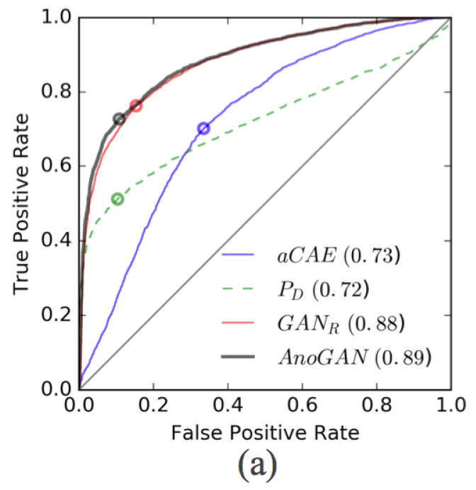

4. Experiments
Result
Best performance : AnoGAN
A useful figure:
Discriminator performance

Slide 21
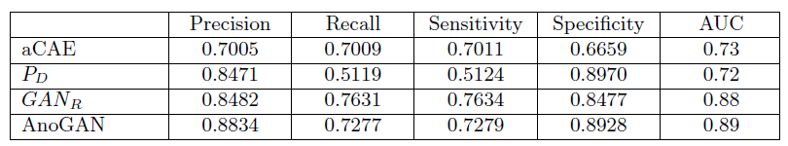
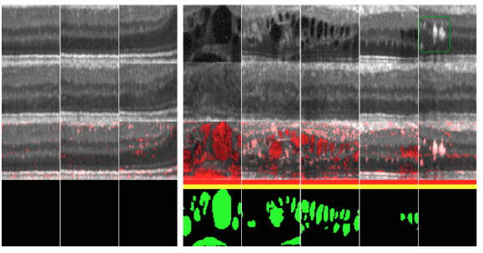
4. Experiments
Result
ROC
Detected
space
Normal Anomaly

Slide 22
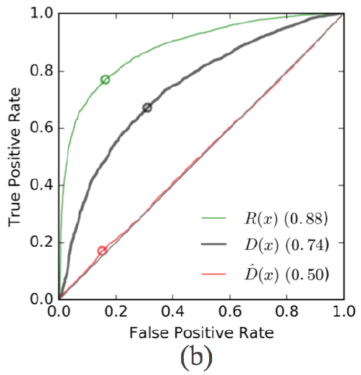

4. Experiments
Result
Best performance :
Residual score
Discrimination score
Reference[13] discrimination score
[13]Yeh, R at al: "Semantic image
inpainting with perceptual and contextual losses." arXiv:1607.07539 (2016)
Notes:
잔류점수는 얼마나 유사한지
식별점수는 차이점을

Slide 23
5. Conclusion

Slide 24
5. Conclusion
Conclusion
Result
AnoGAN Precision 0.88
The first GAN based anomaly detection
Detecting anomaly Without specific training anomaly data
(Unsupervised learning)
Limitation
quantitative evaluation: subset of anomaly classes is limited.

Slide 25
Q & A

