Slide 1
Learning Reduced-Round
Cipher Behavior
using Machine Learning
Ansh Gaur · Kavya Karthik · Pratyush Gangwar
IIIT Delhi · Applied Cryptography

Slide 2
Problem Statement
Can an ML model predict ciphertext from plaintext for a reduced-round block cipher — and at which round does learnability collapse?
Black-Box Oracle Setup
Evaluation Metrics
Plaintext P ∈ {0,1}ⁿ
Bitwise Accuracy
Fraction of correct bits predicted
Random baseline = 50%
Round Function × r
Hamming Distance
Average bit errors per sample
Random baseline = n/2
Ciphertext C ∈ {0,1}ⁿ
Block Accuracy
Whether the entire block is predicted correctly
Fixed secret key k · Seed 42 · 80/20 split
Goal: maximize r while keeping accuracy > 50%

Slide 3
Experimental Setup
Target Ciphers
Cipher | Block Size | Design | Architecture
SIMON-32/64 | 32-bit | Feistel | AND + ROT + XOR
SPECK-32/64 | 32-bit | ARX | ModAdd + ROT + XOR
PRESENT-64/80 | 64-bit | SPN | 4-bit S-box + Bit Permutation
GIFT-64/128 | 64-bit | SPN | 4-bit S-box + Bit-sliced Layer
ML Models
Linear Regression
MLP
CNN
MINE
Captures only affine structure (XOR / permutations). One binary classifier per output bit. Useful as a baseline.
FC layers (512 → 512 → 256), BatchNorm, ReLU, 10% dropout. Global view of all input bits simultaneously.
1D conv blocks (64, 128, 256 ch, kernel 3) + two dense layers. Inductive bias aligns with nibble-level S-boxes.
Mutual Information Neural Estimator. Shared encoder + autoregressive decoder. Information-theoretic lens on leakage.

Slide 4
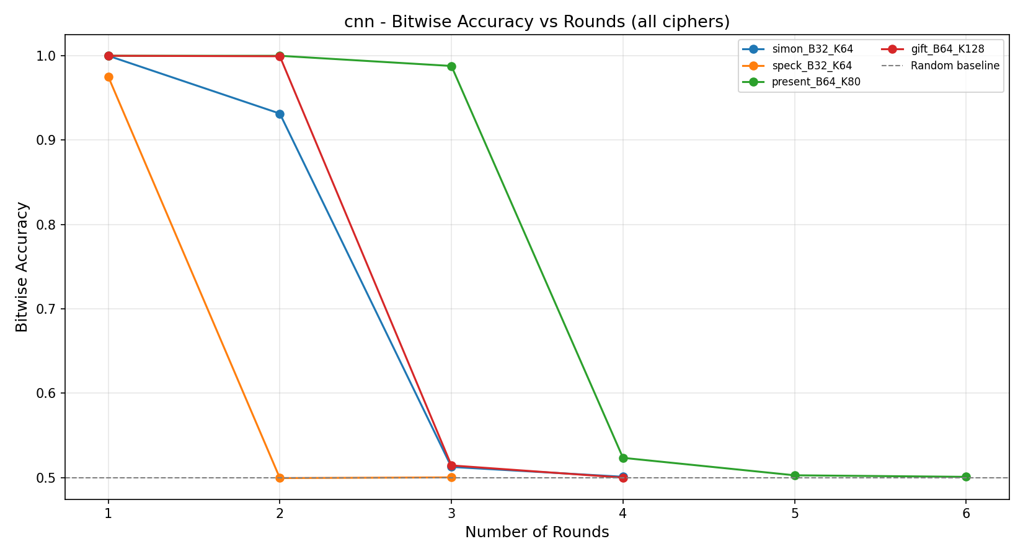
Results Overview — Maximum Learnable Rounds
Cipher | Lin. Reg. | MLP | CNN | MINE | Best
SIMON-32/64 | 1 | 3 ✓ | 2 | 2 | 3 (MLP)
SPECK-32/64 | 0 | 1 | 1 | 1 | 1 (all)
PRESENT-64/80 | 1 | 2 | 3 ★ | 2 | 3 (CNN)
GIFT-64/128 | 1* | 1 | 2 | 1 | 2 (CNN)
★ CNN on PRESENT: 98.8% bitwise accuracy at r = 3 · *Lin. Reg. on GIFT: only 59.3% at r = 1

Slide 5
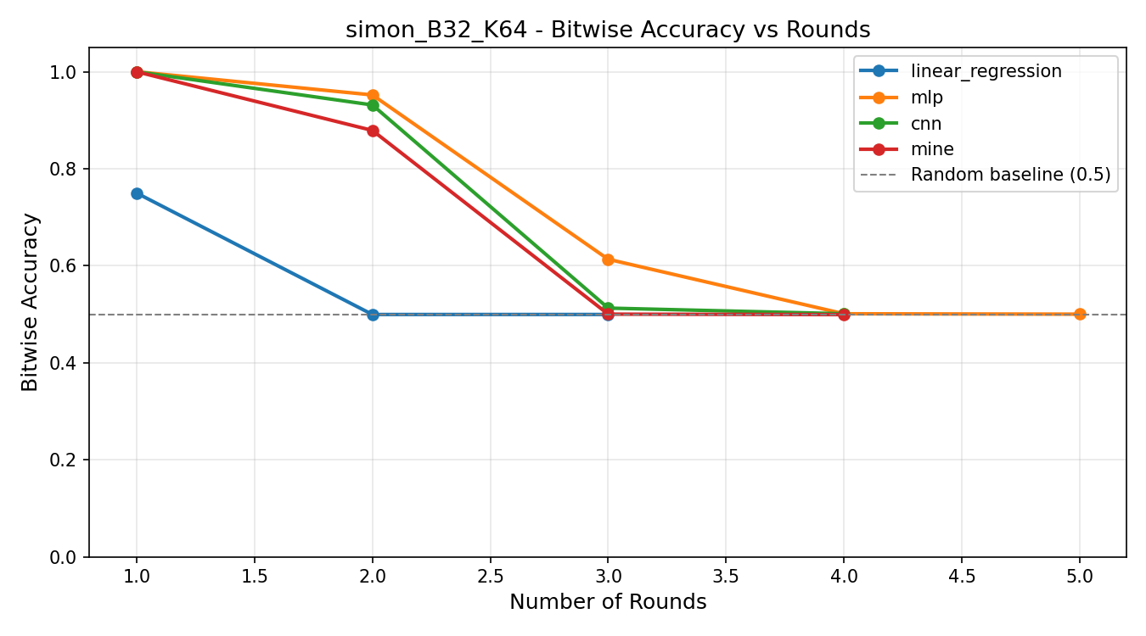
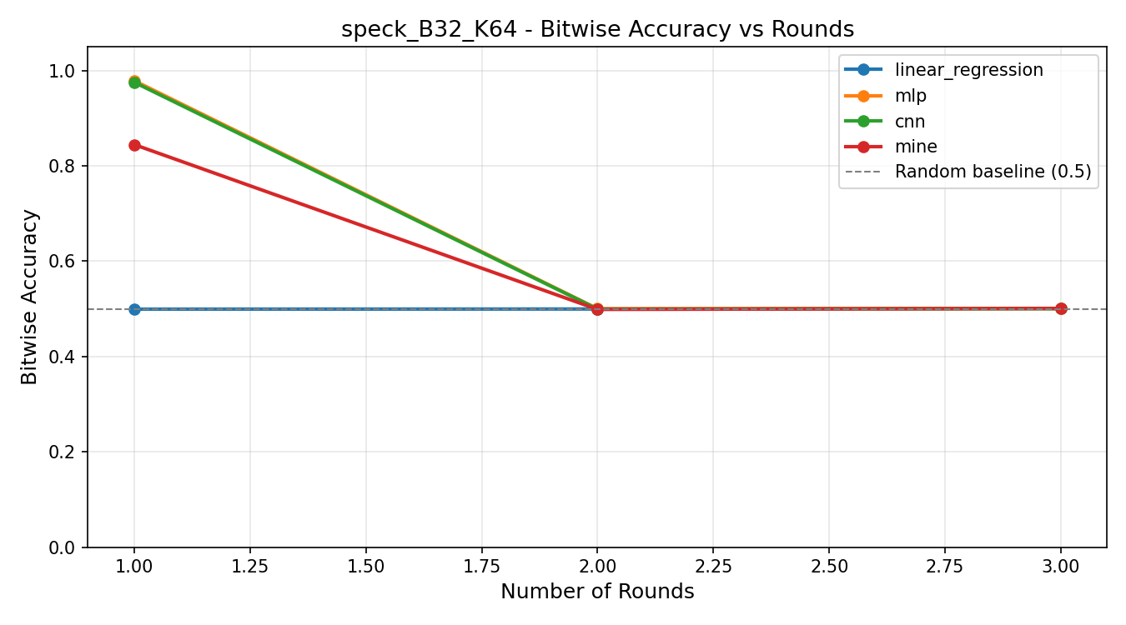
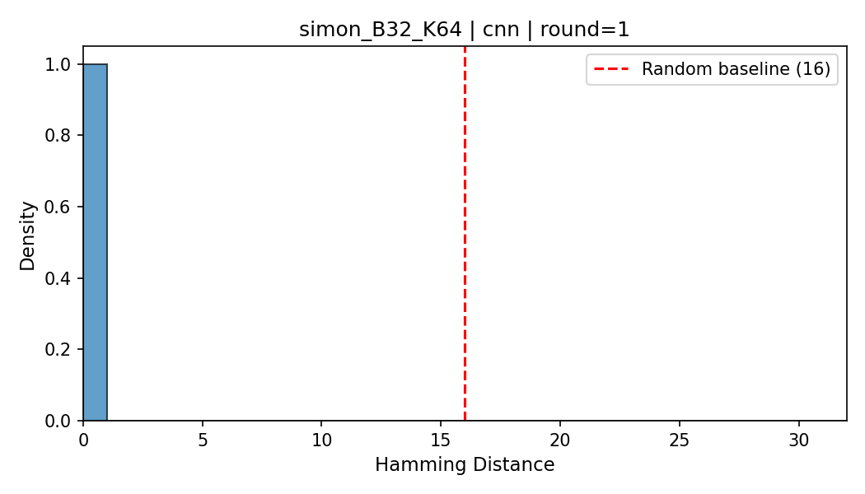
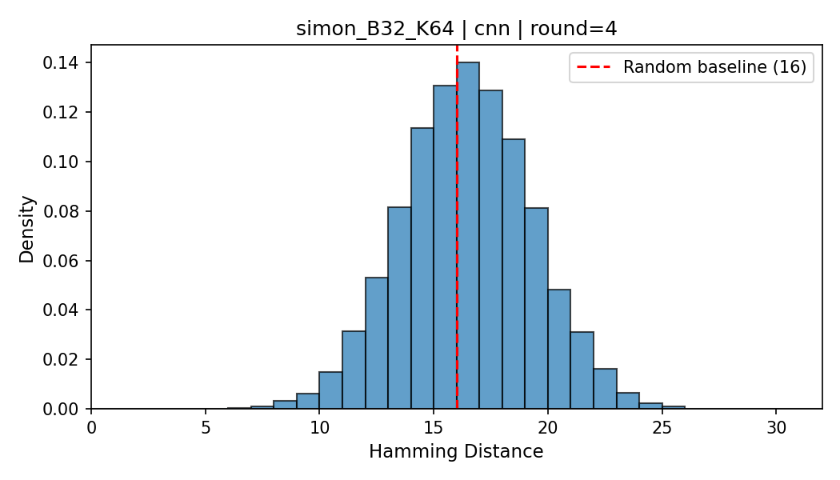
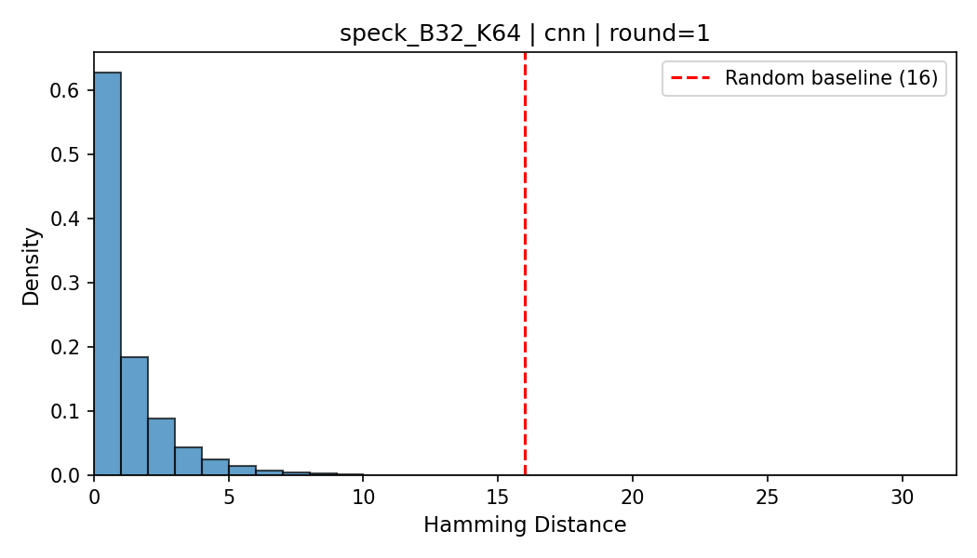
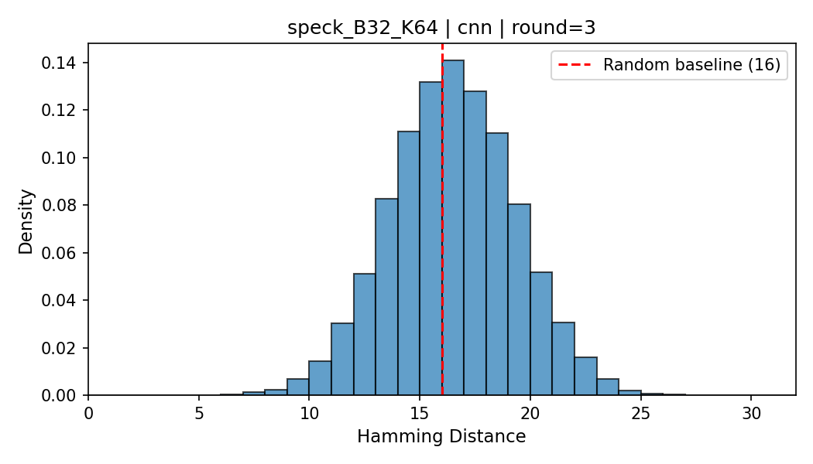
Cipher Deep Dive — SIMON-32/64 & SPECK-32/64
SIMON-32/64
SPECK-32/64
Feistel · AND + ROT + XOR
ARX · ModAdd + ROT + XOR ← Most Robust
Hamming Distance: r=1 (learned) vs r=4 (random)
Hamming Distance: r=1 (partial) vs r=3 (fully random)

Slide 6
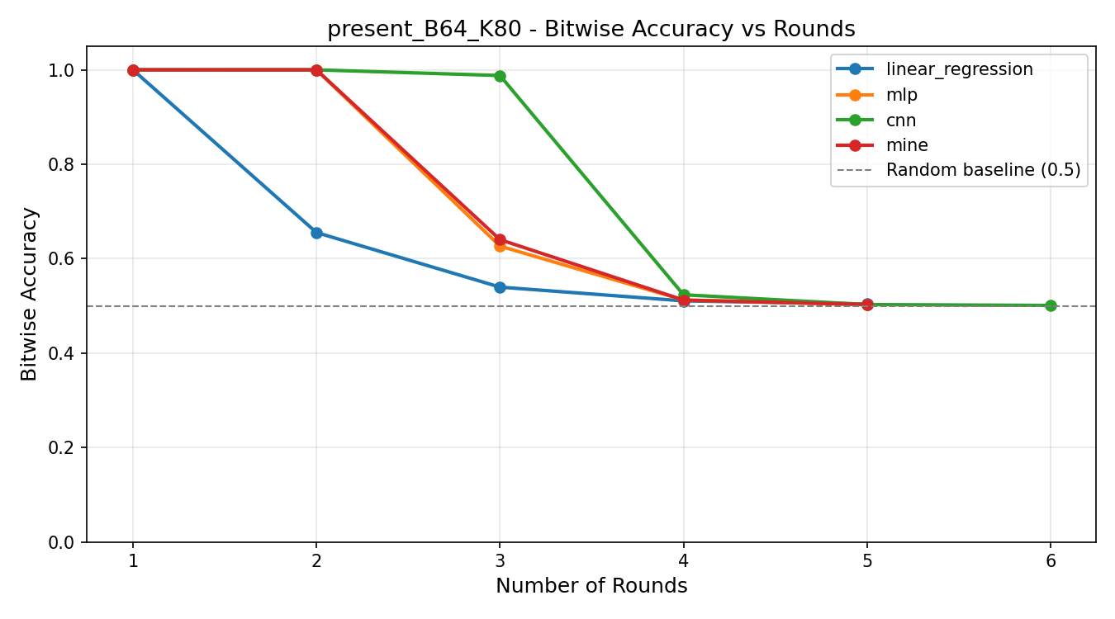
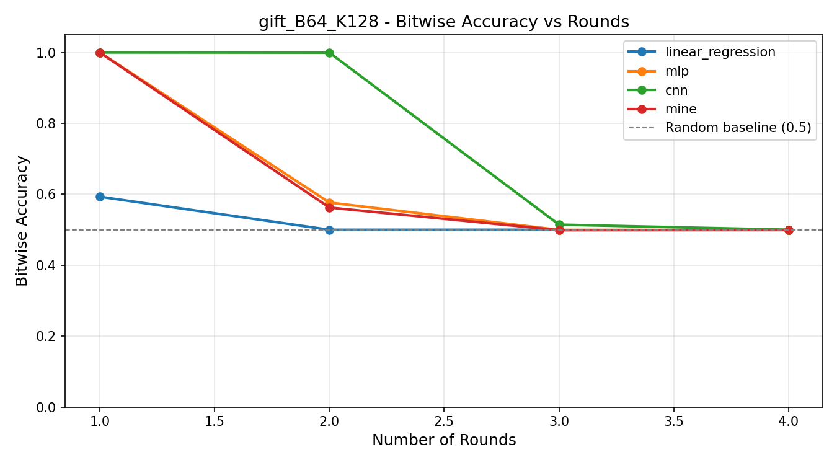
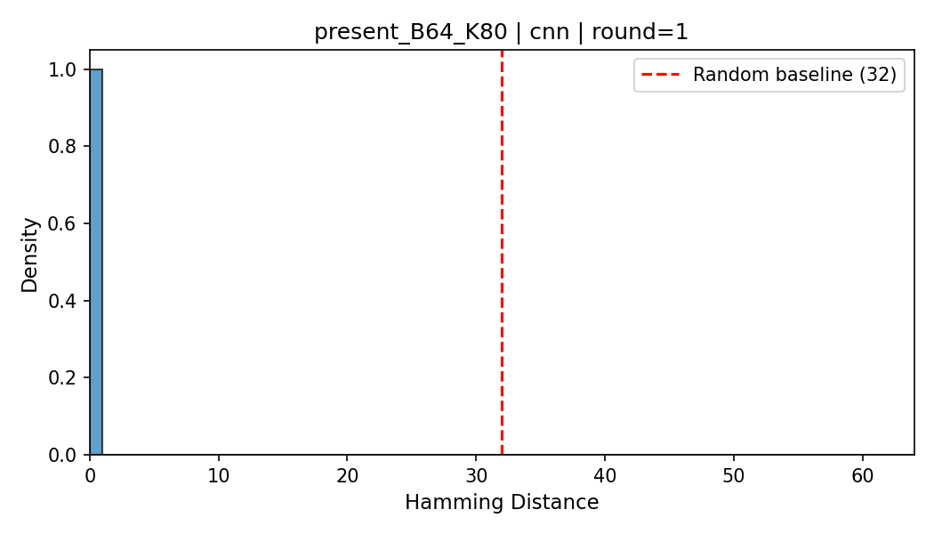
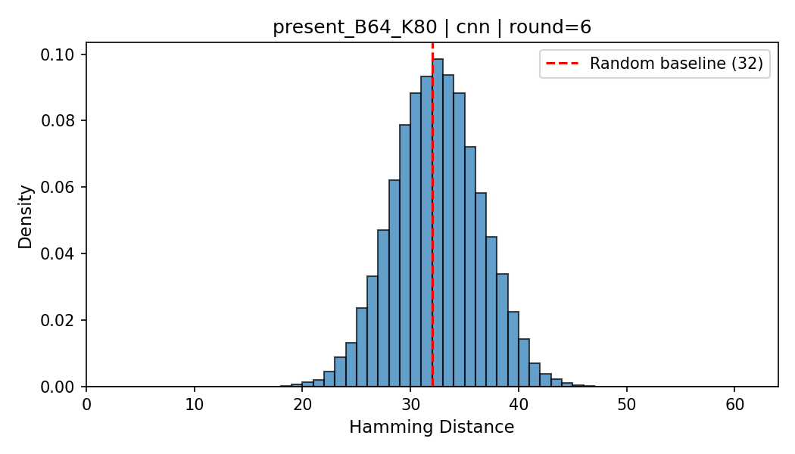
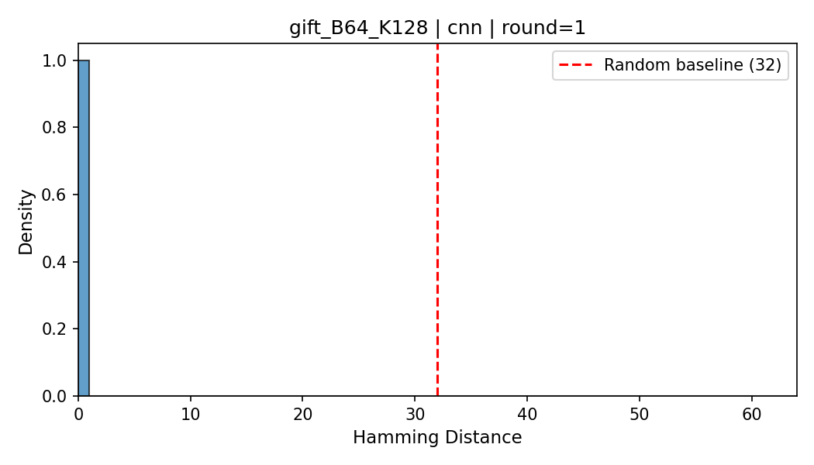

Cipher Deep Dive — PRESENT-64/80 & GIFT-64/128
PRESENT-64/80
GIFT-64/128
SPN · 4-bit S-box + Bit Permutation ← Most Learnable
SPN · Same S-box as PRESENT + Bit-sliced Layer
CNN Hamming: r=1 (perfect prediction) vs r=6 (fully random)
CNN Hamming: r=1 (almost perfect) vs r=4 (fully random)

Slide 7
Analysis & Key Takeaways
Learnability Order (easiest → hardest to crack)
PRESENT
SIMON
GIFT
SPECK
Simple bit-shuffle
Slow diffusion
AND-based Feistel
Moderate diffusion
Bit-sliced layer
Faster diffusion
Modular addition
Instant non-linearity
← easier to learn
harder to learn →
CNN dominates — 3 of 4 ciphers
CNN's 1D conv inductive bias perfectly matches nibble-level S-boxes and ARX carry propagation. The lone exception is SIMON, where MLP's global bit-view wins by 1 round — SIMON's Feistel structure affects all bit positions simultaneously.
MINE validates the information-theoretic limit
MINE tracks mutual information I(P;C) directly. Prediction accuracy collapses precisely when MINE measures zero mutual information — confirming the drop is due to true cryptographic pseudorandomness, not model weakness.
Full-round ciphers are secure against ML attacks
All four ciphers converge to Binomial(n, 0.5) Hamming distributions well before their full round count. Outputs become indistinguishable from random, confirming that modern lightweight ciphers resist this class of ML-based cryptanalysis.

Slide 8
Conclusion
PRESENT
SPECK
98.8%
CNN
Most Learnable
3 rounds (CNN)
Most Robust
1 round max
Peak Accuracy
PRESENT r=3
Best Model
3 of 4 ciphers
ML models can learn reduced-round cipher behavior with high accuracy,
but full-round outputs are
indistinguishable from random —
confirming modern lightweight ciphers are secure against ML-based attacks.
Ansh Gaur · Kavya Karthik · Pratyush Gangwar | IIIT Delhi | Applied Cryptography

