Slide 1
STAT 403
IOS Mobile App
Zhiying Xie, Yifei Chen, Seoyoung Park, Ziqi (Katie) Chen

Slide 2
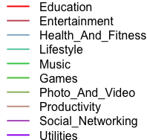
Dataset-IOS Mobile Apps
Obtained from Kaggle ​https://www.kaggle.com/ramamet4/app-store-apple-data-set-10k-apps​
Contains details for 7198 apps from 16 aspects (16 variables in the dataset) from iTunes Search API

Slide 3
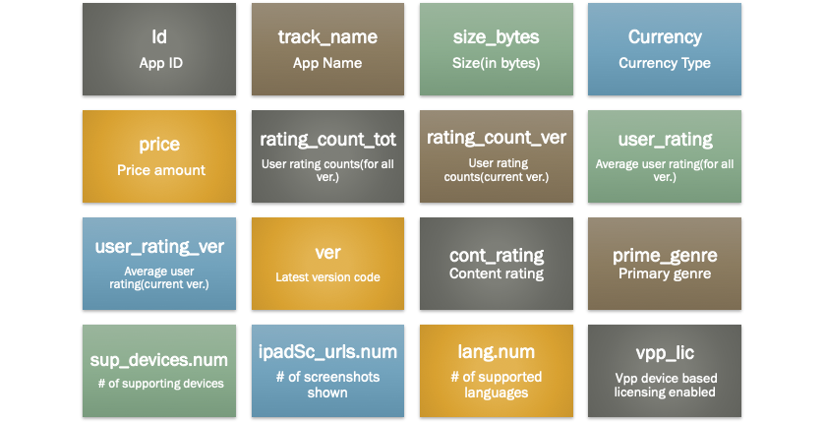
Variables in the dataset

Slide 4
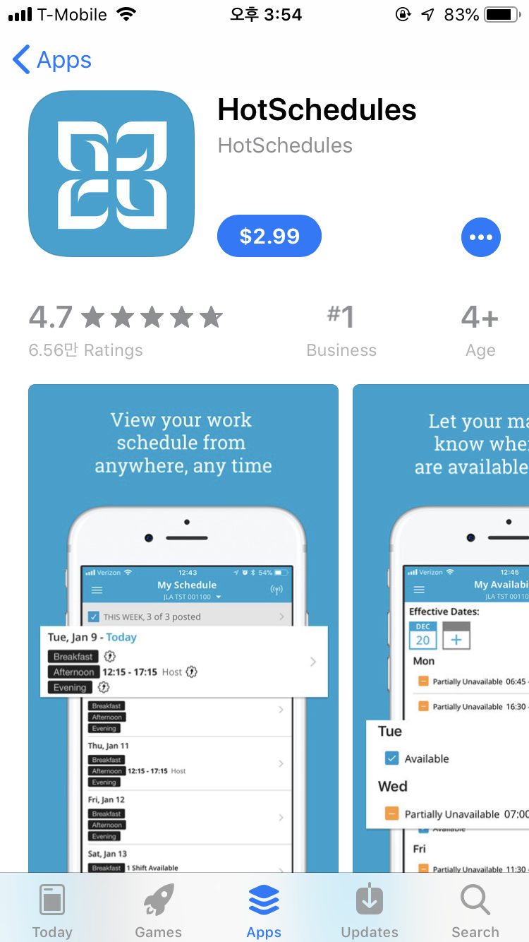
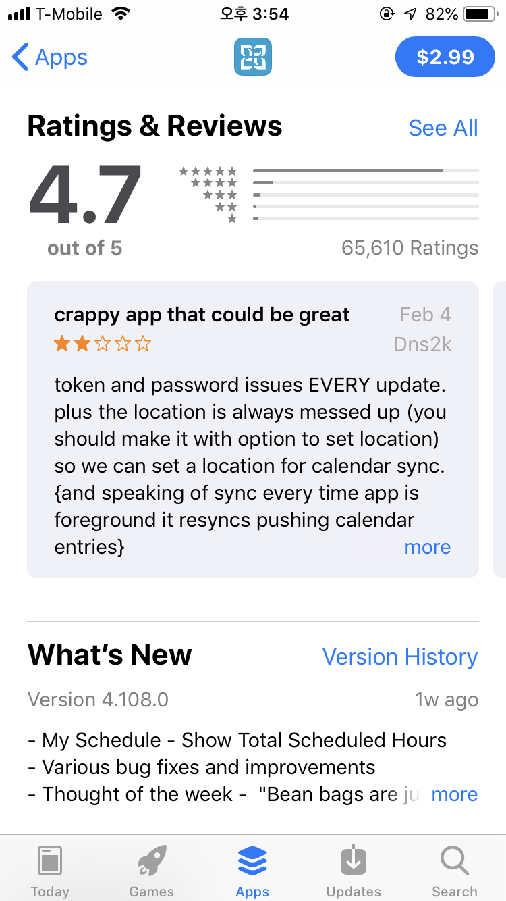
currency
price
user_rating
cont_rating
rating_count_tot
prime_genre
ver
ipadSc_urls.num

Slide 5
Data Analysis Procedures
Exploratory data analysis (EDA) of the Original Data
Process the Data
Delete the apps with average rating and total rating counts equal to 0
Resampling
Use bootstrap methods to gain 95% CI of the variables
Prediction Models

Slide 6
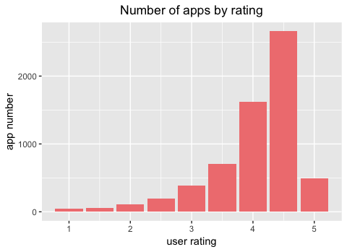
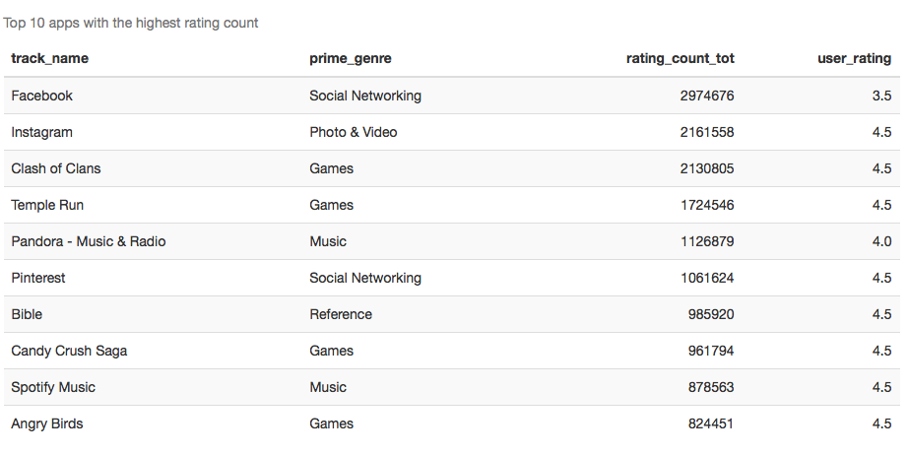
General Information
Notes:
The plot on the left side is the number of apps for each rating ranges from 1 to 5. It shows that most apps have rating 4.5. The table on the right is a list of top 10 apps that have the highest rating count regardless of the genre. We can see that the user rating does not highly depend on the rating count.

Slide 7
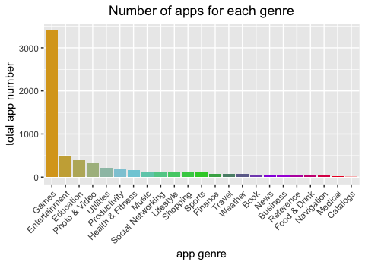
General Information (cont)
Notes:
We group by and order the genres based on the number of apps each genre has. We observe that the number of apps that belong to Games category is 54%.

Slide 8


Research Questions
How is user rating categorized by genres affected by variables such as prices, sizes, languages and screenshots of the apps?
Using resampling methods (bootstrap)
What could be some important factors to predict the rating of an APP?
AIC: predicting the rating of a new app using the model coefficients we got.
Notes:
In this project, we want to answer two questions. The first one is “how is ...?” We would do this part by using bootstrap. The second question is “What could be some…?” In this part we would use AIC to select variables and build regression model to predict the user rating.

Slide 9
Analysis of Data
Main variables:
Dependent variable
User rating (continuous)
Independent variable
Total rating count (discrete)
Ipad Screenshot (discrete)
Number of Languages (discrete)
Number of Supporting Devices (discrete)
Price (continuous)
Size in bytes (continuous)
Notes:
Our dependent variable is the user rating. We eliminate variables that do not provide us much information such as id, app name, currency, etc. We also eliminate rating count and user rating score for app’s current version because using total value would give us a broad picture of how people value the app.
Next Sebrina would explain how we do the bootstrap.

Slide 10
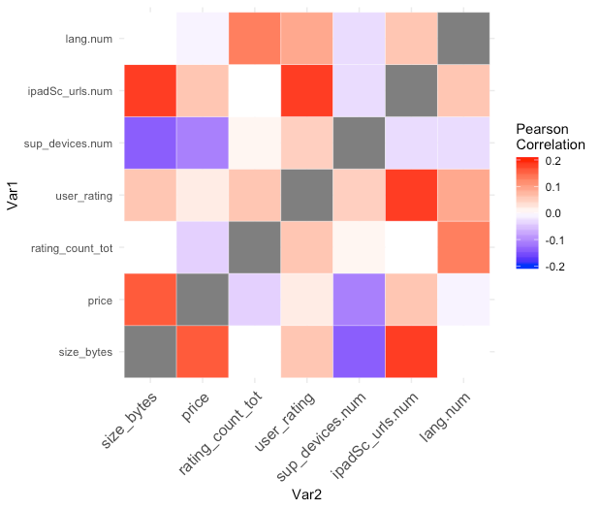
Correlation between variables
4 variables that are most correlated to the average user rating count:
# of screenshots, # of languages, size in bytes, and total rating counts

Slide 11
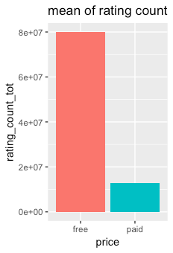
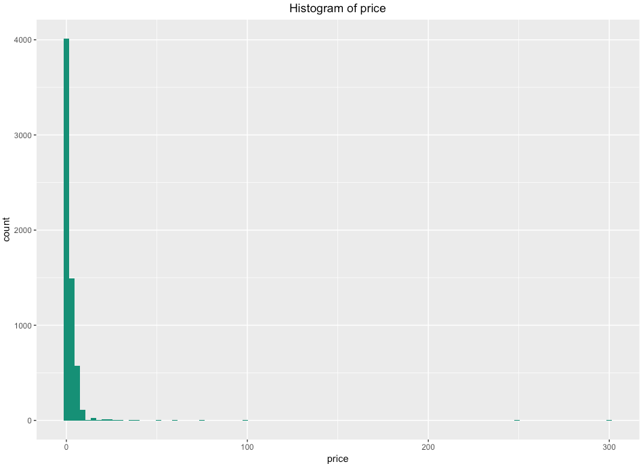
Price
in frequency
Rating count vs price
Rating count
price

Slide 12
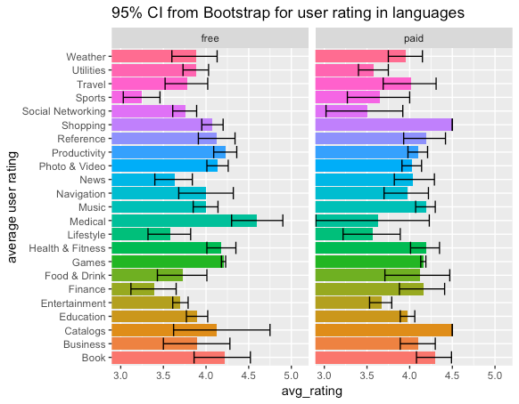
User Rating
in Price
95% CI from Bootstrap for user rating in price

Slide 13
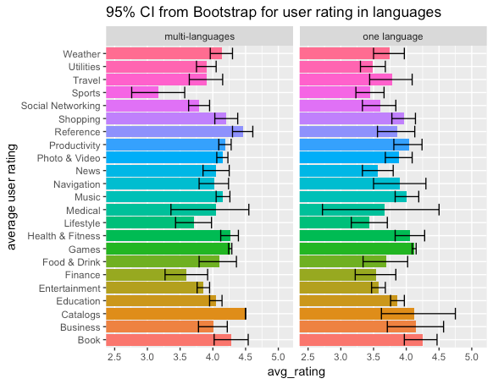
User Rating
in languages

Slide 14
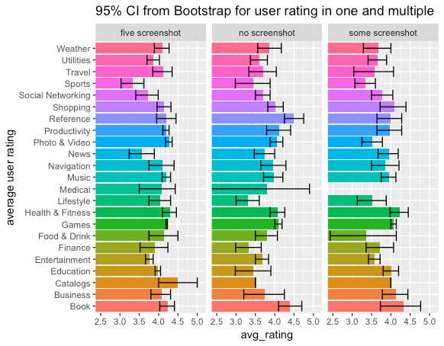
User Rating
in screenshot
95% CI from Bootstrap for user rating in screenshots

Slide 15
Model of User Rating (overall)
y = user rating (0-5)
x_1 = number of screen shot
x_2 = number of languages
x_3 = size in MB
x_4 = total rating count
x_5 = number of supportive devices
Notes:
This is the model of user rating for overall data.
We used the number of screen shot, the number of languages, size, total rating count, and the number of supportive devices to predict the user rating.
R^2 : 0.818
R-squared (R2) is a statistical measure that represents the proportion of the variance for a dependent variable that's explained by an independent variable or variables in a regression model

Slide 16
Model of User Rating (Paid & Free)
Model for free apps:
Model for paid apps:
y = user rating (0-5)
x_1 = number of screen shot
x_2 = number of languages
x_3 = size in MB
x_4 = total rating count
x_5 = number of supportive devices
x_6 = price
Notes:
These are the models that are divided by paid apps and free apps.
Since the paid apps differ in price, the price variable is also included as x_6.
And the number of supportive devices, x_5 is excluded because the AIC doesn’t change whether we put it or not.
R^2 for free model: 0.8519
R^2 for paid model: 0.7457
** paid model**
Include price feature
Exclude x_5 since AIC doesn’t change
The Akaike information criterion (AIC) is an estimator of the relative quality of statistical models for a given set of data.

Slide 17
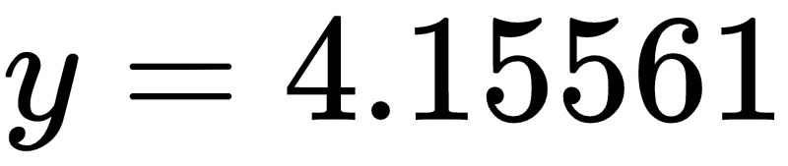
Predict the user rating of an app
- For example:
For a paid game app ($0.99) with the 3 screenshots in ipad Itunes stores, 4 usable languages, size of 34.4 MB, total rating count of 6334, and 10 supportive devices, what is the predicted user rating disregarding its content?
predicted user rating :
→
y = user rating (0-5)
x_1 = number of screen shot
x_2 = number of languages
x_3 = size in MB
x_4 = total rating count
x_5 = number of supportive devices
x_6 = price
Notes:
Using our model, we can now predict the user rating if you are wondering what the user rating would be for your app. For example, if the app is made like this, we can use the model for paid apps to predict the user rating, and it comes out 4.15 for this app.

Slide 18
Thank you

Slide 19

Notes:
Any questions?

Slide 20
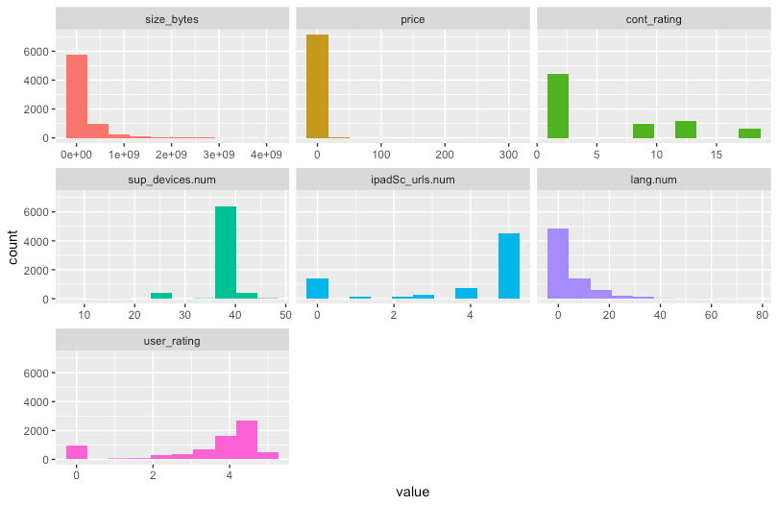
(a)
(b)
(c)
(d)
(e)
(f)
(g)

