Slide 1



$I^{2}AM:$Interpreting Image-To-Image Latent Diffusion Models via Bi-Attribution Maps
Junseo Park and Hyeryung Jang
Dongguk University, South Korea
{mki730, hyeryung.jang}@dgu.ac.kr

Slide 2
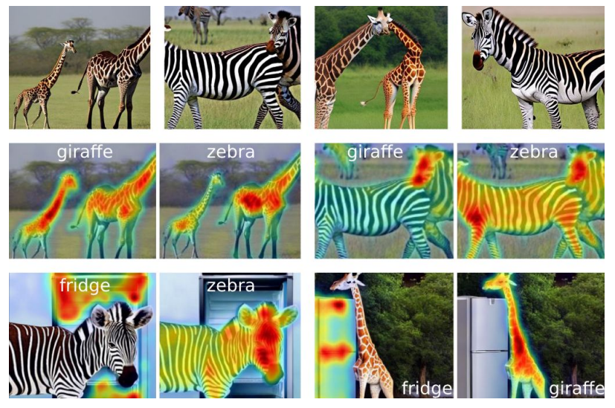
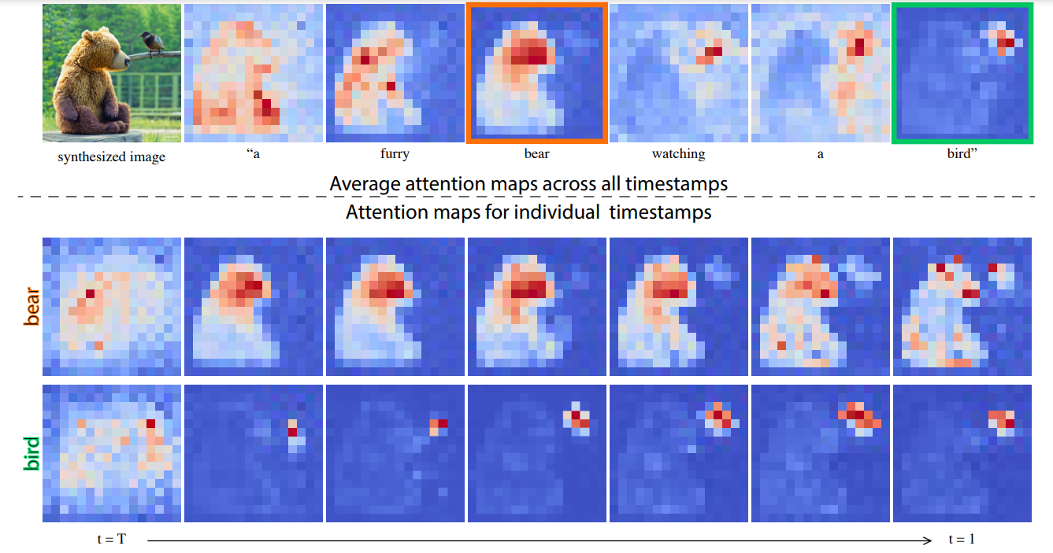
INTRODUCTION
Recent XAI efforts on diffusion models have largely focused on text-to-image (T2I) models via cross-attention maps between text token and generated image patch
DAAM [1]
Prompt-to-Prompt [2]

Slide 3
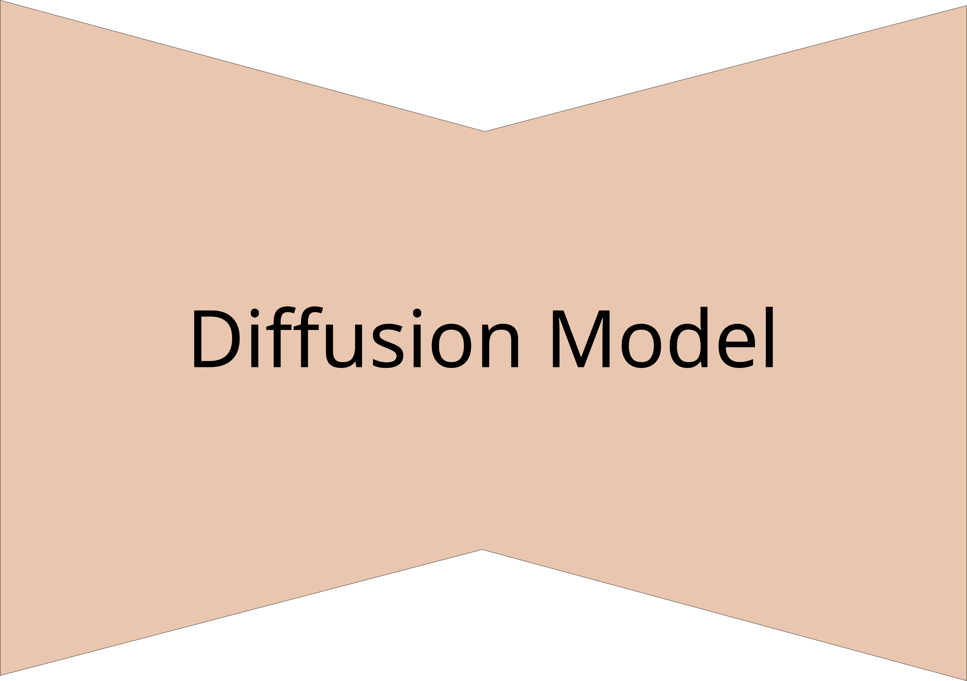
INTRODUCTION
The interpretability in image-to-image (I2I) diffusion models remains underexplored
Reference image
Text
Image
Generated image
Input
Input
Output
<Text-to-image>
<Image-to-image>

Slide 4
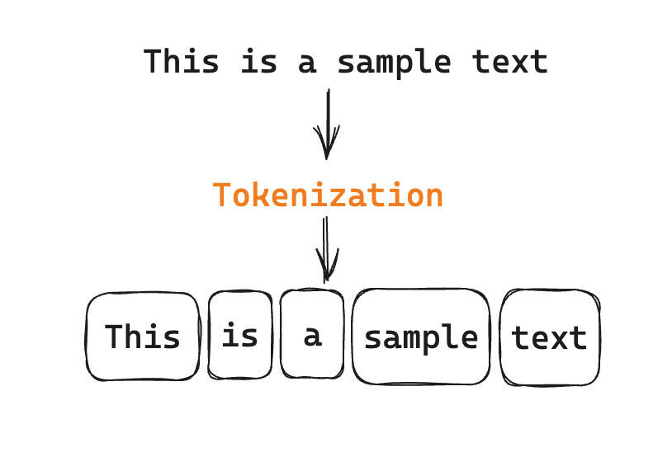
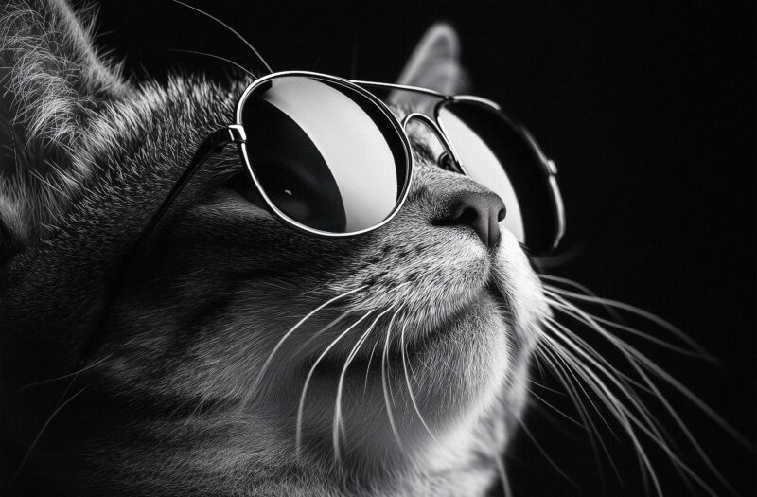

CHALLENGING ISSUES
Text-to-Image (T2I): independent separation of text (tokenization)
Image-to-Image (I2I): spatial and contextual continuity of reference image
Notes:
필요한 부분만 딱 자르기 어렵다

Slide 5


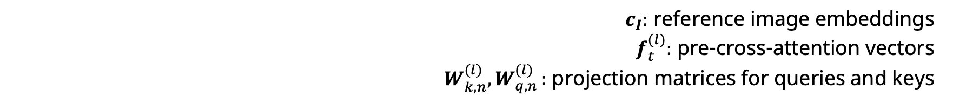
METHOD: I²AM
The shared image domain between reference and generated images
Uni-directional visualization:
Text
Image
Bi-directional visualization:
Image
Image
Bi-directional attention scores
Reference-to-Generated attention score : influence of reference patch
Generated-to-Reference attention score : influence of generated patch
$c_{I}:$ reference image embeddings $f_{t}^{(l)}:$ pre-cross-attention vectors
$W_{k,n}^{(l)}{,W}_{q,n}^{(l)}:$ projection matrices for queries and keys
Notes:
이 score를 바탕으로 다음의 attribution map을 생성

Slide 6
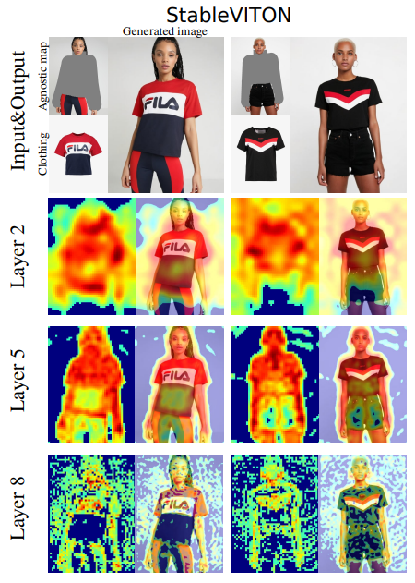
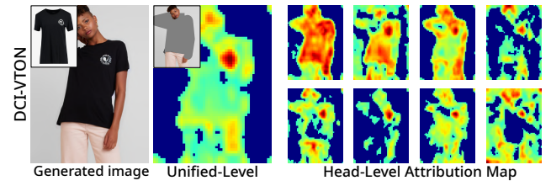
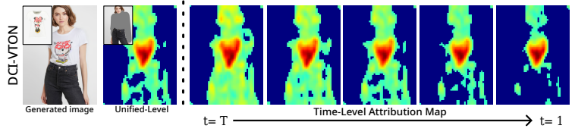
METHOD: I²AM
Attribution maps tailored for diffusion models
Unified / Layer / Head / Time -level attribution maps
Head-Level attribution maps
Time-Level attribution maps
Layer-Level attribution maps

Slide 7
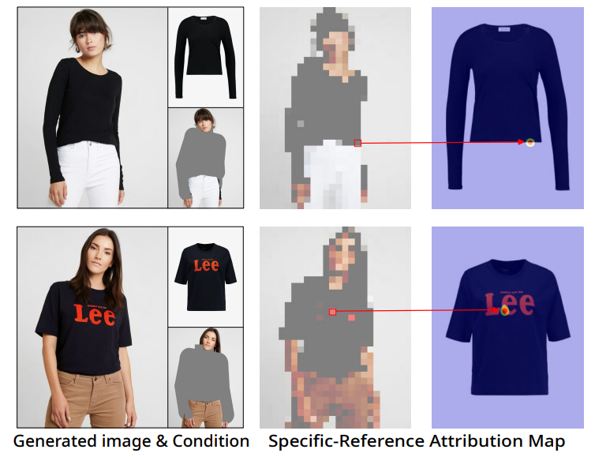
METHOD : I²AM
Specific-reference attribution map

Slide 8
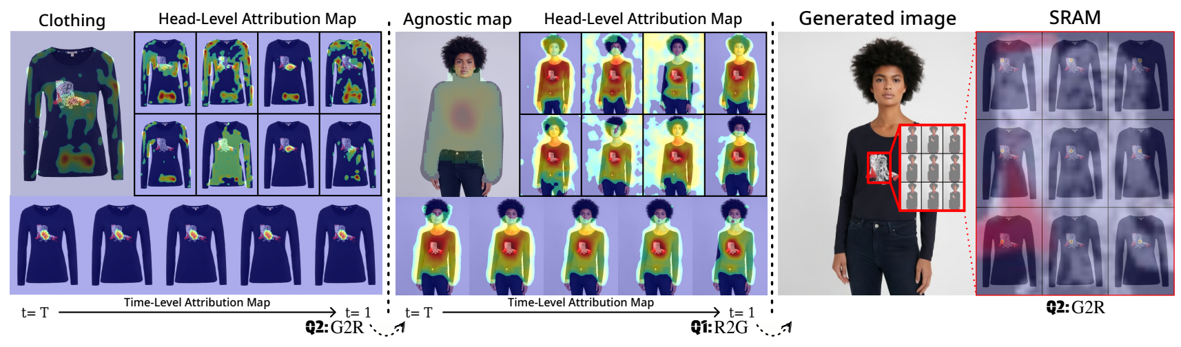
EXPERIMENTS
Task: inpainting and super-resolution tasks
Model
Inpainting: Paint-by-Example [3], DCI-VTON [4], StableVITON [5]
Super-resolution: PASD [6], SeeSR [7]

Slide 9
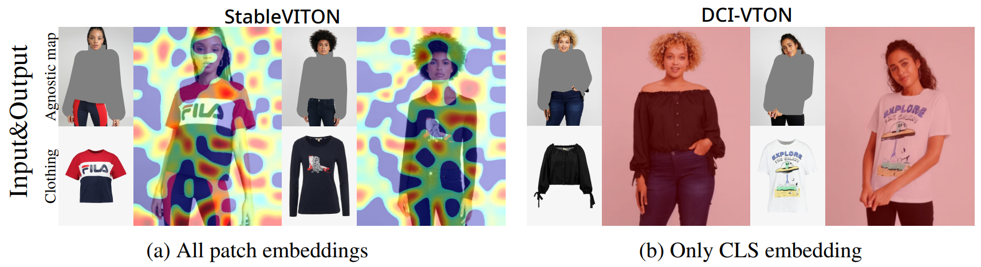
EXPERIMENTS
Comparison with other T2I attention-based method (DAAM [1])

Slide 10
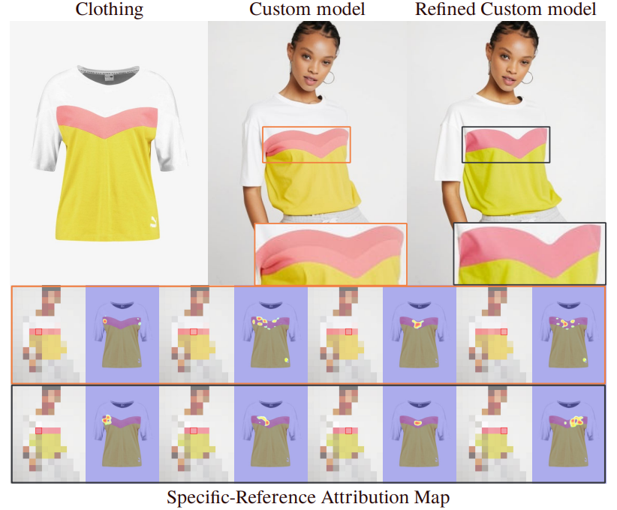
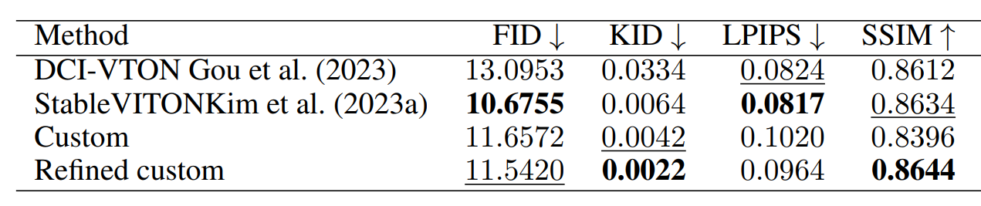
EXPERIMENTS
Model debugging and refinement
Utilize I²AM to analyze attention alignment in custom model
Refine custom model for better consistency and performance

Slide 11
References
Reference papers
[1] Tang, Raphael, et al. "What the daam: Interpreting stable diffusion using cross attention.“, arxiv 2022.
[2] Hertz, Amir, et al. "Prompt-to-prompt image editing with cross attention control.“, arxiv 2022.
[3] Yang, Binxin, et al. "Paint by example: Exemplar-based image editing with diffusion models." Proceedings of the IEEE/CVF Conference on Computer Vision and Pattern Recognition. 2023.
[4] Gou, Junhong, et al. "Taming the power of diffusion models for high-quality virtual try-on with appearance flow." Proceedings of the 31st ACM International Conference on Multimedia. 2023.
[5] Kim, Jeongho, et al. "Stableviton: Learning semantic correspondence with latent diffusion model for virtual try-on." CVPR 2024.
[6] Yang, Tao, et al. "Pixel-aware stable diffusion for realistic image super-resolution and personalized stylization." European Conference on Computer Vision. Cham: Springer Nature Switzerland, 2024.
[7] Wu, Rongyuan, et al. "Seesr: Towards semantics-aware real-world image super-resolution." Proceedings of the IEEE/CVF conference on computer vision and pattern recognition. 2024.

Slide 12
THANK YOU.

