Slide 1
Class Activation Map
Learning Deep Features for Discriminative Localization
Grad-CAM: Visual Explanations from Deep Networks via Gradient-based Localization

Slide 2
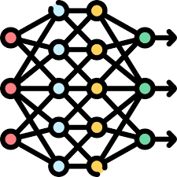

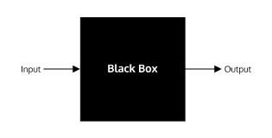
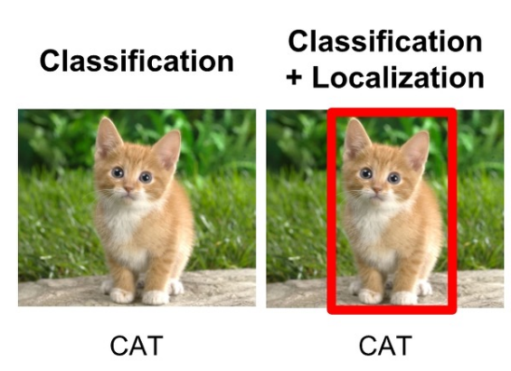
Issues on CNN
Success in image deep learning since the appearance of CNN
However, CNN (or Deep learning) works as a black box
Objective
Visualize what the model thinks is important when making predictions
Object localization only with class label

Slide 3
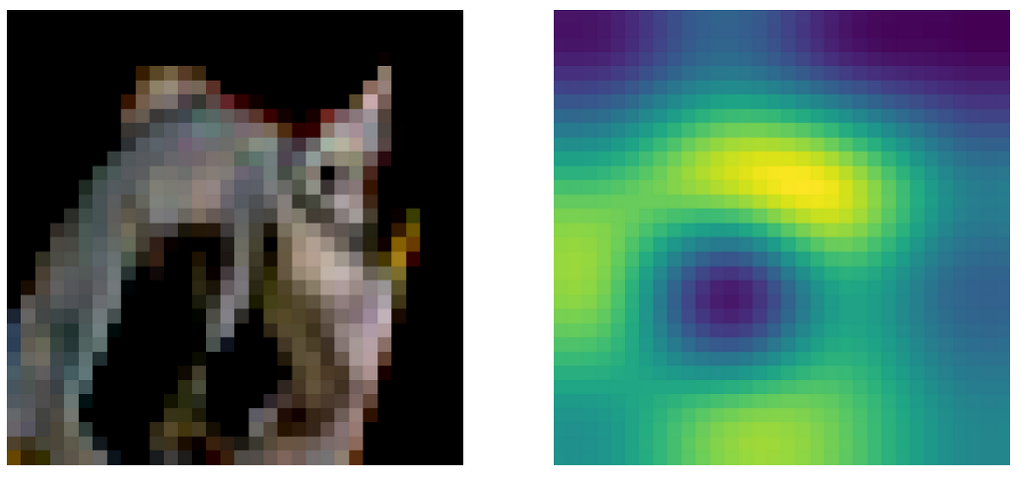
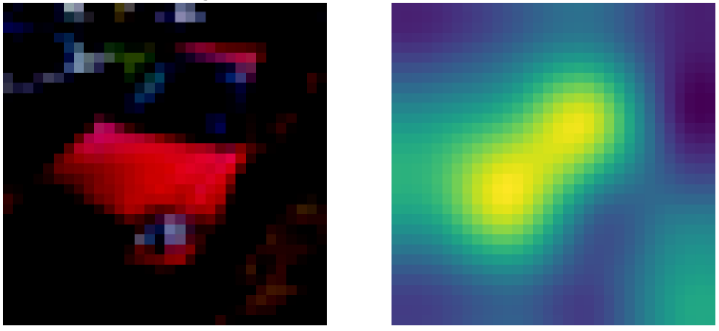
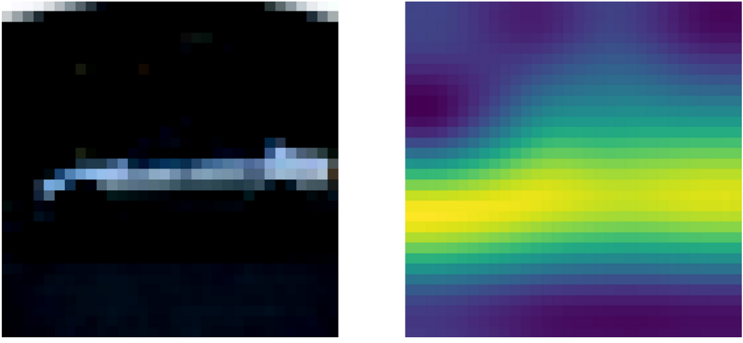
Results: CIFAR10
Can see where model focus when it classify objects
CAM
Grad-CAM

Slide 4
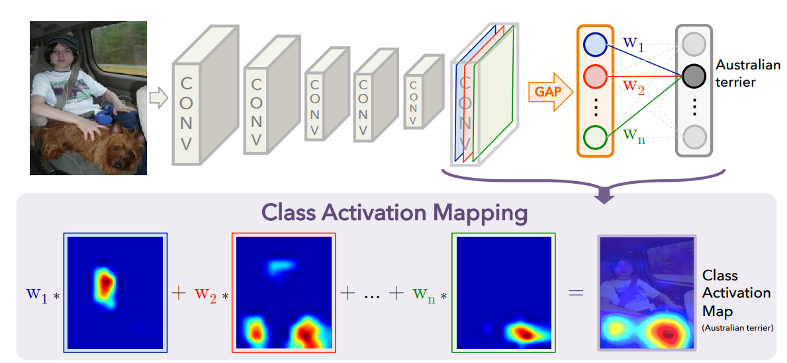
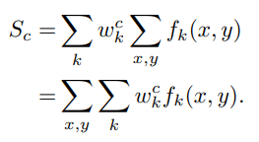

Method: CAM
Main component: feature map, GAP (Global Average Pooling), weights

Slide 5
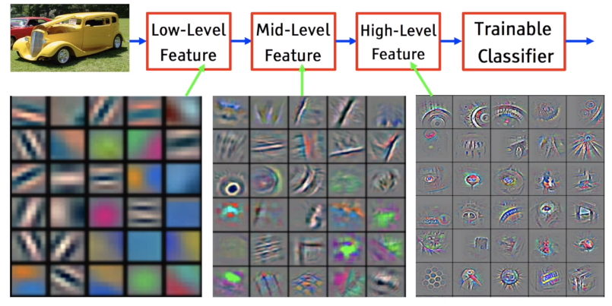

Method: CAM
Feature map: output of CNN
CNN works as a feature extractor
Based on kernel, extract local information

Slide 6

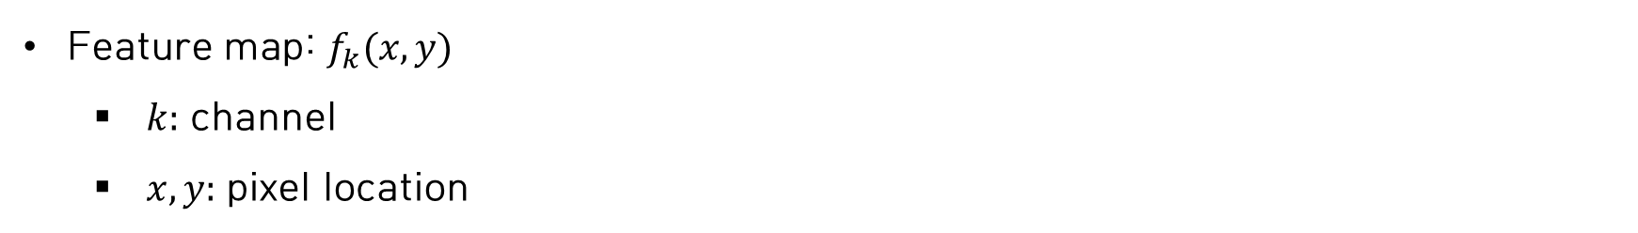



Method: CAM
Feature map: $f_{k}(x,y)$
$k:$ channel
$x,y:$ pixel location
$$f_{k}(x,y)$$
CNN
$$k=3$$
$$k=2$$
$$(x=1,y=1)$$
$$k=1$$

Slide 7
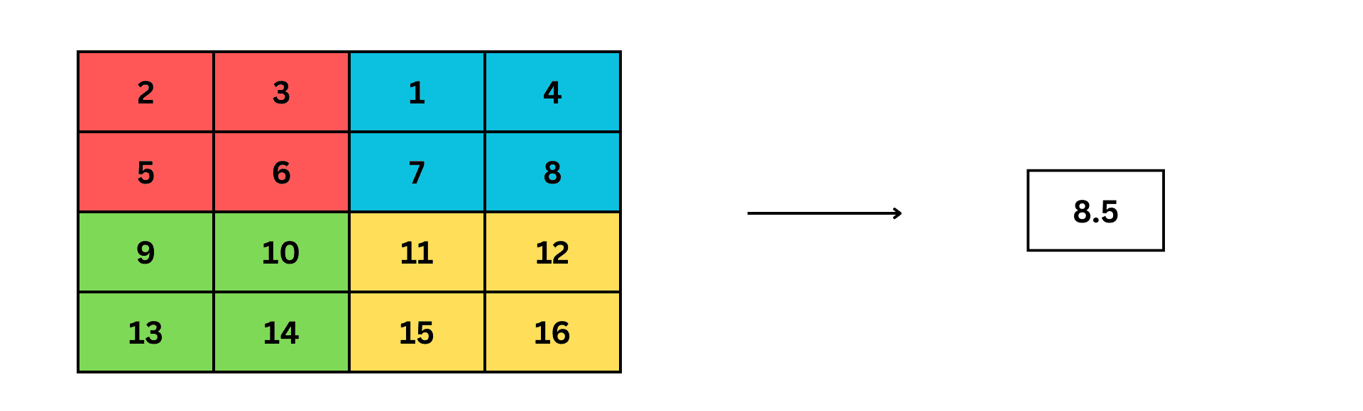

Method: CAM
GAP (Global Average Pooling)
Value representative of the channel
$$k=1$$

Slide 8




Method: CAM
GAP (Global Average Pooling)
Value representative of the channel
$$k=3$$
$$k=2$$
$$(x=1,y=1)$$
$$k=1$$

Slide 9
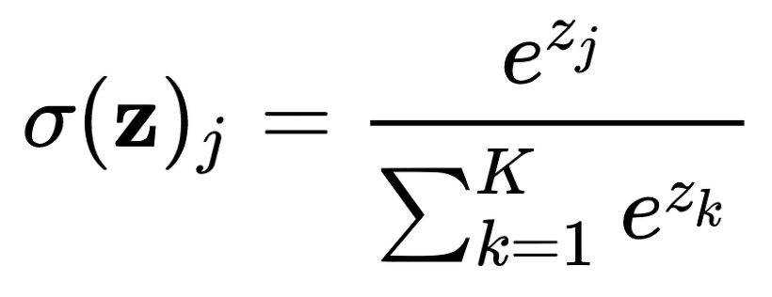

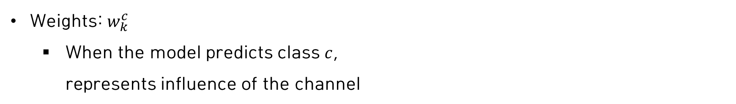





Method: CAM
Weights: $w_{k}^{c}$
When the model predicts class $c$, represents influence of the channel
$$w_{3}^{1}$$
Cat $(c=1)$
$$k=3$$
dog
$$k=2$$
$$(x=1,y=1)$$
$$k=1$$

Slide 10








Method: CAM
Weights: $w_{k}^{c}$
When the model predicts class $c$, represents influence of the channel
$$x_{3}$$
$$w_{3}^{1}$$
$$z_{j}=x_{1}w_{1}^{1}{+x}_{2}w_{2}^{1}{+x}_{3}w_{3}^{1}$$
$$w_{2}^{1}$$
Cat $(c=1)$
Weighted sum
$$x_{2}$$
$$w_{3}^{1}$$
dog
$$x_{1}$$
Softmax

Slide 11

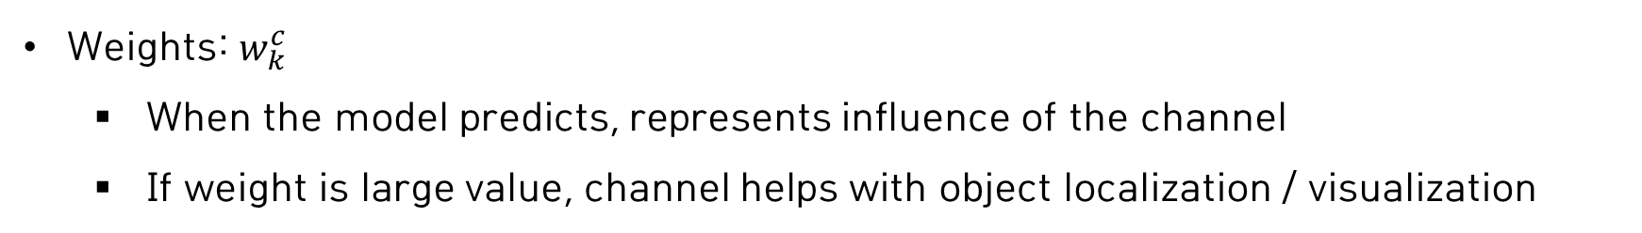
Method: CAM
Weights: $w_{k}^{c}$
When the model predicts, represents influence of the channel
If weight is large value, channel helps with object localization / visualization
10
$$c$$
1
Cat $(c=1)$
1
$$k=3$$
1
Dog
$$k=2$$
$$(x=1,y=1)$$
$$k=1$$

Slide 12
Method: CAM
Weights: $w_{k}^{c}$
When the model predicts, represents influence of the channel
If weight is large value, channel helps with object localization / visualization
-10
$$c$$
-1
Cat $(c=1)$
1
$$k=3$$
1
Dog
$$k=2$$
$$(x=1,y=1)$$
$$k=1$$

Slide 13
Method: CAM
Due to the sequential combination of the feature map, GAP, and weight, weight indicate the importance of the feature map

Slide 14
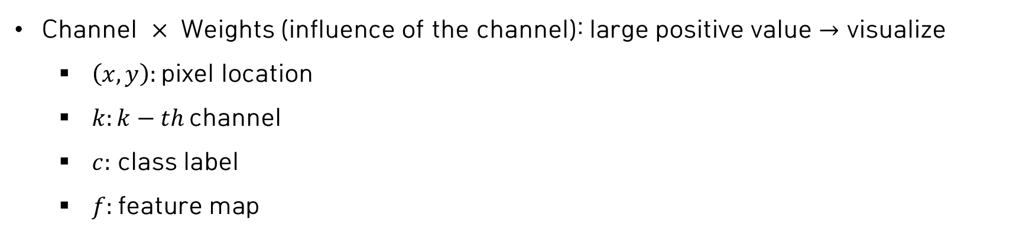
Method: CAM
Channel $×$ Weights (influence of the channel): large positive value $→$ visualize
$\left(x,y\right):$pixel location
$k:k−th$channel
$c:$ class label
$f:$feature map

Slide 15
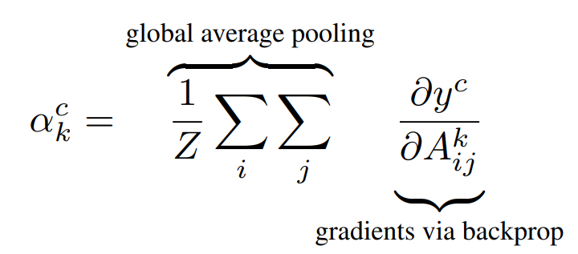
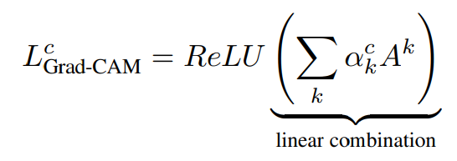

Method: Grad-CAM
Limitation of CAM
Model structure is constrained
Replace weights in Channel $×$ Weights (influence of the channel)

Slide 16






Method: Grad-CAM
Gradient
The degree to which class predictions change as the value of feature map changes
When the model predicts, represents influence of the channel
$$y_{c}$$
Cat $(c=1)$
$$f_{k}\left(x,y\right)=A_{ij}^{k}$$
$$k=3$$
Dog
$$k=2$$
$$(x=1,y=1)$$
$$k=1$$

Slide 17
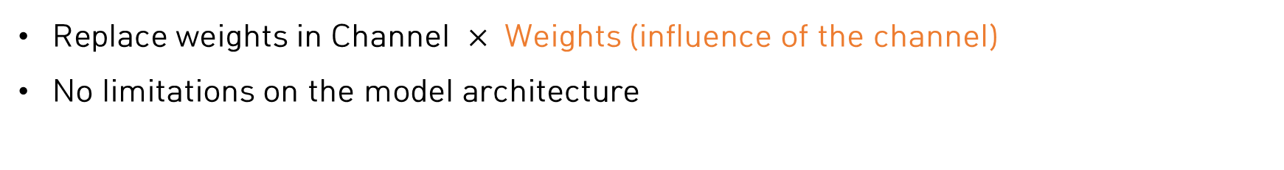
Method: Grad-CAM
Replace weights in Channel $×$ Weights (influence of the channel)
No limitations on the model architecture
$$w_{k}^{c}≡$$

Slide 18





Method: Grad-CAM
Replace weights in Channel $×$ Weights (influence of the channel)
$$w_{k}^{c}≡$$
$$f_{k}\left(x,y\right)=A_{ij}^{k}$$
$$F^{k}$$
$$\frac{∂y^{c}}{∂F^{k}}=\frac{\frac{∂y^{c}}{∂A_{ij}^{k}}}{\frac{∂F^{k}}{∂A_{ij}^{k}}}$$
$$k=3$$
$$k=2$$
$$(x=1,y=1)$$
$$k=1$$

Slide 19










Method: Grad-CAM
Replace weights in Channel $×$ Weights (influence of the channel)
$$w_{k}^{c}≡$$
$$\frac{∂y^{c}}{∂F^{k}}=\frac{\frac{∂y^{c}}{∂A_{ij}^{k}}}{\frac{∂F^{k}}{∂A_{ij}^{k}}}$$
$$y^{c}$$
$$x_{3}$$
$$w_{3}^{1}$$
$$\frac{∂F^{k}}{∂A_{ij}^{k}}=\frac{1}{Z},\frac{∂y^{c}}{∂F^{k}}=w_{k}^{c}$$
Cat $(c=1)$
$$w_{2}^{1}$$
$$x_{2}$$
$$\frac{1}{Z}\sum_{ij}{A_{ij}^{k}} =F^{k}$$
$$w_{3}^{1}$$
dog
$$x_{1}$$

Slide 20


Method: Grad-CAM
Replace weights in Channel $×$ Weights (influence of the channel)
$$w_{k}^{c}≡$$
$$\frac{∂y^{c}}{∂F^{k}}=\frac{\frac{∂y^{c}}{∂A_{ij}^{k}}}{\frac{∂F^{k}}{∂A_{ij}^{k}}}$$
$$\frac{∂F^{k}}{∂A_{ij}^{k}}=\frac{1}{Z},\frac{∂y^{c}}{∂F^{k}}=w_{k}^{c}$$
$$\sum_{ij}{w_{k}^{c}} =\sum_{ij}{\frac{∂y^{c}}{∂A_{ij}^{k}}×Z}$$
$$w_{k}^{c}=\frac{∂y^{c}}{∂A_{ij}^{k}}×Z$$
$$\frac{1}{Z}\sum_{ij}{A_{ij}^{k}} =F^{k}$$

Slide 21





Method: Grad-CAM
Replace weights in Channel $×$ Weights (influence of the channel)
$$w_{k}^{c}≡$$
$$w_{k}^{c}=\frac{∂y^{c}}{∂A_{ij}^{k}}×Z$$
$$\sum_{ij}{w_{k}^{c}} =\sum_{ij}{\frac{∂y^{c}}{∂A_{ij}^{k}}×Z}$$
$$w_{k}^{c}×Z=\sum_{ij}{\frac{∂y^{c}}{∂A_{ij}^{k}}×Z}$$
$$w_{k}^{c}=\sum_{ij}{\frac{∂y^{c}}{∂A_{ij}^{k}}}$$
$$\sum_{ij}{1} =Z$$

Slide 23

Method: Grad-CAM
This is only true in CAM structures with GAP
$$\frac{∂y^{c}}{∂F^{k}}=\frac{\frac{∂y^{c}}{∂A_{ij}^{k}}}{\frac{∂F^{k}}{∂A_{ij}^{k}}}$$
$$w_{k}^{c}≡$$

Slide 24
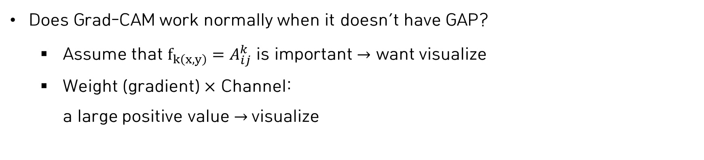
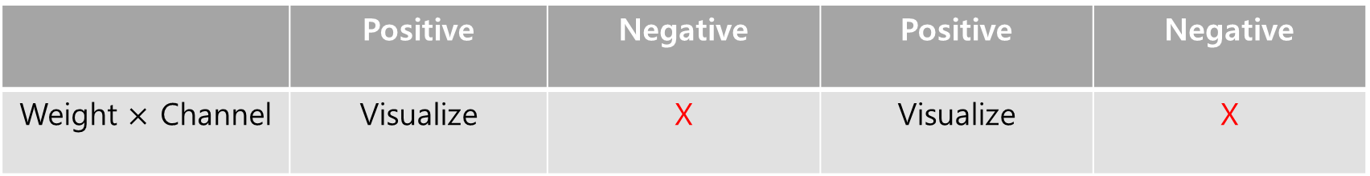
Method: Grad-CAM
Does Grad-CAM work normally when it doesn’t have GAP?
Assume that $f_{k\left(x,y\right)}=A_{ij}^{k}$ is important $→$ want visualize
Weight (gradient) $×$ Channel: a large positive value $→$visualize
Weight always positive
Channel always positive
 | Positive | Negative | Positive | Negative
Weight $×$ Channel | Visualize | X | Visualize | X

Slide 25





Method: Grad-CAM
Gradient
Actually, don’t move in the any direction of gradient
The magnitude of gradient is more important than the direction of gradient
$↑$ Influence $↓$
$$\frac{∂y^{c}}{∂A_{ij}^{k}}=100$$
$$\frac{∂y^{c}}{∂A_{ij}^{k}}=1$$
$$\frac{∂y^{c}}{∂A_{ij}^{k}}=−100$$
$$\frac{∂y^{c}}{∂A_{ij}^{k}}=−1$$

Slide 26






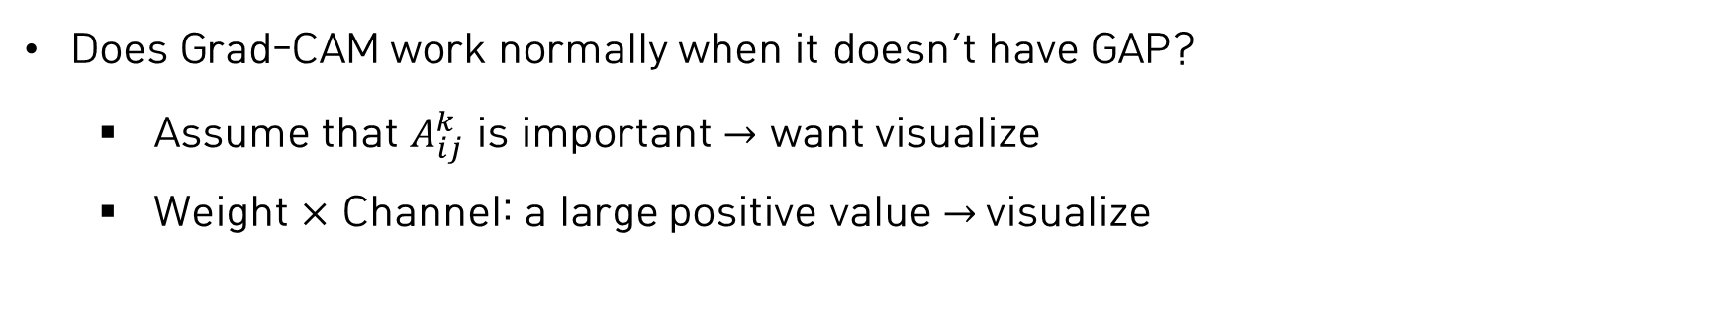
Method: Grad-CAM
Does Grad-CAM work normally when it doesn’t have GAP?
Assume that $A_{ij}^{k}$ is important $→$ want visualize
Weight $×$ Channel: a large positive value $→$visualize
$$y^{c}$$
$$\frac{∂y^{c}}{∂A_{ij}^{k}}=100$$
$$\frac{∂y^{c}}{∂A_{ij}^{k}}=−100$$
$$A_{ij}^{k}$$
$$90$$
$$100$$

Slide 27




Method: Grad-CAM
Does Grad-CAM work normally when it doesn’t have GAP?
Assume that $A_{ij}^{k}$ is important $→$ want visualize
Weight $×$ Channel: a large positive value $→$visualize
$$\frac{∂y^{c}}{∂A_{ij}^{k}}=−100$$
$$\frac{∂y^{c}}{∂A_{ij}^{k}}=100$$
$$y^{c}$$
$$A_{ij}^{k}$$
$$−100$$
$$−90$$

