Slide 1
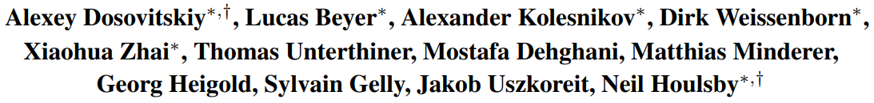

An Image is Worth 16x16 Words: Transformers for Image Recognition at Scale
ICLR(2021), 24561 citation

Slide 2
Table of Contents
Introduction
Background
Method
Experiments

Slide 3
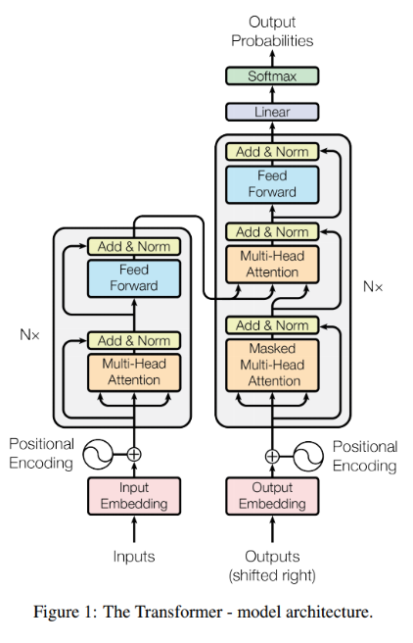
Introduction
Appearance of Transformer
The performance of transformer’s self-attention-based model has improved in NLP
Likewise, a self-attention-based structure was applied to Computer Vision
However, it was not more efficient than CNNs
Because of inductive bias

Slide 4




Introduction
Inductive bias in CNN
Prior knowledge: Locality & Translation equivariance
Locality
Pixel local information is important
Translation equivariance
Learn specific patterns regardless of object location
1
1
0
0
0
0
1
1
4
2
1
1
1
2
1
1
0
$$⊗$$
$$=$$
0
1
1
$$⊗$$
$$=$$
1
1
2
1
1
1
2
4
0
0
0
0
1
1

Slide 5
Introduction
Advantage of transformer
Computational efficiency
Parallel processing
Scalability
Continuous improvement as dataset and model sizes continue to grow

Slide 6
Summarization
“Using the computational efficiency and scalability, shows that CNN is not necessary”

Slide 7
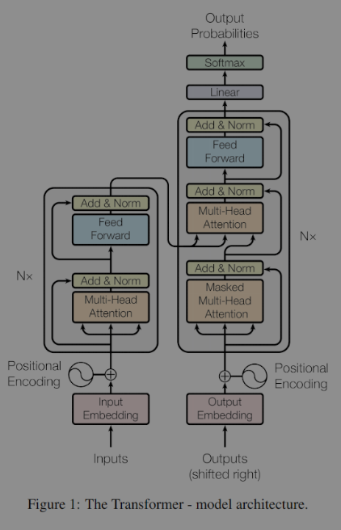
Background
Encoder in Transformer
Input Embedding
Positional Embedding
Self-attention
Add & Normalization
Feed Forward

Slide 8
Background
Encoder in Transformer
Input Embedding
Positional Embedding
Self-attention
Add & Normalization
Feed Forward

Slide 9

Background
Input Embedding
Semantic information about the input data
Positional Embedding
Location information about data
Self-attention
Can see correlation information between data
E.g.
I have a friend named Mary. She is a student.

Slide 10
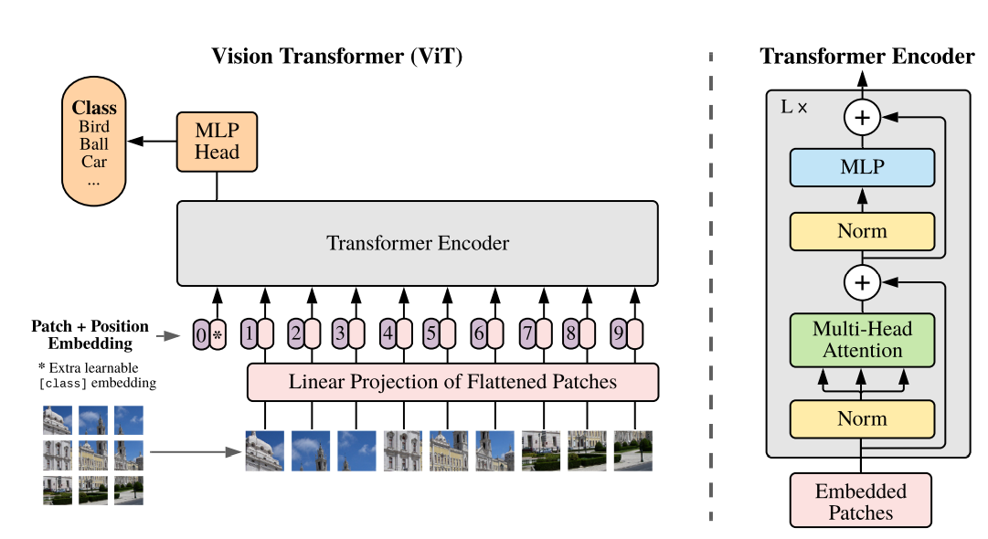
Method
Using the computational efficiency and scalability, shows that CNN is not necessary
Use encoder of standard transformer
Proceed to the classification task

Slide 11
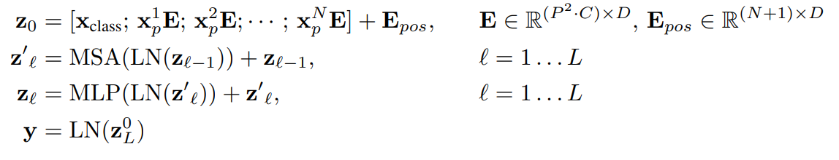
Method
⑥
⑤
④
③
①
②

Slide 12




Method
①
W
P
1
2
3
P
H
6
5
4
7
8
9
$$image X ∈R^{W×H×1}$$
$$x_{p} ∈R^{p×p}$$
$$X_{p} ∈R^{N×p×p}$$

Slide 13


Method
②
W
P
P
H
$$x_{p} ∈R^{p^{2}}$$
$$X_{p} ∈R^{N×p^{2}}$$
$$image X ∈R^{W×H×1}$$
$$x_{p} ∈R^{p×p}$$
$$X_{p} ∈R^{N×p×p}$$

Slide 14




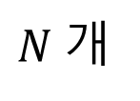
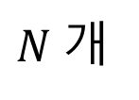

Method
③
$$p^{2}$$
. . .
. . .
$N$개
$N$개
fc layer $∈R^{p^{2}×D}$
$$X_{p} ∈R^{N×p^{2}}$$
$$X_{p} ∈R^{N×D}$$

Slide 15
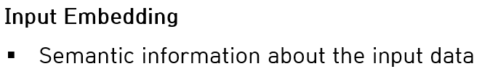
Method
$$p^{2}$$
. . .
. . .
$N$개
$N$개
fc layer $∈R^{p^{2}×D}$
$$X_{p} ∈R^{N×p^{2}}$$
$$X_{p} ∈R^{N×D}$$

Slide 16
Method
④

Slide 17
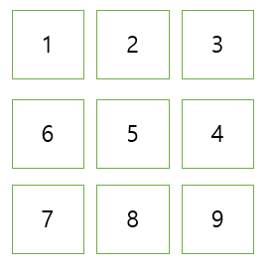

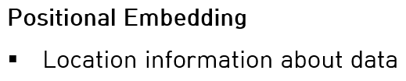

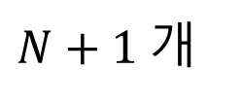
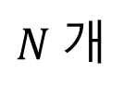
Method
Classification
learnable class embedding
. . .
. . .
$N+1$개
$N$개
$$X_{p} ∈R^{(N+1)×D}$$

Slide 18

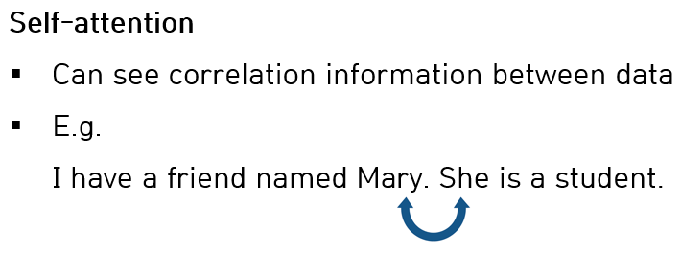
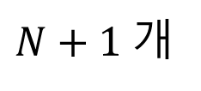

Method
. . .
$N+1$개
$$X_{p} ∈R^{(N+1)×D}$$

Slide 19
Method
⑤

Slide 20

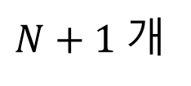







Method
. . .
1
Query
$N+1$개
. . .
. . .
2
$N+1$개
Key
$N+1$개
. . .
3
Value
$$X_{p} ∈R^{(N+1)×D}$$
$N+1$개
fc layer $∈R^{D×D}$

Slide 21
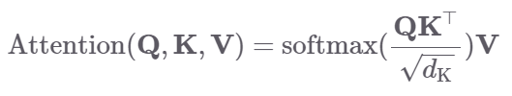






Method
. . .
Query$∈R^{(N+1)×D}$
$N+1$개
. . .
Key$∈R^{(N+1)×D}$
$N+1$개
. . .
Value$∈R^{(N+1)×D}$
$N+1$개

Slide 22
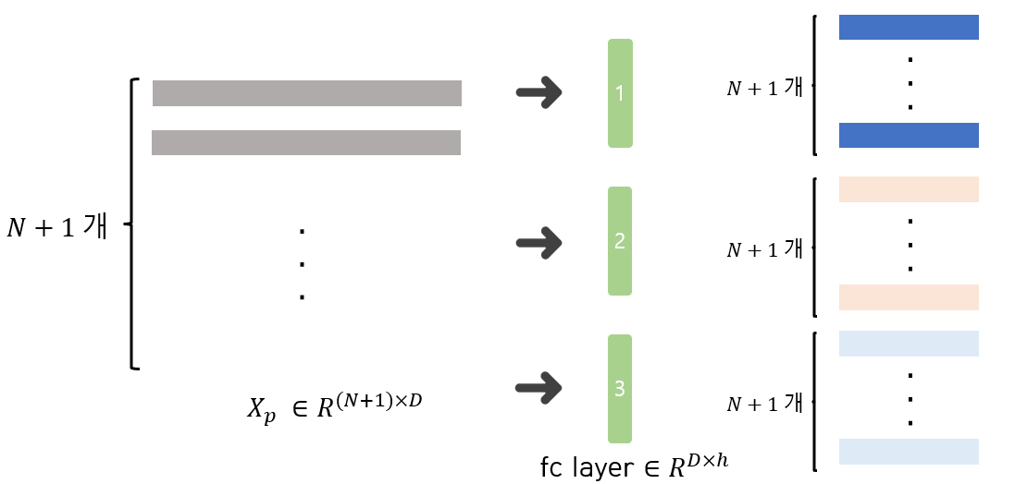







Method
$N+1$개
$N+1$개
. . .
. . .
. . .
$N+1$개
$N+1$개
Query$∈R^{(N+1)×D}$
${Key}^{T} ∈R^{D×(N+1)}$
$QK^{T}∈R^{(N+1)×(N+1)}$

Slide 23
Method
$N+1$개
$N+1$개
. . .
. . .
. . .
$N+1$개
$N+1$개
Query$∈R^{(N+1)×D}$
${Key}^{T} ∈R^{D×(N+1)}$
$QK^{T}∈R^{(N+1)×(N+1)}$
Correlation between class embedding and class embedding
Correlation between class embedding and last patch

Slide 24
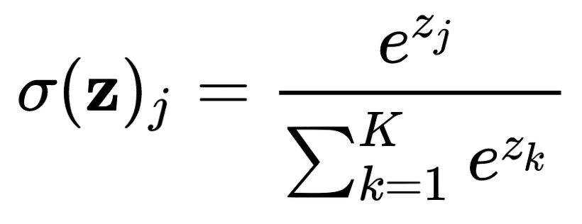



Method
$N+1$개
. . .
. . .
0.1
0.8
$N+1$개
Class embedding is highly related to the last patch
$QK^{T}∈R^{(N+1)×(N+1)}$

Slide 25





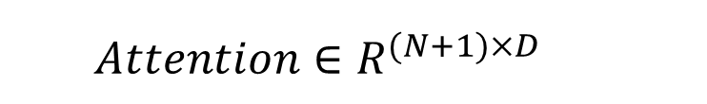
Method
$N+1$개
. . .
. . .
. . .
$$×0.1$$
$N+1$개
$N+1$개
$N+1$개
$$×0.8$$
$QK^{T}∈R^{(N+1)×(N+1)}$
Value$∈R^{(N+1)×D}$
$$Attention∈R^{(N+1)×D}$$
. . .
0.1
0.8
Class embedding is highly related to the last patch

Slide 26
Method
$N+1$개
. . .
. . .
$$×0.1$$
$N+1$개
$N+1$개
$N+1$개
$$×0.8$$
$QK^{T}∈R^{(N+1)×(N+1)}$
Value$∈R^{(N+1)×D}$
$$Attention∈R^{(N+1)×D}$$
It contains a lot of information about the last patch

Slide 27
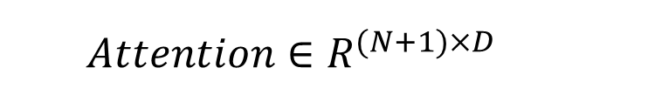
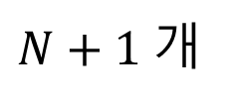
Method
. . .
$N+1$개
$$Attention∈R^{(N+1)×D}$$

Slide 28
Method
⑤

Slide 29
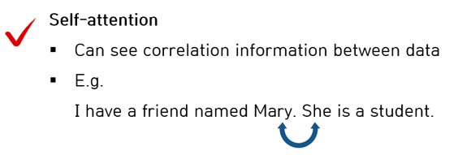
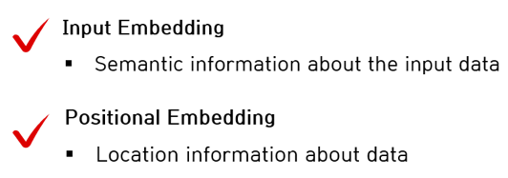

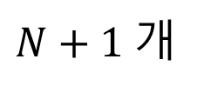
Method
. . .
. . .
$N+1$개
$N+1$개
$$Attention∈R^{(N+1)×D}$$
$$X_{p} ∈R^{(N+1)×D}$$

Slide 30
Method
. . .
$N+1$개
$$Attention∈R^{(N+1)×D}$$

Slide 31
Method
⑥

Slide 32



Method
Image representation
. . .
$N+1$개
$$Attention∈R^{(N+1)×D}$$
fc layer $∈R^{D×\# of class}$

Slide 33
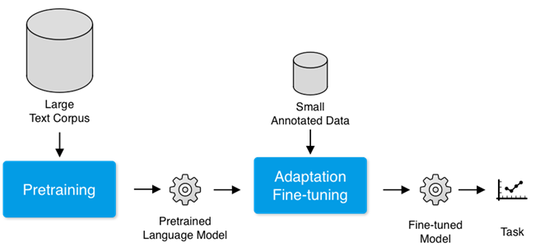
Experiments
In NLP,
Transfer with small dataset after performing pre-training with large scale dataset
Same setting as NLP in CV

Slide 34
Experiments
Dataset Setting
Pre-training Dataset
Fine-tuning Dataset
ImageNet validation, ReaL, CIFAR-10/100, Oxford
VTAB
Pre-trained Dataset | # of classes | # of images
ImageNet-1k | 1000 | 1.3M
ImageNet-21k | 21k | 14M
JFT | 18k | 303M (high-resolution)

Slide 35
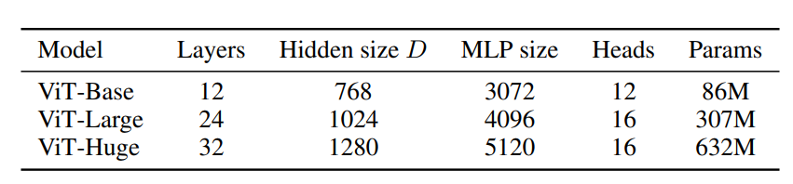
Experiments
Model Setting for scalability

Slide 36
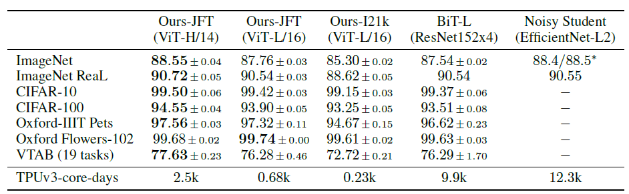
Experiments
Comparison to SOTA
ViT models pre-trained on JFT-300M outperform ResNet-based baselines with significantly less computational resources.

Slide 37
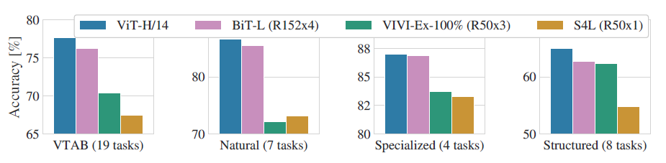
Experiments
Comparison to SOTA
Natural – tasks like Pets, CIFAR, etc
Specialized – medical and satellite imagery
Structured – tasks that require geometric understanding like localization
ViT-H/14 outperforms BiT-L and other methods on the respective groups of VTAB.

Slide 38
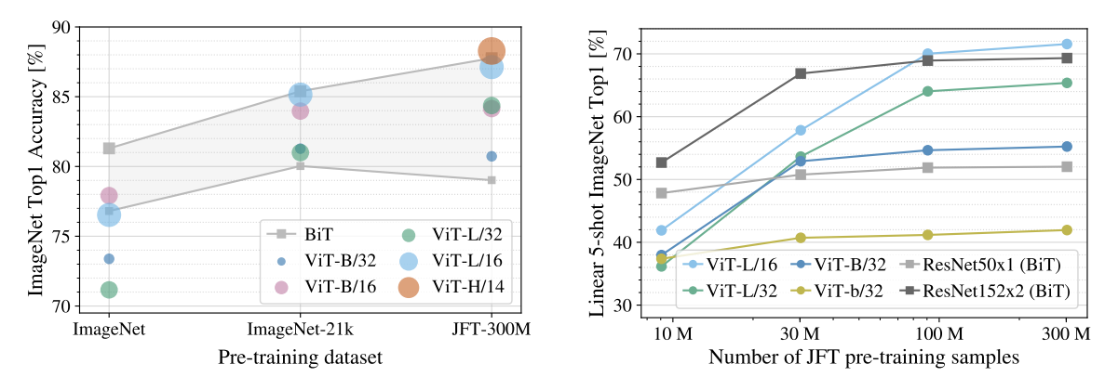
Experiments
Pre-training Data Requirements
Performance increases with larger pre-trained datasets and models.

Slide 39
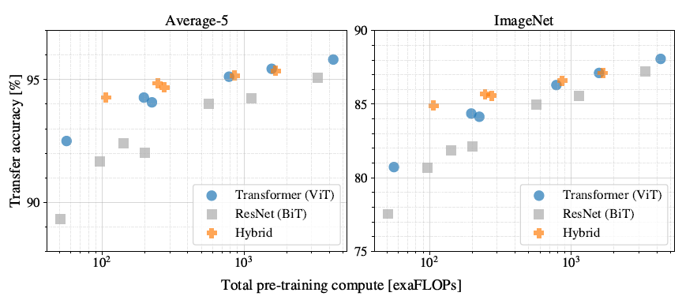
Experiments
Scaling Study
ViTs outperform ResNets with the same computational budget.

Slide 40
Experiments
Scaling Study
When achieving similar transfer accuracy, ViT has a lower pre-training cost than ResNet.

Slide 41
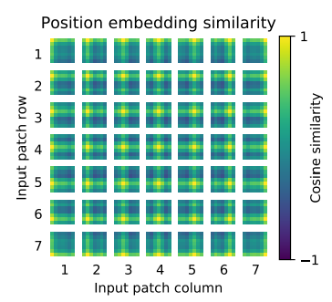
Experiments
Similarity of position embeddings of ViT-L/32
Reflects the patch location information well

Slide 42
Thank you.

Slide 43

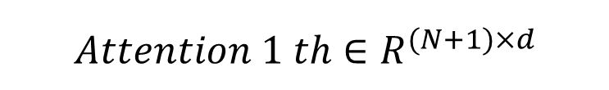


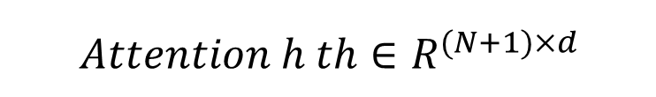

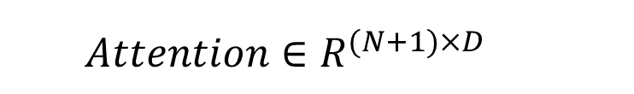
Method
. . .
. . .
$N+1$개
$N+1$개
$$Attention 1 th∈R^{(N+1)×d}$$
$$Attention h th∈R^{(N+1)×d}$$
$head$개, $(d×head=D)$
. . .
$$Attention∈R^{(N+1)×D}$$
$N+1$개

