Slide 1
Improving Language Understanding by Generative Pre-Training
OpenAI 2018

Slide 2
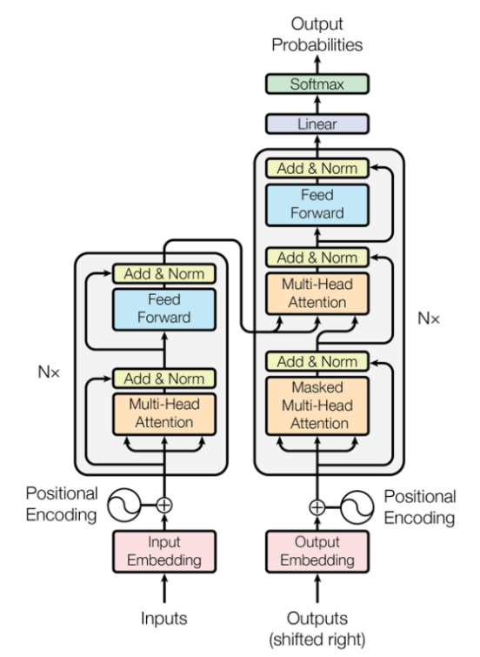
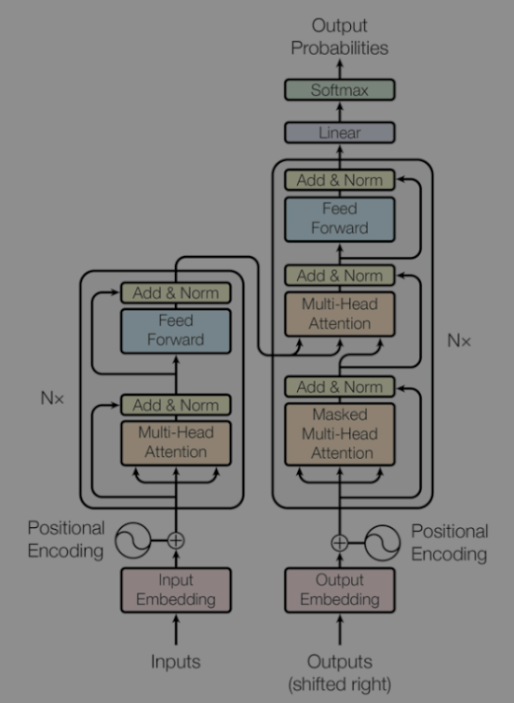
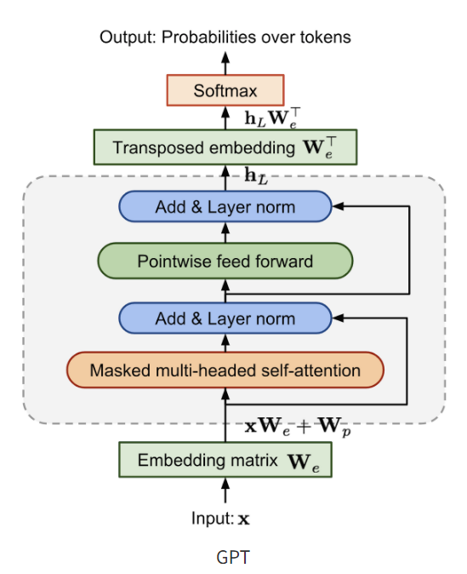
Background

Slide 3
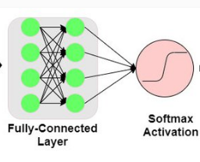


Objective
Efficiently utilize unlabeled text corpus in training
In fine-tuning, even a slight change in the model architecture makes it effective
Convert input

Slide 4
Method
Unsupervised -> Supervised learning
For generalization For target task
Learn text representation ?
정보를 효과적으로 전달하도록 text를 이해하는 과정

Slide 5
Method : Unsupervised
Next token prediction
<start>
I
am
a
student
<end>
<start>
I
am
a
student
<end>
X 12

Slide 6
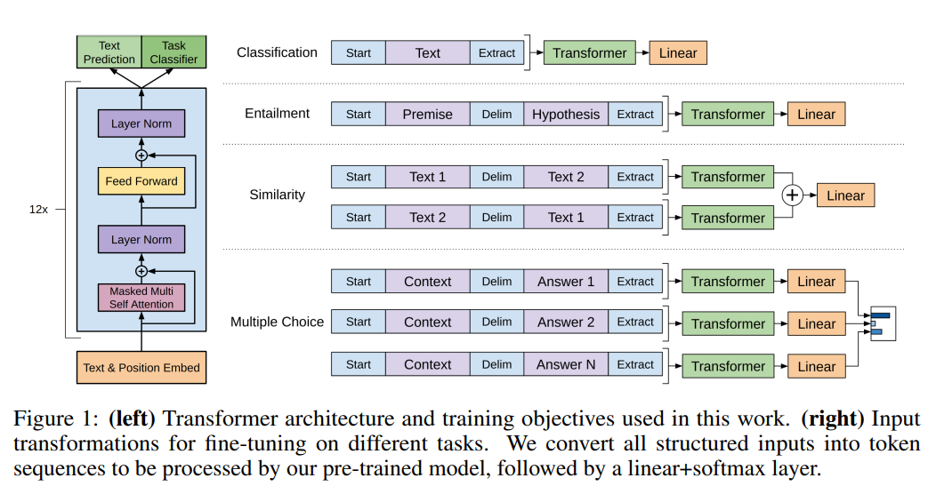
Method : Supervised
Add fc
Convert input, add delimiter

Slide 7
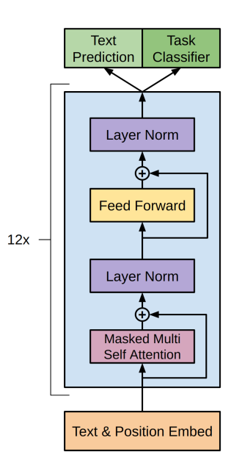
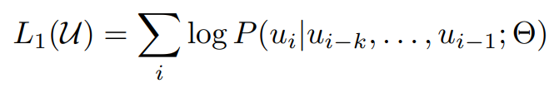


Method : Supervised
Next token prediction
Classification
=>

Slide 8
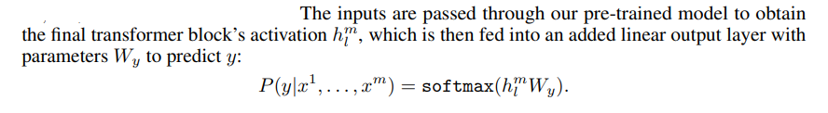
Method : Supervised
<start>
I
am
a
student
<end>
Auxiliary objective function
For generalization improvement

Slide 9
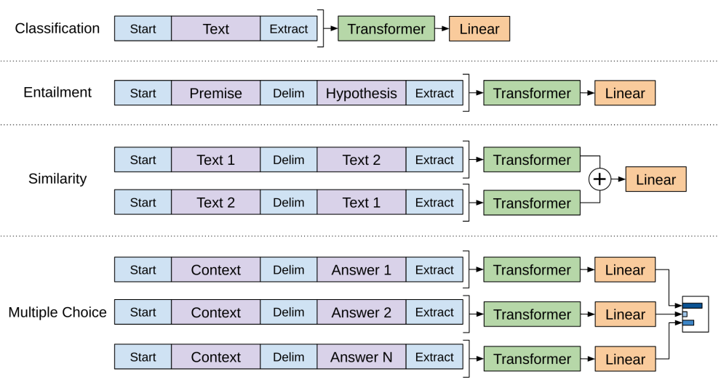
Method : Supervised
Target task

Slide 10

Method : Supervised
Target task
오늘 시험 망쳤어 -> 긍정, 부정

Slide 11
Method : Supervised
Target task
두 문장 간의 관계 파악 (전제, 가설)
전제: 개가 산책 중
가설 : 개가 밖에 있다
-> 참, 거짓, 알 수 없다

Slide 12
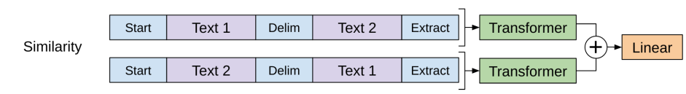
Method : Supervised
Target task
Python , Java -> 유사, 비유사

Slide 13
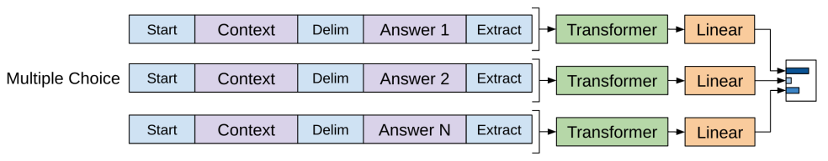
Method : Supervised
Target task
성북구는 어디있어 -> 서울 -> 0.8
-> 부산 -> 0.1
-> 대구 -> 0.1

Slide 14
Experiment
Dataset.
BooksCorpus dataset : 7,000 unique unpublished books
Fine-tuning.
3 epochs of training was sufficient for most cases

Slide 15
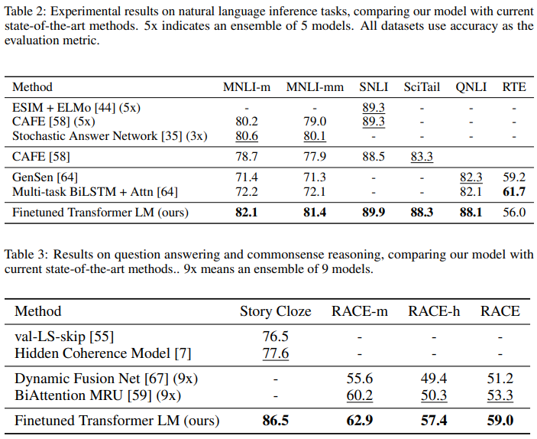
Experiment
Our task-agnostic model outperforms architectures
Crafted for each task

Slide 16

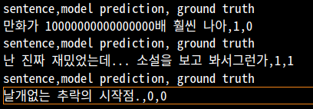
Experiment
네이버 영화 리뷰 -> text classification(긍정, 부정)

