Slide 1

ShiftAware balances history with current evidence
If we track each speaker, can we better recognise when their emotion changes?
SPEAKER PRIOR
Own speaker memory
Previous predicted emotion
↘
LEARNED GATE β
PREDICT
→
Receives shift probability
Balances prior and evidence
7 emotion probabilities
Then update memory
↗
CURRENT EVIDENCE
Current utterance (RoBERTa)
Other speakers + conversation
P(emotion) = (1 − β) P(prior) + β P(evidence)
Wang Zhoufu · Workstream 6
Source: emotionshift/models/shiftaware/{model,heads}.py · RoBERTa: Liu et al. (2019)
1
Notes:
Hi, I'm Wang Zhoufu. My part is ShiftAware. The idea is simple: can remembering each speaker help us recognise changes in emotion? We use RoBERTa to read each sentence, alongside memories of the speaker and the conversation. We then balance what the speaker's history suggests with what they're saying now. The model makes its prediction before updating its memory, using only the conversation so far.

Slide 2
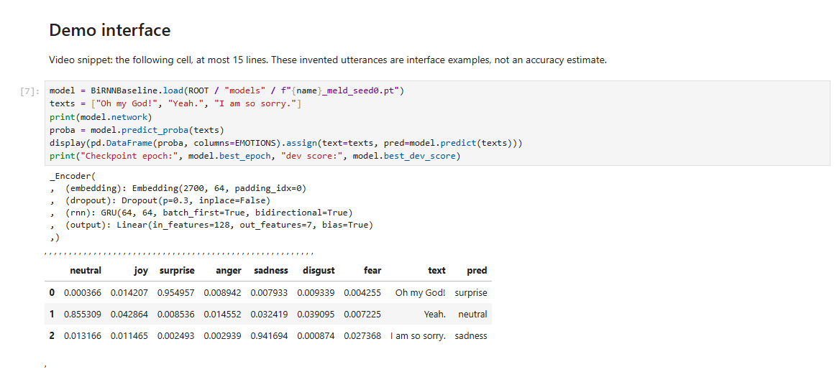
A learned gate mixes two emotion distributions
prior_log_probs = prior_logits.float().log_softmax(-1)
evidence_log_probs = evidence_logits.float().log_softmax(-1)
log_probs = torch.logaddexp(
F.logsigmoid(-gate_logits.float())[:, None] + prior_log_probs,
F.logsigmoid(gate_logits.float())[:, None] + evidence_log_probs,
)
Normalise separately → combine in log space
β is a learned gate; the shift probability is one of its inputs.
Memory stores predictions; gold labels enter only the loss.
Source: emotionshift/models/shiftaware/heads.py · lines 85–86 and 94–97 (mixture branch)
2
Notes:
Here's how that balance works in Python. We turn the history and current evidence into two sets of emotion probabilities. A learned gate, called beta, mixes them together. It also receives a prediction of whether the speaker's emotion has changed. We calculate this in log space to keep it stable. The memory stores our own predictions, rather than the correct labels.

Slide 3
Higher macro-F1 did not yield better shift recognition
MELD F1 (%)
SHIFT TARGET NOT MET
−0.36 pp
MELD shift turns vs context
RoBERTa · 95% CI [−2.44, +1.71]
MELD stable turns: −2.68 pp
95% CI [−4.62, −0.59]
DailyDialog shift turns: −4.72 pp
95% CI [−6.70, −2.81]
Shift head AUROC ≈ 75: detects change,
not the new emotion
Only ShiftAware uses class weighting, so its macro-F1 gain does not isolate the shift head.
Sources: reports/summary/{e1_main,paired}.csv · MELD test · 5 seeds · variants chosen on dev
3
Notes:
These results are averaged over five runs. On MELD, ShiftAware gives our highest macro F1, at 46.3. But class weighting also differs, so we can't credit that gain to the shift head alone. On turns where emotion changes, it scores slightly below context RoBERTa, with no clear improvement. Scores also fall on stable turns, and on DailyDialog's shift turns. So we didn't meet our target. Detecting that an emotion changed doesn't necessarily help us identify the new emotion.

Slide 4
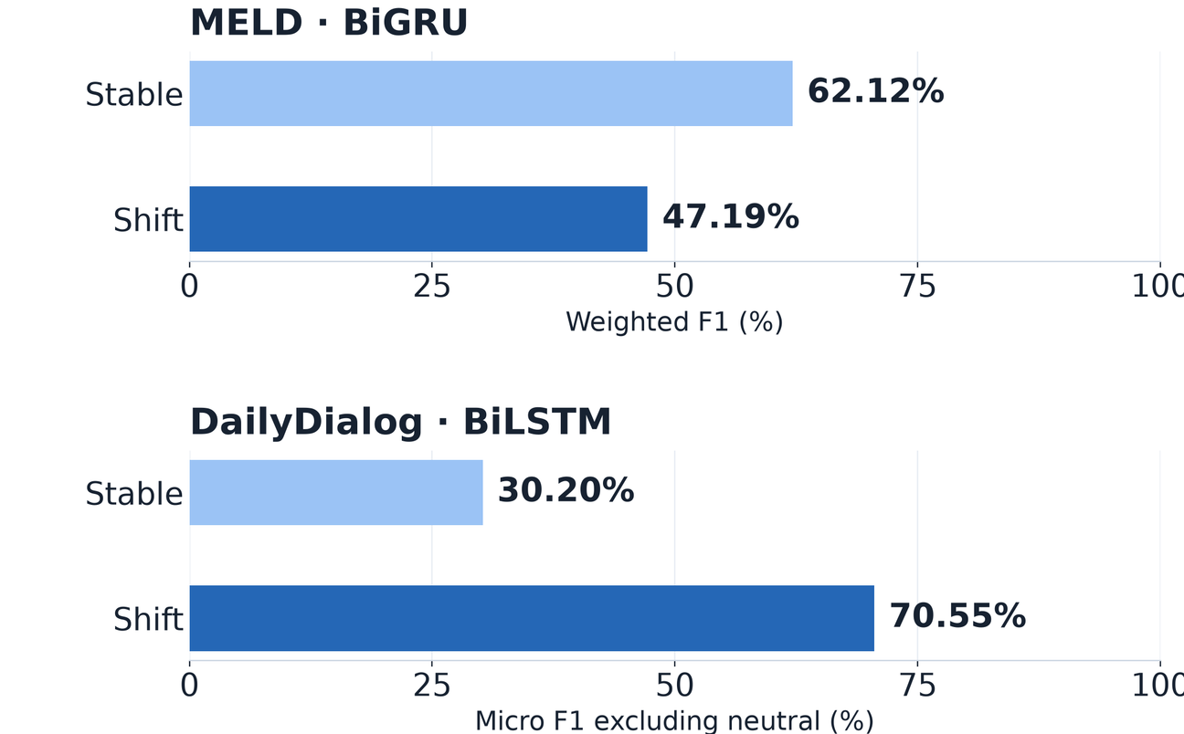
References
Liu, Y., Ott, M., Goyal, N., Du, J., Joshi, M., Chen, D., Levy, O.,
Lewis, M., Zettlemoyer, L., & Stoyanov, V. (2019). RoBERTa:
A robustly optimized BERT pretraining approach. arXiv.
https://arxiv.org/abs/1907.11692
EmotionShift project team. (2026). EmotionShift [Source code and
experimental results]. GitHub.
https://github.com/qkuku1117-lgtm/emotionshift
Result sources: reports/summary/e1_main.csv; reports/summary/paired.csv
Selection: reports/shiftaware/selection.md
EE6405 · EmotionShift · Workstream 6 · Wang Zhoufu
4
Notes:
No narration. Show briefly after the conclusion; merge into group references if preferred.

