Slide 1

BiGRU / BiLSTM: words in both directions
INPUT
EMBED
ENCODE
OUTPUT
Current turn
≤64 tokens
Learned
64D vectors
BiGRU or
BiLSTM
Linear layer
7 emotions
Combine forward + backward states → 7-class, weighted loss
LSTM also maintains a cell state. Neither model receives conversation history.
1
Notes:
For my work I compared BiGRU and BiLSTM. Both read the current utterance in both directions and combine their hidden states to classify seven emotions. LSTM also maintains a cell state. Both learn embeddings from scratch using class-weighted loss, without conversation history. We ran five seeds and selected models on development scores only.

Slide 2
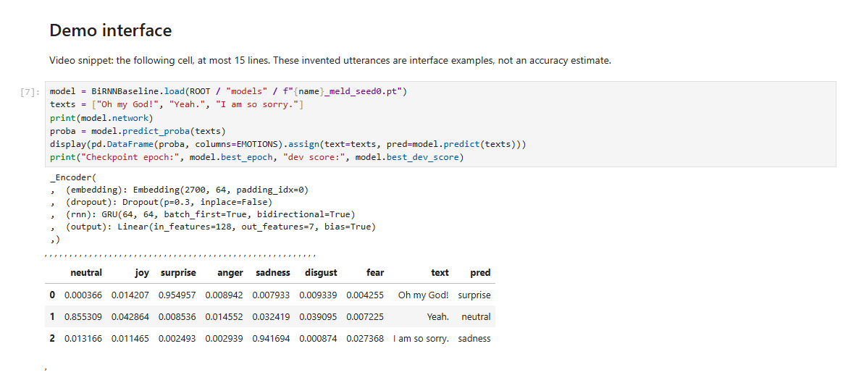
Demo under b2_bigru_bilstm.ipynb
2
Notes:
Here is a demo using our model. The texts we are testing here are: "Oh my God!", which is predicted with surprise, "Yeah." with neutral, and "I am so sorry." with sadness

Slide 3
TF-IDF remains stronger on both datasets
55.08%
48.28%
MELD · BiGRU · WEIGHTED F1
DAILYDIALOG · BiLSTM · MICRO F1*
±0.45 pp SD · macro F1 35.38%
Seed-0 95% CI [52.44, 56.73]%
±0.78 pp SD · macro F1 38.83%
Seed-0 95% CI [46.04, 51.36]%
Model († dev-selected) | MELD / DailyDialog (%)
TF-IDF + SVM (B1 reference) | 56.78 / 53.03
BiGRU | 55.08† / 48.95
BiLSTM | 54.90 / 48.28†
5-seed means; *excludes neutral, test_dedup. CIs: 1,000 dialogue resamples; B1 not rerun.
3
Notes:
Here we compare our baseline TF-IDF with our models. During development selection we chose BiGRU for MELD and BiLSTM for DailyDialog. Their scores were 55.08 and 48.28 percent respectively, both below the baseline TF-IDF.

Slide 4
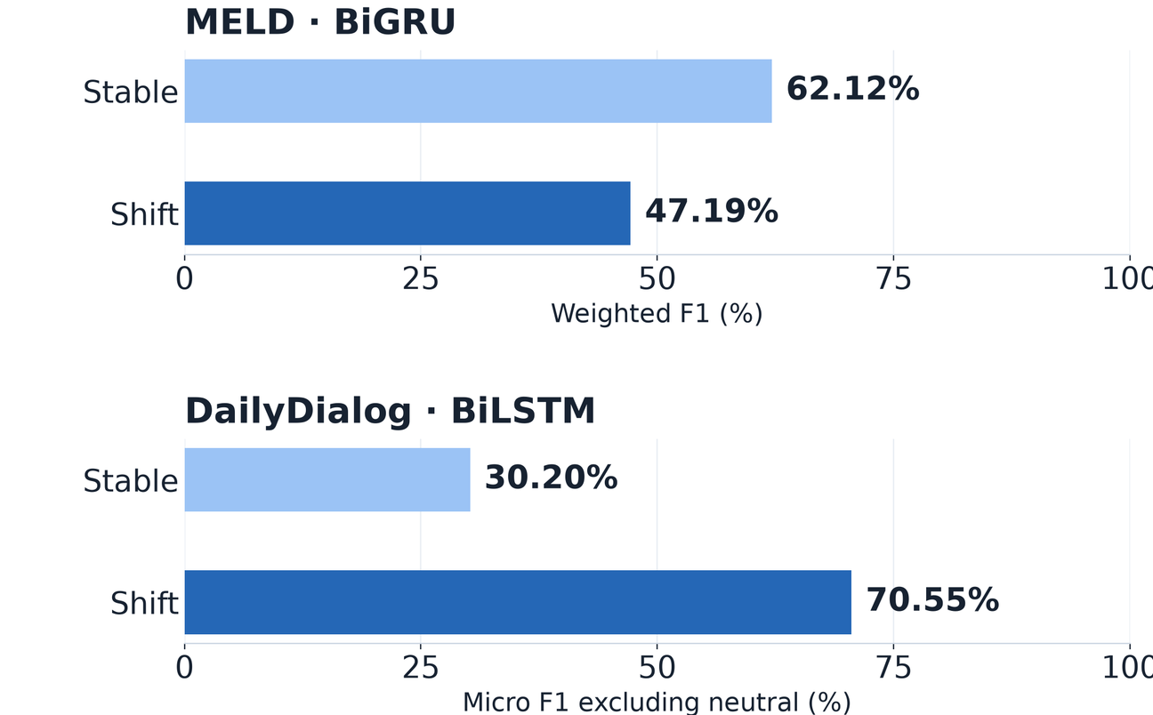
MELD shifts expose a performance gap
−14.93
percentage points on MELD
BiGRU: 47.19% shift vs 62.12% stable
DailyDialog BiLSTM:
70.55% shift vs 30.20% stable.
Excluding neutral changes this comparison
Shift = emotion change from the same speaker's previous turn. Five-seed means; gold strata for evaluation only.
4
Notes:
Now we talk about shift. Shifts is the emotion change of the same speaker compare to the previous turn. On MELD, BiGRU scored about fifteen points lower on shifts than stable turns. DailyDialog shows the opposite pattern, but excluding neutral and differing emotion prevalence affect this comparison, as neutral is the predominant emotion in stable for example.

