Slide 1
Chapter 2 The Relational Model

Slide 2
Ch2 The Relational Model
Data Model (数据模型)
is a set of definitions describing how real-world data is conceptually represented as computerized information.
It also describes the types of operations available to access and update this information.
Relational Model (关系模型)
Object-Relational Model (对象关系模型)
Database Principles & Programming

Slide 3
Ch2 The Relational Model
2.1 The CAP Database
2.2 Naming the Parts of a Database
2.3 Relational Rules
2.4 Keys, Superkeys, and Null Values
2.5 Relational Algebra
2.6 Set-Theoretic Operations
2.7 Native Relational Operations
2.8 The Interdependence of Operations
2.9 Illustrative Examples
2.10 Other Relational Operations
Database Principles & Programming

Slide 4
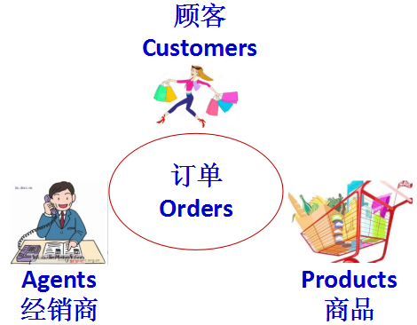
2.1 The CAP Database
Example: Figure 2.1 & 2.2
CAP Database: look at pg. 28, Figure 2.2
Data Model: look at pg.27, Figure 2.1
CUSTOMERS
cid
cname
city
discnt
c001
TipTop
Duluth
10.00
c002
Basics
Dallas
12.00
c003
Allied
Dallas
8.00
c004
ACME
Duluth
8.00
c006
ACME
Kyoto
0.00
Database Principles & Programming

Slide 5
Example: Figure 2.1 & 2.2 (cont.)
AGENTS
aid | aname | city | percent
a01 | Smith | New York | 6
a02 | Jones | Newark | 6
a03 | Brown | Tokyo | 7
a04 | Gray | New York | 6
a05 | Otasi | Duluth | 5
a06 | Smith | Dallas | 5
Database Principles & Programming

Slide 6
Example: Figure 2.1 & 2.2 (cont.)
PRODUCTS
pid | pname | city | quantity | price
P01 | comb | Dallas | 111400 | 0.50
p02 | brush | Newark | 203000 | 0.50
p03 | razor | Duluth | 150600 | 1.00
p04 | pen | Duluth | 125300 | 1.00
p05 | pencil | Dallas | 221400 | 1.00
p06 | folder | Dallas | 123100 | 2.00
p07 | case | Newark | 100500 | 1.00
Database Principles & Programming

Slide 7
ORDERS
ordno | month | cid | aid | pid | qty | dollars
1011 | jan | c001 | a01 | p01 | 1000 | 450.00
1012 | jan | c001 | a01 | p01 | 1000 | 450.00
1019 | feb | c001 | a02 | p02 | 400 | 180.00
1017 | feb | c001 | a06 | p03 | 600 | 540.00
1018 | feb | c001 | a03 | p04 | 600 | 540.00
1023 | mar | c001 | a04 | p05 | 500 | 450.00
1022 | mar | c001 | a05 | p06 | 400 | 720.00
1025 | apr | c001 | a05 | p07 | 800 | 720.00
1013 | jan | c002 | a03 | p03 | 1000 | 880.00
1026 | may | c002 | a05 | p03 | 800 | 704.00
1015 | jan | c003 | a03 | p05 | 1200 | 1104.00
1014 | jan | c003 | a03 | p05 | 1200 | 1104.00
1021 | feb | c004 | a06 | p01 | 1000 | 460.00
1016 | jan | c006 | a01 | p01 | 1000 | 500.00
1020 | feb | c006 | a03 | p07 | 600 | 600.00
1024 | mar | c006 | a06 | p01 | 800 | 400.00
Database Principles & Programming

Slide 8
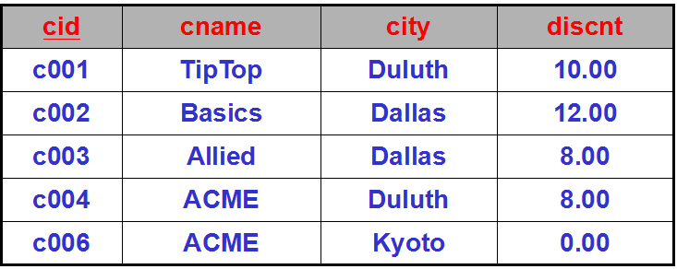
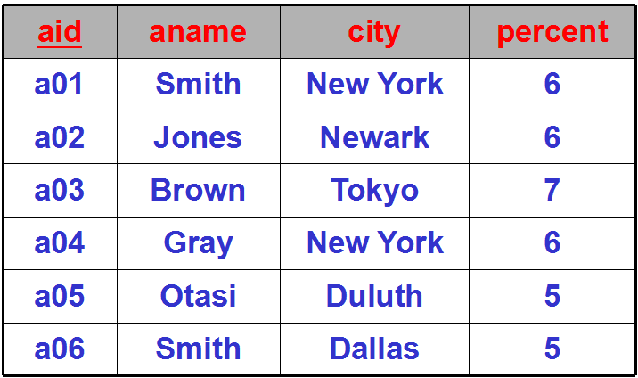
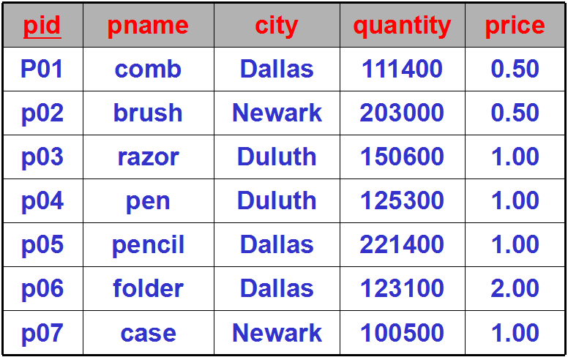
2.1 The CAP Database
Note
More columns
id, name
discnt, percent,quantity, price, month, qty
city
dollars
More rows
no two rows in a table is same
More tables
unique identifier
Database Principles & Programming

Slide 9
2.2 Naming the Parts of a Database
Terminology (术语)
Table (Relation)
Old: file of records
Column names (Attributes)
Old: field names of records
Rows (Tuples)
Old: records of a file
Table heading (Schema)
Old: set of attributes
Database Principles & Programming

Slide 10
2.2 Naming the Parts of a Database
关系模型 | 关系数据库管理系统(SQL) | 文件系统
Relation （关系） | Table （表） | File of Records
Attribute （属性） | Column （列） | Field
Tuple （元组） | Row （行） | Record
Schema （模式） | Table Heading （表头） | Type of Record
Database Principles & Programming

Slide 11
2.2 Naming the Parts of a Database
table name
column name
CUSTOMERS
cid
cname
city
discnt
c001
TipTop
Duluth
10.00
c002
Basics
Dallas
12.00
table heading
c003
Allied
Dallas
8.00
c004
ACME
Duluth
8.00
c006
row
ACME
Kyoto
0.00
table
column
Database Principles & Programming

Slide 12
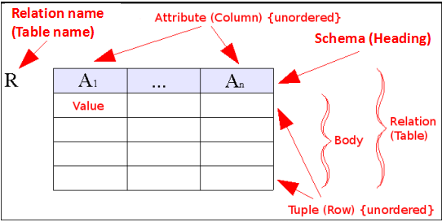
2.2 Naming the Parts of a Database
Definition
database
a set of named tables, or relations.
CAP = { CUSTOMERS, AGENTS,
PRODUCTS, ORDERS }
Heading of table (schema)
a set of named columns
Head(CUSTOMERS) =
{ cid, cname, city, discnt }
Database Principles & Programming

Slide 13
2.2 Naming the Parts of a Database
Note
The number of rows changes frequently and rows are not remembered by users;
the columns usually DON'T change in number, many names are remembered, and USED TO POSE QUERIES.
Database Principles & Programming

Slide 14
2.2 Naming the Parts of a Database
Note
The number of rows changes frequently and rows are not remembered by users;
the columns usually DON'T change in number, many names are remembered, and USED TO POSE QUERIES.
Program-Data Independence (数据独立性)
when asked to make up a query to answer a question, query must still answer the question even if all the data changes.
http://en.wikipedia.org/wiki/Data_independence
Database Principles & Programming

Slide 15
2.2 Naming the Parts of a Database
Column type (也称 Domain, Datatype)
Domain(city): a set of city names
A table is DECLARED in SQL.
Columns have certain TYPES as in SQL:
real, integer, char(13), date
…
Database Principles & Programming

Slide 16
2.2 Naming the Parts of a Database
Problems of Column type (cont.)
Most commercial database systems don’t support types consisting of enumerated sets(as with city, month).
Integrity (完整性)
Domain(city in CUSTOMERS) vs Domain(city in AGENTS) ?
particular type
Database Principles & Programming

Slide 17
2.2 Naming the Parts of a Database
Relational Algebra (关系代数)
Domain of column is like an enumerated type.
Domain(City)
all the city names in the U.S.
Domain(Discnt)
all floats between 0.00 and 20.00.
Database Principles & Programming

Slide 18
2.2 Naming the Parts of a Database
Cartesian Product (笛卡儿乘积)
Set: CID = Domain(cid), CNAME = Domain(cname), CITY = Domain(city), DISCNT = Domain(discnt), then consider:
CID x CNAME x CITY x DISCNT
consisting of all tuples: (w, x, y, z), w in CID, x in CNAME, y in CITY, z in DISCNT
A relation between these four domains is a subset of the Cartesian product.
CUSTOMERS ⊆ CID x CNAME x CITY x DISCNT
Database Principles & Programming

Slide 19
2.2 Naming the Parts of a Database
设有一个由学号sno、姓名name和系别dept等三个属性所构成的学生关系S：
S
sno | name | dept
1 | 张山 | 数学
2 | 李英 | 数学
3 | 王华 | 中文
在该关系中加入上述的三个学生元组，在关系代数中，上述的学生关系可以被表示为下面的集合：
S = { (1,张三,数学)，(2,李英,数学)，(3,王华,中文) }
Database Principles & Programming

Slide 20
2.2 Naming the Parts of a Database
S
S
sno | name | dept
1 | 张山 | 数学
2 | 李英 | 数学
3 | 王华 | 中文
假设只考虑上述的三个学生元组，那么：
Domain(sno) = {1, 2, 3}
Domain(name) = {张三, 李英, 王华}
Domain(dept) = {数学, 中文}
将上述的三个值域进行笛卡尔乘积运算可得到如下的关系表W：
将上述的三个值域进行笛卡尔乘积运算可得到如下的关系表W：
Database Principles & Programming

Slide 21
W
1 | 张山 | 数学
1 | 李英 | 数学
1 | 王华 | 数学
2 | 张山 | 数学
2 | 李英 | 数学
2 | 王华 | 数学
3 | 张山 | 数学
3 | 李英 | 数学
3 | 王华 | 数学
1 | 张山 | 中文
1 | 李英 | 中文
1 | 王华 | 中文
2 | 张山 | 中文
2 | 李英 | 中文
2 | 王华 | 中文
3 | 张山 | 中文
3 | 李英 | 中文
3 | 王华 | 中文
原关系S (背景为黄色的三个元组所组成的集合)显然只是笛卡尔乘积结果关系W的一个真子集。
Database Principles & Programming

Slide 22
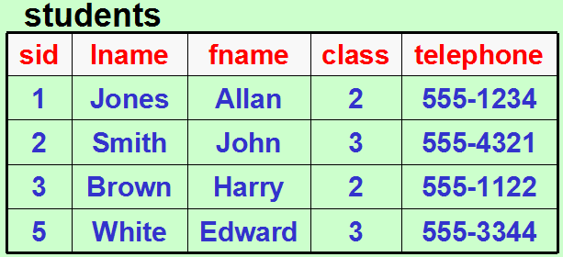
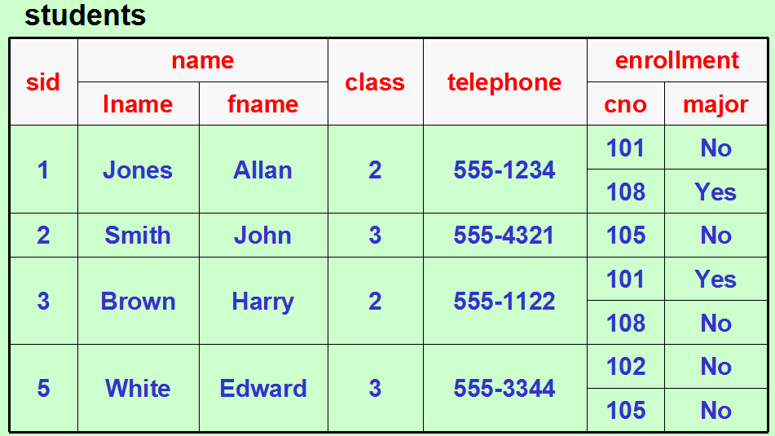
2.3 Relational Rules
Relation Model
Object-Relation Model
Notes:
什么样的二维表才能被称为是一个‘关系’？

Slide 23
2.3 Relational Rules
Rule 1. First Normal Form Rule
Rule 2. Access Rows by Content Only Rule
Rule 3. The Unique Row Rule
Database Principles & Programming

Slide 24
2.3 Relational Rules
Rule 1. First Normal Form Rule
columns that have multi-valued attributes (repeating fields) or have any internal structure (record) are not permitted.
enrollment have multi-valued attr. & name have internal structure
Database Principles & Programming

Slide 25
Rule 1. First Normal Form Rule
对于含内部结构的属性name，可以将其所有的成员属性合并在一起，或者用其成员属性来代替属性name。
两种方案的区别仅在于从数据库中可以访问到的最小‘name’数据单位不同。
方案 1
sid | name | class | telephone | ......
1 | Jones Allan | 2 | 555-1234 | ......
2 | Smith John | 3 | 555-4321 | ......
3 | Brown Harry | 2 | 555-1122 | ......
5 | White Edward | 3 | 555-3344 | ......
方案 2
sid | lname | fname | class | telephone | ......
1 | Jones | Allan | 2 | 555-1234 | ......
2 | Smith | John | 3 | 555-4321 | ......
3 | Brown | Harry | 2 | 555-1122 | ......
5 | White | Edward | 3 | 555-3344 | ......
Database Principles & Programming

Slide 26
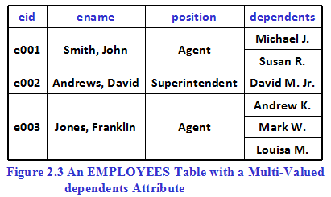
Rule 1. First Normal Form Rule
In relational model, employees table can't have column "dependents" which contains multiple dependent's names (Figure 2.3)
In Object-Relational model, Figure 2.3 is OK!
Database Principles & Programming

Slide 27
Rule 1. First Normal Form Rule
根据 rule 1 的要求，可以有三种模式设计修改方案：
在‘职工’表中设置多个 'dependents' 属性 (Figure 2.4)
只设置一个单值的'dependents' 属性，然后通过多个不同的元组来记录一个职工的多个家属信息 (next slide)
创建‘职工’和‘家属’两张关系表，之后可以通过表的join运算来获得Figure 2.3中的信息 (Figure 2.5)
但①和②都不是正确的模式设计方案！
Database Principles & Programming

Slide 28
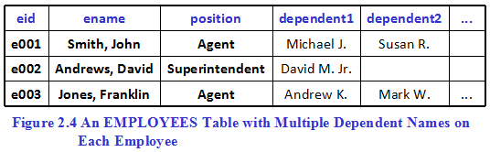
Notes:
方案①的缺陷：1）需要预先设置尽可能多的dependent字段，以便能够记录每一位职工的所有家属信息；2）每个职工的家属人数不固定，很难描述对职工家属字段的访问要求；3）在关系表的存储空间组织上存在比较大的浪费。

Slide 29
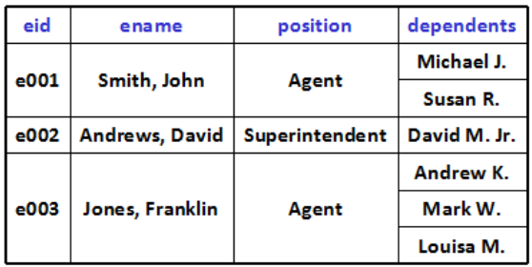
eid | ename | position | dependent
e001 | Smith, John | Agent | Michael J.
e001 | Smith, John | Agent | Susan R.
e002 | Andrews, David | Superintendent | David M. Jr.
e003 | Jones, Franklin | Agent | Andrew K.
e003 | Jones, Franklin | Agent | Mark W.
e003 | Jones, Franklin | Agent | Louisa M.
employee table with single-valued dependent attribute
Notes:
方案①的缺陷：1）关系模式是确定的，便于用户访问命令的书写；2）每个职工的信息可能会在多个不同的职工元组上重复存储，存在较大的存储空间浪费现象，以及其他模式设计上的缺陷（见第六章数据库设计）。

Slide 30
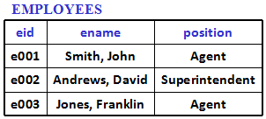
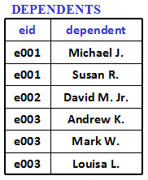
Figure 2.5
方案③避免了前述的方案①和②的所有缺陷！

Slide 31
2.3 Relational Rules
Rule 2. Access Rows by Content Only Rule
can only retrieve rows by their content, the attribute values that exist in each row.
rule 2 implies:
No order to the rows
No order to the columns
Disallows "pointers to rows" (RID - row ID)
Most relational products break this rule by allowing users to get at rows by RIDs;
new object-relational products have refs as part of syntax.
Database Principles & Programming

Slide 32
2.3 Relational Rules
Rule 3. The Unique Row Rule
Two rows can't be same in all attributes at once.
So that a relation is an unordered SET of tuples.
But many products allow this for efficiency of load.
There are even some tables where it is a good thing (temperature readings in table, might repeat).
But in the current Chapter, Chapter 2, we will assume that all these rules hold perfectly.
Database Principles & Programming

Slide 33
2.4 Keys, Superkeys, and Null Values
Idea of Keys
some set of columns in a table distinguishes rows.
[E.g] cid in CUSTOMERS, ordno in ORDERS
defined by DBA
which set of columns has this property
It is USEFUL to have such a key for a table
other tables can refer to a row in this table
e.g. cid in CUSTOMERS
Database Principles & Programming

Slide 34
2.4 Keys, Superkeys, and Null Values
Key & Superkey
Superkey
is a set of columns that has the uniqueness property
[e.g.] A superkey for CUSTOMERS：
(cid, cname)
key
is a minimal superkey: no subset of columns also has uniqueness property.
[e.g.] A key for CUSTOMERS：cid
Database Principles & Programming

Slide 35
2.4 Keys, Superkeys, and Null Values
Def. 2.4.1 Table Key
Given a table T, with Head(T)={A₁,A₂,…,A_{n}}. A key for the table T, sometimes called a candidate key (候选关键字), is a set of attributes, K={A_{i1},…,A_{ik}}, with two properties:
If u, v are distinct tuples of T, then by designer intention u[K]≠v[K]; that is ,there will always exist at least one column, A_{im}, in the set of columns K such that u[A_{im}]≠v[A_{im}]
No proper subset H of K has property 1
Superkey: a set of columns that fulfills property 1 but not necessarily property 2.
Database Principles & Programming

Slide 36
2.4 Keys, Superkeys, and Null Values
Question: pg. 28, Figure 2.2, PRODUCTS
pid | pname | city | quantity | price
P01 | comb | Dallas | 111400 | 0.50
p02 | brush | Newark | 203000 | 0.50
p03 | razor | Duluth | 150600 | 1.00
p04 | pen | Duluth | 125300 | 1.00
p05 | pencil | Dallas | 221400 | 1.00
p06 | folder | Dallas | 123100 | 2.00
p07 | case | Newark | 100500 | 1.00
Is pid a key for PRODUCTS ? pname ? city ?
(pid, city) a key for PRODUCTS ? Is superkey ?
Database Principles & Programming
Notes:
根据关键字的定义及关系中的元组取值情况，判断该关系的关键字是什么

Slide 37
2.4 Keys, Superkeys, and Null Values
Example 2.4.1. Consider the table T:
A | B | C | D
a1 | b1 | c1 | d1
a1 | b2 | c2 | d1
a2 | b2 | c1 | d1
a2 | b1 | c2 | d1
Assume intent of designer is that this table will remain with the same contents.
Then can determine keys from content alone (this is a VERY UNUSUAL situation).
Database Principles & Programming

Slide 38
[Exp. 2.4.1]
A | B | C | D
a1 | b1 | c1 | d1
a1 | b2 | c2 | d1
a2 | b2 | c1 | d1
a2 | b1 | c2 | d1
No single column can be a key.
原因：没有哪一个属性的取值能够满足关键字定义中的条件1！
以属性‘A’为例，无法满足：“对表中的任意两个元组t₁和t₂，都有t₁[A]≠t₂[A]”

Slide 39
[Exp. 2.4.1]
A | B | C | D
a1 | b1 | c1 | d1
a1 | b2 | c2 | d1
a2 | b2 | c1 | d1
a2 | b1 | c2 | d1
No single column can be a key.
No set of columns can be a key if it contains D.
Because:
the value of column D in row is same as each other
If the set of X and D is a key (the set of X and D has property 1 of KEY), then the set of X has property 1 of KEY.

Slide 40
No single column can be a key.
No set of columns can be a key if it contains D.
A | B | C | D
a1 | b1 | c1 | d1
a1 | b2 | c2 | d1
a2 | b2 | c1 | d1
a2 | b1 | c2 | d1
Pairs: AB, AC, BC. Each of these pairs distinguishes all rows. Therefore all are keys.
A
B
C
D
Is ‘AB’ a key?
a1
b1
…
…
a1
b2
…
…
a2
b1
…
…
a2
b2
…
…
Notes:
以AB属性组合为例
在该关系中，对于任意的两个元组，他们要么在属性A上的取值不同，要么在属性B上的取值不同，因而他们在AB属性集上的取值肯定是不一样的。因而‘AB’属性组合满足关键字定义中的property 1。另外，由于单个的属性A或属性B都不具备property 1，因而属性集AB也满足条件property 2，因此，‘AB’是该关系的一个关键字。
同理，我们也可证明，AC和BC也都是该关系的关键字。

Slide 41
[Exp. 2.4.1]
A | B | C | D
a1 | b1 | c1 | d1
a1 | b2 | c2 | d1
a2 | b2 | c1 | d1
a2 | b1 | c2 | d1
No single column can be a key.
No set of columns can be a key if it contains D.
Pairs: AB, AC, BC. Each of these pairs distinguishes all rows. Therefore all are keys.
All other sets (must have 3 or more elements) contain one of these or else D as a proper subset.
Therefore no more keys.
Notes:
对于有3个或更多个属性组成的属性集合，其中肯定真包含着属性D，或者真包含着AB、AC或者BC中的一个，因而该属性集合不可能满足定义中的property 2！

Slide 42
2.4 Keys, Superkeys, and Null Values
Various keys specified by intent of DBA are called Candidate Keys.
A Primary Key (主关键字) is defined to be the candidate key chosen by the designer to identifies rows of T used in references by other tables.
Database Principles & Programming

Slide 43
2.4 Keys, Superkeys, and Null Values
Def. 2.4.3 Primary Key of a Table
A primary key of a table T is the candicate key chosen by the database designer to uniquely identify specific rows of T.
cid is a primary key of CUSTOMERS
maybe used in references by other tables.
ORDERS references CUSTOMERS by cid.
Database Principles & Programming

Slide 44
Th. 2.4.2. Every table T has at least one key.
Proof. Given a table T with Head(T) = {A₁...A_{n}}.
SET UP TO LOOP:
Let attribute set S₁ be this entire set.
LOOP:
Now S₁ is a superkey for T; either S₁ is a Key for T or it has a proper subset S₂, such that S₂ is also a superkey for T.
Now, either S₂ is a Key or it has a proper subset S₃, such that S₃ is also a superkey for T.
But each successive element in the sequence S₁, S₂, S₃, . . . has a smaller number of columns (it is a PROPER subset), and we can never go to 0 (0 columns don't have unique values) or below.
Thus this must be a finite sequence with a smallest set at the end S_{n}. That must be the key.

Slide 45

input heading of relation R.
K := Head(R)
K is a superkey for R.
K := S
K is a key for R?
K has a proper subset S, and S is also a superkey for R.
No
Yes
end of proof.

Slide 46
2.4 Keys, Superkeys, and Null Values
Th. 2.4.2. Every table T has at least one key.
Proof. Given a table T with Head(T) = {A₁ ... A_{n}}.
令 K := Head(T), 则K是表T的一个超键(superkey)
While (K是表T的超键)
{
IF (存在K的一个真子集S，且S也是T的超键)
THEN { K:=S; continue; }
ELSE break;
}
Return key K for T;
Database Principles & Programming

Slide 47
2.4 Keys, Superkeys, and Null Values
Null Values (空值)
A null value is placed in a field of a table when a specific value is either unknown or inappropriate.
[e.g.] Insert a new agent:
(a12, Beowulf, unknown, unknown)
Agent hasn't been assigned a percent commission or city yet (still in training, but want to have a record of him).
Database Principles & Programming

Slide 48
2.4 Keys, Superkeys, and Null Values
Null Values (cont.)
A null value can be used for either a numeric or character type. BUT IT HAS A DIFFERENT VALUE FROM ANY REAL FIELD. In particular, it is not zero (0) or the null string ('').
It is handled specially by commercial databases.
Database Principles & Programming

Slide 49
AGENTS
aid | aname | city | percent
a01 | Smith | New York | 6
a02 | Jones | Newark | 6
a03 | Brown | Tokyo | 7
a04 | Gray | New York | 6
a05 | Otasi | Duluth | 5
a06 | Smith | Dallas | 5
a12 | Beowulf | unknown | unknown
Query all agents with percent < 6 ?
Query all agents with percent<6 or percent>=6 ?
Query all agents with city <> ‘New York’ ?
Database Principles & Programming
Notes:
要判断一个agent是否满足查询要求，可以将该agent元组在percent属性上的取值代入条件表达式中进行计算，如果计算结果为true，那么该客户就是满足条件的客户，其元组将作为该查询的结果元组返回；如果计算结果是false，那么该agent就不满足查询条件，其元组将不会出现在返回的结果集合中。
作为unknown的空值，不管与什么值进行比较运算，其结果都是false！

Slide 50
aid | aname | city | percent
a01 | Smith | New York | 6
a02 | Jones | Newark | 6
a03 | Brown | Tokyo | 7
a04 | Gray | New York | 6
a05 | Otasi | Duluth | 5
a06 | Smith | Dallas | 5
a12 | Beowulf | unknown | unknown
AGENTS
Query all agents with percent < 6 ?
aid | aname | city | percent
a05 | Otasi | Duluth | 5
a06 | Smith | Dallas | 5

Slide 51
AGENTS
aid | aname | city | percent
a01 | Smith | New York | 6
a02 | Jones | Newark | 6
a03 | Brown | Tokyo | 7
a04 | Gray | New York | 6
a05 | Otasi | Duluth | 5
a06 | Smith | Dallas | 5
a12 | Beowulf | unknown | unknown
Query all agents with percent < 6 or percent >= 6 ?
aid | aname | city | percent
a01 | Smith | New York | 6
a02 | Jones | Newark | 6
a03 | Brown | Tokyo | 7
a04 | Gray | New York | 6
a05 | Otasi | Duluth | 5
a06 | Smith | Dallas | 5

Slide 52
AGENTS
aid | aname | city | percent
a01 | Smith | New York | 6
a02 | Jones | Newark | 6
a03 | Brown | Tokyo | 7
a04 | Gray | New York | 6
a05 | Otasi | Duluth | 5
a06 | Smith | Dallas | 5
a12 | Beowulf | unknown | unknown
Query all agents with city <> ‘New York’ ?
aid | aname | city | percent
a02 | Jones | Newark | 6
a03 | Brown | Tokyo | 7
a05 | Otasi | Duluth | 5
a06 | Smith | Dallas | 5

Slide 53
2.4 Keys, Superkeys, and Null Values
Rule 3. Entity Integrity Rule
(实体完整性)
No Column belonging to a primary key of a table T is allowed to take on NULL values for any row in T.
与 “Rule 3. The Unique Row Rule”是等价的。
Database Principles & Programming

Slide 54
2.5 Relational Algebra
Relational Algebra（关系代数）
abstract language introduced by E. F. Codd
information stored in the form of tables
results of a query in table form
operations of relational algebra
Database Principles & Programming

Slide 55
2.5 Relational Algebra
Fundamental Operations of Relational Algebra
two types of operations
set-theoretic operations
depend on fact that table is a set of rows
native relational operations
depend on structure of table
Database Principles & Programming

Slide 56
set-theoretic operations
NAME | SYMBOL | FORM | EXAMPLE
UNION (并) | ∪ | UNION | R ∪ S
INTERSECTION (交) | ∩ | INTERSECT | R ∩ S
DIFFERENCE (差) | – | MINUS | R – S
PRODUCT (乘积) | × | TIMES | R × S
Database Principles & Programming

Slide 57
native relational operations
NAME | SYMBOL | FORM | EXAMPLE
PROJECT (投影) | R [ ] | R [ ] | R[A_{i1},…,A_{ik}]
 | π |  | π_{Ai1,…,Aik} (R)
SELECT (选择) | R where C | R where C | R where A₁=5
 | δ | δ_{C}(R) | δ_{A1=5} (R)
JOIN (联接) | ∞ | JOIN | R ∞ S
DIVISION (除法) | ÷ | DIVIDEBY | R ÷ S
Database Principles & Programming

Slide 58
2.6 Set-Theoretic Operations
Concepts in relational model
Def 2.6.1 Compatible Tables (相容表)
Def 2.6.2 Union, Intersection, Difference
Def 2.6.4 Product
Database Principles & Programming

Slide 59
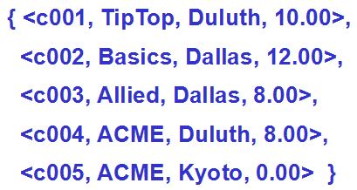
Concepts
不论是哪一个关系（被访问的访问对象、访问结果，或者是访问过程中所生成的中间关系），我们都需要明确其关系模式和元组集合是什么。
以下图左所示的顾客关系Customer为例，其关系模式Head(Customer)={cid,cname,city,discnt}；在关系代数中，该关系可以被看成是如下图右所示的元组集合：
Database Principles & Programming

Slide 60
2.6 Set-Theoretic Operations
Def. 2.6.1 Compatible Tables (相容表)
Tables R and S are compatible if they have the same headings
that is , if Head(R)=Head(S), with attributes chosen from the same domains and with the same meanings.
Database Principles & Programming
Notes:
相容表的判定方法：1）两个关系有相同数量的属性；2）可以在两个关系的属性之间建立一一对应，且对应的属性应该具有相同的domain和meaning；3）在关系代数这样的理论模型中，常用的假设是：同名的属性具有相同的domain和meaning；4）由于column name只是作为关系中属性的表示符号，因此，我们也可以通过对关系中的属性进行换名来达到如下的目标：同名的属性都具有相同的domain和meaning，而不同名的属性则是有着不同的domain或者不同的meaning

Slide 61
Compatible Table (example 1)
R₁
A | B | C
a1 | b1 | c1
a1 | b2 | c3
a2 | b1 | c2
S₁
A | B | C
a1 | b1 | c1
a1 | b1 | c2
a1 | b2 | c3
a3 | b2 | c3
Tables R₁ and S₁ are compatible because:
with the same number of columns
each pair of columns (one in table R₁, and another in table S₁) have:
the same domains (character), and
the same meanings, such as the same name of columns
Database Principles & Programming
Notes:
两个关系具有相同个数的属性，且对应的同名属性都具有相同的domain和meaning

Slide 62
Compatible Table (example 2)
R₂
A | B | C
a1 | b1 | c1
a1 | b2 | c3
a2 | b1 | c2
S₂
A | B | C
1 | b1 | c1
1 | b1 | c2
1 | b2 | c3
3 | b2 | c3
Tables R₂ isn’t compatible with table S₂ because:
The domain of column A in table S₂ is integer, and the domain of column A in table R₂ is character, and that
We can’t find a pair of columns(X, A)(X is a column in table R₂, and A is a column in table S₂) with the same domain (integer)
Database Principles & Programming
Notes:
虽然两个关系具有完全相同的关系模式，但无法做到“在他们的属性之间建立起一一对应的关系，且对应的属性之间都具有相同的domain和meaning”（这里可以通过元组上的属性值来判断一个属性的domain）

Slide 63
Compatible Table (example 3)
R₃
A | B | C
a1 | b1 | c1
a1 | b2 | c3
a2 | b1 | c2
S₃
A | B | D
a1 | b1 | c1
a1 | b1 | c2
a1 | b2 | c3
a3 | b2 | c3
Tables R₃ isn’t compatible with table S₃ because:
We can’t find a pair of columns(?, D) with the same meanings (? is a column in table R₃, and D is a column in table S₃)
In relational algebra, two columns are said to have the same meanings if they have the same name of column.
Database Principles & Programming
Notes:
可以通过对属性进行换名（D <==> C）来进行判断

Slide 64
Compatible Table (example 4)
R₄
A | B | C
a1 | b1 | c1
a1 | b2 | c3
a2 | b1 | c2
S₄
A | B | C | D
a1 | b1 | c1 | d1
a1 | b1 | c2 | d1
a1 | b2 | c3 | d1
a3 | b2 | c3 | d1
Tables R₄ isn’t compatible with table S₄ because:
The number of columns in table R₄ isn’t equal to the number of columns in table S₄
Database Principles & Programming
Notes:
属性个数不同，不可能是Compatible Table

Slide 65
Compatible Table (example 5)
R₅
A | B | C
a1 | b1 | c1
a1 | b2 | c3
a2 | b1 | c2
S₅
A | C | B
a1 | c1 | b1
a1 | c2 | b1
a1 | c3 | b2
a3 | c3 | b2
Tables R₅ and S₅ are compatible because:
with the same headings of table
We can move the column B to the left of the column C in table S₅ because No order to the columns.
Database Principles & Programming
Notes:
属性在表中的排列次序不同，不影响对是不是Compatible Table的判断

Slide 66
Compatible Table (example 5)
S₅
A | C | B
a1 | c1 | b1
a1 | c2 | b1
a1 | c3 | b2
a3 | c3 | b2
S₅
A
B
C
a1
b1
c1
a1
b1
c2
a1
b2
c3
a3
b2
c3
R₅
A
B
C
a1
b1
c1
a1
b2
c3
a2
b1
c2
Database Principles & Programming

Slide 67
2.6 Set-Theoretic Operations
Def 2.6.2 Union, Intersection, Difference
Let R and S be two compatible tables, where Head(R) = Head(S)
R∪S is a table with the same heading as R (or S), for each row t in R or in S, t in R∪S
R∩S is a table with the same heading as R (or S), for each row t in R, if t appear in S, then t in R∩S
R–S is a table with the same heading as R (or S), for each row t in R, if t don’t appear in S, then t in R–S
Database Principles & Programming

Slide 68

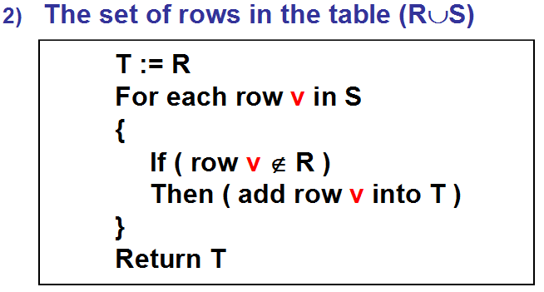
[Define of Union] R ∪ S
前提条件：
结果关系：

Slide 69
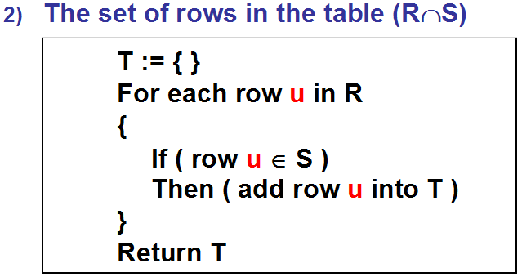
[Define of Intersection] R ∩ S
前提条件：
结果关系：

Slide 70
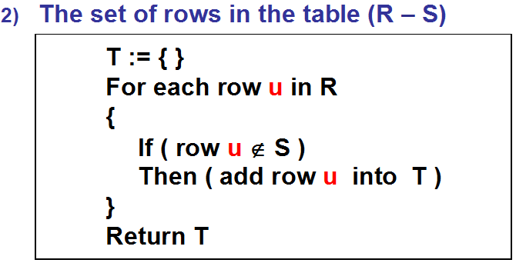
[Define of Difference] R – S
前提条件：
结果关系：

Slide 71
2.6 Set-Theoretic Operations
Example 2.6.2
A
B
B
A ∪ B
A ∩ B
A – B
Database Principles & Programming

Slide 72
2.6 Set-Theoretic Operations
The UNION and INTERSECTION operations are commutative (交换律) and associative (结合律).
R ∪ S = S ∪ R
R ∩ S = S ∩ R
(R ∪ S) ∪ T = R ∪ (S ∪ T)
(R ∩ S) ∩ T = R ∩ (S ∩ T)
Database Principles & Programming

Slide 73
2.6 Set-Theoretic Operations
The DIFFERENCE operation is not commutative
R – S ≠ S – R
R – S = R – (R ∩ S)
S – R = S – (R ∩ S)
R ∩ S = R – (R – S) = S – (S – R)
(R – S) ∩ S = Φ
(R – S) ∩ R = R – S
(R – S) ∩ (S – R) = Φ
Database Principles & Programming

Slide 74
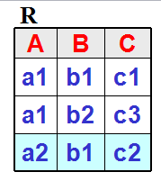
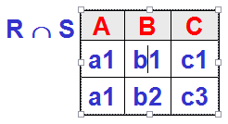
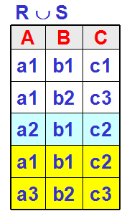
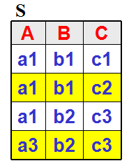

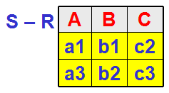
Exp. 2.6.1 The rows with blue background appear only in R, and the rows with yellow background appear only in S.

Slide 75
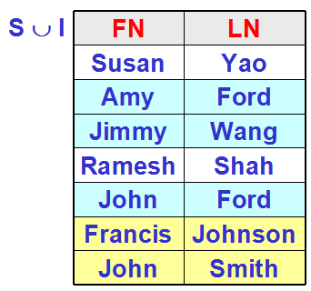
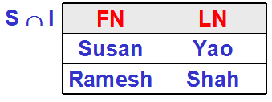
STUDENT(S)
FN | LN
Susan | Yao
Amy | Ford
Jimmy | Wang
Ramesh | Shah
John | Ford
INSTRUCTOR(I)
FN | LN
Ramesh | Shah
Francis | Johnson
Susan | Yao
John | Smith

Slide 76
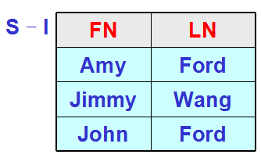
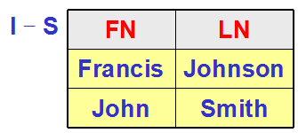
STUDENT(S)
FN | LN
Susan | Yao
Amy | Ford
Jimmy | Wang
Ramesh | Shah
John | Ford
INSTRUCTOR(I)
FN | LN
Ramesh | Shah
Francis | Johnson
Susan | Yao
John | Smith

Slide 77
2.6 Set-Theoretic Operations
Def 2.6.3 Assignment, Alias
Table R : R(A₁,A₂,…,A_{n})
赋值运算：
S(B₁,B₂,…,B_{n}) := R(A₁,A₂,…,A_{n})
Define a new table S, and
Domain(B_{i}) = Domain(A_{i}) for all i (1≤i≤n)
The content of the new table S is exactly the same as the old table R.
for each row t in table R, t in table S, and
for each row t in table S, t in table R
Database Principles & Programming
Notes:
可以利用‘赋值’运算创建临时的中间关系：1）可以用已有的关系创建中间关系；2）可以用一个关系代数表达式的计算结果创建中间关系。
中间关系有关系名，并且可以定义新的属性名和调整属性的排列次序。

Slide 78
2.6 Set-Theoretic Operations
表的赋值：S := R
简单的‘表的赋值’操作，可用于为关系R起一个别名 (alias)
或者理解为：定义了一个与关系R‘完全相同’的中间关系S（相同的关系模式和元组集合）
通常用于‘关系自身的连接运算’！
赋值运算也可以用来保存计算的‘中间结果’
Database Principles & Programming

Slide 79
2.6 Set-Theoretic Operations
Example 2.6.3: T := (R ∪ S) – (R ∩ S)
We can define the table T by writing
T₁ := (R ∪ S)
T₂ := (R ∩ S)
T := T₁ – T₂
Database Principles & Programming

Slide 80
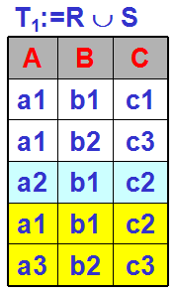
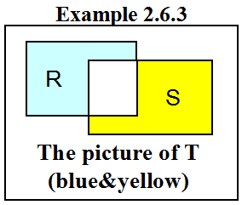
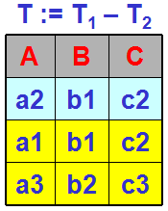
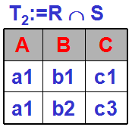
R
A | B | C
a1 | b1 | c1
a1 | b2 | c3
a2 | b1 | c2
S
A | B | C
a1 | b1 | c1
a1 | b1 | c2
a1 | b2 | c3
a3 | b2 | c3

Slide 81
2.6 Set-Theoretic Operations
Def 2.6.4 Product R × S
The product of the tables R and S is a table T that
if Head(R)={A₁,…,A_{n}}, Head(S)={B₁,…,B_{m}}, then
Head(T) = {R.A₁, …, R.A_{n}, S.B₁, …, S.B_{m}}
t is a row in T if and only if
There are two rows u in R and v in S such that
t(R.A_{i}) = u(A_{i}) for 1≤i≤n, and
t(S.B_{k}) = v(B_{k}) for 1≤k≤m
Database Principles & Programming

Slide 82
Head(R) = { A₁, …, A_{n} }，Head(S) = { B₁, …, B_{m} }
Head(R×S) = {A₁, …, A_{n}, B₁, …, B_{m} }
The set of rows in the table R × S
For each row u in R
{
}
For each row v in S
{
}
Then we have a row t in the table R×S
Which
{
t[ A_{i} ] = u[ A_{i} ] for all i, 1≤i≤n
t[ B_{j} ] = v[ B_{j} ] for all j, 1≤j≤m
}

Slide 83
Example 2.6.4
R
R × S
A | B | C
a1 | b1 | c1
a1 | b2 | c3
a2 | b1 | c2
R.A | R.B | R.C | S.B | S.C | S.D
a1 | b1 | c1 | b1 | c1 | d1
a1 | b1 | c1 | b1 | c1 | d3
a1 | b1 | c1 | b2 | c2 | d2
a1 | b1 | c1 | b1 | c2 | d4
a1 | b2 | c3 | b1 | c1 | d1
a1 | b2 | c3 | b1 | c1 | d3
a1 | b2 | c3 | b2 | c2 | d2
a1 | b2 | c3 | b1 | c2 | d4
a2 | b1 | c2 | b1 | c1 | d1
a2 | b1 | c2 | b1 | c1 | d3
a2 | b1 | c2 | b2 | c2 | d2
a2 | b1 | c2 | b1 | c2 | d4
S
B | C | D
b1 | c1 | d1
b1 | c1 | d3
b2 | c2 | d2
b1 | c2 | d4
Database Principles & Programming

Slide 84
T := R × S
If the number of columns in table R is C_{R}, the number of columns in table S is C_{S}, then
the number of columns in product of tables R and S is (C_{R} + C_{S})
If the number of rows in table R is N_{R}, the number of rows in table S is N_{S}, then
the number of rows in product of tables R and S is (N_{R} × N_{S})
Database Principles & Programming

Slide 85
2.7 Native Relational Operations
The Native Relational Operations of relational algebra are
projection (π)
select columns in table
selection (δ)
select rows in table
join (∞)
combine a table with another table or itself
division (÷)
a complex operation of relational algebra
Database Principles & Programming

Slide 86
Def 2.7.1 Projection: R [ A_{i1}, A_{i2}, …, A_{ik} ]
Head(R) = {A₁,A₂,…,A_{n}}
A_{ij}∈Head(R) for all 1≤j≤k
the projection of R on attributes A_{i1}, A_{i2}, …, A_{ik}, is a table T that
Head(T) = { A_{i1},…,A_{ik} }
for every row r in the table R there will be a single row t in the table T such that
r[A_{ij}] = t[A_{ij}] for 1≤j≤k
can be writed as π_{Ai1,…,Aik} (R)
cast out duplicate rows in the result of projection!
Database Principles & Programming

Slide 87
Example 2.7.1
list all customer names from the CUSTOMERS (is denoted by C) table in figure 2.2
CN := C[cname] or CN := π_{cname}(C)
C
cid | cname | city | discnt
c001 | TipTop | Duluth | 10.00
c002 | Basics | Dallas | 12.00
c003 | Allied | Dallas | 8.00
c004 | ACME | Duluth | 8.00
c006 | ACME | Kyoto | 0.00
CN
cname
TipTop
Basics
Allied
ACME
Database Principles & Programming

Slide 88
Example 2.7.1 (cont.)
C
π_{city}(C)
cid0 | cname | city | discnt
c001 | TipTop | Duluth | 10.00
c002 | Basics | Dallas | 12.00
c003 | Allied | Dallas | 8.00
c004 | ACME | Duluth | 8.00
c006 | ACME | Kyoto | 0.00
city
Duluth
Dallas
Kyoto
cast out duplicate rows ‘Duluth’ and ‘Dallas’ in the result of the projection of C on column ‘city’.
Database Principles & Programming

Slide 89
Example 2.7.1 (cont.)
S
S[A]
S[B,A]
S[B,C]
A | B | C
a1 | b1 | c1
a1 | b1 | c3
a2 | b2 | c2
a1 | b2 | c4
A
a1
a2
B | A
b1 | a1
b2 | a2
b2 | a1
B | C
b1 | c1
b1 | c3
b2 | c2
b2 | c4
cast out duplicate rows (a1)
cast out duplicate rows (b1, a1)
Database Principles & Programming

Slide 90
2.7 Native Relational Operations
Def 2.7.2 Selection
Assume Head(S) = {A₁,A₂,…,A_{n}}, the selection operation on S creates a new table, denoted by
S where C or δ_{C} (S)
with the same set of attributes, and consisting of those rows of S that obey the selection condition C.
Database Principles & Programming

Slide 91
2.7 Native Relational Operations
Def. The selection condition C
C can be any comparison of the form
A_{i} θ A_{j} or A_{i} θ a
where A_{i} and A_{j} are attributes of S having the same domain, a is a constant from Domain(A_{i}), and θ is one of the comparison operators <, >, =, <=, >=, <>
If C and C’ are conditions, then new conditions can be writing
C AND C’ , C OR C’ , NOT C
Database Principles & Programming

Slide 92
Example 2.7.2
CUSTOMERS
cid | cname | city | discnt
c001 | TipTop | Duluth | 10.00
c002 | Basics | Dallas | 12.00
c003 | Allied | Dallas | 8.00
c004 | ACME | Duluth | 8.00
c006 | ACME | Kyoto | 0.00
Find all customers based in ‘Kyoto’
T := CUSTOMERS where city = ‘Kyoto’
T
cid
cname
city
discnt
c006
ACME
Kyoto
0.00
Database Principles & Programming

Slide 93
pid | pname | city | quantity | price
P01 | comb | Dallas | 111400 | 0.50
p02 | brush | Newark | 203000 | 0.50
p03 | razor | Duluth | 150600 | 1.00
p04 | pen | Duluth | 125300 | 1.00
p05 | pencil | Dallas | 221400 | 1.00
p06 | folder | Dallas | 123100 | 2.00
p07 | case | Newark | 100500 | 1.00
Find the products stored in ‘Dallas’ that cost more than $0.50
PRODUCTS where city=‘Dallas’ AND price>0.50
Database Principles & Programming

Slide 94
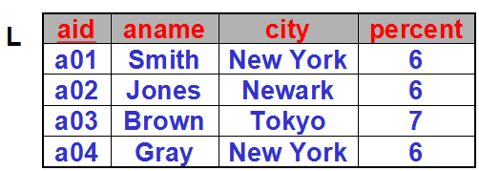
Exp. 2.7.3: Retrieve all pairs of agents, both with a percentage commission of at least 6%, and both stationed in the same city.
Step 1: All agents who have a percentage commission of at least 6%
L := AGENTS where percent >= 6
M := AGENTS where percent >= 6
(M is the same table with L)

Slide 95
Example 2.7.3
Step 2: Retrieve all pairs of agents, both with a percentage commission of at least 6%, and both stationed in the same city.
L
M
aid | ... | city | per.
a01 | ... | New York | 6
a02 | ... | Newark | 6
a03 | ... | Tokyo | 7
a04 | ... | New York | 6
aid | ... | city | per.
a01 | ... | New York | 6
a02 | ... | Newark | 6
a03 | ... | Tokyo | 7
a04 | ... | New York | 6
PAIRS := (L × M) where L.city = M.city
Database Principles & Programming

Slide 96
L
M
aid
aname
city
percent
aid
aname
city
percent
a01
Smith
New York
6
a01
Smith
New York
6
a02
Jones
Newark
6
a02
Jones
Newark
6
a03
Brown
Tokyo
7
a03
Brown
Tokyo
7
a04
Gray
New York
6
a04
Gray
New York
6
PAIRS := (L × M) where L.city = M.city
L.aid
L.aname
L.city
L.percent
M.aid
M.aname
M.city
M.percent
a01
Smith
New York
6
a01
Smith
New York
6
a01
Smith
New York
6
a04
Gray
New York
6
a02
Jones
Newark
6
a02
Jones
Newark
6
a03
Brown
Tokyo
7
a03
Brown
Tokyo
7
a04
Gray
New York
6
a01
Smith
New York
6
a04
Gray
New York
6
a04
Gray
New York
6
Database Principles & Programming
Notes:
在中间结果关系PAIRS中，存在一些没有意义或语义冗余的元组。

Slide 97
L
M
aid
aname
city
percent
aid
aname
city
percent
a01
Smith
New York
6
a01
Smith
New York
6
a02
Jones
Newark
6
a02
Jones
Newark
6
a03
Brown
Tokyo
7
a03
Brown
Tokyo
7
a04
Gray
New York
6
a04
Gray
New York
6
(L × M) where L.city = M.city
and L.aid < M.aid
L.aid | L.aname | L.city | L.percent | M.aid | M.aname | M.city | M.percent
a01 | Smith | New York | 6 | a01 | Smith | New York | 6
a01 | Smith | New York | 6 | a04 | Gray | New York | 6
a02 | Jones | Newark | 6 | a02 | Jones | Newark | 6
a03 | Brown | Tokyo | 7 | a03 | Brown | Tokyo | 7
a04 | Gray | New York | 6 | a01 | Smith | New York | 6
a04 | Gray | New York | 6 | a04 | Gray | New York | 6
Database Principles & Programming
Notes:
通过添加选择条件‘L.aid<M.aid’，可以过滤掉那些无意义或者冗余的中间结果。

Slide 98

Example 2.7.4
In example 2.7.3, can we replace P2 with P3 ?
L
aid
aname
city
percent
a01
Smith
New York
6
a02
Jones
Newark
6
a03
Brown
Tokyo
7
a04
Gray
New York
6
Database Principles & Programming
Notes:
P3只是返回两者都位于New York的供应商

Slide 99
2.7 Native Relational Operations
Def 2.7.3 Precedence of Relational Operations
Precedence | Operators
Highest | PROJECT
 | SELECT
 | PRODUCT
 | JOIN, DIVIDEBY
 | INTERSECTION
Lowest | UNION, DIFFERENCE
Database Principles & Programming

Slide 100
Example 2.7.5 Complex Query
CUSTOMERS → C AGENTS → A
PRODUCTS → P ORDERS → O
[exp 2.7.5] Find all cities where we have either custormers who have a discount of less than 10% or agents who make a commission of less than 6%.
T₁ := (C where discnt < 10) [city]
T₂ := (A where percent < 6) [city]
T := T₁ ∪ T₂
Database Principles & Programming
Notes:
为了简化表示，用单个首字母来作为各个关系的关系名。

Slide 101
[exp 2.7.5] Find all cities where we have either custormers who have a discount of less than 10% or agents who make a commission of less than 6%.
T₁ := (C where discnt < 10) [city]
T₂ := (A where percent < 6) [city]
T := T₁ ∪ T₂
另外一种错误的表示方法：
R₁ := (C where discnt < 10)
R₂ := (A where percent < 6)
R := (R₁ ∪ R₂) [city]
其中的‘并’运算非法！
Database Principles & Programming
Notes:
两个中间关系R1和R2的Heading不一样！

Slide 102
Complex Query
Find cname and city of customers and aname of agents that the customer lives in the same city with agents.
((CxA) where C.city=A.city)[C.cname,C.city,A.aname]
(C x A)
(C x A) where C.city = A.city
能否用如下的分步表示形式来表示该查询？
T := (CxA) where C.city=A.city
R := T [C.cname, C.city, A.aname]
可以，但不够严谨！
Database Principles & Programming
Notes:
在步骤2中，只有中间表T，表名C和A都是非法的。

Slide 103
Complex Query
Find pid, month and qty of order whose customer’s name is ‘Allied’
((CxO) where C.cid=O.cid and C.cname=‘Allied’) [ O.pid, O.month, O.qty ]
or
((((C where cname=‘Allied’) [cid] ) x O )
where C.cid=O.cid ) [ O.pid,O.month,O.qty ]
Database Principles & Programming
Notes:
有两种表示方法：先执行两个关系的笛卡尔乘积合并，再执行元组选择查询；或者先在一个关系上执行元组选择查询，然后再用查询的结果关系与订单关系进行笛卡尔乘积合并

Slide 104
Complex Query
Find ordno of orders for customer, agent and product combinations that are all in the same city.
( ( C[cid, city] x A[aid, city] x P[pid, city] x O )
where C.city = A.city and P.city = A.city
and C.cid = O.cid
and A.aid = O.aid
and P.pid = O.pid ) [ O.ordno ]
Database Principles & Programming

Slide 105
Complex Query
Find cid of customers who have a highest discount in all customers.
CUSTOMERS
cid
cname
city
discnt
c001
TipTop
Duluth
10.00
c002
Basics
Dallas
12.00
c003
Allied
Dallas
8.00
c004
ACME
Duluth
8.00
c006
ACME
Kyoto
0.00
Database Principles & Programming

Slide 106
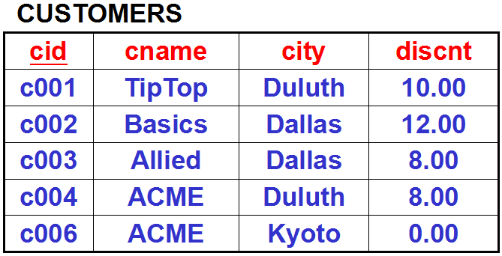
Find cid of customers who have a highest discount in all customers.
【思路】要判断一个客户c的折扣是不是最高的，检查方法如下：
如果存在一个客户k，客户k的折扣大于客户c的折扣，那么客户c的折扣就不是最高的
如果对于所有的客户k来说，客户k的折扣都小于或等于客户c的折扣，那么客户c的折扣就是当前所有客户中最高的
要确定客户c的折扣是最高的(情况②)，需要遍历Customers表中的所有客户元组k，且都满足: k.discnt <= c.discnt
如果仅仅是想确认客户c的折扣不是最高的(情况①)，只要找到一个客户元组k满足: k.discnt > c.discnt
( difficult )
( easy )
Notes:
困难在于：k.discnt <= c.discnt 只是表示客户k和c的折扣比较，而不能表示所有的客户k和客户c的折扣比较。活着说，要确认客户c满足查询条件（即折扣最高），需要对于customers表中的每一个客户k，都有 k.discnt <= c.discnt，而关系代数中没有提供这样的比较运算

Slide 107
Complex Query
Find cid of customers who have a highest discount in all customers.
Find all cid of customers
R₁ := C [cid]
Find cid of customers whose discount less than another customer. Let S := C, then
R₂:=((CxS) where C.discnt<S.discnt)[C.cid]
calculate the result of this query by DIFFERENCE operation.
T := R₁ − R₂
Notes:
思路：
1）将所有客户划分为不相交的两个子集：‘折扣最高的客户集合M’和‘折扣不是最高的客户集合N’
2）用所有客户构成的集合（即R1）减去‘折扣不是最高的客户集合N’（即R2），可以获得折扣最高的客户集合（T）
3）该查询在任何时候都能返回当前customers表中折扣最高的顾客！

Slide 108
2.7 Native Relational Operations
The Native Relational Operations of relational algebra are
projection (π)
select columns in table
selection (δ)
select rows in table
join (∞)
combine a table with another table or itself
division (÷)
a complex operation of relational algebra
Database Principles & Programming

Slide 109
2.7 Native Relational Operations
Def 2.7.4 Join (equijoin, natural join)
Join 运算被称为 ‘联接’ 运算
又被称为 ‘等值联接’ (equijoin)
或者 ‘自然联接’ (natural join)
其作用是：根据两个关系中的同名属性的相等比较，来实现两个关系的合并
可以表示为 ‘ R join S ’ 或者 ‘ R ∞ S ’
其形式化定义如下

Slide 110
Def 2.7.4 Join
We have two tables R and S, with headings:
Head(R) = { A₁, …, A_{n}, B₁, …, B_{k} }
Head(S) = { B₁, …, B_{k}, C₁, …, C_{m} }
Then
Head(R∞S) = {A₁,…,A_{n},B₁,…,B_{k},C₁,…,C_{m}}
Database Principles & Programming
Notes:
join运算结果关系的关系模式

Slide 111
Then
Head(R∞S) = { A₁, …, A_{n}, B₁, …, B_{k} , C₁, …, C_{m} }
The set of rows in the table R∞S
For each row u in R
{
}
For each row v in S
{
}
If ( u[B_{i}] = v[B_{i}] for all i (1≤i≤k) )
Then we have a row t in the table R∞S
Which {
t[A_{i}] = u[A_{i}] for all i, 1≤i≤n
t[C_{i}] = v[C_{i}] for all i, 1≤i≤m
t[B_{i}] = u[B_{i}] = v[B_{i}] for all i, 1≤i≤k
}
Database Principles & Programming
Notes:
R∞S 结果关系中的元组生成过程（伪代码）
在笛卡尔乘积运算中，不需要中间的IF条件检查，每一个u和v都可以合并得到一条笛卡尔乘积的结果元组！

Slide 112
Example 2.7.6
R
S
R∞S
A | B1 | B2
a1 | b1 | b1
a1 | b2 | b1
a2 | b1 | b2
B1 | B2 | C
b1 | b1 | c1
b1 | b1 | c2
b1 | b2 | c3
b2 | b2 | c4
A | B1 | B2 | C
a1 | b1 | b1 | c1
a1 | b1 | b1 | c2
a2 | b1 | b2 | c3
在这里，R∞S相当于是：
可以仔细体会R∞S与R×S的区别
Database Principles & Programming

Slide 113
与join运算有关的一些等价变换规则
If Head(R) ∩ Head(S) = Φ , then R∞S = R x S
If Head(R) = Head(S) , then R∞S = R ∩ S
If Head(R) ⊆ Head(S) , then R∞S ⊆ S
Database Principles & Programming

Slide 114
Complex Query
Find cname and city of customers and aname of agents that the customer lives in the same city with agents.
（基于笛卡尔乘积的查询表示方法）
((CxA) where C.city=A.city)[C.cname,C.city,A.aname]
CUSTOMERS
AGENTS
cid
cname
city
discnt
aid
aname
city
percent
采用JOIN运算可以将该查询简化表示为：
( C ∞ A ) [ C.cname, C.city, A.aname ]
Database Principles & Programming

Slide 115
Complex Query
Find pid, month and qty of order whose customer’s name is ‘Allied’
( (C x O) where C.cid = O.cid and C.cname = ‘Allied’ ) [ O.pid, O.month, O.qty ]
or
( ( ( (C where cname = ‘Allied’) [cid] ) x O ) where C.cid = O.cid ) [ O.pid, O.month, O.qty ]
可简化表示为：
((C∞O)where C.cname=‘Allied’)[O.pid,O.month,O.qty]
Database Principles & Programming

Slide 116
Complex Query
Find ordno of orders for customer, agent and product combinations that are all in the same city.
((C[cid,city] x A[aid,city] x P[pid,city] x O)
where C.city = A.city and P.city = A.city
and C.cid=O.cid
and A.aid=O.aid
and P.pid=O.pid )
[ O.ordno ]
可简化表示为： ( C ∞ A ∞ P ∞ O ) [ O.ordno ]
Database Principles & Programming

Slide 117
Example 2.7.7
Customers: C(cid, cname, city, discnt)
Agents: A(aid, aname, city, percent)
Products: P(pid, pname, city, quantity, price)
Orders: O(ordno, month, cid, aid, pid, qty, dollars)
Example 2.7.7: Find the names of the customers who have ordered product ‘p01’
( ( C ∞ O ) where pid = ‘p01’ ) [ C.cname ]
Database Principles & Programming

Slide 118
Example 2.7.8
Customers: C(cid, cname, city, discnt)
Agents: A(aid, aname, city, percent)
Products: P(pid, pname, city, quantity, price)
Orders: O(ordno, month, cid, aid, pid, qty, dollars)
Example 2.7.8: Get names of customers who order at least one product costing $0.50.
T1 := ((O∞(P where price=0.50)[pid])∞C)[cname]
T2 := ((O∞P where price=0.50)∞C)[cname]
Question: T1 is equal to T2 ? Why ?
Database Principles & Programming
Notes:
T2增加了一个要求“客户和商品必须是位于同一个城市”，这也是为什么在T1中要预先对关系P进行投影操作[pid]的原因！
目的就是在与关系C进行join运算前，先通过投影运算过滤掉其中的某个同名的city属性。
当然了，如果不使用join运算，改为使用product运算来合并关系P和C，则不需要这样的投影运算，但需要添加选择运算 where O.cid=C.cid and O.pid=P.pid

Slide 119
Customers: C(cid, cname, city, discnt)
Agents: A(aid, aname, city, percent)
Products: P(pid, pname, city, quantity, price)
Orders: O(ordno, month, cid, aid, pid, qty, dollars)
（思考题）
Example 2.7.8: Get names of customers who order at least one product costing $0.50.
T1 := ((O ∞ (P where price=0.50)[pid]) ∞ C) [cname]
T2 := ((O ∞ (P where price=0.50)) ∞ C) [cname]
T3 := (((O ∞ P) ∞ C) where price=0.50) [cname]
T4 := (((O ∞ P[pid]) ∞ C) where price=0.50) [cname]
Question: Which is correct ?
Notes:
需要仔细检查每一步中间计算结果的关系模式，确保后续所有计算步骤的可执行！
T1是正确的，T2和T3的结果语义与题目要求不符（要求商品和客户位于同一个城市中），T4是错误的（在join运算的中间结果中，已经没有了属性price）

Slide 120
2.7 Native Relational Operations
Database Principles & Programming
The Product and Join operations are commutative and associative.
R × S = S × R
R ∞ S = S ∞ R
(R × S) × T = R × (S × T)
(R ∞ S) ∞ T = R ∞ (S ∞ T)

Slide 121
2.7 Native Relational Operations
Def 2.7.5 The Division Operation
Consider two tables R and S, where
Head(S) ⊂ Head(R)
Specifically, assume that
Head(R) = { A₁,A₂,…,A_{n}, B₁,B₂,…,B_{m} }
Head(S) = { B₁,B₂,…,B_{m} }
The table T is the result of the division R÷S if
Head(T) = { A₁,A₂,…,A_{n} }
T contains the largest possible set of rows t
Database Principles & Programming

Slide 122
2.7 Native Relational Operations
Def 2.7.5 T := R÷S
Head(R) = { A₁,A₂,…,A_{n}, B₁,B₂,…,B_{m} }
Head(S) = { B₁,B₂,…,B_{m} }
Head(T) = { A₁,A₂,…,A_{n} }
T contains the largest possible set of rows t such that :
for each row s in S, we can find one row r in R, where
t(A_{i}) = r(A_{i}) for 1≤i≤n, and
s(B_{j}) = r(B_{j}) for 1≤j≤m
Database Principles & Programming

Slide 123
Difference between join and division
 | T = R ∞ S | T = R ÷ S
Head(R) | {A₁,…,A_{n},B₁,…,B_{k}} | {A₁,…,A_{n},B₁,…,B_{m}}
Head(S) | {B₁,…,B_{k},C₁,…,C_{m}} | { B₁,…,B_{m} }
Head(T) | {A₁,…,A_{n},B₁,…,B_{k}, C₁,C₂,…,C_{m}} | { A₁,A₂,…,A_{n} }
Database Principles & Programming
Notes:
联接运算和除法运算的对比

Slide 124
Result of T=R∞S | A row t is in the table R∞S if and only if there are two rows u in R and v in S, such that u[B_{i}] = v[B_{i}] for all i (1≤i≤k); then t[A_{i}] = u[A_{i}] for all i, 1≤i≤n t[C_{i}] = v[C_{i}] for all i, 1≤i≤m t[B_{i}] = u[B_{i}] = v[B_{i}] for all i, 1≤i≤k
Result of T=R÷S | T contains the largest possible set of rows t such that for each row s in S, we can find one row r in R, where t(A_{i}) = r(A_{i}) for 1≤i≤n and s(B_{j}) = r(B_{j}) for 1≤j≤m
Database Principles & Programming
Notes:
两个运算符的结果元组的生成方法（采用不同的描述方法）

Slide 125
Result of T=R∞S
For each row u in R
{
For each row v in S
{
If (u[B_{i}] = v[B_{i}] for all i (1≤i≤k)) Then
{
Generates a row t of T suct that
t[A_{i}] = u[A_{i}] for all i, 1≤i≤n
t[C_{i}] = v[C_{i}] for all i, 1≤i≤m
t[B_{i}] = u[B_{i}] = v[B_{i}] for all i, 1≤i≤k
}
}
}
Database Principles & Programming

Slide 126
Result of T=R÷S
1. Assume a row t is in T, then:
for each row s in S
{
we can find a row r in R, and
{
t(A_{i}) = r(A_{i}) for 1≤i≤n
s(B_{j}) = r(B_{j}) for 1≤j≤m
}
}
2. T contains the largest possible set of rows t
Database Principles & Programming

Slide 127
Example 2.7.9
R
S₁
T₁
A
B
C
A | B | C
a1 | b1 | c1
a2 | b1 | c1
a1 | b2 | c1
a1 | b2 | c2
a2 | b1 | c2
a1 | b2 | c3
a1 | b2 | c4
a1 | b1 | c5
c1
R ÷ S₁
a1
b1
?
a2
b1
a1
b2
S₂
C
T₂
A
B
R ÷ S₂
c2
a1
b2
?
a2
b1
S₃
C
T₃
A
B
c1
R ÷ S₃
a1
b2
?
c2
a2
b1

Slide 128
Example 2.7.9 (cont.)
R
S₁
T₁
C
A
B
A | B | C
a1 | b1 | c1
a2 | b1 | c1
a1 | b2 | c1
a1 | b2 | c2
a2 | b1 | c2
a1 | b2 | c3
a1 | b2 | c4
a1 | b1 | c5
a2 | b2 | c2
c1
R ÷ S₁
a1
b1
a2
b1
a1
b2
S₂
C
T₂
A
B
c2
R ÷ S₂
a1
b2
a2
b1
a2
b2
S₃
C
T₃
A
B
c1
R ÷ S₃
a1
b2
c2
a2
b1
Notes:
在上一个例子中，我们在被除数关系R中添加一条新的元组(a2,b2,c2)，然后重新执行这三个除法运算，可以看出，他们结果集的关系是：
T3 = T1 ∩ T2

Slide 129
Example 2.7.9 (cont.)
R
S₄
T₄
C
A | B | C
a1 | b1 | c1
a2 | b1 | c1
a1 | b2 | c1
a1 | b2 | c2
a2 | b1 | c2
a1 | b2 | c3
a1 | b2 | c4
a1 | b1 | c5
A
B
c1
R ÷ S₄
a1
b2
c2
?
c3
c4
S₅
C
T₅
c1
A
B
c2
R ÷ S₅
?
c3
c4
c5
Database Principles & Programming

Slide 130
Example 2.7.9 (cont.)
R
S₆
T₆
A | B | C
a1 | b1 | c1
a2 | b1 | c1
a1 | b2 | c1
a1 | b2 | c2
a2 | b1 | c2
a1 | b2 | c3
a1 | b2 | c4
a1 | b1 | c5
B
C
A
b1
c1
R ÷ S₆
a1
?
a2
S₇
T₇
B
C
A
R ÷ S₇
a1
b1
c1
?
b2
c1
Database Principles & Programming

Slide 131
2.7 Native Relational Operations
Database Principles & Programming
Theorem 2.7.6
if R = T × S, then
T = R ÷ S
S = R ÷ T
if T = R ÷ S, then
T × S ⊆ R

Slide 132
Example
R
T
A | B
a1 | b1
a2 | b2
A | B | C | D
a1 | b1 | c1 | d1
a1 | b1 | c2 | d2
a1 | b1 | c3 | d3
a2 | b2 | c1 | d1
a2 | b2 | c2 | d2
a2 | b2 | c3 | d3
R = T × S
S
C | D
c1 | d1
c2 | d2
c3 | d3
Database Principles & Programming

Slide 133
Example
R
S
R' = T × S
A | B | C | D
a1 | b1 | c1 | d1
a1 | b1 | c2 | d2
a1 | b1 | c3 | d3
a1 | b2 | c1 | d1
a2 | b2 | c1 | d1
a2 | b2 | c2 | d2
a2 | b2 | c3 | d3
a2 | b1 | c2 | d2
C | D
c1 | d1
c2 | d2
c3 | d3
A | B | C | D
a1 | b1 | c1 | d1
a1 | b1 | c2 | d2
a1 | b1 | c3 | d3
a2 | b2 | c1 | d1
a2 | b2 | c2 | d2
a2 | b2 | c3 | d3
T = R÷S
A | B
a1 | b1
a2 | b2
R' ⊆ R
Database Principles & Programming

Slide 134
2.7 Native Relational Operations
why we use division ?
what kind of question does it answer about the data.
Example
Get cids of customers who order products p01 ?
Get cids of customers who order products p01 and p02 ?
Get cids of customers who order all products ?
Database Principles & Programming
Notes:
为什么要定义‘除法’运算？
引入‘除法’运算后，可以方便我们描述哪一类操作要求？

Slide 135
PRODUCTS (P)
ORDERS (O)
pid | pname | ...
p01 | comb | ...
p02 | brush | ...
p03 | razor | ...
ordno | cid | aid | pid | ...
1011 | c001 | ... | p01 | ...
1012 | c002 | ... | p01 | ...
1019 | c001 | ... | p02 | ...
1017 | c002 | ... | p02 | ...
1018 | c004 | ... | p01 | ...
1023 | c004 | ... | p02 | ...
1022 | c002 | ... | p03 | ...
1025 | c006 | ... | p03 | ...
1013 | c003 | ... | p03 | ...
1.Get cids of customers who order products p01?
(O where pid='p01') [ cid ]
Database Principles & Programming

Slide 136
PRODUCTS (P)
ORDERS (O)
pid | pname | ...
p01 | comb | ...
p02 | brush | ...
p03 | razor | ...
ordno | cid | aid | pid | ...
1011 | c001 | ... | p01 | ...
1012 | c002 | ... | p01 | ...
1019 | c001 | ... | p02 | ...
1017 | c002 | ... | p02 | ...
1018 | c004 | ... | p01 | ...
1023 | c004 | ... | p02 | ...
1022 | c002 | ... | p03 | ...
1025 | c006 | ... | p03 | ...
1013 | c003 | ... | p03 | ...
2. Get cids of customers who order products p01 and p02 ?
(O where pid='p01')[cid] ∩ (O where pid='p02')[cid]
Database Principles & Programming

Slide 137
PRODUCTS (P)
ORDERS (O)
pid | pname | ...
p01 | comb | ...
p02 | brush | ...
p03 | razor | ...
..... | ..... | .....
ordno | cid | aid | pid | ...
1011 | c001 | ... | p01 | ...
1012 | c002 | ... | p01 | ...
1019 | c001 | ... | p02 | ...
1017 | c002 | ... | p02 | ...
1018 | c004 | ... | p01 | ...
1023 | c004 | ... | p02 | ...
1022 | c002 | ... | p03 | ...
1025 | c006 | ... | p03 | ...
1013 | c003 | ... | p03 | ...
..... | ..... | ..... | ..... | .....
3. Get cids of customers who order all products?
Database Principles & Programming
Notes:
因为商品表中的商品数量是变化的，而且每个商品的编号需要从表中查出来，所以无法像第2个查询一样来表示该查询。

Slide 138
2.7 Native Relational Operations
Example 2.7.11
Get names of customers who order all products ?
If a customer (row c in CUSTOMERS) order all products, then for each product (row p in PRODUCTS), we can find a row o in ORDERS such that
o.cid = c.cid and o.pid = p.pid
Database Principles & Programming
Notes:
在关系代数中，除了‘除法’运算符外，没有其他运算符可以直接来描述这样的查询语义

Slide 139
CUSTOMERS
ORDERS
cid | cname | city | discnt
c001 | TipTop | Duluth | 10.00
c002 | Basics | Dallas | 12.00
c003 | Allied | Dallas | 8.00
c004 | ACME | Duluth | 8.00
c006 | ACME | Kyoto | 0.00
ordno | month | cid | aid | pid | qty | dollars
1011 | jan | c001 | a01 | p01 | 1000 | 450.00
1012 | jan | c002 | a01 | p01 | 1000 | 440.00
1019 | feb | c001 | a02 | p02 | 400 | 180.00
1017 | feb | c002 | a06 | p02 | 600 | 264.00
1018 | feb | c004 | a03 | p01 | 600 | 276.00
1023 | mar | c004 | a04 | p02 | 1000 | 460.00
1022 | mar | c002 | a05 | p03 | 400 | 352.00
1025 | apr | c006 | a05 | p03 | 800 | 800.00
1013 | jan | c003 | a03 | p03 | 1000 | 920.00
PRODUCTS
pid | pname | city | price
p01 | comb | Dallas | 0.50
p02 | brush | Newark | 0.50
p03 | razor | Duluth | 1.00
Database Principles & Programming
Notes:
如果给定一个客户，我们要确认他是否购买过所有品种的商品，可以通过“先查出该客户的所有订单，再从他的订单中投影出他曾经购买过的所有商品编号的集合，最后再检查，他所有购买过的商品集合是否覆盖（或包含）着商品表（products）中的所有商品！
但我们的查询目标，是要找到所有满足上述条件的客户。

Slide 140
We can answer the request which use keyword ‘all’ by ‘division’ operation.
First: get cids of customers who order all products.
T := ORDERS[cid,pid] ÷ PRODUCTS[pid]
1) Why must project PRODUCTS on pid ?
2) Why must project ORDERS on cid, pid ?
columns of divisor must be subset of columns of dividend.
We only try to find the value of cid in ORDERS the same for all pid.
Second: get names of customers
T₁ := ( ( T ) ∞ C ) [cname]
Database Principles & Programming
Notes:
我们可以分析一下这一类查询的特点：
1）查询的目标对象是顾客；2）一个客户c是否满足查询条件，我们需要使用‘一组’商品（我们称其为‘条件对象’）来判断，该客户是不是购买过其中的所有商品；
3）普通的查询是“只要目标对象和某一个条件对象之间具有购买关系，就可以得到该目标对象满足查询条件”的结论，但是在本题中，我们需要“目标对象与所有的条件对象都具有购买关系”
4）虽然我们也可以用前面所介绍的其他算法来表示该查询，但表达式会很长很复杂，而且不利于用户理解
5）引入‘除法’运算的目标就是为了简化这一类查询的表示

Slide 141
Get names of customers who order all products ?
First: get cids of customers who order all products.
T := ORDERS[cid,pid] ÷ PRODUCTS[pid]
Second: get names of customers
T₁ := ( ( T ) ∞ C ) [cname]
合并之后得到如下的表示(T₁)：
((ORDERS[cid,pid]÷PRODUCTS[pid])∞C)[cname]
Question: Can answer this request by writing?
T₂: (O ∞ C) [cname, pid] ÷ P[pid]
Database Principles & Programming
Notes:
T2表达式的语法虽然没有问题，但其运算结果的语义却不符合本题目的查询要求！

Slide 142
Example 2.7.11 (cont.)
Question: Can answer this request by writing
T₂ := (O ∞ C) [cname, pid] ÷ P[pid] ?
CUSTOMERS
ORDERS
cid
cname
city
discnt
ordno
month
cid
aid
pid
qty
dollars
c001
TipTop
Duluth
10.00
1011
jan
c001
a01
p01
1000
450.00
c002
Basics
Dallas
12.00
1012
jan
c002
a01
p01
1000
440.00
c003
Allied
Dallas
8.00
1019
feb
c001
a02
p02
400
180.00
c004
ACME
Duluth
8.00
1017
feb
c002
a06
p02
600
264.00
c006
ACME
Kyoto
0.00
1018
feb
c004
a03
p01
600
276.00
PRODUCTS
1023
mar
c004
a04
p02
1000
460.00
pid
pname
city
price
1022
mar
c002
a05
p03
400
352.00
p01
comb
Dallas
0.50
1025
apr
c006
a05
p03
800
800.00
p02
brush
Newark
0.50
p03
razor
Duluth
1.00
1013
jan
c003
a03
p03
1000
920.00
Database Principles & Programming
Notes:
T2错误原因分析：在这一个除法表达式中，被除数是由cname和pid组成的，它反映了具有某个名字(name)的客户与商品之间的购买关系，但是一个name可能对应着多个不同的客户，因而，其结果集可能包含着“一组同名的客户，他们购买过的商品合并在一起涵盖了商品表中的所有商品”这样的错误结果。
所以，在除法的使用上，我们强调，被除数中必须是由目标对象和条件对象的关键字组成，而除数关系仅含条件对象的关键字。

Slide 143
T₁ := ((O[cid, pid] ÷ P[pid]) ∞ C) [cname]
O[cid, pid]
P[pid]
cid | pid
c001 | p01
c002 | p01
c001 | p02
c002 | p02
c004 | p01
c004 | p02
c002 | p03
c006 | p03
c003 | p03
pid
p01
p02
p03
cid
c02
÷
=
C
cid
cname
city
discnt
c001
TipTop
Duluth
10.00
c002
Basics
Dallas
12.00
c003
Allied
Dallas
8.00
c004
ACME
Duluth
8.00
c006
ACME
Kyoto
0.00
Database Principles & Programming
Notes:
正确的除法表达式的计算过程

Slide 144
O[cid, pid]
CUSTOMERS
(O∞C)[cname, pid]
cid | pid
c001 | p01
c002 | p01
c001 | p02
c002 | p02
c004 | p01
c004 | p02
c002 | p03
c006 | p03
c003 | p03
cid | cname | ...
c001 | TipTop | ...
c002 | Basics | ...
c003 | Allied | ...
c004 | ACME | ...
c006 | ACME | ...
cname
pid
TipTop
p01
Basics
p01
TipTop
p02
Basics
p02
ACME
p01
ACME
p02
Basics
p03
ACME
p03
Allied
p03
Database Principles & Programming
Notes:
错误表达式的计算过程

Slide 145
T₂ := (O ∞ C) [cname, pid] ÷ P[pid]
(O∞C)[cname, pid]
cname | pid
TipTop | p01
Basics | p01
TipTop | p02
Basics | p02
ACME | p01
ACME | p02
Basics | p03
ACME | p03
Allied | p03
P[pid]
T₂[cname]
pid
p01
p02
p03
cname
÷
=
Basics
?
ACME
Database Principles & Programming

Slide 146
Example 2.7.10
Get names of customers who order all products ordered by customer ‘c006’ ?
Step 1: find all products ordered by customer ‘c006’
R₁ := (ORDERS where cid = ‘c006’)[pid]
Step 2: find cid of customers who order all products ordered by customer ‘c006’
R₂ := ORDERS [ cid, pid ] ÷ R₁
Step 3: find cnames of customers
R₃ := ( R₂ ∞ C ) [ cname ]
Database Principles & Programming
Notes:
一组需要使用除法的例子

Slide 147
Example 2.7.10
Get pid of products ordered through all agents ?
Get name of products ordered by all customers who live in Dallas ?
answer
ORDERS [ aid, pid ] ÷ AGENTS [ aid ]
answer
R₁ := (CUSTOMERS where city=‘Dallas’)[cid]
R₂ := ORDERS [ cid, pid ] ÷ R₁
R₃ := ( PRODUCTS ∞ R₂ ) [ pname ]
Database Principles & Programming

Slide 148
Example 2.7.10
Get cids of customers who order all products priced at $0.50.
Get cids of customers who order all products that anybody orders.
answer
R₁ := (PRODUCTS where price = 0.50) [pid]
R₂ := ORDERS [ cid, pid ] ÷ R₁
answer
ORDERS [ cid, pid ] ÷ ORDERS [ pid ]
Database Principles & Programming

Slide 149
Example of Operations of Relational Algebra
When & How to use
project / select
union / intersection / minus
product / join / division
Difference
between product and join ?
between join and division ?
between minus and ‘not equal’ ?
Database Principles & Programming
Notes:
下面通过一组例子来说明，如何使用关系代数表达式来正确地表示用户的查询要求，以及如何写出正确的查询表达式。

Slide 150
Example of Operations of Relational Algebra
Customers: C(cid, cname, city, discnt)
Agents: A(aid, aname, city, percent)
Products: P(pid, pname, city, quantity, price)
Orders: O(ordno, month, cid, aid, pid, qty, dollars)
Exp 1. Get aids of agents who do not supply product p02.
A[aid] — (O where pid = 'p02')[aid]
Database Principles & Programming
Notes:
在数据库中，很少使用‘不等’比较这样的查询条件！

Slide 151
Example of Operations of Relational Algebra
Customers: C(cid, cname, city, discnt)
Agents: A(aid, aname, city, percent)
Products: P(pid, pname, city, quantity, price)
Orders: O(ordno, month, cid, aid, pid, qty, dollars)
Exp 2. Get aids of agents who supply only product p02.
O[aid] — (O where pid <> 'p02')[aid]
? A[aid] — (O where pid <> 'p02')[aid]
×
Database Principles & Programming

Slide 152
Review of exp1 & exp2
Exp 1. Get aids of agents who do not supply product p02.
A[aid] — (O where pid = 'p02')[aid]
Exp 2. Get aids of agents who supply only product p02.
O[aid] — (O where pid <> 'p02')[aid]
Database Principles & Programming
Notes:
这两个查询，其条件中都带有‘否定’语义（或者说‘排他性’语义），这样一类查询的表示，通常需要换个思考角度来考虑。

Slide 153
Example of Operations of Relational Algebra
Customers: C(cid, cname, city, discnt)
Agents: A(aid, aname, city, percent)
Products: P(pid, pname, city, quantity, price)
Orders: O(ordno, month, cid, aid, pid, qty, dollars)
Exp 3. Get aids of agents who take orders on at least that set of products ordered by c004.
O[aid, pid] ÷ (O where cid = 'c004')[pid]
Database Principles & Programming

Slide 154
Example of Operations of Relational Algebra
Customers: C(cid, cname, city, discnt)
Agents: A(aid, aname, city, percent)
Products: P(pid, pname, city, quantity, price)
Orders: O(ordno, month, cid, aid, pid, qty, dollars)
Exp 4. Get cids of customers who order p01 and p07.
(O where pid='p01')[cid]∩(O where pid='p07')[cid]
×
? (O where pid = 'p01' and pid = 'p07')[cid]
×
((O where pid='p01')∩(O where pid='p07'))[cid]
Database Principles & Programming

Slide 155
Example of Operations of Relational Algebra
Customers: C(cid, cname, city, discnt)
Agents: A(aid, aname, city, percent)
Products: P(pid, pname, city, quantity, price)
Orders: O(ordno, month, cid, aid, pid, qty, dollars)
Exp 5. Get cids of customers who order p01 or p07.
Answer 1:
(O where pid='p01')[cid] ∪ (O where pid='p07')[cid]
Answer 2:
(O where pid = 'p01' or pid = 'p07')[cid]
Answer 3:
((O where pid='p01') ∪ (O where pid='p07')) [cid]
Database Principles & Programming

Slide 156
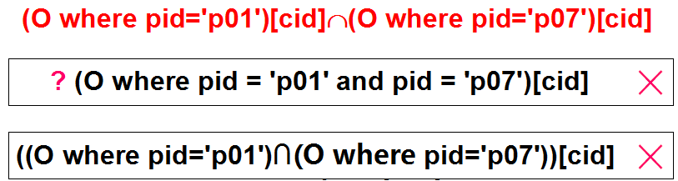
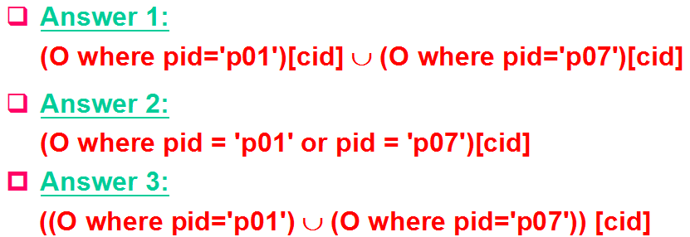
Review of exp4 & exp5
Exp 4. Get cids of customers who order p01 and p07.
Exp 5. Get cids of customers who order p01 or p07.
Database Principles & Programming

Slide 157
Example of Operations of Relational Algebra
Customers: C(cid, cname, city, discnt)
Agents: A(aid, aname, city, percent)
Products: P(pid, pname, city, quantity, price)
Orders: O(ordno, month, cid, aid, pid, qty, dollars)
Exp 6. List all cities inhabited by customers who order product p02 or agents who place an order for p02.
T₁ := ((O where pid = 'p02') JOIN C)[city]
T₂ := ((O where pid = 'p02') JOIN A)[city]
T := T₁ UNION T₂
Database Principles & Programming

Slide 158
Example of Operations of Relational Algebra
Customers: C(cid, cname, city, discnt)
Agents: A(aid, aname, city, percent)
Products: P(pid, pname, city, quantity, price)
Orders: O(ordno, month, cid, aid, pid, qty, dollars)
Exp 7. Get aids of agents who place an order for at least one customer that uses product p01.
((O where pid = 'p01')[cid] JOIN O) [aid]
Database Principles & Programming

Slide 159
Example of Operations of Relational Algebra
Customers: C(cid, cname, city, discnt)
Agents: A(aid, aname, city, percent)
Products: P(pid, pname, city, quantity, price)
Orders: O(ordno, month, cid, aid, pid, qty, dollars)
Exp 8. Get aids of agents who place orders for all customers that uses product p01.
O[cid, aid] ÷ (O where pid = 'p01')[cid]
请注意与前一个例子 Exp 7 的比较！
Database Principles & Programming

Slide 160
Example of Operations of Relational Algebra
Customers: C(cid, cname, city, discnt)
Agents: A(aid, aname, city, percent)
Products: P(pid, pname, city, quantity, price)
Orders: O(ordno, month, cid, aid, pid, qty, dollars)
Exp 9. Retrieve product ids for all products that are not ordered by any customers living in a city beginning with the letter "D".
T₁ := C where city >= 'D' and city < 'E'
T₂ := P [ pid ] — ( O JOIN T₁ ) [ pid ]
Database Principles & Programming

Slide 161
Example of Operations of Relational Algebra
Customers: C(cid, cname, city, discnt)
Agents: A(aid, aname, city, percent)
Products: P(pid, pname, city, quantity, price)
Orders: O(ordno, month, cid, aid, pid, qty, dollars)
Exp 10. Retrieve cids of customers with the largest discounts.
Answer 1
CY := C
T₁:=((CY×C) where CY.discnt>C.discnt)[C.cid]
T₂ := C[cid] − T₁
Database Principles & Programming

Slide 162
Example of Operations of Relational Algebra
Customers: C(cid, cname, city, discnt)
Exp 10. Retrieve cids of customers with the largest discounts.
Answer 2 (by division)
CY := C
T₁(cyid, cid) :=
((CY × C) where CY.discnt >= C.discnt)
[CY.cid, C.cid]
T₂ := T₁ ÷ C[cid]
不能少了 =
Database Principles & Programming

Slide 163
Review of exp10
Exp 10. Retrieve cids of customers with the largest discounts.
Answer 1: CY := C
T₁ := ((CY×C) where CY.discnt>C.discnt)[C.cid]
T₂ := C[cid] − T₁
Answer 2: CY := C
T₁(cyid,cid):=
((CY×C) where CY.discnt>=C.discnt)
[CY.cid, C.cid]
T₂ := T₁ ÷ C[cid]
Database Principles & Programming

Slide 164
2.8 The Interdependence of Operations
Theorem 2.8.1: A ∩ B = A – ( A – B )
Theorem 2.8.2
Head(R) = { A₁,…,A_{n},B₁,…,B_{k} }
Head(S) = { B₁,…,B_{k},C₁,…,C_{m} }
T₁ := R × S
T₂ := (T₁) where R.B₁=S.B₁ and … and R.B_{k}=S.B_{k}
T₃ := T₂[R.A₁,…,R.A_{n},R.B₁,…,R.B_{k},S.C₁,…,S.C_{m}]
Then: T₃ = R ∞ S
Database Principles & Programming

Slide 165
2.8 The Interdependence of Operations
Theorem 2.8.3
If Head(R) = { A₁ . . . A_{n} B₁ . . . B_{m} } and
Head(S) = { B₁ . . . B_{m} }
R ÷ S = R[A₁...A_{n}] - ((R[A₁...A_{n}] X S) - R) [A₁...A_{n}]
T₁ := R[A₁, …, A_{n}]
T₂ := T₁ X S
T₃ := T₂ – R
T₄ := T₃ [A₁, …, A_{n}]
R ÷ S := T₁ – T₄
Database Principles & Programming
Notes:
如果不‘除法’运算符，我们也可以通过一个复杂的计算过程来获得最终的查询结果。但显然，这么长的一个复杂表达式，其查询语义是很难一眼看清楚的。

Slide 166
‘除’运算的推导过程
T_{max} := π_{A1...An} ( R )
// T_{max}是最大可能的结果元组集合
R_{max} := T_{max} X S
// R_{max}与关系R是同类关系
T₁ := R_{max} – R
T₂ := π_{A1...An} ( T₁ )
// T₂是关系T_{max}中不满足除运算的结果要求的那些元组
// 理由：对于关系T₂中的一个元组q，至少能在关系S中找到一个元组s，使得由元组q和s所构成的元组(q,s)不在关系R中出现。
R ÷ S := T_{max} – T₂
Notes:
除法结果的推导公式，其每一步计算的语义解释。

Slide 167
2.8 The Interdependence of Operations
The set of basic relational operations
(union, difference, product, selection, projection)
Relationally Complete
Database Principles & Programming

Slide 168
2.9 Illustrative Examples
Customers: C(cid, cname, city, discnt)
Agents: A(aid, aname, city, percent)
Products: P(pid, pname, city, quantity, price)
Orders: O(ordno, month, cid, aid, pid, qty, dollars)
Exp 2.9.1: Get the names of customers who order at least one product priced at $0.50.
(((P where price=0.50)[pid] ∞ O) ∞ C) [cname]
注意：Customers和Products表中都有同名的city属性，要防止它们对本次查询的干扰！
Database Principles & Programming

Slide 169
Customers: C(cid, cname, city, discnt)
Agents: A(aid, aname, city, percent)
Products: P(pid, pname, city, quantity, price)
Orders: O(ordno, month, cid, aid, pid, qty, dollars)
Exp 2.9.2: Find cids of all customers who don’t place any order through agent a03.
在下述两个表达式中，请选出能够正确表达本次查询需求的那一个。
C[cid] – (O where aid = ‘a03’) [cid]
O[cid] – (O where aid = ‘a03’) [cid]
√
×
Database Principles & Programming

Slide 170
Customers: C(cid, cname, city, discnt)
Agents: A(aid, aname, city, percent)
Products: P(pid, pname, city, quantity, price)
Orders: O(ordno, month, cid, aid, pid, qty, dollars)
Exp 2.9.3: Retrieve customers who place orders only through agent a03.
在下述两个表达式中，请选出能够正确表达本次查询需求的那一个。
O[cid] – (O where aid <> ‘a03’) [cid]
C[cid] – (O where aid <> ‘a03’) [cid]
√
×
Database Principles & Programming

Slide 171
Customers: C(cid, cname, city, discnt)
Agents: A(aid, aname, city, percent)
Products: P(pid, pname, city, quantity, price)
Orders: O(ordno, month, cid, aid, pid, qty, dollars)
Exp 2.9.4: Find products that have never been ordered by a customer based in New York through an agent based in Boston.
T₁ := (C where city = ‘New York’) [cid]
T₂ := (A where city = ‘Boston’) [aid]
T₃ := (((T₁ join O) join T₂)
T₄ := P[pid] – T₃[pid]
注意：中间每一步投影运算的重要性！
Database Principles & Programming

Slide 172
Customers: C(cid, cname, city, discnt)
Agents: A(aid, aname, city, percent)
Products: P(pid, pname, city, quantity, price)
Orders: O(ordno, month, cid, aid, pid, qty, dollars)
Exp 2.9.5: Get names of customers who order all products priced at $0.50.
T₁ := P where price = 0.50
T₂ := O [cid, pid] ÷ T₁ [pid]
T₃ := (T₂ join C) [cname]
注意：第二步‘除法’表达式的正确写法！
Database Principles & Programming

Slide 173
一组运用‘除法’运算的例子
Exp 2.9.6: Get cids of customers who order all products that anybody orders.
O[cid, pid] ÷ O[pid]
Exp 2.9.7: Get aids of agents who take orders on at least that set of products ordered by c004.
O[aid, pid] ÷ (O where cid = 'c004')[pid]
Database Principles & Programming

Slide 174
Exp 2.9.8: Get cids of customers who order both products p01 and p07.
Answer 1:
T₁ := (O where pid='p01') [cid]
T₂ := (O where pid='p07') [cid]
T₃ := T₁ ∩ T₂
Answer 2: (by division)
T₁ := P where (pid='p01' or pid='p07')
T₂ := O [cid, pid] ÷ T₁ [pid]
Database Principles & Programming

Slide 175
一组运用‘联接’运算的例子
Exp 2.9.9: Get cids of customers who place an order through at least one agent who places an order for product p03.
T₁ := (O where pid = ‘p03’)[aid]
T₂ := (T₁ ∞ O) [cid]
Exp 2.9.10: Get cids of all customers who have the same discount as any customer in Dallas or Boston.
T₁ := C where city=‘Dallas’ or city=‘Boston’
T₂ := (T₁ [discnt] join C) [cid]
Database Principles & Programming

Slide 176
2.9 Illustrative Examples
Exp 2.9.11: List pids of products that are ordered through agents who place orders for (possibly different) customers who order at least one product from an agent who has placed an order for customer c001.
4
3
2
1
Find aids of agents who has placed an order for customer c001: T₁ := (O where cid = ‘c001’)[aid]
Find cids of customers who order at least one product from an agent in T₁: T₂ := (T₁ ∞ O) [cid]
Find aids of agents who place orders for customers in T₂: T₃ := (T₂ ∞ O) [aid]
Find pids of products that are ordered through agents in T₃: T₄ := (T₃ ∞ O) [pid]
Database Principles & Programming

Slide 177
2.9 Illustrative Examples
Exp 2.9.12: Get pids of products not ordered by any customer living in a city whose name begin with the letter D.
T₁ := (C where city>=‘D’ and city<‘E’) [cid]
T₂ := (T₁ ∞ O) [ pid ]
T₃ := P [ pid ] – T₂
Database Principles & Programming

Slide 178
2.10 Other Relational Operations
Database Principles & Programming
OUTER JOIN（外联接）
LEFT OUTER JOIN （左外联接）
RIGHT OUTER JOIN （右外联接）
THETA JOIN （θ-联接）

Slide 179
2.10 Other Relational Operations
R
A | B
a1 | b1
a2 | b2
a3 | b5
R JOIN S
A
B
C
a1
b1
c1
S
B | C
b1 | c1
b2 | c2
b3 | c3
b4 | c4
a2
b2
c2
无法反向重构原来的关系R和S
Database Principles & Programming

Slide 180
反向重构关系R： (R left outer join S) [A, B]
R
A | B
a1 | b1
a2 | b2
a3 | b5
R LEFT OUTER JOIN S
A
B
C
a1
b1
c1
a2
b2
c2
a3
b5
null
S
R RIGHT OUTER JOIN S
B | C
b1 | c1
b2 | c2
b3 | c3
b4 | c4
A
B
C
a1
b1
c1
a2
b2
c2
null
b3
c3
null
b4
c4
反向重构关系S： (R right outer join S) [B, C]
Database Principles & Programming

Slide 181
T = R Left Outer Join S
For each row u in R {
Found = false;
For each row v in S {
If (u[B_{i}] = v[B_{i}] for all i (1≤i≤k)) Then {
Found = true;
Generates a row t of T suct that:
t[A_{i}] = u[A_{i}] for all 1≤i≤n
t[B_{i}] = u[B_{i}] = v[B_{i}] for all 1≤i≤k
t[C_{i}] = v[C_{i}] for all 1≤i≤m
}
}
If (Found == false) Then {
Generates a row t of T such that:
t[A_{i}] = u[A_{i}] for all 1≤i≤n
t[B_{i}] = u[B_{i}] for all 1≤i≤k
t[C_{i}] = NULL for all 1≤i≤m
}
}
生成自然联接的结果元组
针对未参与自然联接的元组u，生成对应的外联接结果元组
Database Principles & Programming

Slide 182
反向重构关系R：((R outer join S) where A<>null )[A, B]
R
A | B
a1 | b1
a2 | b2
a3 | b5
R OUTER JOIN S
A
B
C
R outer join S =
(R left outer join S)
UNION
(R right outer join S)
a1
b1
c1
a2
b2
c2
S
B | C
b1 | c1
b2 | c2
b3 | c3
b4 | c4
a3
b5
null
null
b3
c3
null
b4
c4
反向重构关系S：((R outer join S) where C<>null )[B, C]
Database Principles & Programming

Slide 183
2.10 Other Relational Operations
R
A | B
a1 | b1
a2 | b2
a3 | b5
S
B | C
b1 | c1
b2 | c2
b3 | c3
b4 | c4
R JOIN S
A | B | C
a1 | b1 | c1
a2 | b2 | c2
R OUTER JOIN S
R LEFT OUTER JOIN S
R RIGHT OUTER JOIN S
A | B | C
a1 | b1 | c1
a2 | b2 | c2
a3 | b5 | null
null | b3 | c3
null | b4 | c4
A | B | C
a1 | b1 | c1
a2 | b2 | c2
a3 | b5 | null
A | B | C
a1 | b1 | c1
a2 | b2 | c2
null | b3 | c3
null | b4 | c4
Database Principles & Programming

Slide 184
2.10 Other Relational Operations
Theta Join
R ∞_{F} S = (R×S) where F
Example 2.10.1: Find all ordno values for orders whose order quantity exceeds the current quantity on hand fro the product.
(O ∞_{O.pid = P.pid and} _{O.qty > P.quantity} P) [ ordno ]
Database Principles & Programming

Slide 185
Review of Operations of Relational Algebra
R
S
A | B | C | D
1 | 2 | 3 | 4
2 | 2 | 5 | 7
9 | 0 | 3 | 8
A | B | C | D
2 | 2 | 3 | 8
1 | 2 | 3 | 4
9 | 1 | 2 | 3
R ∩ S
R ∪ S
R − S
A | B | C | D
1 | 2 | 3 | 4
A | B | C | D
1 | 2 | 3 | 4
2 | 2 | 5 | 7
9 | 0 | 3 | 8
2 | 2 | 3 | 8
9 | 1 | 2 | 3
A | B | C | D
2 | 2 | 5 | 7
9 | 0 | 3 | 8
Database Principles & Programming

Slide 186
Review of Operations of Relational Algebra
R × S
R.A | R.B | R.C | R.D | S.A | S.B | S.C | S.D
1 | 2 | 3 | 4 | 2 | 2 | 3 | 8
1 | 2 | 3 | 4 | 1 | 2 | 3 | 4
1 | 2 | 3 | 4 | 9 | 1 | 2 | 3
2 | 2 | 5 | 7 | 2 | 2 | 3 | 8
2 | 2 | 5 | 7 | 1 | 2 | 3 | 4
2 | 2 | 5 | 7 | 9 | 1 | 2 | 3
9 | 0 | 3 | 8 | 2 | 2 | 3 | 8
9 | 0 | 3 | 8 | 1 | 2 | 3 | 4
9 | 0 | 3 | 8 | 9 | 1 | 2 | 3
Database Principles & Programming

Slide 187
Review of Operations of Relational Algebra
R
S
R ∞ S
A | B | C | D
1 | 2 | 3 | 4
1 | 4 | 8 | 3
2 | 4 | 2 | 6
1 | 1 | 4 | 7
D | E
5 | 1
6 | 4
7 | 3
6 | 8
A | B | C | D | E
2 | 4 | 2 | 6 | 4
2 | 4 | 2 | 6 | 8
1 | 1 | 4 | 7 | 3
Database Principles & Programming

Slide 188
Review of Operations of Relational Algebra
S₁
C | D
3 | 4
5 | 6
R÷S₁
A | B
1 | 2
7 | 8
R
A | B | C | D
1 | 2 | 3 | 4
7 | 8 | 5 | 6
7 | 8 | 3 | 4
1 | 2 | 5 | 6
1 | 2 | 4 | 2
S₂
C | D
3 | 4
R÷S₂
A | B
1 | 2
7 | 8
S₃
C | D
3 | 4
5 | 6
4 | 2
R÷S₃
A | B
1 | 2
Database Principles & Programming

Slide 189
Exercise
Database Principles & Programming
课后练习
教材：2.1， 2.2，2.4，2.5

