Slide 1
第二章 数据的机器级表示 ——数制和编码、整数的表示

Slide 2
主要内容
数制和编码
整数的表示
实数的表示

Slide 3
你知道数码相机拍摄一张照片的过程吗？
离散化、编码
各类数据之间的转换关系

Slide 4
数值数据的表示
数值数据表示的三要素
进位计数制
定、浮点表示
如何用二进制编码
即：要确定一个数值数据的值必须先确定这三个要素。
例如，机器数 01011001的值是多少？
进位计数制
十进制、二进制、十六进制、八进制数及其相互转换
定/浮点表示（解决小数点问题）
定点整数、定点小数
浮点数（可用一个定点小数和一个定点整数来表示）
定点数的编码（解决正负号问题）
原码、补码、反码、移码 （反码很少用）
答案是：不知道！

Slide 5
Sign and Magnitude （原码的表示）
Decimal
Binary
Decimal
Binary
01
2
3
4
5
6
7
0000
0001
0010
0011
0100
0101
0110
0111
-0
-1
-2
-3
-4
-5
-6
-7
1000
1001
1010
1011
1100
1101
1110
1111
容易理解, 但是：
0 的表示不唯一，故不利于程序员编程
加、减运算方式不统一
需额外对符号位进行处理，故不利于硬件设计
特别当 a<b时，实现 a-b比较困难
从 50年代开始，整数都采用补码来表示
但浮点数的尾数用原码定点小数表示
Notes:
Sign and magnitude is convenient for human, but not convenient for computer.
Since 1950’s, all computers use 2’s complement representation.
Complement:
Need different ways to do addition and subtraction. We’ll see soon that 2’s complement need not to distinguish between addition and subtraction.

Slide 6
补码 - 模运算（modular运算）
重要概念：在一个模运算系统中，一个数与它除以“模”后的余数等价。
现实世界中的模运算系统
时钟是一种模12系统
假定钟表时针指向10点，要将它拨向6点， 则有两种拨法：
① 倒拨4格：10- 4 = 6
② 顺拨8格：10+8 = 18 ≡ 6 (mod 12)
模12系统中： 10- 4 ≡ 10+8 (mod 12)
- 4 ≡ 8 (mod 12)
则，称8是- 4对模12的补码 （即：- 4的模12补码等于8）。
同样有 -3 ≡ 9 （mod 12）
-5 ≡ 7 （mod 12）等
结论1： 一个负数的补码等于模减该负数的绝对值。
结论2： 对于某一确定的模，某数减去小于模的另一数，总可以用该数加上另一数负数的补码来代替。
补码（modular运算）：+ 和– 的统一
Notes:
Supplement slide: More about 2’s complement.

Slide 7

计算机中的运算器是模运算系统
8位二进制加法器模运算系统
计算0111 1111 - 0100 0000 = ?
0111 1111 - 0100 0000 = 0111 1111 + (2⁸- 0100 0000)
=0111 1111 + 1100 0000 = 1 0011 1111 (mod 2⁸)
= 0011 1111
[X]_{补}= 2^{n} + X （-2^{n}≤X＜ 2^{n} ，mod 2^{n}）
只留余数，“1”被丢弃
结论1： 一个负数的补码等于对应正数补码的“各位取反、末位加1”

Slide 8
求特殊数的补码
假定机器数有n位
① [-2^{n-1}]_{补}= 2^{n} - 2^{n-1} = 10…0（n-1个0） （mod 2^{n}）
② [-1]_{补}= 2^{n} - 0…01 = 11…1（n个1） （mod 2^{n}）
③ [+0]_{补}= [-0]_{补}= 00…0（n个0）
32位机器中，int、short、char型数据的机器数各占几位？

Slide 9
补码与真值之间的简便转换
例: 设机器数有8位，求123和-123的补码表示。
如何快速得到123的二进制表示？
解: 123 = 127 – 4 = 01111111B – 100B = 01111011B
– 123= – 01111011B
[01111011]_{补}= 2⁸ + 01111011 = 100000000 + 01111011
= 01111011 (mod 2⁸)，即 7BH。
[– 01111011]_{补}= 2⁸ – 01111011 = 10000 0000 – 01111011
= 1111 1111 – 0111 1011 +1
= 1000 0100 +1
= 1000 0101，即 85H。
各位取反，末位加1
当机器数为16位时，结果怎样？

Slide 10
主要内容
数制和编码
整数的表示
实数的表示

Slide 11
Unsigned integer(无符号整数)
机器中字的位排列顺序有两种方式：（例：32位字: 0…01011₂）
高到低位从左到右：0000 0000 0000 0000 0000 0000 0000 1011
高到低位从右到左：1101 0000 0000 0000 0000 0000 0000 0000
Leftmost和rightmost这两个词有歧义，故用LSB(Least Significant Bit)来表示最低有效位，用MSB来表示最高有效位
高位到低位多采用从左往右排列
一般在全部是正数运算且不出现负值结果的场合下，可使用无符号数表示。例如，地址运算，编号表示，等等
无符号整数的编码中没有符号位
能表示的最大值大于位数相同的带符号整数的最大值（Why？）
例如，8位无符号整数最大是255（1111 1111）
而8位带符号整数最大为127（0111 1111）
总是整数，所以很多时候就简称为“无符号数”
LSB
MSB

Slide 12
Signed integer（带符号整数，定点整数）
计算机必须能处理正数(positive) 和负数(negative)，MSB表示数符
有三种定点编码方式
Signed magnitude （原码）
现用来表示浮点（实）数的尾数
One’s complement （反码）
现已不用于表示数值数据
Two’s complement （补码）
50年代以来，所有计算机都用补码来表示定点整数
为什么用补码表示带符号整数？
补码运算系统是模运算系统，加、减运算统一
数0的表示唯一，方便使用
比原码和反码多表示一个最小负数

Slide 13
C语言整数的表示
无符号整数
使用自然二进制表示
带符号整数
使用补码表示
 | 宽度 | 最大值 | 最小值
unsigned char | 1 | 255 | 0
unsigned short | 2 | 65536 | 0
unsigned int | 4 | 4294967295 | 0
unsigned long | 4 | 4294967295 | 0
 | 宽度 | 最大值 | 最小值
char | 1 | 127 | -128
short | 2 | 32767 | -32768
int | 4 | 2147483647 | -2147483648
long | 4 | 2147483647 | -2147483648
Notes:
可以适当举一些例子

Slide 14
C语言程序中的整数
例如，考虑以下C代码：
1 int x = –1;
2 unsigned u = 2147483648;
3
4 printf ( “x = %u = %d\n”, x, x);
5 printf ( “u = %u = %d\n”, u, u);
在32位机器上运行上述代码时，它的输出结果是什么？为什么？
x = 4294967295 = –1
u = 2147483648 = –2147483648
因为–1的补码整数表示为“11…1”，作为32位无符号数解释时，其值为2³²–1= 4 294 967 296–1 = 4 294 967 295。
2³¹的无符号数表示为“100…0”，被解释为32位带符号整数时，其值为最小负数：–2³²⁻¹ = –2³¹ = –2 147 483 648。

Slide 15
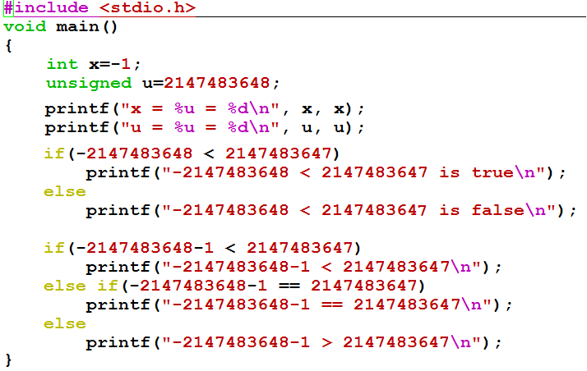

C99的结果大家回去试试。
gcc –std=c99
C90上的运行结果是什么？

Slide 16
常量的默认类型
C90
范围 | 类型
0~2³¹-1 | int
2³¹~2³²-1 | unsigned int
2³²~2⁶³-1 | long long
2⁶³~2⁶⁴-1 | unsigned long long
C99
范围 | 类型
0~2³¹-1 | int
2³¹~2⁶³-1 | long long
2⁶³~2⁶⁴-1 | unsigned long long

Slide 17
C语言默认类型转换顺序（32位）
高 double ←← float
↑ ↑
↑ unsigned long long
↑ ↑
↑ long long
↑ ↑
↑ unsigned int（unsigned long）
↑ ↑
低 int （long） ←← char, short，unsigned short
float计算前必然转换为double；
char，short计算前必然转换为int；

Slide 18
C语言默认类型转换顺序（64位）
高 double ←← float
↑ ↑
↑ unsigned long
↑ ↑
↑ long
↑ ↑
↑ unsigned int
↑ ↑
低 int （long） ←← char, short，unsigned short
float计算前必然转换为double；
char，short计算前必然转换为int；

Slide 19
C99的结果大家回去试试。
gcc –std=c99
C90上的运行结果是什么？

Slide 20
C语言程序中的整数
关系 表达式 | 类 型 | 结 果 | 说明
0 = = 0U -1 < 0 -1 < 0U 2147483647 > -2147483647 - 1 2147483647U > -2147483647 - 1 2147483647 > (int) 2147483648U -1 > -2 (unsigned) -1 > -2 | 无 带 无 带 无 带 带 无 | 1 1 0* 1 0* 1* 1 1 | 00…0B = 00…0B 11…1B (-1) < 00…0B (0) 11…1B (2³²-1) > 00…0B(0) 011…1B (2³¹-1) > 100…0B (-2³¹) 011…1B (2³¹-1) < 100…0B(2³¹) 011…1B (2³¹-1) > 100…0B (-2³¹) 11…1B (-1) > 11…10B (-2) 11…1B (2³²-1) > 11…10B (2³²-2)
带*的结果与常规预想的相反！

Slide 21
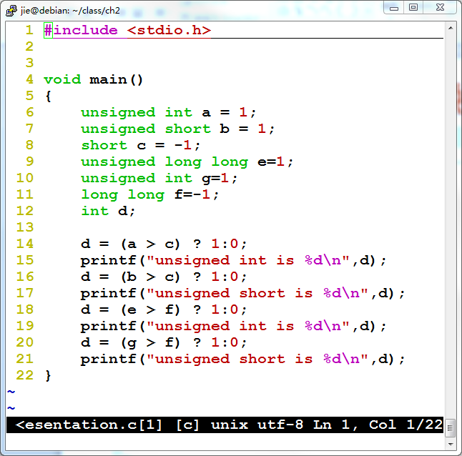
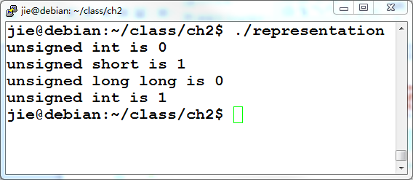
类型转换实例
结果跟你想的一样吗，为什么？

Slide 22
主要内容
数制和编码
整数的表示
实数的表示

Slide 23
科学计数法(Scientific Notation)与浮点数
Example:
mantissa (尾数) exponent(阶码、指数)
6.02 x 10 ²¹
decimal point radix (base，基)
° Normalized form（规格化形式）: 小数点前只有一位非0数
° 同一个数有多种表示形式。例：对于数 1/1,000,000,000
• Normalized (唯一的规格化形式): 1.0 x 10⁻⁹
• Unnormalized（非规格化形式不唯一）: 0.1 x 10⁻⁸, 10.0 x 10⁻¹⁰
for Binary Numbers:
mantissa（尾数） exponent（指数）
0.101_{two} x 2 ⁻¹⁰
binary point 基为2
只要对尾数和指数分别编码，就可表示一个浮点数（即：实数）
Notes:
Before we move on to the floating-point representation, let’s review the familiar scientific notation. For example, we can use 6.02x10²¹ to represent 6,020,000,000,000,000,000,000. Here, the part before x is called mantissa, the base is 10, the power of ten is called exponent.
What the exponent mean? Who knows that?
Exponent is used for deciding the position of decimal point. When we change exponent,the decimal point can be floated. In this example, If we change the exponent to 31, it means the number of digits of real value will be 31+1=32,the number become longer and it’s value is more larger, but we need not increase the number of digits in exponent. It’s still 2 digits.
In the scientific notation, a mantissa with no leading 0s and only one digit to left of decimal point is called to be normalized. It means an normalized number should have a nonzero leftmost digit. So, there is only one normalized form, whereas there are many unnormalized forms. For example, if we want to represent 1/1,000,000,000, the normalized form is 1.0x10⁻⁹ , whereas 0.1x10⁻⁸ and 10.0x10⁻¹⁰n are not normalized number. In this example, the exponent is negative (-9), it means the actual decimal point should be to the left of the
9th place.
With this scientific notation, We only need to describe mantissa and exponent. Every normalized mantissa is a fixed-point number because there is only one nonzero digit in the integer part. Every exponent is a integer which decides the place of decimal point, so they are short and can be also represented in fixed-point numbers. So we can use two short fixed-point numbers to represent a very long number.

Slide 24
浮点数(Floating Point)的表示范围
例：画出下述32位浮点数格式的规格化数的表示范围。
0 1 8 9 31
第0位数符S；第1～8位为8位移码表示阶码E（偏置常数为128）；第9～31位为24位二进制原码小数表示的尾数M。规格化尾数的小数点后第一位总是1，故规定第一位默认的“1”不明显表示出来。这样可用23个数位表示24位尾数。
+/-0.1xxxxx × 2E
S
阶码E
尾数M
最大正数：0.11…1 x 2^{11…1} =(1-2⁻²⁴) x 2¹²⁷
最小正数：0.10…0 x 2^{00…0} =(1/2) x 2⁻¹²⁸
因为原码是对称的，所以其表示范围关于原点对称。
可表示的负数
零
可表示的正数
负上溢
负下溢
正下溢
正上溢
-
(1
-
2
-
2
4
)
×
2
127
-
2
-
129
0
2
-
129
(1
-
2
-
2
4
)
×
2
127
数轴
机器0：尾数为0 或 落在下溢区中的数
浮点数范围比定点数大，但数的个数没变多，故数之间更稀疏，且不均匀

Slide 25


“Father” of the IEEE 754 standard
直到80年代初，各个机器内部的浮点数表示格式还没有统一
因而相互不兼容，机器之间传送数据时，带来麻烦
1970年代后期, IEEE成立委员会着手制定浮点数标准
1985年完成浮点数标准IEEE 754的制定
This standard was primarily the work of one person, UC Berkeley math professor William Kahan.
现在所有计算机都采用IEEE 754来表示浮点数
www.cs.berkeley.edu/~wkahan/
ieee754status/754story.html
Prof. William Kahan
Notes:
In the late 1970s, IEEE set up a committee to standardize floating-point arithmetic. The goal was not only to permit floating-point data to be exchanged among different computers but also to provide hardware designers with a model known to be correct. The resulting work led to IEEE Standard 754 which was finished in 1985. Nowadays, most computers use IEEE 754 standard to represent floating-point numbers. This standard was primarily the work of one person, UC Berkeley math professor William Kahan. People call him the father of the IEEE 754 standard. Because of his contribution to the standard, he won ACM Turing Award in 1989. This is the highest prize in computation field, It’s equivalent to Nobel Prize.

Slide 26
IEEE 754标准
规定：小数点前总是“1”，故可隐含表示。注意：和前面例子规定不一样,这里更合理!
规格化数：+/-1.xxxxxxxxxx_{two} x 2^{Exponent}
Single Precision ：
S Exponent Significand
1 bit 8 bits 23 bits
° Sign bit: 1 表示negative ; 0表示 positive
°Exponent（阶码 / 指数）:
SP规格化数阶码范围为0000 0001 (-126) ~ 1111 1110 (127)
bias为127 (single),
全0和全1用来表示特殊值！
为什么用127？若用128,则阶码范围为多少？
°Significand（尾数）:
• 规格化尾数最高位总是1，所以隐含表示，省1位
• 1 + 23 bits （ single）1 + 52 bits （double）
SP: (-1)^{S} x (1 + Significand) x 2^{(Exponent-127)}
0000 0001 (-127) ～ 1111 1110 (126)
DP: (-1)^{S} x (1 + Significand) x 2^{(Exponent-1023)}
Notes:
IEEE 754 standard defines three formats: Single precision(32 bits), double precision (64 bits) and extended precision (80 bits). (The extended-precision format is intended to reduce round off errors. It is used primarily inside floating-point arithmetic units.) All of them start with a sign bit for the number as a whole, 1 means negative, 0 means positive. Next is the exponent, using bias (or excess) of 127 for single precision, 1023 for double precision. The minimum 0 and maximum exponent (255 and 2047) are not used for normalized numbers, because they have special uses. It means the exponents of normalized numbers range from 1 to 254 for single precision. Finally, we have significand field. Because normalized numbers always have a leading 1 before binary point, so we needn’t store this bit. In order to pack more bits, the standard use one implicit bit of leading 1 for normalized numbers. So for single precision, the mantissa of an normalized number has 1+23 bits. To summarize the above information, we can get the formula for single precision number. From this formula, we can see that : if s is 1, the number will be negative, if s is 0, the number will be positive. This 1 is the implicit leading 1, and then plus significand, will be the mantissa. Because we store the biased exponent which add 127 to the real value in this bit pattern, it means that the real value of the exponent should be subtract 127 from biased exponent. For normalized double precision numbers, the formula is similar except for ….
Any question for this?
If we know the bit pattern of an normalized floating-point number, we can calculate the value of this number using the formula.

Slide 27
Ex: Converting Binary FP to Decimal
C0A00000H is the hex. Rep. Of an IEEE 754 SP FP number
110000001 010 0000 0000 0000 0000 0000
(-1)^{S} x (1 + Significand) x 2^{(Exponent-127)}
°Sign: 1 => negative
°Exponent:
• 10000001_{two} = 129_{ten}
• Bias adjustment: 129 - 127 = 2
°Significand:
1 + 0x2⁻¹+ 1x2⁻² + 0x2⁻³ + 0x2⁻⁴ + 0x2⁻⁵ +...
=1 +2⁻² = 1 +0.25 = 1.25
°Represents: -1.25_{ten}x2² = - 5
Notes:
If we know the hexadecimal representation of an IEEE 754 single precision number, how to calculate the actual value of this number? Here is an example. Suppose the hex form is BEE00000H. At first, we should convert the hex form to binary form, we get the binary form 1011 1110 1110 0000 0000 …0000, and for single precision, we have 1 sign bit, which is 1, 8 bits for exponent, which is 0111 11101, and the remainder is 23-bit significand. Then we can use the formula to calculate the value.
Step 1: sign bit is 1, it means the number is negative
Step 2: exponent is 01111101=2⁶ +2⁵ + 2⁴ +2³ +2¹ =64+32+16+8+1=125, because we use excess 127, so we should subtract 127 to get the actual value of exponent. 125-127=-2
Step 3: here actual mantissa is 1.1100..0, so the value should be 1+…., …. The result is 1.75
Step 4: So the actual value is
Any question about that?

Slide 28
Ex: Converting Binary FP to Decimal
BEE00000H is the hex. Rep. Of an IEEE 754 SP FP number
1011 11101 110 0000 0000 0000 0000 0000
(-1)^{S} x (1 + Significand) x 2^{(Exponent-127)}
°Sign: 1 => negative
°Exponent:
• 0111 1101_{two} = 125_{ten}
• Bias adjustment: 125 - 127 = -2
°Significand:
1 + 1x2⁻¹+ 1x2⁻² + 0x2⁻³ + 0x2⁻⁴ + 0x2⁻⁵ +...
=1+2⁻¹ +2⁻² = 1+0.5 +0.25 = 1.75
°Represents: -1.75_{ten}x2⁻² = - 0.4375
Notes:
If we know the hexadecimal representation of an IEEE 754 single precision number, how to calculate the actual value of this number? Here is an example. Suppose the hex form is BEE00000H. At first, we should convert the hex form to binary form, we get the binary form 1011 1110 1110 0000 0000 …0000, and for single precision, we have 1 sign bit, which is 1, 8 bits for exponent, which is 0111 11101, and the remainder is 23-bit significand. Then we can use the formula to calculate the value.
Step 1: sign bit is 1, it means the number is negative
Step 2: exponent is 01111101=2⁶ +2⁵ + 2⁴ +2³ +2¹ =64+32+16+8+1=125, because we use excess 127, so we should subtract 127 to get the actual value of exponent. 125-127=-2
Step 3: here actual mantissa is 1.1100..0, so the value should be 1+…., …. The result is 1.75
Step 4: So the actual value is
Any question about that?

Slide 29
Ex: Converting Decimal to FP
-0.75
1. Denormalize: -0.75
2. Convert integer part:
0 = 0₂
3. Convert fractional part:
.75 = .5 + .25 = .11₂
4. Put parts together and normalize:
0.11 = 1.1 x 2⁻¹
5. Convert exponent: 127 - 1 = 126 = 0111 1110₂
10111 1110 100 0000 0000 0000 0000 0000
The Hex rep. is BF40 0000H
Notes:
If we know the value of an number, how to represent it in floating-point form? Here is an exercise. Please spend 4 minutes to try it.
Let’s check your answers. Firstly, then, and then, finally, the result is C14C0000H. Have you got that? Any question?

Slide 30
Ex: Converting Decimal to FP
-12.75
1. Denormalize: -12.75
2. Convert integer part:
12 = 8 + 4 = 1100₂
3. Convert fractional part:
.75 = .5 + .25 = .11₂
4. Put parts together and normalize:
1100.11 = 1.10011 x 2³
5. Convert exponent: 127 + 3 = 128 + 2 = 1000 0010₂
11000 0010 100 1100 0000 0000 0000 0000
The Hex rep. is C14C0000H
Notes:
If we know the value of an number, how to represent it in floating-point form? Here is an exercise. Please spend 4 minutes to try it.
Let’s check your answers. Firstly, then, and then, finally, the result is C14C0000H. Have you got that? Any question?

Slide 31
Normalized numbers（规格化数）
前面的定义都是针对规格化数（normalized form）
How about other patterns?
Exponent Significand Object
1-254 anything Norms
implicit leading 1
0 0 ?
0 nonzero ?
255 0 ?
255 nonzero ?

Slide 32
Representation for 0
How to represent 0?
exponent: all zeros
significand: all zeros
What about sign? Both cases valid.
+0: 0 00000000 00000000000000000000000
-0: 1 00000000 00000000000000000000000
Notes:
If exponent and significand bits are all zeros, it means the value is 0. It could be positive 0 or negative 0. They are equal.

Slide 33
Representation for +∞/-∞
In FP, 除数为0的结果是 +/- ∞, 不是溢出异常.（整数除0为异常）
∞ ：infinity
为什么要这样处理?
• 可以利用+∞/-∞作比较。 例如：X/0>Y可作为有效比较
How to represent +∞/-∞?
• Exponent : all ones (11111111B = 255)
• Significand: all zeros
+∞ : 0 11111111 00000000000000000000000
-∞ : 1 11111111 00000000000000000000000
Operations
5.0 / 0 = +∞, -5.0 / 0 = -∞
5+(+∞) = +∞, (+∞)+(+∞) = +∞
5 - (+∞) = -∞, (-∞) - (+∞) = -∞ etc
Notes:
Do you know the infinity symbol ∞? Who can tell me the meaning of this symbol? As we know, if x!=0, when y tend to 0, then x/y tend to ∞. So IEEE 754 suggested x/0 (any finite number divided by 0)should produce infinity, not overflow. Because we can do further computations with infinity, For example, if a program have comparison X/0 > Y, it won’t produce overflow, it can be a valid comparison.
If exponent bits are all ones and significand bits are all zeros, the value is infinity. It could be positive infinity or negative infinity. They are not equal. There are some operations with infinity. Any finite number add infinity will be infinity.

Slide 34
Representation for“Not a Number”
Sqrt (- 4.0) = ? 0/0 = ?
Called Not a Number (NaN) - “非数”
How to represent NaN
Exponent = 255
Significand: nonzero
NaNs can help with debugging
Operations
sqrt (-4.0) = NaN 0/0 = NaN
op (NaN,x) = NaN +∞+(-∞) = NaN
+∞- (+∞) = NaN ∞/∞ = NaN
etc.
Notes:
Who can tell me what is the result of the square root of –4.0 ? Yes, the result is undefined. 0 divided by 0, infinity divided by infinity are all the same. If infinity is not an error, these should not be either. We call them Not a Number. We read it NaN. In this situation, the exponent bits will be all ones, the significand will be nonzero bit pattern.
We can use NaN to help with debugging. If the calculating result is NaN, we can set some test point to see what happened.
There are some operations which may produce NaN. We can define any finite number operate with NaN will produce NaN. Infinity minus infinity will produce NaN, and so on.

Slide 35
Representation for Denorms(非规格化数)
What have we defined so far? (for SP)
Exponent Significand Object
0 0 +/-0
0 nonzero Denorms
1-254 anything Norms
implicit leading 1
255 0 +/- infinity
255 nonzero NaN
Used to represent
Denormalized
numbers
Notes:
We have defined normalized number, we briefly call them norms, we also have defined 0, infinity and NaN, we have know that: …….. we have used all combination except for this one, we can use this combination to represent denormalized numbers.

Slide 36
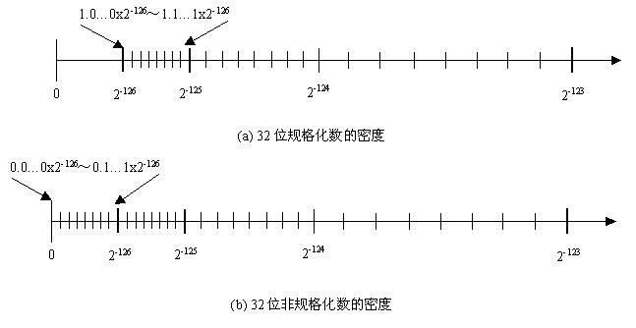
Representation for Denorms
1.0…0x2⁻¹²⁶~ 1.1…1x2⁻¹²⁶
GAP
0
2⁻¹²⁶
2⁻¹²⁵
2⁻¹²⁴
2⁻¹²³
Normalized numbers
0.0…0x2⁻¹²⁶~ 0.1…1x2⁻¹²⁶
0
2⁻¹²⁶
2⁻¹²⁵
2⁻¹²⁴
2⁻¹²³
Denorms
(-1)^{s}×0.xx…x ×2⁻¹²⁶
Notes:
As we know, in IEEE standard, normalized numbers are those with the form: +/- 1.aa…a x 2^{bb…b}, where aa…a can be anything(from 00…0 to 11…1), bb…b can be from 00…01 ( the value is 1-127=-126) to 11…10 (the value is 254-127=127). Considering positive number, the smallest number is 1.00…0 x 2⁻¹²⁶ . Between 0 and the smallest number there is a big gap. IEEE use the combination of exponent=00…0 and significand=nonzero to fill in this gap. These number are called denormalized numbers. We briefly call them denorms. In denorm form, the exponent is always 00…0, and no implicit leading 1, the significand is nonzero bit pattern. It means denormalized numbers have form of +/- 0.aa…a x 2⁻¹²⁶ , here aa…a can be 0.00…01, 0.000…10, ……., 0.11…1.
Any questions about that?
There are a lot of things you should think about here. Like 1….,2…..3…..

Slide 37
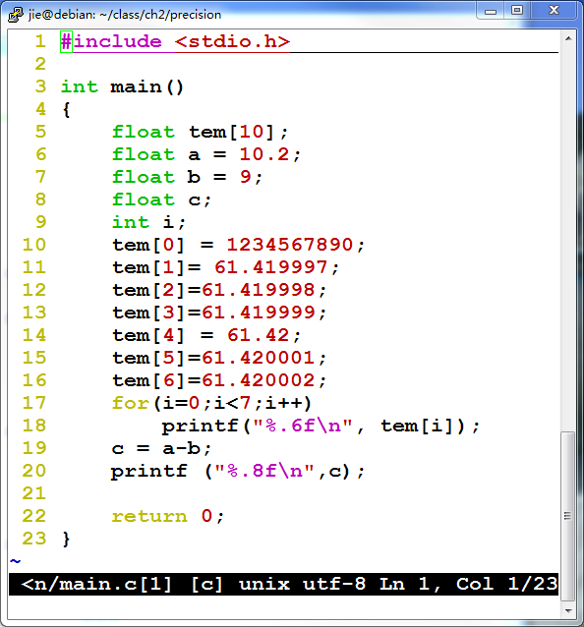
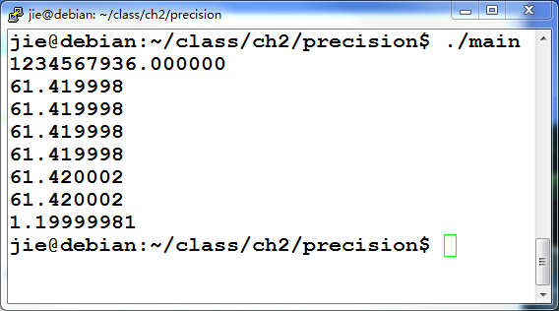
关于浮点数精度的一个例子
61.419998和61.420002是两个可表示数，两者之间相差0.000004。当输入数据是一个不可表示数时，机器将其转换为最邻近的可表示数。
单精度浮点数的有效位数为7

Slide 38
例
假定变量i、f、d的类型分别是int、float和double，它们可以取除+∞、–∞和NaN以外的任意值。请判断下列每个C语言关系表达式在32位机器上运行时是否永真。
A. i = = (int) (float) i
B. f = = (float) (int) f
C. i = = (int) (double) i
D. f = = (float) (double) f
E. d = = (float) d
F. f = = –(–f)
F
F
T
T
F
T

