Slide 1



Quality Degradation Attack in Synthetic Data
Qinyi Liu, Dong Liu, Farhad Vadiee, Mohammad Khalil, Pedro P. Vergara Barrios
University of Bergen, Norway
Delft University of Technology, Netherlands

Slide 2
Motivation and Background
Synthetic data is widely used for privacy-preserving data sharing.
Existing research primarily focuses on recipient privacy attacks (such as membership inference).
Our focus: Internal/upstream attacks – Data owners or generators intentionally degrading the quality of synthesized data

Slide 3
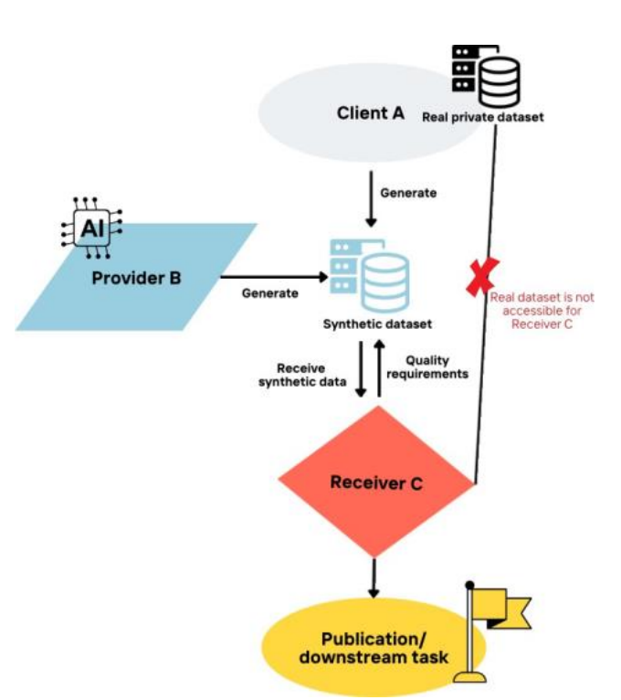
2. Threat Models:
Attacker Role: Client A (data owner), Provider B (generator provider), or intruder
Attacker Capabilities: Manipulation of real data, generation process parameters, or post-processing output
Objective: Increase statistical divergence + reduce downstream prediction performance

Slide 4
3. Attacks types:
Upstream attacks: 1) incorrect or inappropriate data sources 2) real-data manipulation
In-processing attacks: SDG parameter / resource manipulation
Post-generation attacks: distribution distortion

Slide 5
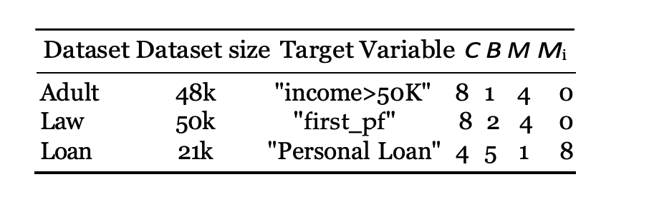
4. Experiment :
Utility | Fidelity
Train-on-Synthetic, Test-on-Real (TSTR) | Wasserstein Distance (WD)
Logistic Regression, Random Forest, MLP | KS statistic
 | Kullback-Leibler Divergence (KLD)

Slide 6
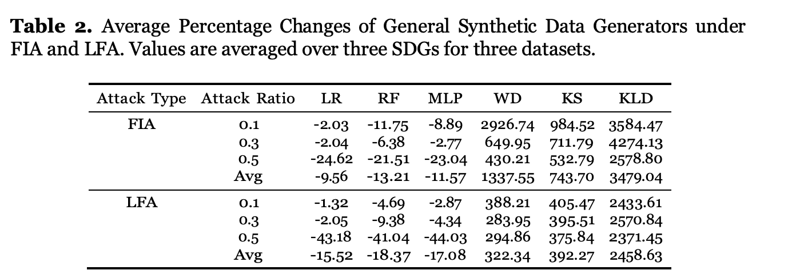
5. Important results :
FIA is highly destructive at low ratios; LFA increases linearly with the ratio.

Slide 7
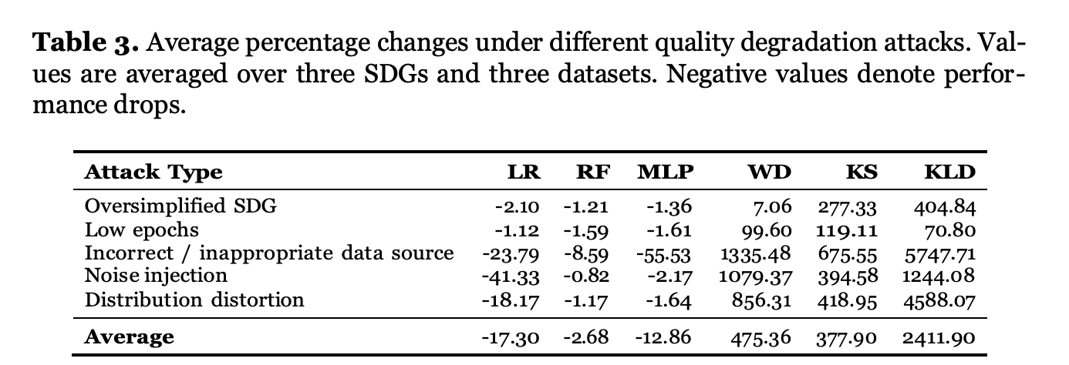
5. Important results :
Overall conclusion: Even minor manipulations can cause significant quality degradation.
Strongest attacks: Incorrect data source (MLP ↓55.5%), Noise injection (LR ↓41%)
In-processing attacks are relatively weaker.

Slide 8
6. DISCUSSION
The SDG pipeline is highly vulnerable to upstream manipulation.
Current privacy protection frameworks are insufficient to guarantee data quality and integrity.

Slide 9
7. IMPLICAITONS
For receivers of synthetic data: Without access to the real dataset, conventional privacy or similarity metrics may fail to detect quality degradation, making assessment misleading.
This highlights the urgent need for integrity verification techniques that do not require real data access — such as provenance tracking, auditing SDG configurations, or post-hoc consistency checks.

Slide 10
7. IMPLICAITONS
This work expands the synthetic data security literature beyond its traditional receiver-centric privacy attacks.
By introducing upstream and in-processing adversaries, we show that slight manipulations can significantly degrade utility and fidelity, calling for a complementary focus on quality and robustness alongside privacy protection.

Slide 11
8. FUTURE DIRECTION
Future directions: Add integrity checking mechanisms, Develop techniques for detecting quality degradation attacks.

Slide 12

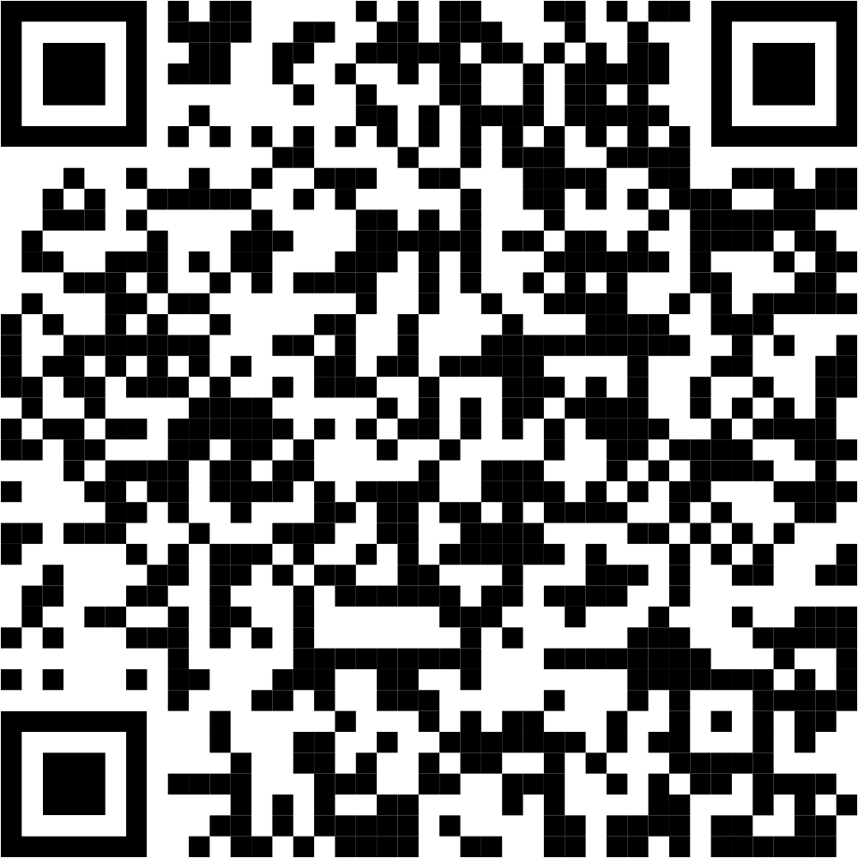

8. CONCLUSION & FUTURE WORK :
QUESTIONS?
CONTRACT ME: Qinyi.liu@uib.no
Connect with me!
Link to the paper

Slide 13
10. REFERENCES :
Dankar, F.K., Ibrahim, M.K., Ismail, L.: A Multi-Dimensional Evaluation of Synthetic Data Generators. IEEE Access 10, 11147–11158 (2022). https://doi.org/10.1109/access.2022.3144765
Papamakarios, G., Nalisnick, E., Rezende, D.J., Mohamed, S., Lakshminarayanan, B.: Normalizing Flows for Probabilistic Modeling and Inference. Journal of Machine Learning Research 22(57), 1–64 (2021).
Hernandez, M., Epelde, G., Alberdi, A., Cilla, R., Rankin, D.: Synthetic Tabular Data Evaluation in the Health Domain Covering Resemblance, Utility, and Privacy Dimensions. Methods of Information in Medicine 62(Suppl 1), e19–e38 (2023). https://doi.org/10.1055/s-0042-1760247
Giomi, M., Boenisch, F., Wehmeyer, C., Tasnádi, B.: A Unified Framework for Quantifying Privacy Risk in Synthetic Data. Proceedings on Privacy Enhancing Technologies 2023(2), 312–328 (2023). https://doi.org/10.56553/popets-2023-0055
Boudewijn, A., Ferraris, A.F., Panfilo, D., Cocca, V., Zinutti, S., Schepper, D., Chauvenet, C.R.: Privacy Measurement in Tabular Synthetic Data: State of the Art and Future Research Directions. arXiv preprint (2023). https://arxiv.org/abs/2311.17453

