Slide 1



Measuring the impact of student gaming behaviors on learner model
30th April 2026
Qinyi Liu
1

Slide 2





Team introduction
Qinyi Liu
SLATE,
University of Bergen
Lin Li
CoLAM,
Monash University
Valdemar Švábenský
Faculty of Informatics,
Masaryk University
Conrad Borchers
HCII,
Carnegie Mellon University
Mohammod Khalil
SLATE,
University of Bergen
2

Slide 3

Background 1
Adaptive learning systems are popular!
Give credit to knowledge tracing models (KT) behind it
3

Slide 4

Background 2
Gaming the system behaviors can disrupt modeling in ALS
“Gaming the system” refers to student exploit the mechanics of educational software to advance without engaging meaningfully with the underlying instructional content
Rapid guessing, systematic answer trialing, and excessive hint requests
4

Slide 5
What’s the problem then?
KT models behind adaptive learning system are highly sensitive to data quality
Gaming the system behaviors messing our data and violate the assumption of KT models
Labelling gaming data is very cost and can’t capture the diversity
5

Slide 6

Let’s think!
Gaming data is actually a form of low-quality data
How about we use data poisoning attacks to simulate the gaming behaviors?
Then we can see how different types of gaming behaviors on KT models’ impacts
Pic sources
6

Slide 7
Research questions
RQ1: How can data poisoning attacks be leveraged to simulate students’ gaming behaviors in ALS?
RQ2: Do different types of simulated gaming behaviors have distinct effects on KT models performance?
RQ3: What insights can DPA detection methods provide for traditional gaming behaviors detection?
7

Slide 8
RQ1
DPA Strategy | How to Poison | Gaming the System Behavior
Random Error Attack | 1) Flip correctness labels 2) Set response time to 1 second | Random guessing, WTF
Hint Abuse Attack | 1) Insert multiple hint requests with short intervals 2) Submit answers quickly after hints 3) Some records only request hints without submitting answers | Hint abuse
Sequential Pattern Attack | 1) Generate repeated submissions with short response times 2) Early answers incorrect, final answer correct | Systematic Answer Trialing, Guess-Read-Guess
8

Slide 9
EXAMPLE: Hint abuse attack
(1) Insert 3–5 hint request records (“hint_request”) into the data for randomly selected students and questions, with intervals of 0.5–1 second.
(2) After the final hint request, simulate the submission of a correct answer with a response time of 0.5 seconds, representing rapid copying behavior.
(3) For 50% of the hint request records, omit corresponding answer submissions, reflecting students who skip intermediate hints and seek only the bottom-out hint without meaningful engagement
9

Slide 10
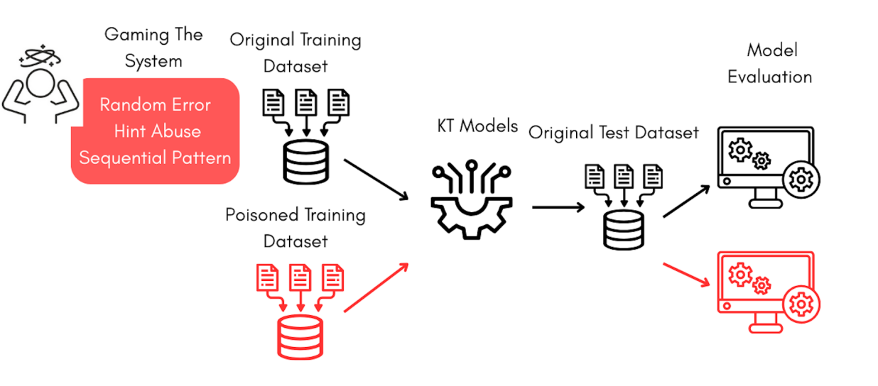
RQ2 – simulated gaming behaviors on KT models
10
Notes:
To address RQ2, we designed the following procedure (see Figure 1): the original dataset is divided into training and
testing sets at an 80:20 ratio. The training set is injected with simulated gaming data (including Random Error, Hint
Abuse, and Sequential Pattern) to generate poisoned training datasets, while the testing set is untainted. This design
aims to evaluate the impact of simulated data by training KT models on poisoned training data and evaluating them
on original testing data, validating the synthetic data generators and enabling comparison of the effects of different
attack types on model performance [22]. Following the training phase, we assessed the models’ performance using the
AUC [19], a standard metric widely adopted at LAK to evaluate various learning analytics models [24, 37]. Finally, to
examine how model performance varies across different poisoning strategies, we trained the models on several poisoned
variants of the original dataset, aligning with the model evaluation step outlined in the experimental workflow.

Slide 11
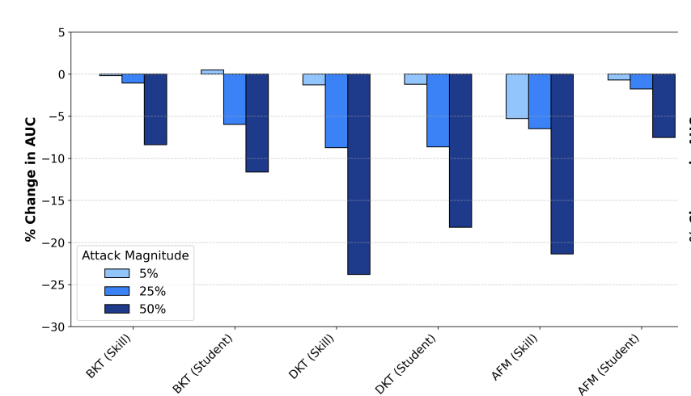
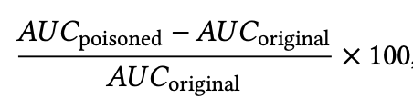
RQ2 - Results
Random Error Attacks consistently caused the
most severe performance degradation
11

Slide 12
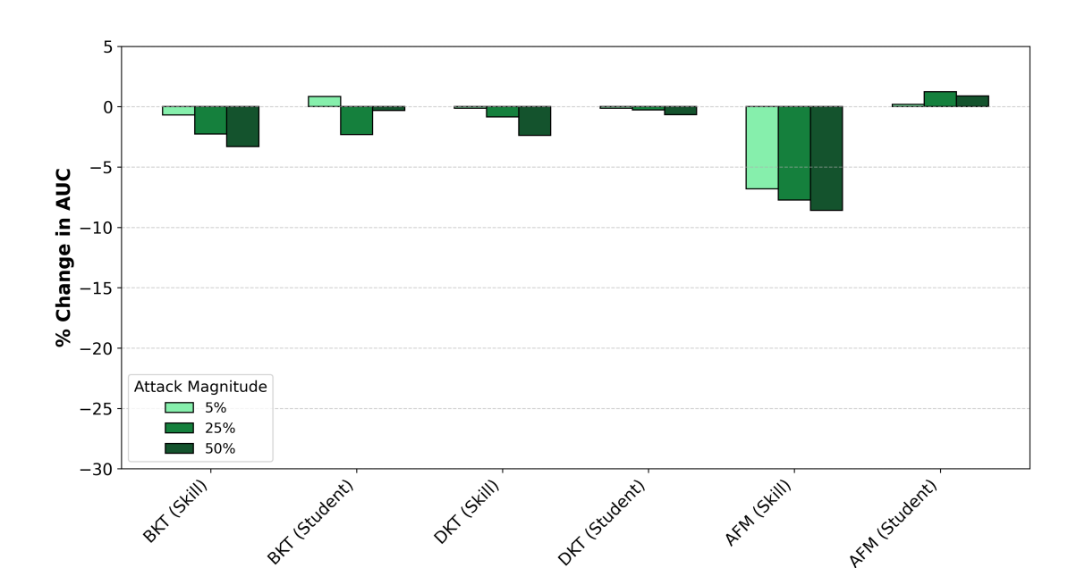
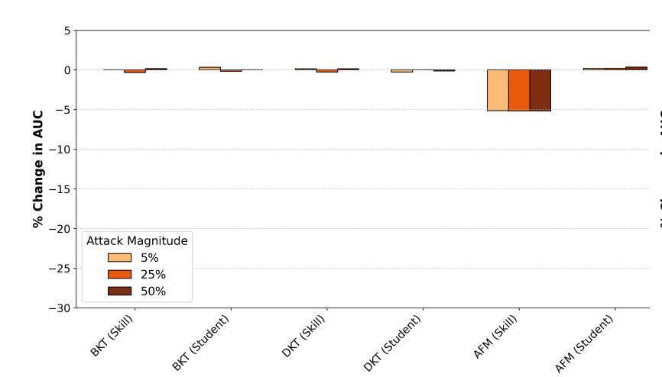
RQ2 - Results
Performance degradation generally increased with higher ratios (e.g., 50% ratio led to 2–3× larger drops than 5% across types)
Sequential pattern attacks remained minimal
12

Slide 13
What does RQ1 & 2 means?
Substantial performance drops?
The system may misinterpret a student's true knowledge state
Students may receive content that is either too easy or too hard for their actual ability
Minimal impact on performance metrics
False robustness: models misclassify cheating as legitimate learning
Hidden risk: personalized learning paths silently compromised without performance warnings
13

Slide 14
RQ3 – gaming detection can learn from DPA detection
Detect
From supervised machine learning detect gaming behaviors to DPA-style unsupervised detection methods
Bring
Bring benefits in two ways:
Reduce
Reduce labelling cost
Ease
Ease of integration with defensive startegies
14

Slide 15
Implications
We need robust KT models and gaming behaviors detections
ALS can embed real time data quality monitoring the gaming behaviors
Cross-disciplinary insights from DPA detection
Integrating Learning analytics with adversarial machine learning holds potential
15

Slide 16



Thank you for listening!
Questions?
This work is supported by the Czech Science Foundation (GAČR) grant no. 25-15839I
Connect with me!
Link to the paper
16

