Slide 1
Human in the Loop Robotics
Quinn Leydon

Slide 2
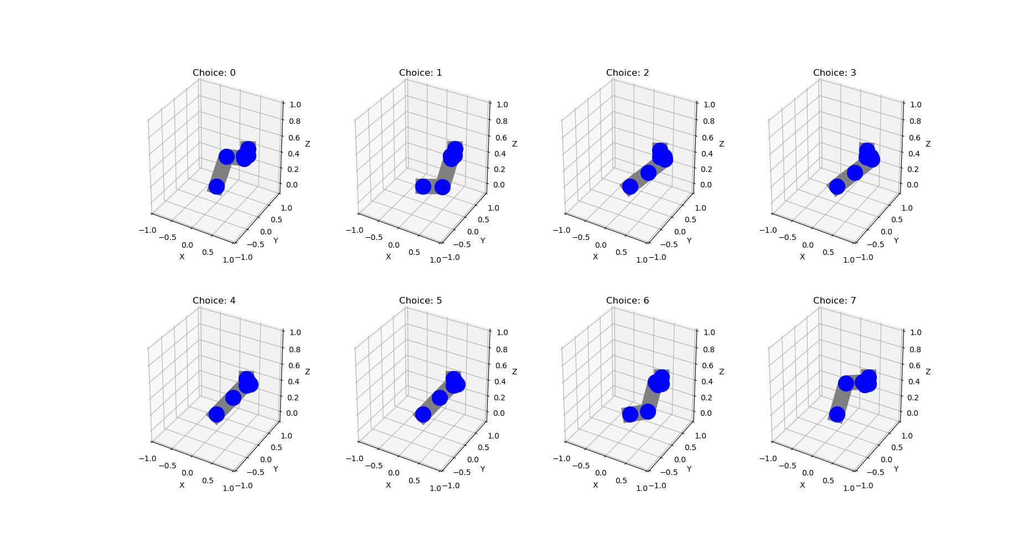
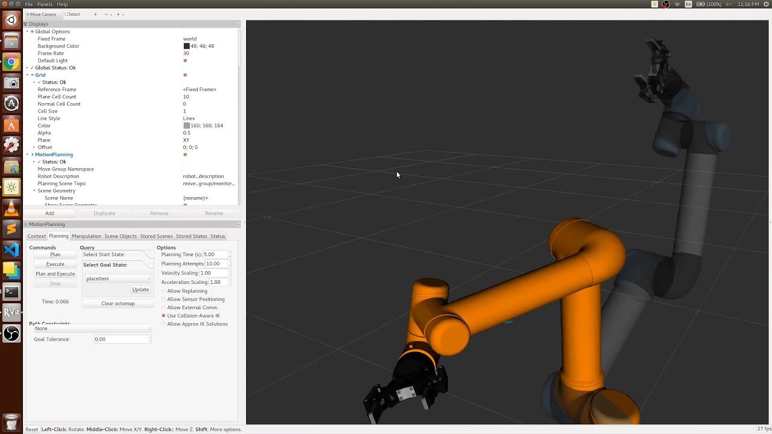
Why Human in the Loop?
Inverse kinematics and trajectory planning
Improvement over Moveit!
Added user control
ROS noetic, Ubuntu 20.04
Written in C++

Slide 3
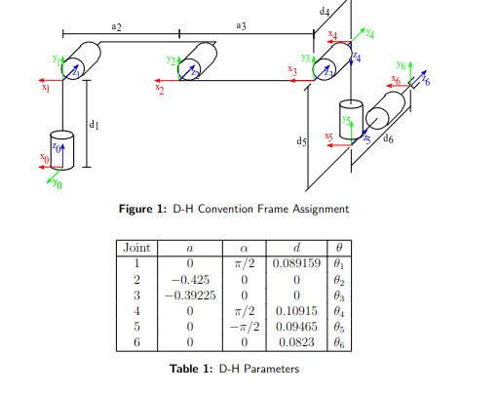
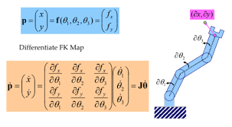
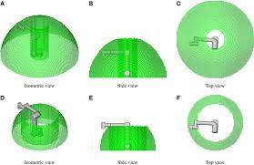
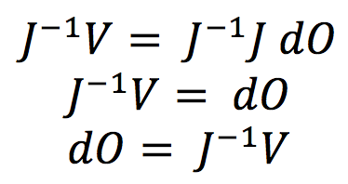
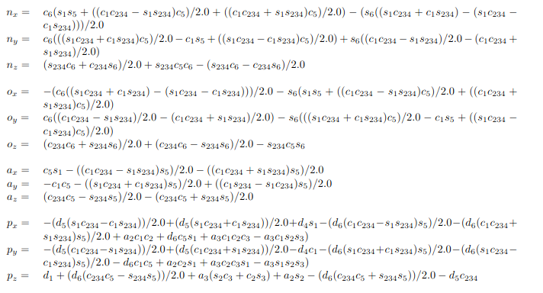
Technical Approaches
Three Types of Inverse Kinematics
1
2
3

Slide 4
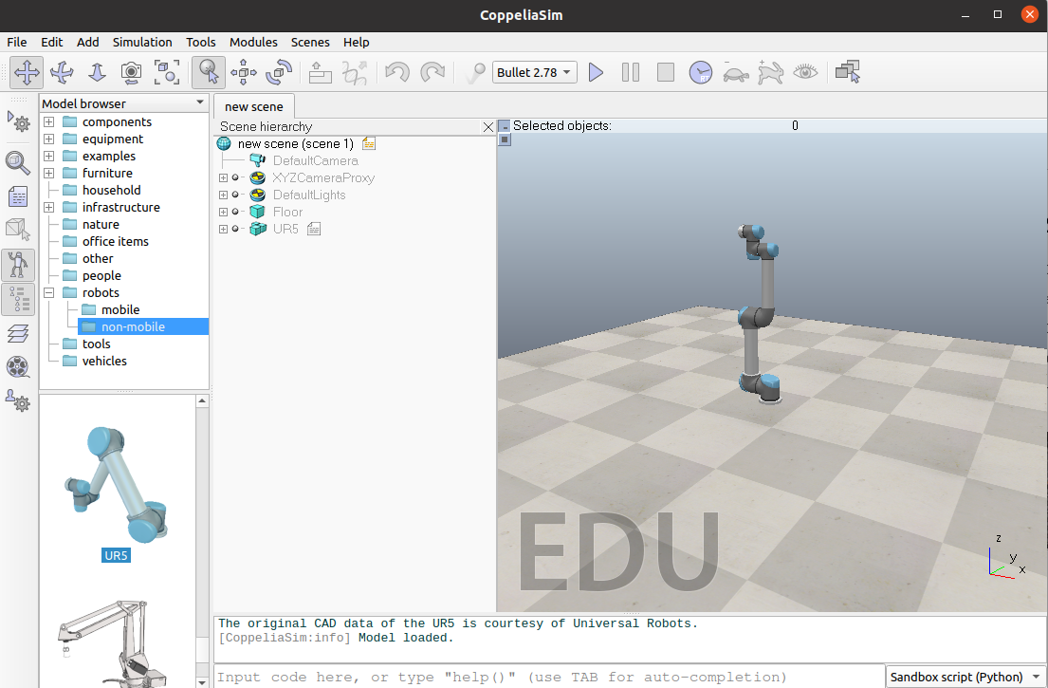
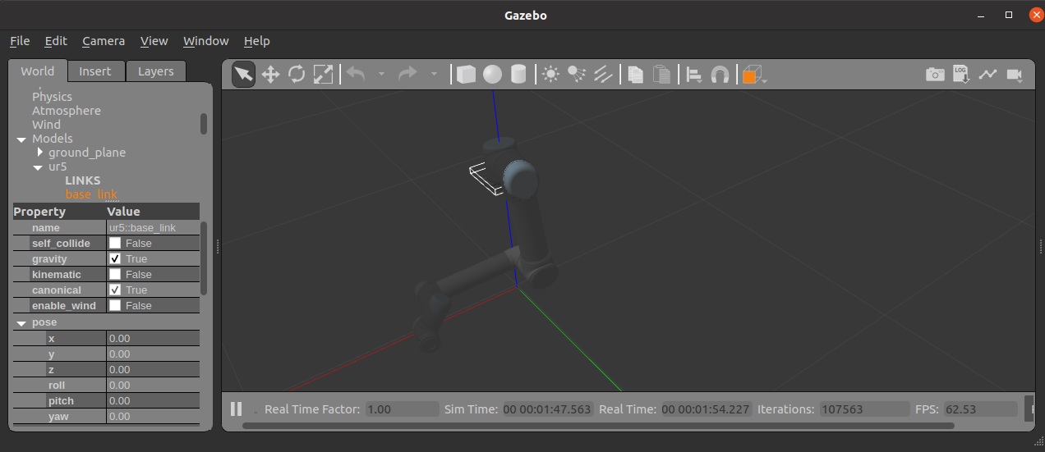
ROS vs Coppeliasim
ROS - Robot Operating System
Coppeliasim - formerly Vrep
Real time universal software
Same software used on physical robot
C++ / Python compliant
Massive open source community
Simulator
Lua / Python
Plug-in and remote API C++
Better physics engine

Slide 5
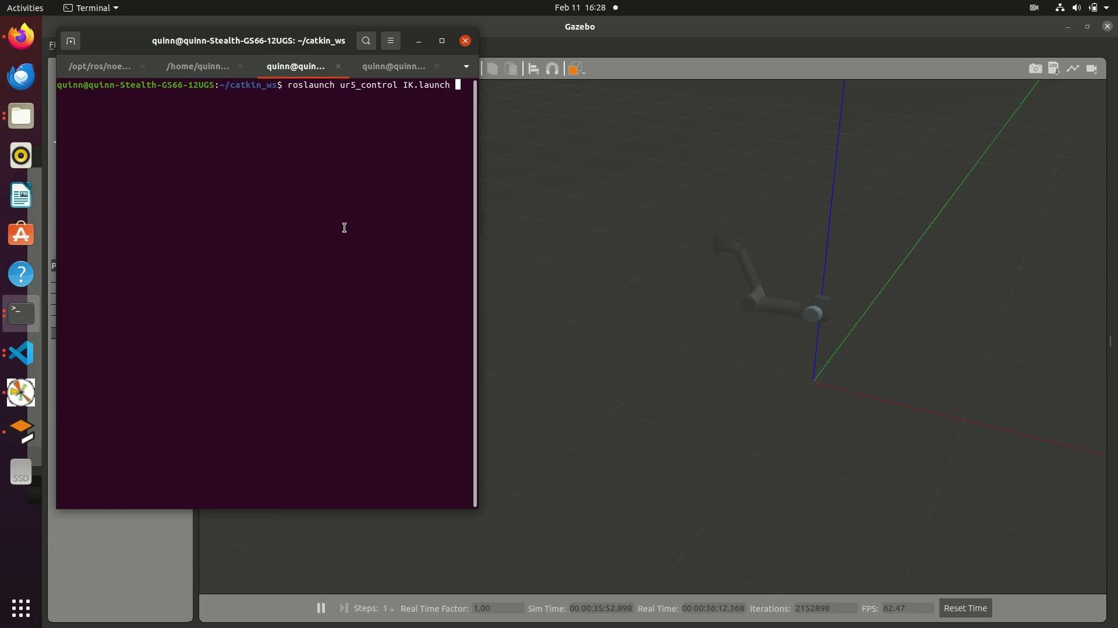
Demo

Slide 6
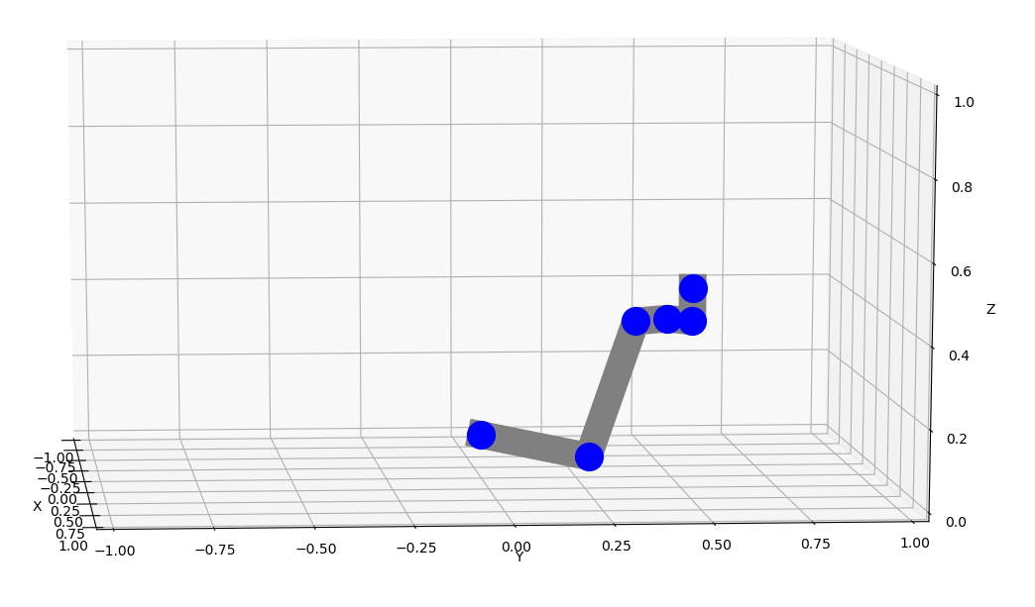
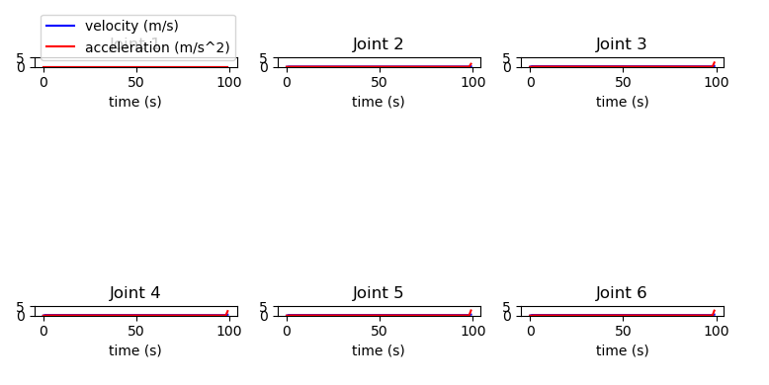
Outcomes
What worked well
What did not work well
C++ trajectory planning
8 possible IK solutions
All 3d projections are interactable
Accumulated error in theta
Constant velocity of joints, boring stats
Command line interface

Slide 7
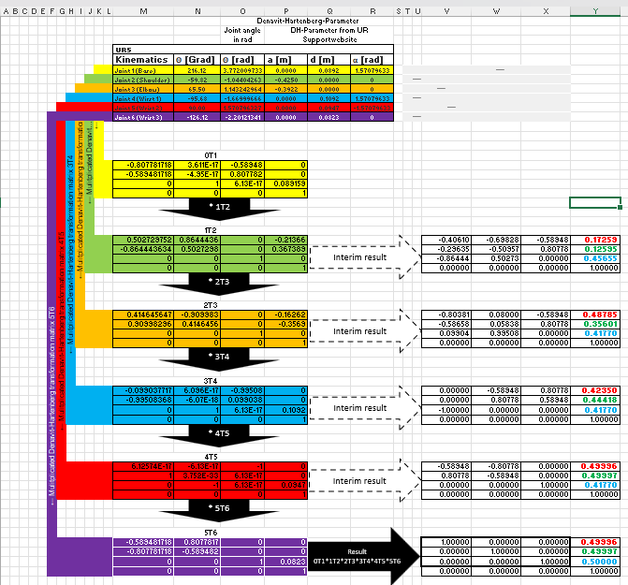
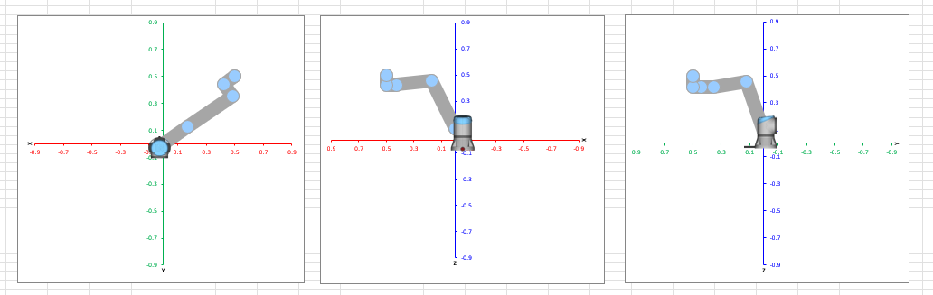
Testing Methodology
Unit Testing
Working case
Below floor
Inaccessible - interior
Inaccessible - exterior
Error Reporting
UR Forward Kinematics
Simulator Functional Testing

Slide 8
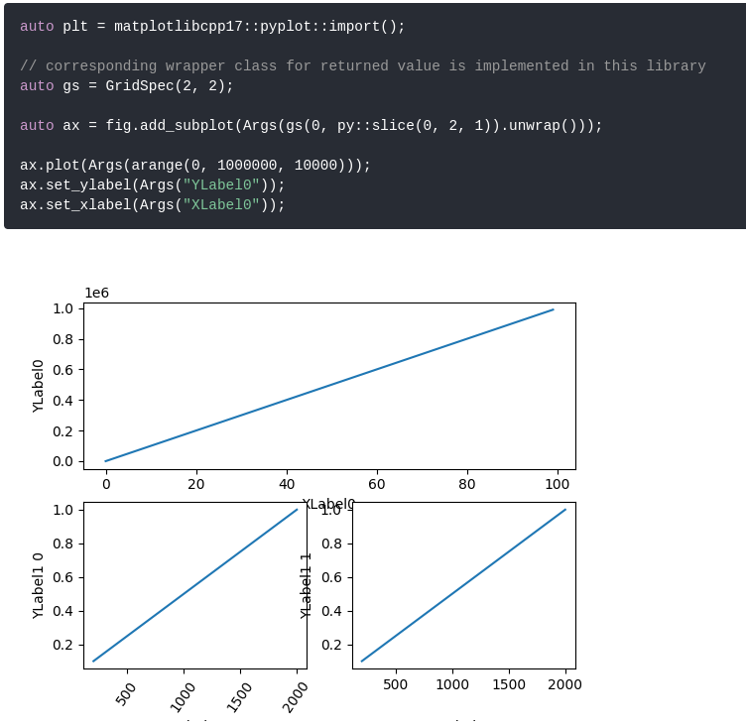
Challenges Encountered
Matplotlibc++17
C++ wrapper for python library
Did not accept Eigen matrix
Limited documentation
UR5
No published IK derivation
Built for Moveit!
Could not publish to /joint_control

Slide 9
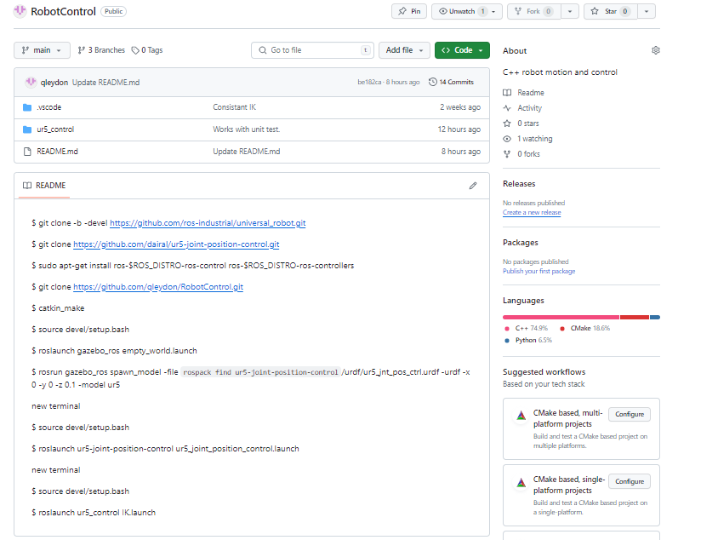
Next Steps to Deployment
Currently in Github
To deploy:
Create Debian Repository
Apply for APT
Make a QT GUI
Would require approx. 1 week additional work

Slide 10
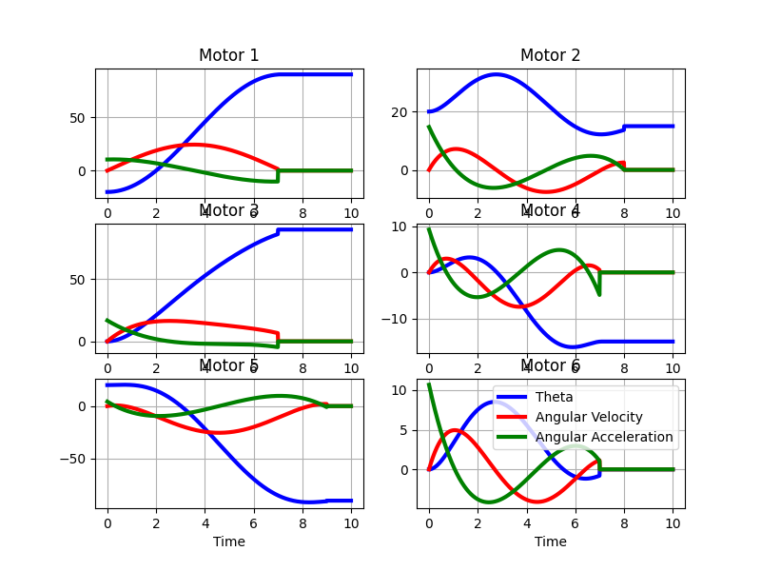
Improvements
QT GUI
Improved path planning
Waypoints
Invalid regions
3/4/5 differential equation for motion
Improve feedback between software and robot

Slide 11
Thanks!
Do you have any questions?
q.leydon@gmail.com
781 336 8162
Please keep this slide for attribution

Slide 12
Additional Slides

Slide 13
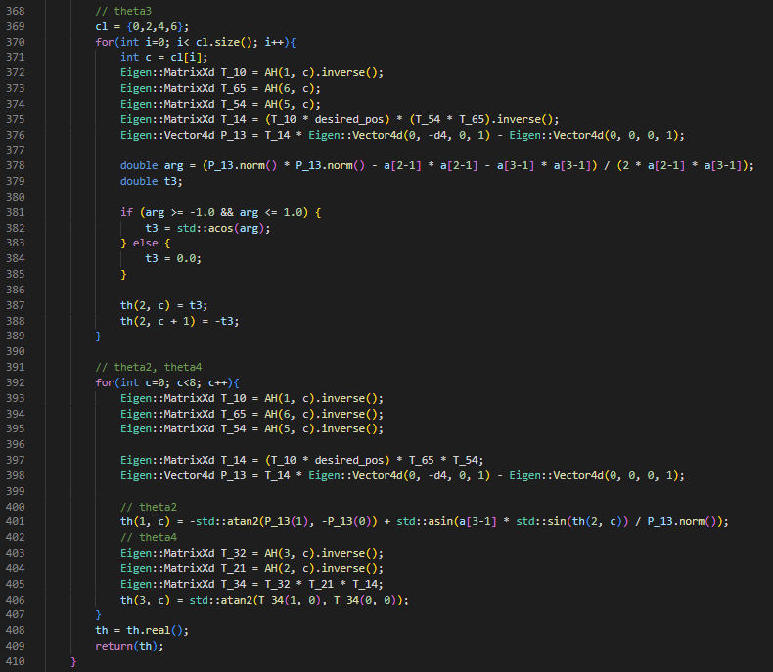
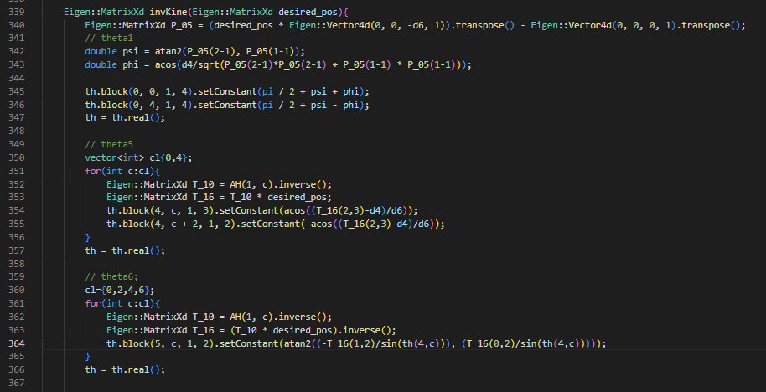
Inverse Kinematics

Slide 14
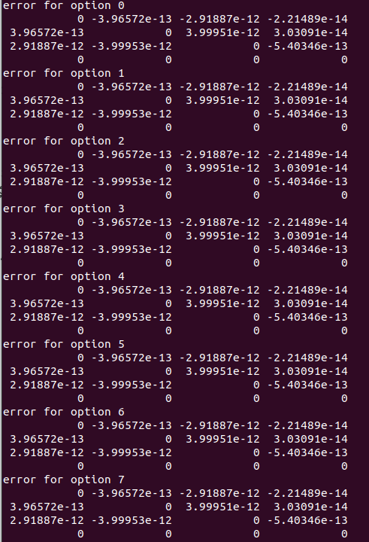
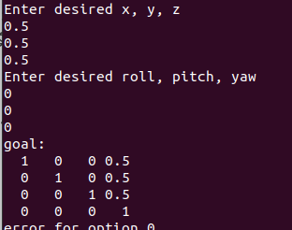
Position Input

Slide 16
Display

Slide 17
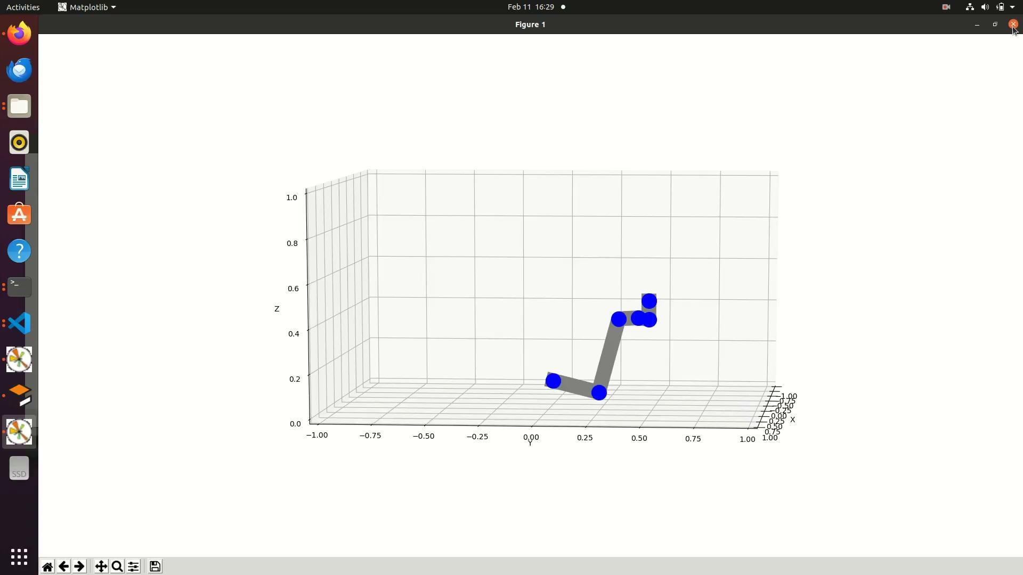

Slide 18
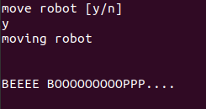
Stats
Corrects accumulated error

