Slide 1
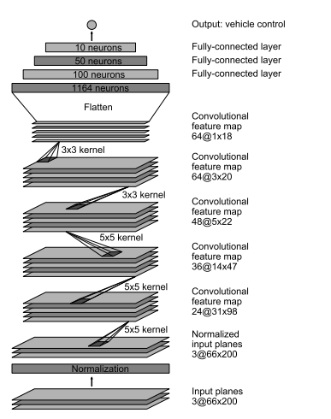
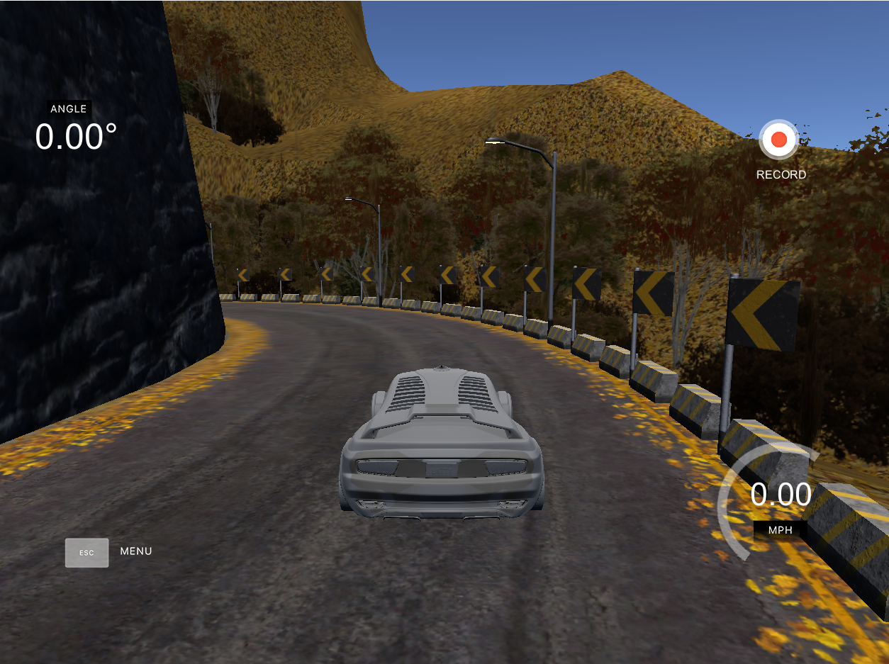

Experiment Pipeline
Unicity
Simulator
Image Preprocessing
Nvidia architecture
Center Image
Left Image (training)
Right Image(training)
Speed(training)
Left Image
Center Image
Right Image
End to End Learning for Self-Driving Cars
https://arxiv.org/pdf/1604.07316.pdf
Steering Angle, Speed

Slide 2
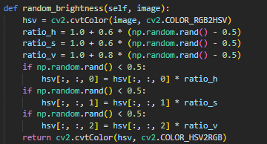
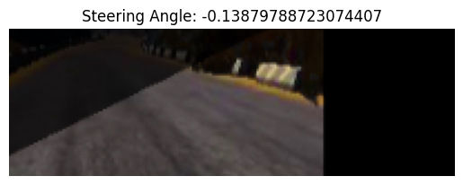
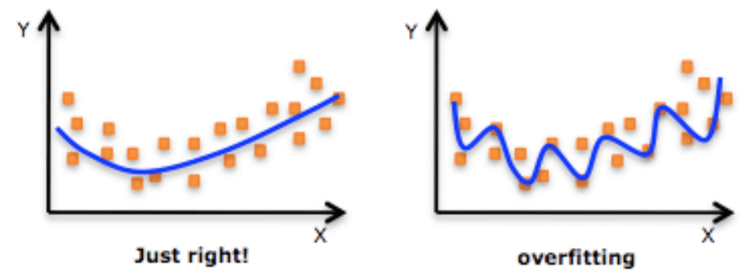
Technical Design (training)
learning_rate=1.0e-4, keep_prob=0.5, batch_size=100, save_best_only=False, test_size=0.3, steps_per_epoch=300, epochs=10
Augmentation
90% chance
Random Translate
Add small amount of noise to Θ
Random Brightness
Chose Image,
Θ or Θ +/- 0.2
Random Shadow
Gaussian noise
Std = 0.2

