Slide 1
COMPILER CONSTRUCTION
Nguyen Thi Thu Huong
Department of Computer Science-HUST
Email: huongnt@soict.hust.edu.vn
Cell phone 0903253796

Slide 2
Why study compilers?
Ability to build a compiler for a (simplified) (programming) language
Ability to express syntax of programming languages
Being familiar with compiler analysis and optimization techniques
Working with data structures
Understanding interactions between algorithms
Experience with large-scale applications development
Help you out on your next big programming project.
Notes:
Not only express syntax of programming langages but also syntax of natural languages

Slide 3
More details about the course
How do computers work?
(instruction set, registers, addressing modes, run-time data structures, ...)
How do compilers work?
What machine code is generated for certain language constructs?
What is good language design?

Slide 4
Course Outline
Functions of a Language Processor
The Phases of a Compiler
Generative Grammar
BNF and Syntax Diagrams
Scanner and Symbol Table
Parsing Backtracking
Predictive Parsing
Semantic Analysis
Intermediate Code Generation
Object Code Generation
Code optimization

Slide 5
Textbooks
Aho.A.V, Sethi.R., Ullman.J.D.
  Compiler : Principles, Techniques and Tools.
  Addison Wesley. (1st edition -1986, 2nd edition – 2007)
Andrew.W.Appel, Maia Gínburg
  Modern Compiler Implementation in C (Java)
  Cambridge University Press.2004
Andrew.W.Appel
  Modern Compiler Implementation in Java
  Cambridge University Press.2009
Bal.H. E.
  Modern Compiler Design.
  John Wiley & Sons Inc (2000)
Charles N. Fischer.
  Crafting a Compiler
  Benjamin-Cummings Pub Co (1987)
www.sourceforge.net

Slide 6
Unit 1.
Language Processors

Slide 7
High Level Programming Languages
Programming languages have taken 5 generation
A language is considered high or low level depending on its abstraction
  A high level language may use natural language elements, be easier to use, or more portable across platforms
  Low level languages are closer to the hardware

Slide 8
The first and the second generation
The first generation: machine language
The second generation : Assembly
Languages of the first and the second generation are low level languages

Slide 9
The Third Generation
Easier to read, write and maintain
Allow declarations
Most 3GLs supports structured programming
Examples: Fortran, Cobol, C, C++, Basic . . . .

Slide 10
The Fourth Generation
Designed with a specific purpose in mind, such as the development of commercial business software
Reduce programming effort, cost of software development
May include form or report builder
Examples :SQL, Visual Basic, Oracle (SQL plus, Oracle Form, Oracle Report). . . .

Slide 11
The Fifth Generation
Based around solving problems using constraints given to the program, rather than using an algorithm written by a programmer
Are designed to make the computer solve a given problem without the programmer
Most constraint-based and logic programming languages and some declarative languages are fifth-generation languages.

Slide 12
Characteristics of high level languages
Hardware independence
Close to natural languages
Easy to read, write and maintain
Programs written in a high-level language must be translated into machine language
Often result in slower execution speed, higher memory consumption

Slide 13
Syntax and Semantics of Programming Languages
Syntax:The way symbols can be combined to create well-formed sentence (program) in the language
Semantics: The meaning of syntactically valid strings in a language

Slide 14
Language Processors
A program that performs tasks, such as translating and interpreting, required for processing a specified programming language. For example,
  Compiler
  Assembler
  Interpreter
  Compiler - Compiler

Slide 15
Language Translation
Native-code compiler: produces machine code
  Compiled languages: Fortran, C, C++…
Interpreter: translates into internal form and immediately executes (read-eval-print loop)
  Interpreted languages: Foxpro, Scheme, Haskell, Python …
Byte-code compiler: produces portable bytecode, which is executed on virtual machine (e.g., Java)
Hybrid approaches
  Source-to-source translation (early C++ → C→compile)
  Just-in-time Java compilers convert bytecode into native machine code when first executed

Slide 16
Language Compilation
Compiler: program that translates a source language into a target language
  Target language is often, but not always, the assembly language for a particular machine
C
source code
C
compiler
x86 ASM
x86
assembler
Pentium op codes

Slide 17
Checks During Compilation
Syntactically invalid constructs
Invalid type conversions
  A value is used in the “wrong” context, e.g., assigning a float to an int
Static determination of type information is also used to generate more efficient code
  Know what kind of values will be stored in a given memory region during program execution
Some programmer logic errors
  Can be subtle: if (a = b) … instead of if (a == b) …

Slide 18
Compilation Process
Syntax and static
type errors
Lexical
analyzer
tokens
Syntax
analyzer +
type checker
ASTs
Intermediate
code gen
IC
IC_{opt}
Final code
gen
Optimizer
raw source
code text
ASM
Assembler
Preprocessor
Source code with
preprocessor directives
Machine code

Slide 19
Phases of Compilation
Preprocessing: conditional macro text substitution
Lexical analysis: convert keywords, identifiers, constants into a sequence of tokens
Syntactic analysis: check that token sequence is syntactically correct
  Generate parse tree, abstract syntax trees (AST), check types
Intermediate code generation: “walk” the ASTs and generate intermediate code
  Apply optimizations to produce efficient code
Object code generation: produce machine code
slide <number>

Slide 20
Compilers vs Interpreters
A compiler or an interpreter is a computer program (or set of programs) that converts program written in high-level language into machine code understood by the computer

Slide 21
Compilers
Scans the entire program and translates it as a whole into machine code.
Takes large amount of time to analyze the source code but the overall execution time is comparatively faster.
Generates the error message only after scanning the whole program.
Programming language like C, C++ use compilers.
Input
Source
Program
Compiler
Target
Program
Error messages
Output

Slide 22
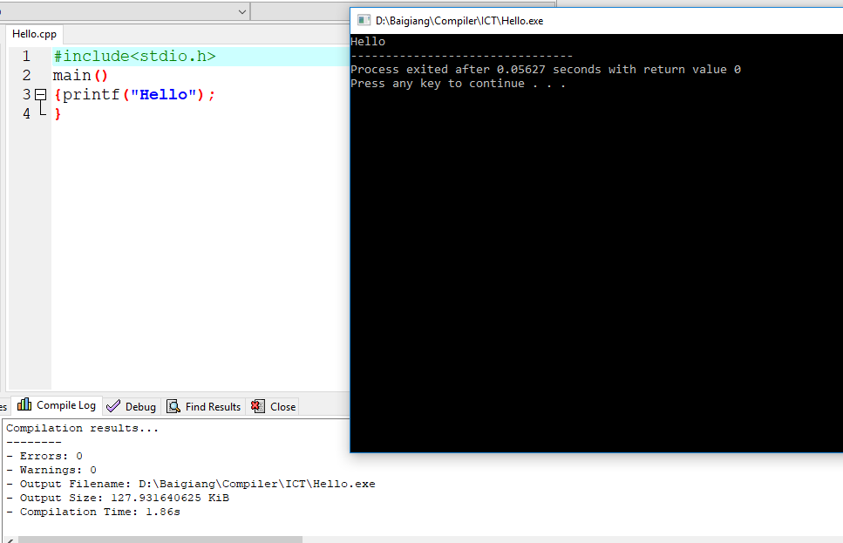
C translator: compiler

Slide 23
Compilers (cont’d)
The most common reason for wanting to transform source code is to create an executable program.
To run a program, execute the compiler (and possibly an assembler) to translate the source program into a machine language program.
Execute the resulting machine language program, supplying appropriate input.

Slide 24
Interpreters
Translates program one statement at a time
Takes less amount of time to analyze the source code but the overall execution time is slower.
Continues translating the program until the first error is met, in which case it stops.
Programming language like Python, Ruby use interpreters.
Oversimplified view:
Source
Program
Interpreter
Output
Input
Error messages

Slide 25
Interpreters (cont’d)
Accepts the source language program and the appropriate input
Itself produces the output of the program.

Slide 26
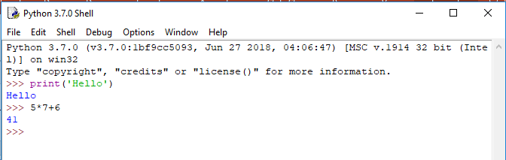
Python translator: interpreter
Python command window

Slide 27
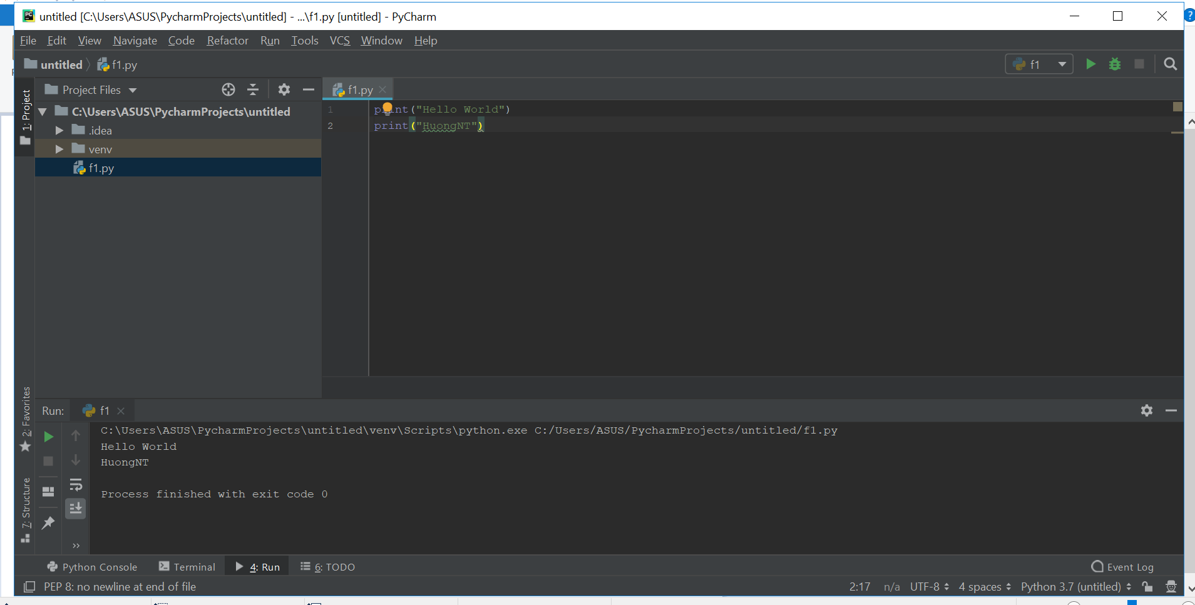
Python IDE: a Python program

Slide 28
Interpreter as a part of compiler
In a compiler implementations
The source code is compiled to a machine language for an idealized virtual machine
The interpreter of accepts the codes and the input, produces the output.
This technique is quite popular to make the compiler independent with the computer

Slide 29
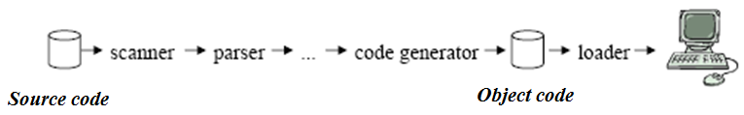
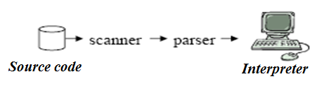
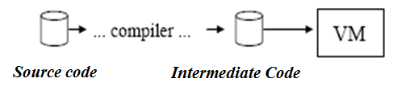
Compilers and Interpreters (cont’d)
A Compiler is a program that translates code of a programming language into machine code (assembly)
An interpreter translates some form of source code into a target representation that it can immediately execute and evaluate
Modification of Interpreter :a program that implements or simulates a virtual machine using the base set of instructions of a programming language as its machine language

Slide 30
Cousins of the compiler
Interpreter
Assembler
Linker
Loader
Preprocessor
Editor
Debugger
Profiler

Slide 31
The context of a compiler in a language processor
Skeletal Source Program
Preprocessor
Source Program
Compiler
Target Assembly Program
Assembler/Interpreter
Relocatable Object Code
Linker+Loader
Libraries and
Relocatable Object Files
Absolute Machine Code

