Slide 1
Unit 5
Scanner

Slide 2
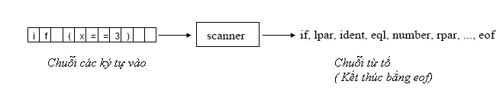
Task of a scanner
Delivers tokens
Skip meaningless characters
  blanks
  Tabulator characters
  End-of-line characters (CR,LF)
  Comments

Slide 3

Tokens have a syntactic structure
Why is scanning not a part of parsing?

Slide 4
Why is scanning not a part of parsing?
It would make parsing more complicated,e.g.
  Difficult distinction between identifiers and keywords
  The scanner must have complicated rules for eliminating blanks, tabs, comments,etc.
  => would lead to very complicated grammars

Slide 5
Token classes of KPL
Unsigned integer
Identifier
Key word: begin,end, if,then, while, do, call, const, var, procedure, program,type, function,of,integer,char,else,for, to,array
Character constant
Operators:
  Arithmetic
    + - */
  Relational
  = != < > <= >=
  Assign :=
Separators
  ( ) . : ; (. .)

Slide 6
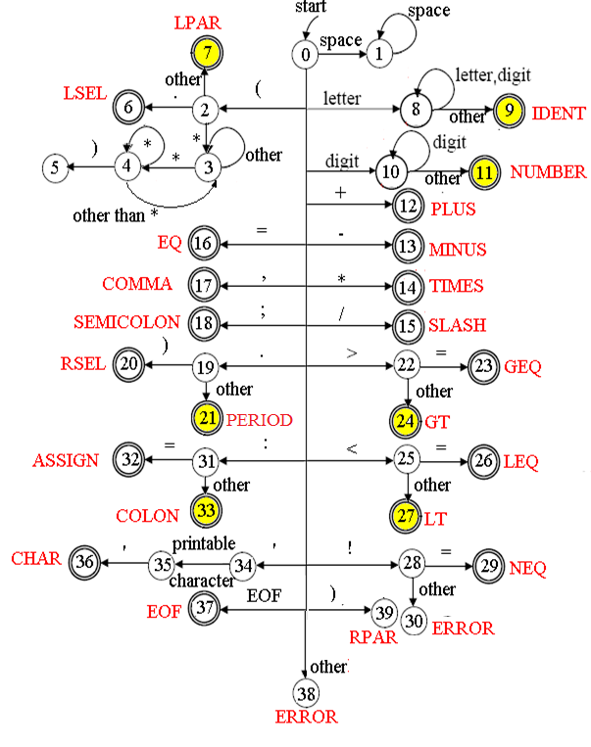
The scanner as Finite Automaton
After every recognized token, the scanner starts in state 0 again
If an illegal character is met, the scanner would change to the states 30 or 38 which tell the scanner to stop scanning and return error messages.
Notice the yellow states

Slide 7
Scanner implementation based on DFA
state = 0;
currentChar = getCurrentChar;
token = getToken();
while ( token!=EOF)
{
state =0;
token = getToken();
  }

Slide 8
Token recognizer
switch (state)
{
case 0 : currentChar = getCurrentChar();
switch (currentChar)
{
case space
state = 1;
case lpar
state = 2;
case letter
state = 8;
case digit
state =10;
case plus
state = 12;
……
}

Slide 9

Token recognizer (cont’d)
case 1:
while (current Char== space) // skip blanks
currentChar = getCurrentChar();
state =0;
case 2:
currentChar = getCurrentChar();
switch (currentChar)
{
case period
state = 6;// token lsel
case times
state =3; //skip comment
else
state =7; // token lpar
}

Slide 10
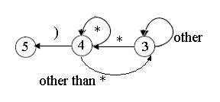
Token recognizer (cont’d)
case 3: // skip comment
currentChar = getCurrentChar();
while (currentChar != times)
{
state = 3;
currentChar = getCurrentChar();
}
state = 4;
case 4:
currentChar = getCurrentChar();
while (currentChar == times)
{
state = 4;
currentChar = getCurrentChar();
}
If (currentChar == lpar) state = 5; else state =3;

Slide 11
Token recognizer (cont’d)
case 9:
if (checkKeyword (token) == TK_NONE)
install_ident();// save to symbol table
else
return checkKeyword(token);
…………

Slide 12
Initialize a symbol table
The following information about identifiers is saved
  Name:string
  Attribute : type name, variable name, constant name. . .
  Data type
  Scope
  Address and size of the memory where the lexeme is located
  . . .

Slide 13
Distinction between identifiers and keywords
Variable ch is assigned with the first character of the lexeme.
Read all digits and letters into string t
Use binary search algorithm to find if there is an entry for that string in table of keyword
If found t.kind = order of the keyword
Otherwise, t.kind =ident
At last, variable ch contains the first character of the next lexeme

Slide 14
Data structure for tokens
enum {
TK_NONE, TK_IDENT, TK_NUMBER, TK_CHAR, TK_EOF,
KW_PROGRAM, KW_CONST, KW_TYPE, KW_VAR,
KW_INTEGER, KW_CHAR, KW_ARRAY, KW_OF,
KW_FUNCTION, KW_PROCEDURE,
KW_BEGIN, KW_END, KW_CALL,
KW_IF, KW_THEN, KW_ELSE,
KW_WHILE, KW_DO, KW_FOR, KW_TO,
SB_SEMICOLON, SB_COLON, SB_PERIOD, SB_COMMA,
SB_ASSIGN, SB_EQ, SB_NEQ, SB_LT, SB_LE, SB_GT, SB_GE,
SB_PLUS, SB_MINUS, SB_TIMES, SB_SLASH,
SB_LPAR, SB_RPAR, SB_LSEL, SB_RSEL
};

