Slide 1
Cryptanalysis of Substitution Cipher
MEMBERS:
Nguyen Quang Linh
Vu Viet Hung
Notes:
Monoalphebetic substitution cipher

Slide 2
Substitution Cipher
Key space: All permutations of Σ = {A, B, C, …, Z}
Cipher text is obtained from the plaintext by replacing each symbol by the corresponding cipher text symbol in the key.
Example:
A B C D E F G H I J K L M N O P Q R S T U V W X Y Z
π = B A D C Z H W Y G O Q X S V T R N M L K J I P F E U
HELLO → YZXXT

Slide 3
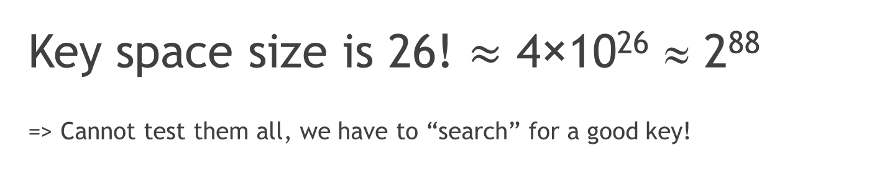
Challenge
Key space size is 26! $≈$ 4×10²⁶ ≈ 2⁸⁸
=> Cannot test them all, we have to “search” for a good key!
Notes:
So what the challenge?
The number of key of caeser cipher is only 25 so we can using exhaustive search, try all possible keys
The number of keys possible with the substitution cipher is much higher, around 2^88 possible keys.
To see how big this number is, we can make a small comparison, there are estimated 10^22 stars in our universe => 40000 times larger than # of stars
Cannot test them all, we have to ‘search’ for a good key
How to break it??

Slide 4
Hill – climbing algorithm
Generate a random key, called the 'parent', decipher the ciphertext using this key. Rate the fitness of the deciphered text, store the result.
Swap characters in the key at random, measure the fitness of the deciphered text using the new key.
If the fitness is higher with the modified key, discard our old 'parent' and store the modified key as the new 'parent'.
Go back to 2, unless no improvement in fitness occurred.
Notes:
As this cycle proceeds, the deciphered text gets fitter and fitter, the key becomes better until either the solution appears
or, the solution is not found => Stuck in local maximum => Try again with different key with hope it will be better
Sometime, the system fails when the true plaintext contains full of unusual quadgrams
Eg: From Zanzibar to Zambia to Zaire, ozone zones make zebras run zany zigzags

Slide 5
Fitness measure
Rating “fitness”: a piece of text very similar to English will get a high score (high fitness), jumble of random characters will get low score.
Steps:
Determining the statistics of English text
Calculate the probability that the ciphertext comes from the same distribution
Notes:
Using counting quadgrams (group of 4 letters)

Slide 6
Quadgram Statistics
Group of 4 letters.
Take a large piece of text and count each of quadgram occur in them.
Divide these counts by the total number of quadgrams encountered to find the probability of each.
Notes:
Eg:
The quadgrams in the text ATTACK are ATTA, TTAC and TACK.
To use quadgrams to determine how similar text is to English, we first need to know which quadgrams occur in English.

Slide 7
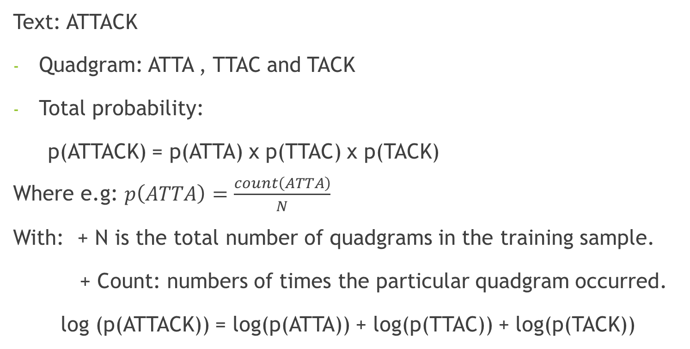
Example
Text: ATTACK
Quadgram: ATTA , TTAC and TACK
Total probability:
p(ATTACK) = p(ATTA) x p(TTAC) x p(TACK)
Where e.g: $p\left(ATTA\right)=\frac{count\left(ATTA\right)}{N}$
With: + N is the total number of quadgrams in the training sample.
+ Count: numbers of times the particular quadgram occurred.
log (p(ATTACK)) = log(p(ATTA)) + log(p(TTAC)) + log(p(TACK))
Notes:
When multiplying many small probabilities, numerical underflow can occur in floating point numbers.
The logarithm is taken of each probability
- Numerical underflow: occurs when the result of a calculation is smaller than the smallest value that can be represented by a type
- This log probability is used as the 'fitness' of a piece of text, higher number means it is more likely to be English

Slide 8
Tools
Ngram.py: score a candidate plaintext, check how likely a piece of text is looks like English.
Transform.py: Delete space, turn the text into upper-case letters and after deciphering, extend string back to normal form for easier reading.
Eg: Ciphertext: Hgkke Frorl → HGKKEFRORL → HELLOWORLD → Hello World
En.py: Load quadgram.txt

Slide 10


