Slide 1
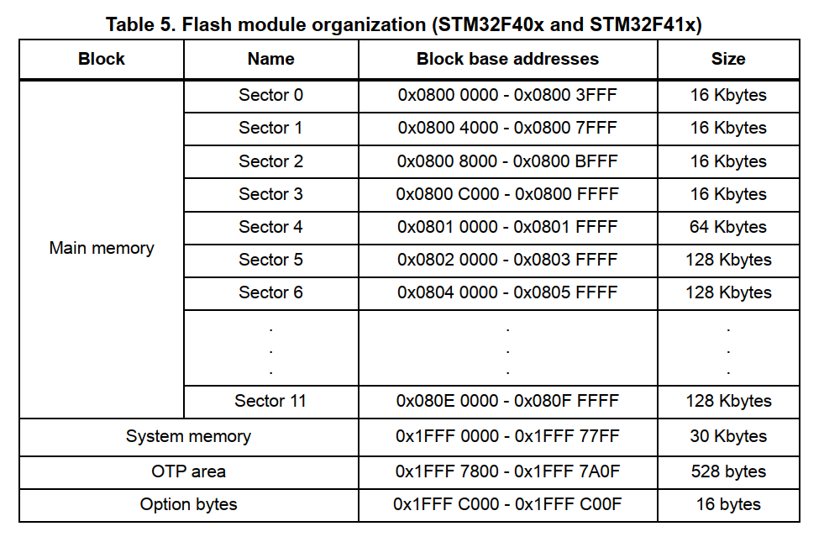
The Flash memory is organized as follows: A main memory block divided into 4 sectors of 16 Kbytes, 1 sector of 64 Kbytes, and 7 sectors of 128 Kbytes – System memory from which the device boots in System memory boot mode – 512 OTP (one-time programmable) bytes for user data The OTP area contains 16 additional bytes used to lock the corresponding OTP data block. – Option bytes to configure read and write protection, BOR level, watchdog software/hardware and reset when the device is in Standby or Stop mode.

Slide 2
Block | Name | Block base addresses | Size
Main memory | Sector 0 | 0x0800 0000 - 0x0800 3FFF | 16 Kbytes
 | Sector 1 | 0x0800 4000 - 0x0800 7FFF | 16 Kbytes
 | Sector 2 | 0x0800 8000 - 0x0800 BFFF | 16 Kbytes | App
 | Sector 3 | 0x0800 C000 - 0x0800 FFFF | 16 Kbytes
 | Sector 4 | 0x0801 0000 - 0x0801 FFFF | 64 Kbytes
 | Sector 5 | 0x0802 0000 - 0x0803 FFFF | 128 Kbytes
 | Sector 6 | 0x0804 0000 - 0x0805 FFFF | 128 Kbytes
 | ... | ... | ...
 | Sector 11 | 0x080E 0000 - 0x080F FFFF | 128 Kbytes
System memory |  | 0x1FFF 0000 - 0x1FFF 77FF | 30 Kbytes
OTP area |  | 0x1FFF 7800 - 0x1FFF 7A0F | 528 bytes
Option bytes |  | 0x1FFF C000 - 0x1FFF C00F | 16 bytes

Slide 3
Command Name : BL_GET_VER
Length
to follow
Command
Code
CRC
1
1
4
Bootloader command
Total Bytes of the packet = 6
“Length to follow ” field will contain the value : 5
Command Code : 0x51
Boot loader version number
(1 byte)
Bootloader reply

Slide 4
Command Name : BL_GET_HELP
Length
to follow
Command
Code
CRC
1
1
4
Bootloader command
Total Bytes of the packet = 6
“Length to follow ” field will contain the value : 5
Command Code : 0x52
Supported Commands codes
Bootloader reply

Slide 5
Command Name : BL_GET_CID
Length
to follow
Command
Code
CRC
1
1
4
Bootloader command
Total Bytes of the packet = 6
“Length to follow ” field will contain the value : 5
Command Code : 0x53
MCU chip Id
LSB
MCU chip Id
MSB
(2 bytes)
Bootloader reply

Slide 6
Command Name : BL_GET_RDP_STATUS
Length
to follow
Command
Code
CRC
1
1
4
Bootloader command
Total Bytes of the packet = 6
“Length to follow ” field will contain the value : 5
Command Code : 0x54
RDP status
(1 bytes)
Bootloader reply

Slide 7
Command Name : BL_GO_TO_ADDR
Length
to follow
Command
Code
Memory address
(LE)
CRC
1
1
4
4
Bootloader command
Base Memory Addr. :
4 Byte base address to jump
Total Bytes of the packet = 10
“Length to follow ” field will contain the value : 9
Command Code : 0x55
status
(1 byte)
Bootloader reply

Slide 8
Command Name : BL_FLASH_ERASE
Length
to follow
Command
Code
Sector
Number
Number
of sectors
CRC
1
1
1
1
4
Bootloader command
Sector number : 0 , 1 , 2 , 3 , 4 ,5 , 6 ,7
Number of sectors : 0 to 7
Total Bytes of the packet = 8
“Length to follow ” field will contain the value : 7
Command Code : 0x56
status
(1 byte)
Bootloader reply

Slide 9
Command Name : BL_MEM_WRITE
Length
to follow
Command
Code
Base Memory address
(LE)
Payload
Length(X)
payload
CRC
1
1
4
1
X
4
Bootloader command
Base Memory Addr. :
4 Byte base address
Payload len: No. of bytes to write
Payload : bytes to write
Total Bytes of the packet = 11+X
“Length to follow ” field will contain the value : 10+X
Command Code : 0x57
status
(1 byte)
Bootloader reply

Slide 10
Command Name : BL_MEM_READ
Length
to follow
Command
Code
Base Memory addr.
(LE)
len
CRC
1
1
4
1
4
Bootloader command
Base Memory Addr. :
4 Byte base address from which data has to be read
len : No. of bytes to read
Total Bytes of the packet = 11
“Length to follow ” field will contain the value : 10
Command Code : 0x59
status
“len” number of bytes
(1+”len” bytes )
Bootloader reply

Slide 11
Command Name : BL_READ_SECTOR_STATUS
Length
to follow
Command
Code
CRC
1
1
4
Bootloader command
Total Bytes of the packet = 6
“Length to follow ” field will contain the value : 5
Command Code : 0x5A
All Sectors status
(2 bytes)
Bootloader reply

Slide 12
Command Name : BL_EN_R_W_PROTECT
Length
to follow
Command
Code
Sector
Details
CRC
1
1
2
4
Bootloader command
Sector details : sector numbers encoded in 12bits
(ex: 0th bit is sector 0)
0: protection
1: No protection
Total Bytes of the packet = 8
“Length to follow ” field will contain the value : 7
Command Code : 0x58
EX:BL_EN_RW_PROTECT
07 58 0f 00 00 00 00 00
00 0f -> 0x000F : sector 0-3: no protection
Notes:
Sector number : 0 , 1 , 2 , 3 , 4 ,5 , 6 ,7
Operation Code : 0(No Protection) , 1(Write Protection ) , 2 (R/W protection)

Slide 13
Command Name : BL_DIS_R_W_PROTECT
Length
to follow
Command
Code
CRC
1
1
4
Bootloader command
Disables Active protection on all the sectors (resumes to default state)
Total Bytes of the packet = 6
“Length to follow ” field will contain the value : 5
Command Code : 0x5C
status
(1 bytes)
Bootloader reply

