Slide 1
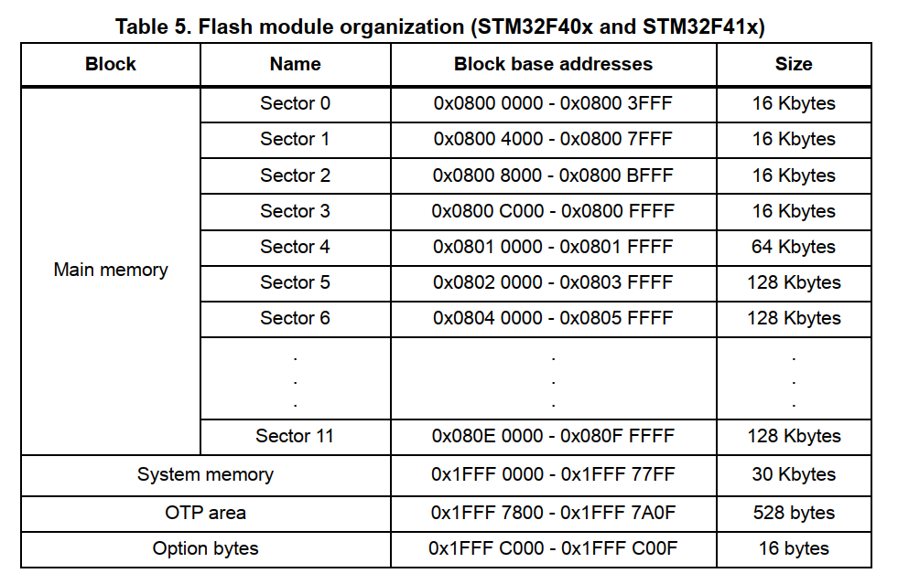
The Flash memory is organized as follows: A main memory block divided into 4 sectors of 16 Kbytes, 1 sector of 64 Kbytes, and 7 sectors of 128 Kbytes – System memory from which the device boots in System memory boot mode – 512 OTP (one-time programmable) bytes for user data The OTP area contains 16 additional bytes used to lock the corresponding OTP data block. – Option bytes to configure read and write protection, BOR level, watchdog software/hardware and reset when the device is in Standby or Stop mode.

Slide 2
Block | Name | Block base addresses | Size
Main memory | Sector 0 | 0x0800 0000 - 0x0800 3FFF | 16 Kbytes
 | Sector 1 | 0x0800 4000 - 0x0800 7FFF | 16 Kbytes
 | Sector 2 | 0x0800 8000 - 0x0800 BFFF | 16 Kbytes | App
 | Sector 3 | 0x0800 C000 - 0x0800 FFFF | 16 Kbytes
 | Sector 4 | 0x0801 0000 - 0x0801 FFFF | 64 Kbytes
 | Sector 5 | 0x0802 0000 - 0x0803 FFFF | 128 Kbytes
 | Sector 6 | 0x0804 0000 - 0x0805 FFFF | 128 Kbytes
 | ... | ... | ...
 | Sector 11 | 0x080E 0000 - 0x080F FFFF | 128 Kbytes
System memory |  | 0x1FFF 0000 - 0x1FFF 77FF | 30 Kbytes
OTP area |  | 0x1FFF 7800 - 0x1FFF 7A0F | 528 bytes
Option bytes |  | 0x1FFF C000 - 0x1FFF C00F | 16 bytes

