Slide 1
Machine Learning
Nikita Volodin
CS411

Slide 2
Why?
Developers cannot:
predict all scenarios
predict all changes over time
solve some of the solutions
Notes:
Any agent is not perfect. Any agent can be improved. However, if agent can be improved, why wouldn’t the developers just add the improvement in the first place? We want the agent to learn because of the three reasons. First of all, <click> developers cannot predict all possible situations that the agent might find itself in. Secondly, <click> developers cannot predict all changes over time. Agent has to learn how to adapt to changing conditions. Thirdly, <click> sometimes developers have no idea how to implement a solution themselves.

Slide 3
Types of problems
Supervised learning
Unsupervised learning
Reinforcement learning
Semi-supervised learning
Notes:
Machine learning tasks are usually classified into three broad categories, depending on the nature of the learning feedback available to a learning system. <click> Supervised learning is type of learning, where the agent is presented with example inputs and desired outputs. The goal of the agent is to learn a general rule that maps inputs to outputs. The feedback here is the desired output. <click> Unsupervised learning is type of learning, where the agent does not receive any feedback for the data. So the agent has to find structure in input on its own. <click> Reinforcement learning is type of learning, where the agent interacts with the environment trying to reach a goal without knowing if it has come closer to the goal or not. In the end it learns from a series of reinforcements – rewards or punishments. It is left up to the agent to decide which actions prior to the reinforcement were most responsible for it. <click> Also, in between supervised and unsupervised learning there is semi-supervised learning. This type of learning, where the agent is present with an incomplete training set. A training set with some of the target outputs missing.

Slide 4
Approaches
Decision tree learning
Association rule learning
Artificial neural networks
Inductive logic programming
Support vector machines
Clustering
Bayesian networks
Reinforcement learning
Representation learning
Similarity and metric learning
Sparse dictionary learning
Genetic algorithms
Notes:
There are a lot of different approaches for machine learning.
However, we will just stop on clustering, artificial neural networks and genetic algorithms.

Slide 5
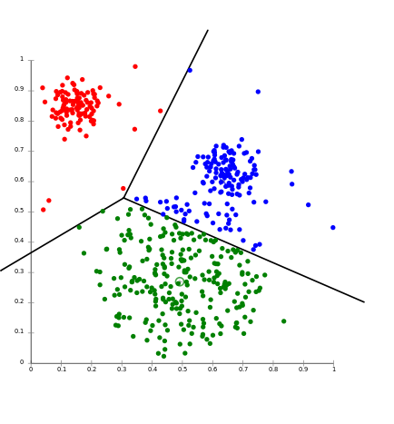
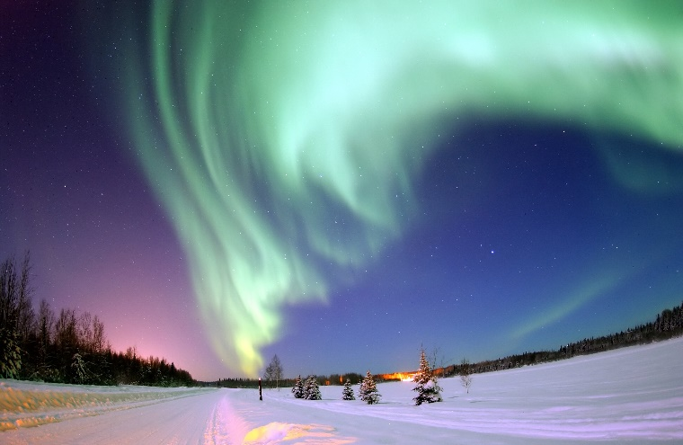

Clustering
Notes:
Clustering is the example of unsupervised learning. <click> With clustering methods we want to assign set of observations into subsets (clusters) so that observations in the same cluster are similar according to some predefined criteria, and observations from different clusters are different according to the same criteria.
The example where clustering is used is recommender system. These systems are recommending new items based on the user’s tastes. They sometimes use clustering algorithms to predict a user’s preferences based on the preferences of other users in the same cluster.
<click> Other example is image segmentation. Clustering can be used to divide an image into distinct regions to detect borders or objects.

Slide 6
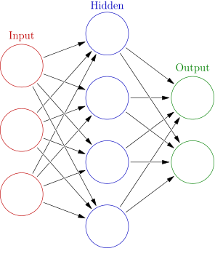
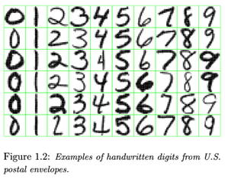
Artificial neural network
Notes:
Artificial neural network is a model inspired by biological neural network (brain). <click> Artificial neural networks are generally presented as systems of interconnected neurons which can compute values from inputs and are capable of machine learning as well as pattern recognition.
<click> One of the applications is a handwriting recognition. For example, this network might be defined by a set of input neurons which may be activated by the pixels of an input image. After being weighted and transformed by a function, the activations of these neurons are then passed on to other neurons. This process is repeated until finally, an output neuron is activated. This determines which character was read.
Among other applications of artificial neural networks is robotics, computer vision and speech recognition.

Slide 7
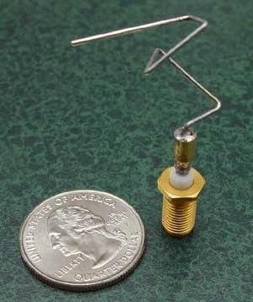
Genetic algorithm
Music:
Emily Howell
http://computoser.com
http://tones.wolfram.com/generate/
Notes:
Genetic algorithm is a search algorithm that mimics the process of natural selection. It uses methods like mutation and crossover to generate new solutions in the hope to find the good solutions to a given problem.
Genetic algorithms are used in a lot of different areas. One of examples is artificial creativity. The goal is to model, simulate or replicate creativity using a computer.
<click> For example, there are computer programs that generate music. They usually take as basis some classical music and generate new. There are few music generator programs. <click> One of them is called “Emily Howell”, <click> other is http://computoser.com, and <click> one more is tones by wolfram.
<click> Another example of artificial creativity is this antenna. This shape was found by evolutionary program to create the best radiation pattern. This antenna was used by NASA in 2006 in ST5 program.

Slide 8
Sources
http://en.wikipedia.org/wiki/Machine_learning
Chapter 18

