Slide 1
RFP code

Slide 2

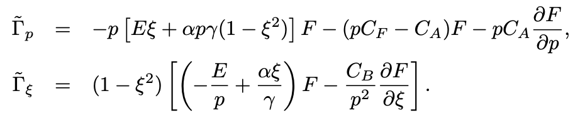
RFP 2D code
It solve the time-dependent 2D RFP equation (F=f p) Flux defined as
It is fully implicit atm. There was some attempt to use IMEX but it is not fully working yet.
Conservative FD with limited flux (QUICK, etc) and central differencing for the collision
DMDA, SNES, Newton, FD coloring (as a preconditioner for JFNK), implicit
It has a slab version and a bounce-averaged version (do not worry about bounce for now)

Slide 3
Typical run
See the README in RFP/runaway2d/Debug/README
runaway -fk_type slab_chiu -fdjac -snes_atol 1e-14 -snes_rtol 1e-9 -snes_stol 1e-14 -snes_max_it 50 -snes_max_funcs 200000 -snes_type newtonls -snes_linesearch_type l2 -snes_mf_operator -snes_max_linear_solve_fail 1000 -ksp_type gmres -ksp_gmres_restart 150 -ksp_rtol 1e-15 -ksp_atol 1e-15 -ksp_max_it 1000 -snes_monitor -dt 0.0001 -ftime 10. -skip 0.5 -snes_mf_operator -ts_type arkimex -ts_arkimex_type l2 -ts_rtol 1e-14 -ts_adapt_dt_min 1e-03 -ts_adapt_dt_max 0.1
python RFP/scripts/processing/runaway2d/plot.py –step 19
The main function is fk_equ_slab.cpp

Slide 4
Plans
Make sure the 2D RFP runs, clean up makefile and add README (qi)
Split RFP into IMEX (qi)
Test the new IMEX scheme using this code
Test the new scheme using a stand-alone (petsc/python) code
Implement RFP without collision in petsc-p4est
Implicit Diffusion operator in petsc-p4est (Johan, Max)
The RFP code is never tested by MMS
We could try to test a MMS and start from there
Or we could write a stand-alone petsc code

Slide 5
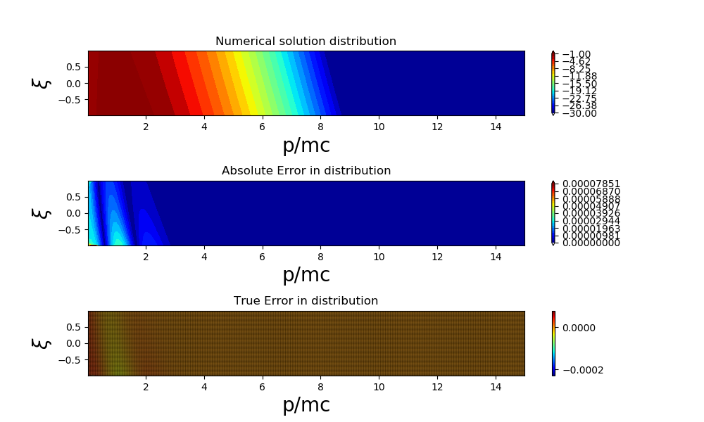
MMS: pure convection
Consider
with the exact solution and CFL=2.0

Slide 6


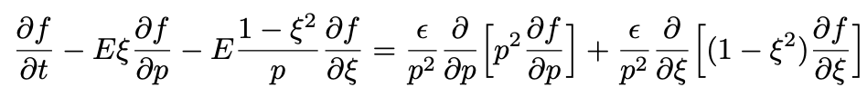

Two more MMS
Without collision. Consider Exact solution is
With collision. Consider Exact solution is

