Slide 1

ONLINE BOOK STORE
B.TECH 2022-26 3RD SEM LEARNING PROJECT Submitted by RAJAT KUMAR DASH, SOUMYA RANJAN MOHAPATRA
Roll No- 22CSE139,22CSE215
BACHELOR IN TECHNOLOGY DEPARTMENT OF COMPUTER SCIENCE & ENGINEERING SCHOOL OF ENGINEERING AND TECHNOLOGY GANDHI INSTITUTE OF ENGINEERING & TECHNOLOGY UNIVERSITY, GUNUPUR- 765022, ODISHA September 2023

Slide 2
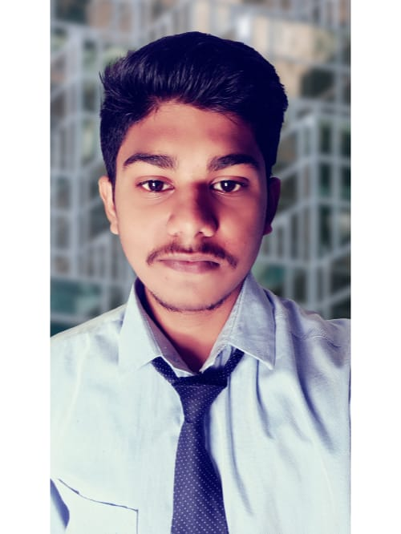
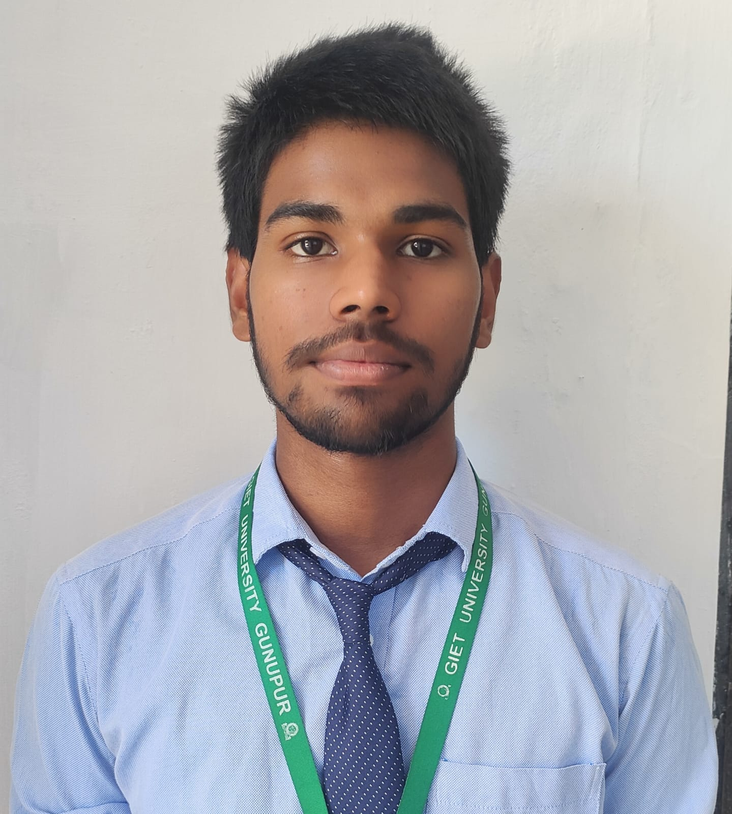
PROJECT PRESENTED BY:
Rajat Kumar Dash 22CSE139
Soumya Ranjan Mohapatra 22CSE215

Slide 3
TABLE of contents :
INTRODUCTON
FEATURES
SOFTWARE USED
FLOWCHART
Conclusion
HARDWARE USED
SCREENSHOT

Slide 4
Introduction
Discover the pure pleasure of reading in our book store at "BookMark," where we've stripped away buying options and carts to focus solely on literary exploration. Our platform offers a tranquil haven for readers who seek the joy of discovering curated titles without the distractions of purchasing. Embrace the simplicity of a seamless journey into literature, where every click leads to the delight of reading. BookMark isn't just a bookstore; it's a serene space designed for genuine book enthusiasts to revel in the essence of storytelling.

Slide 5
FEATURES:
User Registered and Login: Allow Users to create accounts and login to personalize their Experience
Download :Everyone can download the book & read without any distraction of purchasing.
Responsive Design: Ensure that website is responsive , so it works seamlessly on various devices , including desktops , tablets and mobile phones
Contact Support : Provide a contact number so user can easily contact us for supporting without any hesitation.

Slide 6
SOFTWARE USED
Design and Visual Elements:
Canva Photoshop: Used for creating and editing images and graphics.
Visual Studio Code: The primary development environment for coding and debugging
Frontend Development:
HTML : Used for structuring the website's content.
CSS : Applied for styling and layout.
Text Editor/IDE:
Database:
Xampp : use for storing the user information.

Slide 7
HARDWARE REQUIREMENT
Laptop/Desktop
Storage
Internet connection
Mobile

Slide 8
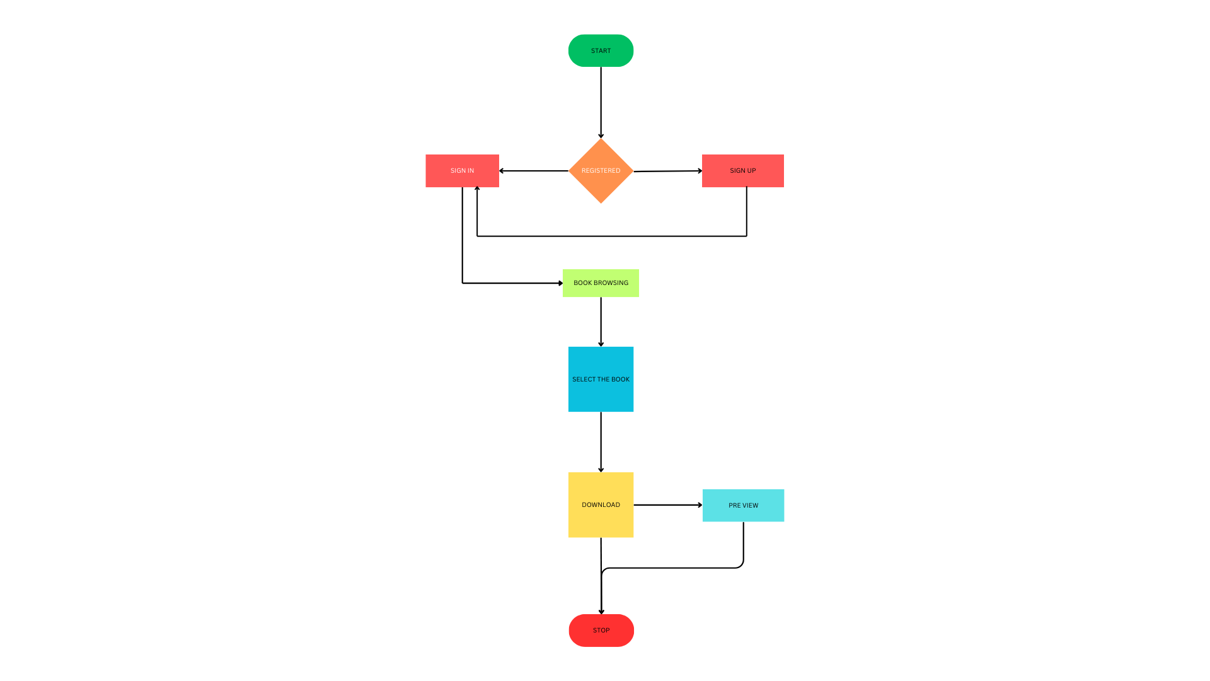
FLOW CHART

Slide 9
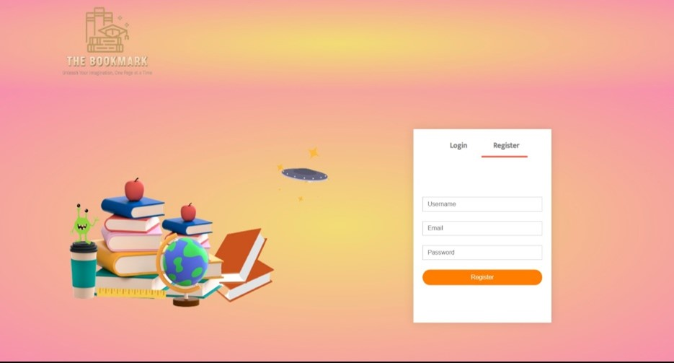
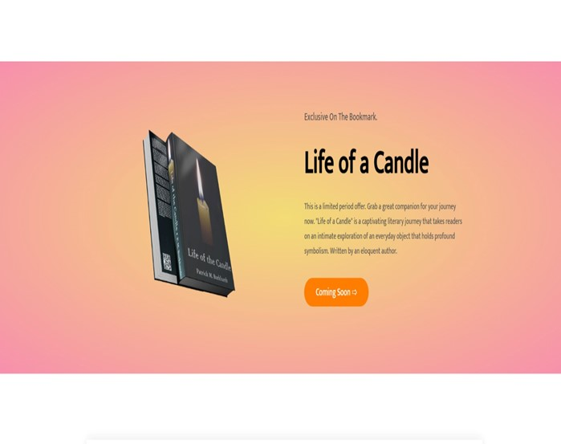
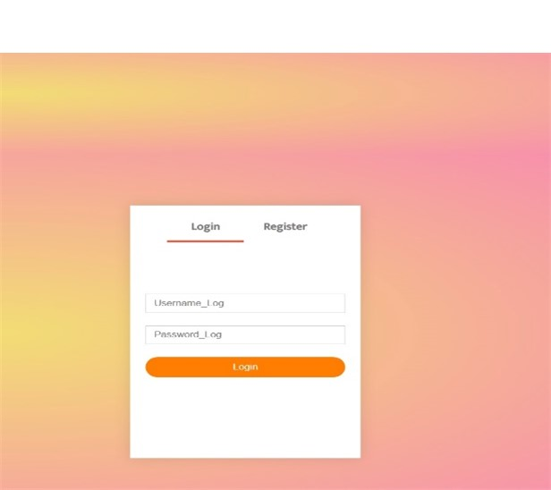
SCREENSHOT

Slide 10
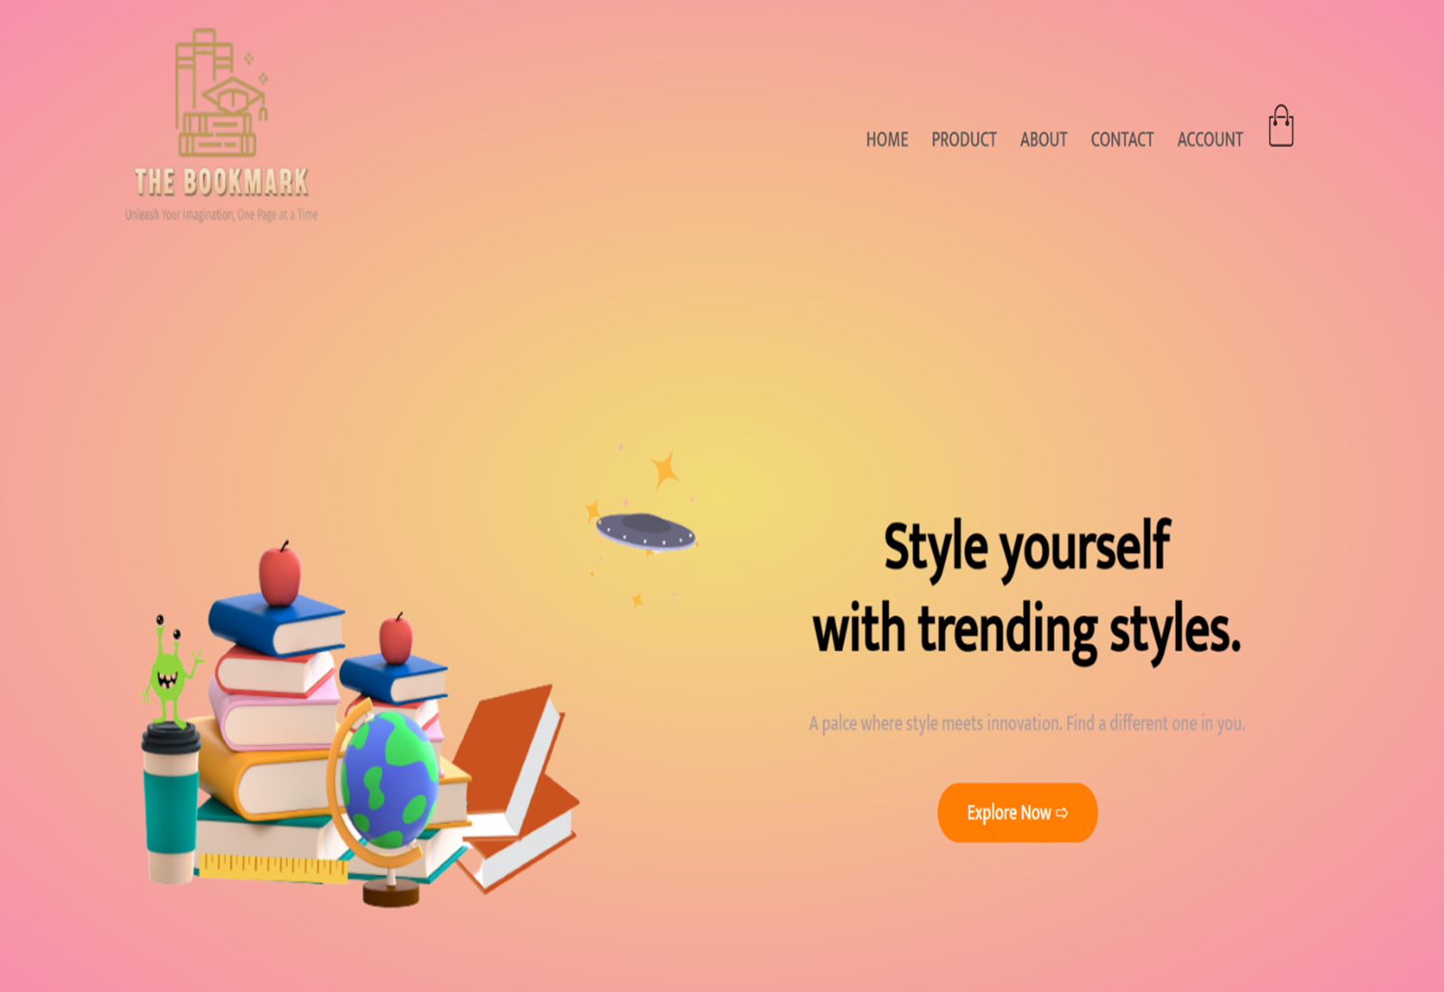
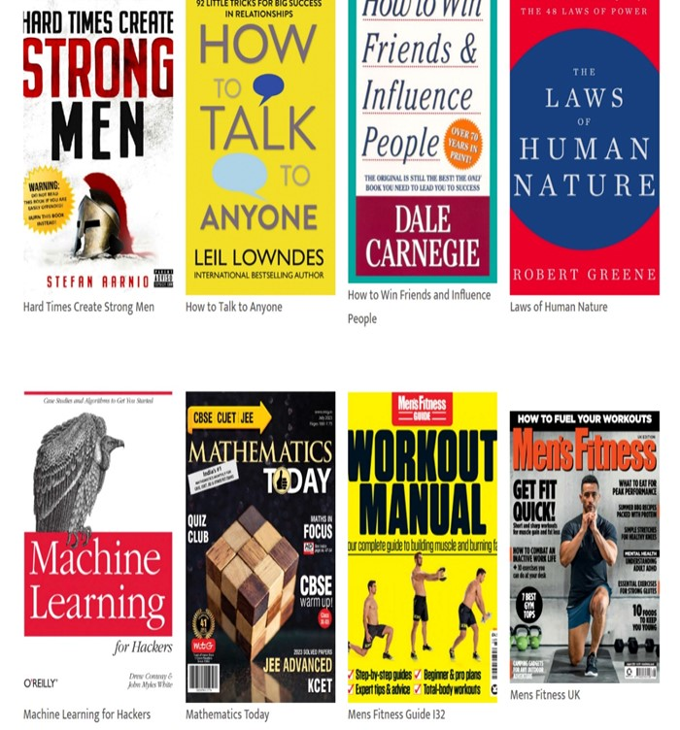
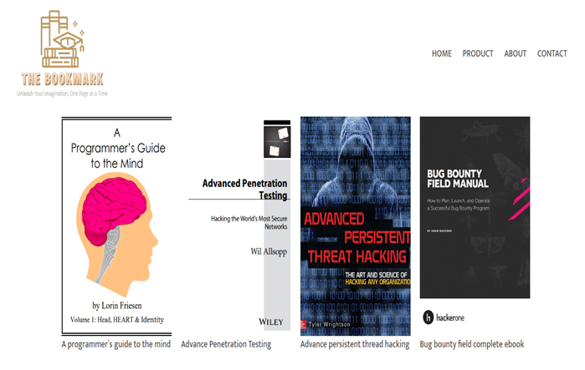
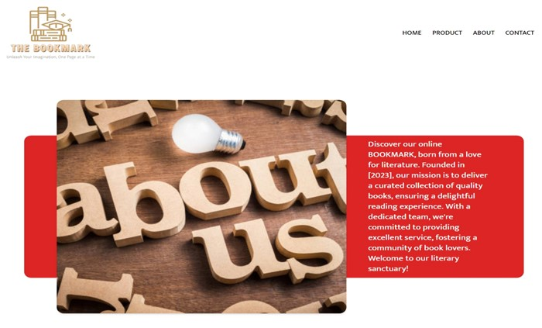
SCREENSHOT

Slide 11
Conclusion
User-friendly navigation and engaging visuals.
Today, we've taken you on a journey through our book store :THE BOOKMARK, and we hope you've enjoyed this glimpse into our world of literature
A vast selection of books across genres.
Thank you for your time and attention.

Slide 12


