Slide 1

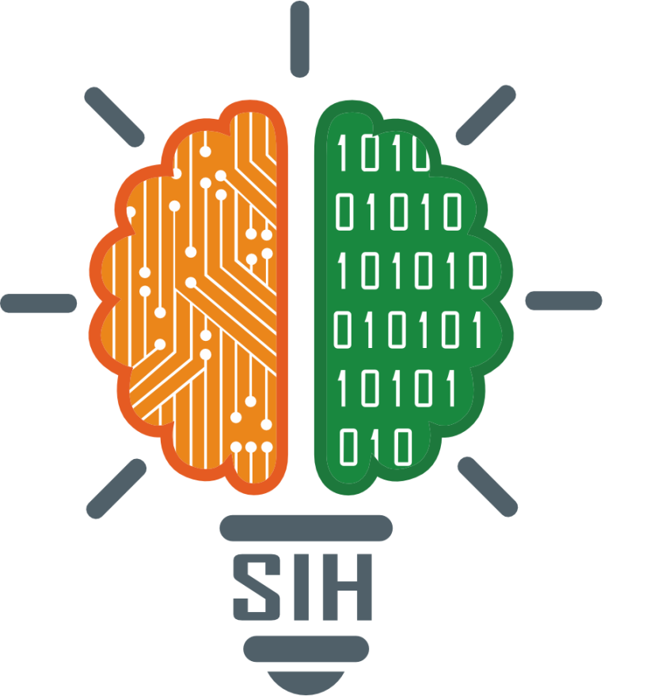
SMART INDIA HACKATHON 2024
TITLE PAGE
Problem Statement ID –SIH1631
Problem Statement Title-AI-Powered Student Assistance Chatbot for Department of Technical Education, Government of Rajasthan.
Theme-Smart Education
PS Category- Software

Slide 2
IDEA TITLE
EduPilot
AI-Powered Student Assistance Chatbot
Detailed explanation of the proposed solution :We are developing chatbot powered by AI to help students with information about technical education in Rajasthan. This chatbot will answer questions about courses, admissions, exam schedules, and other important topics.
How it addresses the problem :The chatbot will make it easier for students to get information quickly. It will reduce the workload on staff and provide accurate answers to common questions. This will improve how information is shared and help students throughout their education.
Innovation and uniqueness of the solution :Our chatbot will use advanced technology to understand and respond to a wide range of questions. It will learn from interactions to give personalized answers and provide real-time updates from educational databases. This makes it more effective than traditional support methods.

Slide 3
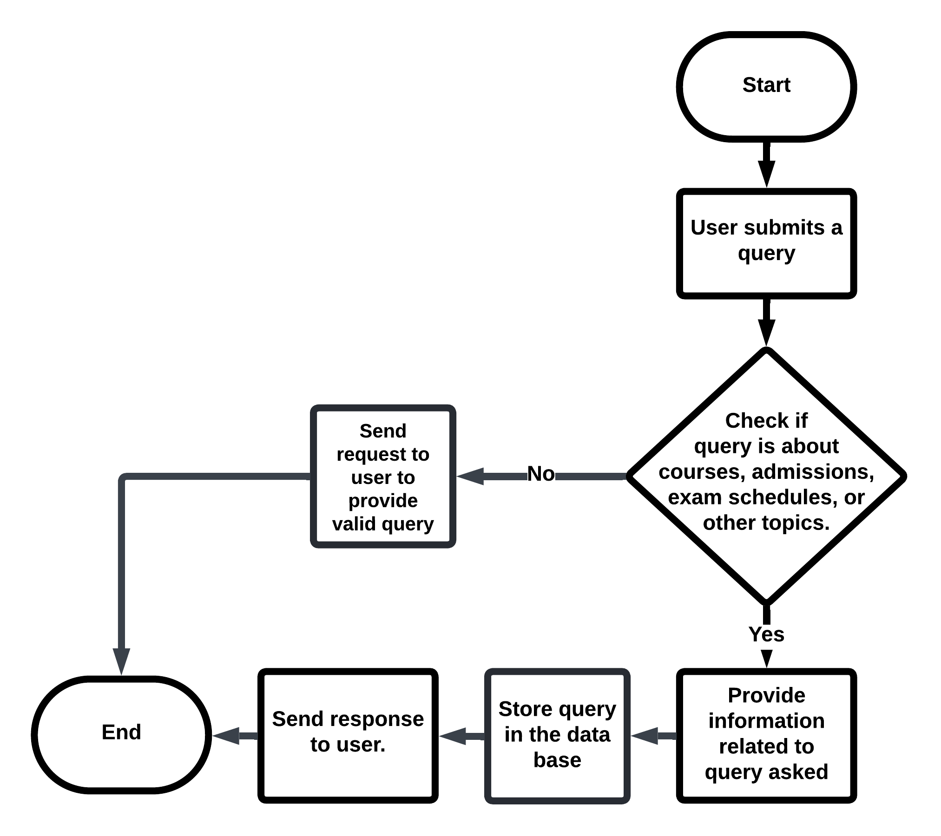
TECHNICAL APPROACH
EduPilot
Technologies to be used:
Frontend- HTML ,CSS,JS
Backend-Node-JS
Database-MongoDB
Programming Language- Python
NLP libraries-NLTK, spaCy, RegExr

Slide 4
FEASIBILITY AND VIABILITY
EduPilot
Analysis of the feasibility of the idea:
With the availability of NLP and ML technologies, which are well-supported by a variety of frameworks and library resources, a chat bot has a great chance of success. The project's breadth is in line with both the demands of education and existing technology.
Potential challenges and risks:
Data Privacy: Ensuring the secure handling of personal data. Accuracy of Responses: Maintaining high accuracy and relevance in responses. Integration Issues: Seamlessly integrating the chatbot with existing educational systems.
Strategies for overcoming these challenges:
Data Privacy: Stick to data protection laws and have strong security measures in place.
Accuracy: Based on user interactions, continuously train and update the chatbot model.
Interface: Work together with IT personnel to guarantee a seamless interface with educational platforms.

Slide 5
IMPACT AND BENEFITS
EduPilot
Potential impact on the target audience:
Student-It helps in educational queries and process.
Administrative Staff-less effort and more effective student inquiry processing.
Benefits of the solution:
It will improve information gathering and support.
It will also reduce employee costs.

Slide 6
RESEARCH AND REFERENCES
EduPilot
Taken reference from :
https://realpython.com/build-a-chatbot-python-chatterbot
https://www.chatbot.com/help/build-your-chatbot/how-to-build-your-chatbot
https://365careers.com
https://dte.rajasthan.gov.in

Slide 7
IMPORTANT INSTRUCTIONS
Please ensure below pointers are met while submitting the Idea PPT:
Kindly keep the maximum slides limit up to six (6). ( Including the title slide)
Try to avoid paragraphs and post your idea in points /diagrams / Infographics /pictures
Keep your explanation precise and easy to understand
Idea should be unique and novel.
You can only use provided template for making the PPT without changing the idea details pointers (mentioned in previous slides).
You need to save the file in PDF and upload the same on portal. No PPT, Word Doc or any other format will be supported.
Note - You can delete this slide (Important Pointers) when you upload the details of your idea on SIH portal.

