Slide 1

CAPSTONE PROJECT PREDICTIVE MODEL FOR HEART FAILURE DETECTION
Presented By
Student Name: Rajat Kumar dash
College Name: Giet university
Department: cse
Email ID: rajatdash2004@gmail.com
AICTE Student ID: STU66064db037d571711689136

Slide 2
OUTLINE
Problem Statement
Proposed System/Solution
System Development Approach (Technology Used)
Algorithm & Deployment
Result (Output Image)
Conclusion
Future Scope
References

Slide 3
Problem Statement
Heart failure is a serious medical condition where the heart is unable to pump blood effectively, leading to a range of health complications. Early prediction of heart failure is crucial, as it can significantly improve patient outcomes by enabling timely intervention and treatment.

Slide 4
Proposed Solution
The proposed system aims to address the challenge of the Heart failure detection to reduce loss of uncounted live . This involves leveraging data analytics and machine learning techniques to forecast Heart failure. The solution will consist of the following components:
Data Collection:
The dataset used for this project was sourced from ‘Kaggle’
which provides comprehensive information on patient health.
Features: Age, Sex, Chest Pain Type, Resting BP, Cholesterol, Fasting BS, Resting ECG, Max HR, Exercise Angina, Old peak, ST Slope, Heart Failure
Data Preprocessing:
Handling Missing Values: Missing data was handled using imputation techniques to ensure completeness
Feature Scaling: Numerical features were scaled using Standard Scaler to standardize the data and improve model performance
Encoding Categorical Variables: Categorical features were encoded to convert them into numerical values
Machine Learning Algorithm:
Implement a machine learning algorithm, such as scikit-learn for model training, including logistic regression, random forest, and support vector machines.
Also used pandas, NumPy, TensorFlow python model and saved as Pickle file.
Deployment:
Develop a user-friendly interface on streamlit that provides real-time predictions for Heart failure.
Deploy the solution on a scalable and reliable platform, considering factors like server infrastructure, response time, and user accessibility.
Evaluation:
Assess the model's performance using appropriate metrics such as Mean Absolute Error (MAE), Root Mean Squared Error (RMSE), or other relevant metrics.
Fine-tune the model based on feedback and continuous monitoring of prediction accuracy.
Current accuracy 91.5%

Slide 5
System Approach
System requirements:
Processor: Intel Core i5 (minimum) or equivalent AMD processor
RAM: 8GB (minimum), 16GB (recommended)
Storage: SSD with at least 256GB
GPU (Optional): NVIDIA GTX 1050 or higher
Operating System: Windows 10, macOS, or Ubuntu 18.04+
Network: 1 Gbps or higher
Library required to build the model:
scikit-learn
pandas and NumPy
Pickle
Git

Slide 6
Algorithm & Deployment
Models Used:
Logistic Regression: A linear model for binary classification
Decision Trees: A model that splits data into branches to make predictions
Random Forest: An ensemble of decision trees to improve prediction accuracy
KNN Classifier: A non-linear model for binary classification
Model Performance:
Accuracy: 91.5%
Preprocessing Steps:
StandardScaler: For scaling numerical features
OneHotEncoder: For encoding categorical variables
Classifier:
Logistic Regression: Used for classification

Slide 7
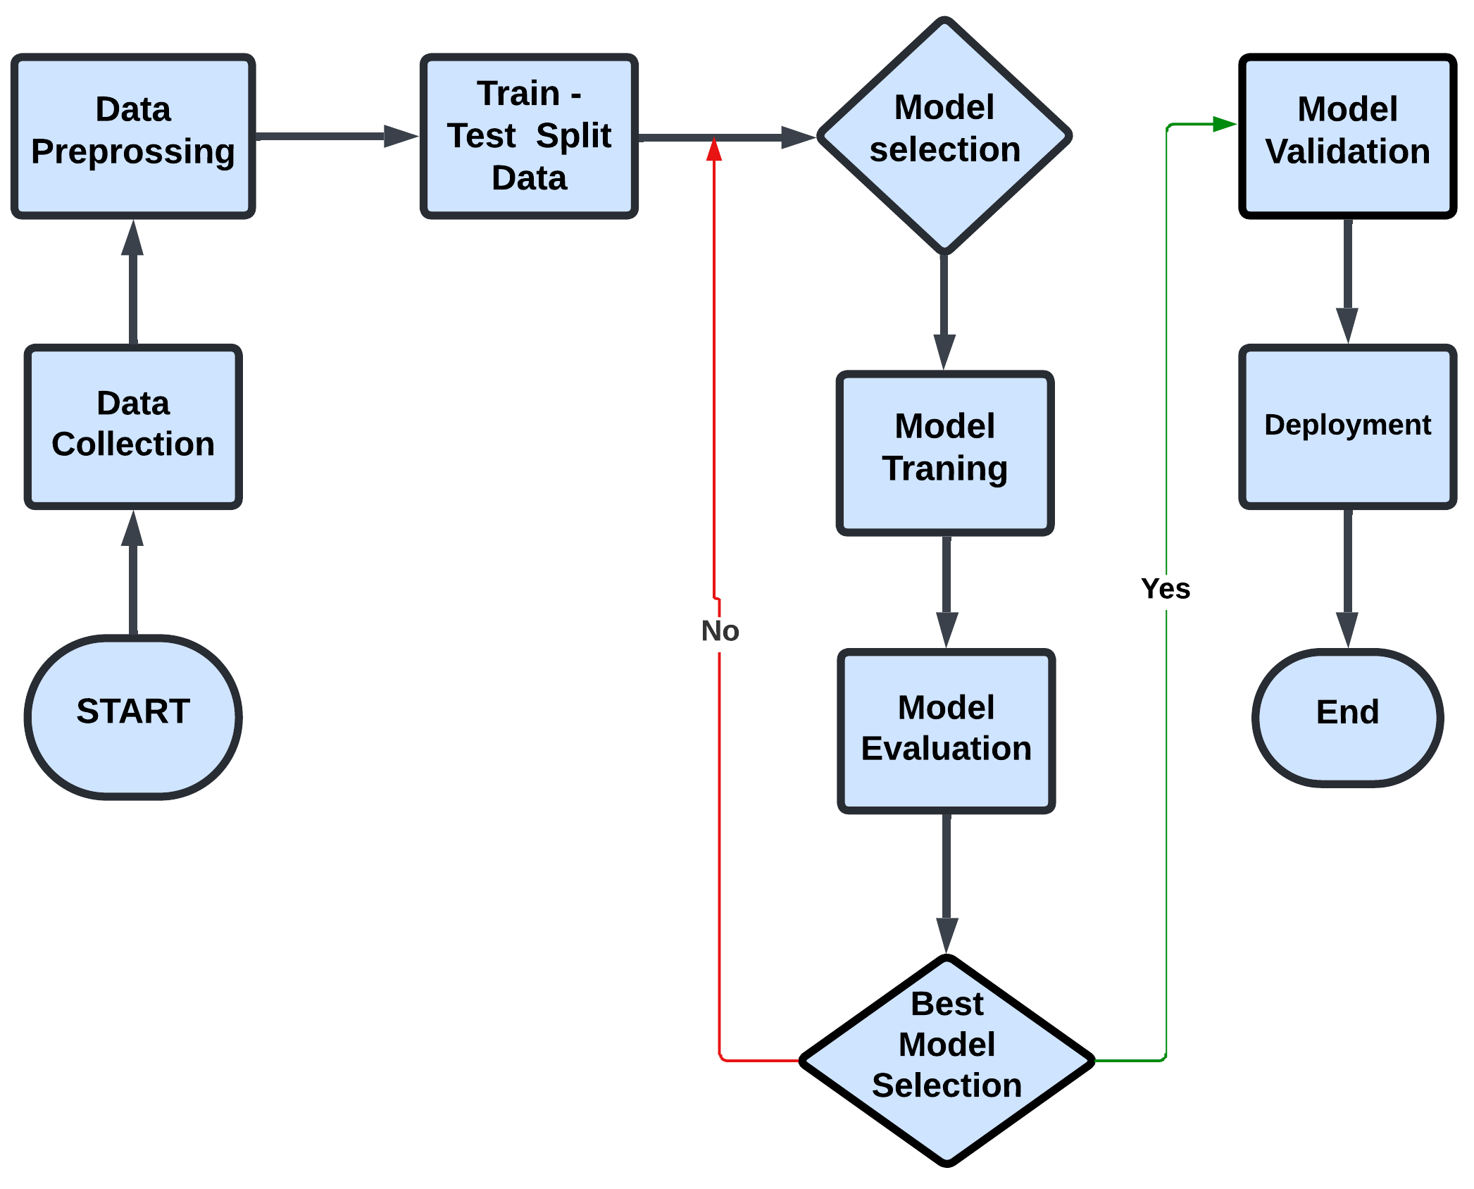
FLOW CHART

Slide 8

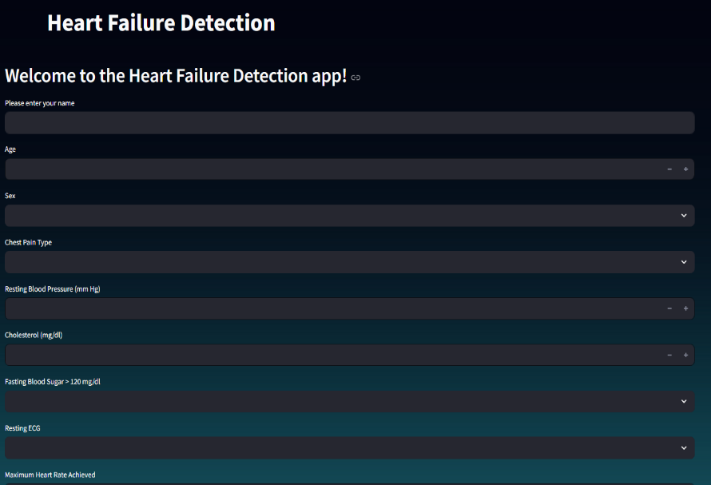
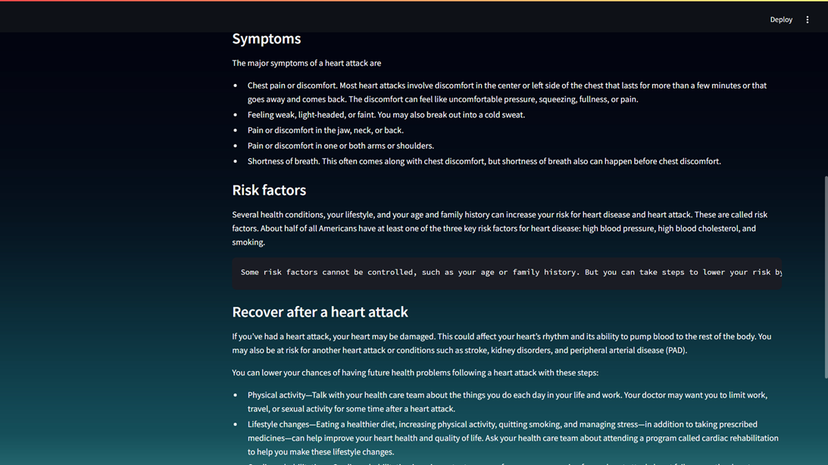
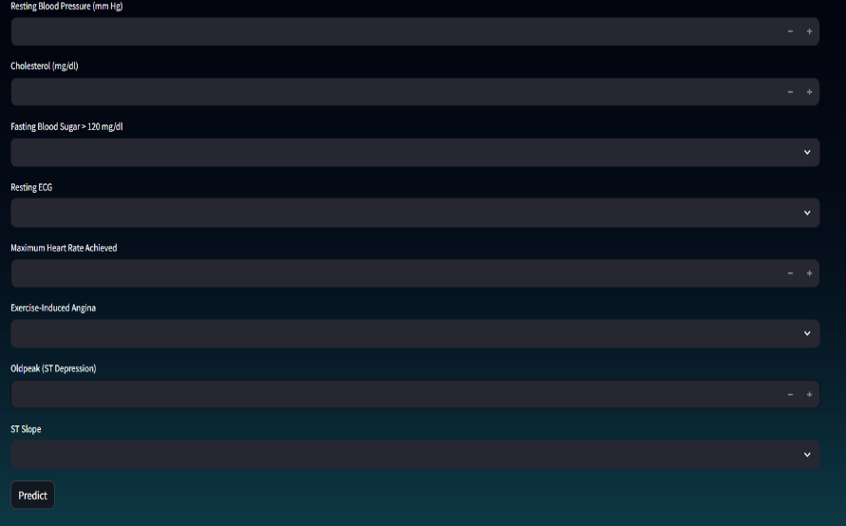
SCREEN SHORT

Slide 9
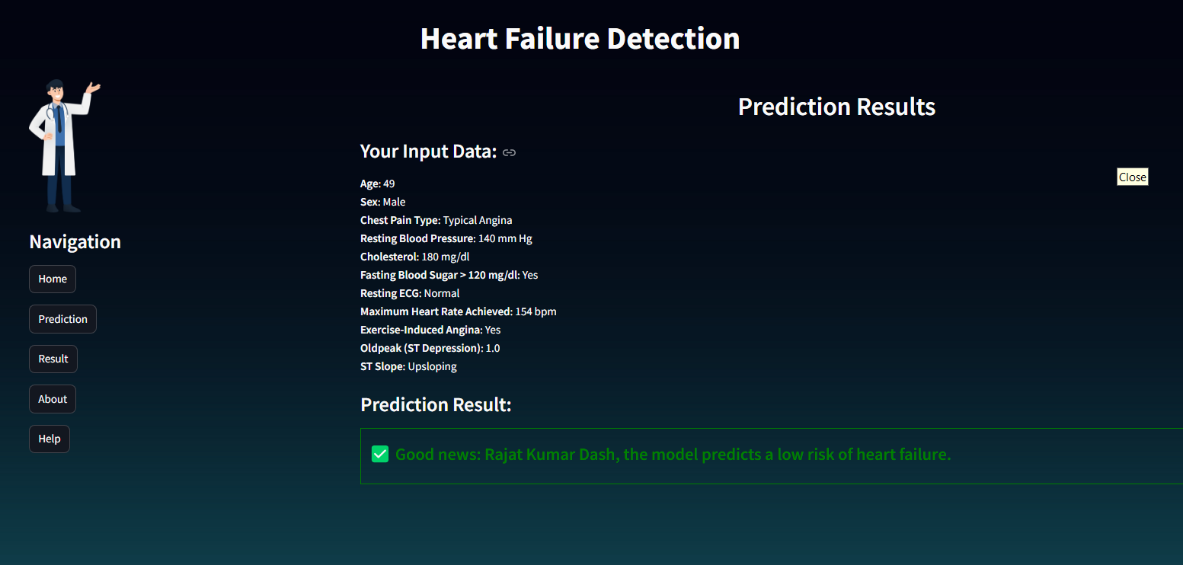
Result

Slide 10
Conclusion
In this project, we developed a heart failure prediction model using a Random Forest Classifier, which achieved the best accuracy after outlier removal. The model effectively predicts patient survival (0) and death (1), highlighting the importance of preprocessing in improving predictive performance. This model could assist healthcare providers in identifying high-risk patients and making informed decisions. However, further validation with larger, diverse datasets is necessary to ensure its robustness and generalizability in different clinical settings.

Slide 11
Future scope
Model Optimization: Explore advanced hyperparameter tuning techniques to further refine the model.
Data Augmentation: Consider augmenting the dataset with synthetic data to address class imbalance and improve model robustness.
Real-Time Prediction: Develop real-time prediction capabilities to integrate the model into clinical settings, providing instant risk assessments.
Integration with EHR Systems: Explore the possibility of integrating the predictive model with Electronic Health Record (EHR) systems to automate data input and enhance usability for healthcare professionals.

Slide 12
References
Articles and Datasets Used
UCI Machine Learning Repository: Heart Disease Dataset. Available at: UCI Heart Disease Dataset
“Heart Failure Prediction Using Machine Learning: A Review.” IEEE Access, 2020
ps://ijaem.net/issue_dcp/Cardiovascular%20Disease%20Predic on%20System.pdf
Documentation for Python and Streamlit
o Python Documentation: Python.org
o Streamlit Documentation: Streamlit.io
o NumPy: https://numpy.org
o Matplotlib: https://matplotlib.org
o SK- Learn: https://scikit-learn.org
Github link- qm-rajat/Heart-Failure-prediction: MY 5th sem ML project

Slide 13
Thank you

