Slide 1

Introducing DPAA
A Bayesian Approach To Evaluating Special Teams Defending Play Performance
Quinn MacLean
2022 Big Data Cup Finals

Slide 2
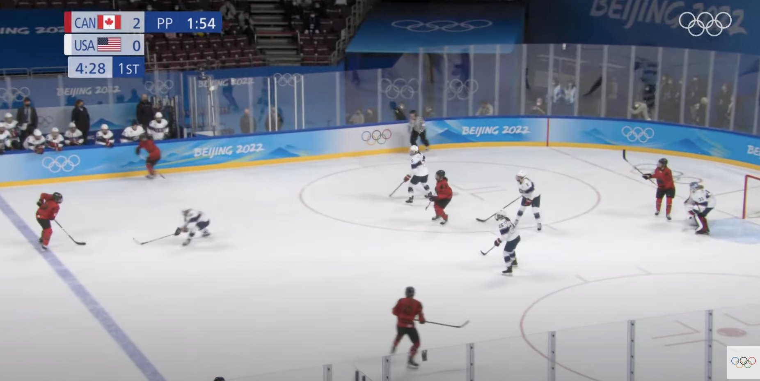
Research Question
Objective: Utilize event & tracking data to understand relative team and individual defensive performance on power plays
Key Questions
What teams/players defended above average?
What are most difficult events to defend against?
What are some observed team/player strategies for defense?
Notes:
Ottawa Hockey Analytics Conference & Shawn Ferris from Hockey-graphs both have emphasized the need to understand more with respect to defense, specifically short handed defense.
Shawn Ferris specifically was quoted as saying in 2020 that we don’t have a true understanding of optimal formations and evaluation of individual players so hope to address that in the later
Utilizing tracking & event data to understand relative team and individual performance
Key questions
What teams/players performed well?
What are difficult events to defend against?
What can we glean as observable strategies for defense

Slide 3
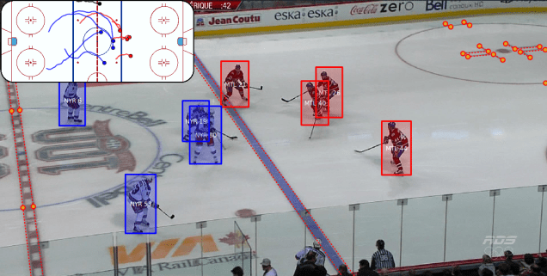
Considerations
2022 Women’s Olympic Hockey Data
Player recognition accuracy
Evaluating closest defensive player
Limited sample size per player
Power play vs even strength play
Notes:
Utilizing 2022 Women’s Olympic Hockey Data
Utilizing statheletes computer vision on local footage to get players coming in and out the frame
Re-fit models to the bucket-less cleaned data for the final presentation
Closest defensive player
Events lists the player in question for takeaway, puck recovery, blocked shot but that’s only a proportion of total plays
Aligned event timeframe to tracking data to get approximate players for a given event
I took every offensive player during an event and identified the closest defensive player throughout the event as the defensive player in question to model and impute for missing data points
~1900 matchups on 500+ events w/ some players guarding multiple players
Could be multiple defensive players assigned to an offensive player for a given play (hence short handed defense player
Limited sample size per player, most defensive player averaged around 6-7 plays
Obvious but wanted to call out that power play defensive play may vary from even strength play, and strategies
For instance less zone entries and more passing observed

Slide 4
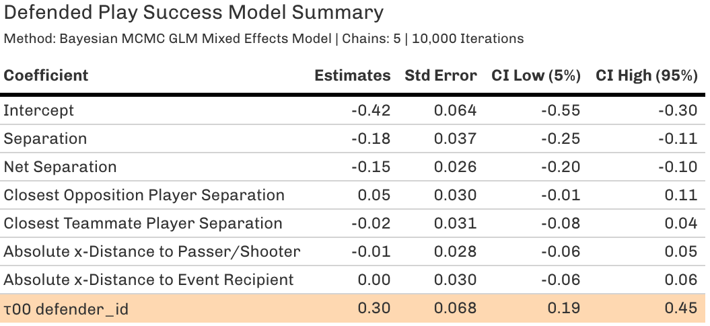
Modeling Approach & Evaluation
Modeling Successfully defended play
Mixed Effects Model using Monte Carlo Markov Chain
Defending Plays Above Average (DPAA): defender’s ability could shape the outcome of a play
Notes:
Modelling successfully defended play
Takeaway
Unsuccessful pass
Dump In/Out resulting in change of possession
Blocked shot attempt
Unsuccessful zone entry
Puck recovery
Utilizing tracking data we were able to get separation metrics and distance from event to fit to the model
Considered variance of separation
Average and Variance of position (x,y)
2nd & 3rd closest separation
Separation at start of event,
After the fact:
Would have tested lagging distance over desired time interval (to measure speed) or sum of distance
Add acceleration, skating velocity, orientation
PowerPlay situation -> i.e.. 5 on 3, 5 on 4
Modelled for each offensive player’s matchup to a defensive player and the outcome of that event
Model
Utilizing a bayesian approach given current olympics may be like other previous events and limited overall sample size
Mixed Effects Model, takes a normal model and identifies, which player had a relative effective the outcome of a play on top of separation metrics identified
Random effects of defender ID
( Optional) Nelder_mead optimizer: helps to minimize the overall prediction error through right parameters in the model (nonlinear optimization)
Basically with each iteration the algorithm will minimize towards the centroid
Doesn’t try to approximate the gradients
Designed for optimizing parameter estimation
Minimized through finding midpoints of each simplex iteration
Minimization based on model error
Monte Carlo Markov Chain uses 5 chains, 10k iterations to ensure that we have an effective sample size to evaluate team/player defensive
Used to approximate the posterior distribution through random sampling in a probabilistic space
Model fit
I placed a wide normal distribution on the intercept -> bqsed on prior believe intercept of defender play could have wider play performance
Normal distribution between 0 and 1 on the prior
Exponential prior on the standard deviation to fit with the wide distribution (prior_aux)
Regularization on separation metrics -> prior_covariance
adapt_delta = 0.8 relaxes target average probability acceptance
Default is highly conservative at 0.95;
QR = False
Logical scaling of the data; given we already applied some regularization techniques
Coefficients
# increase in offense separation, decreases the probability of a successful defended play by 16.2%
# increase in net separation decreases by probability of a successful defended play by 13.8%
# closest opposite separation increases successfully defended play by ~5%
Checks
Posterior Checks of distribution
Logistic binomial Distribution reflected in the posterior checks for each draw
Y replicated simulation to actual
Using Gelman & Rubin’s scale reduction factor or Rhat of all variables less than 1.05 which give evidence to proper convergence of the model and an effective sample size
Sigma or Defender ID is 0.3, one of the highest coefficient gives us evidence that the defender can cause the outcome of a play
Standard error for all fixed variables less than 0.05 and
-0.42 intercept, defenders already starting at a disadvantage given a class imbalance of successfuls

Slide 5
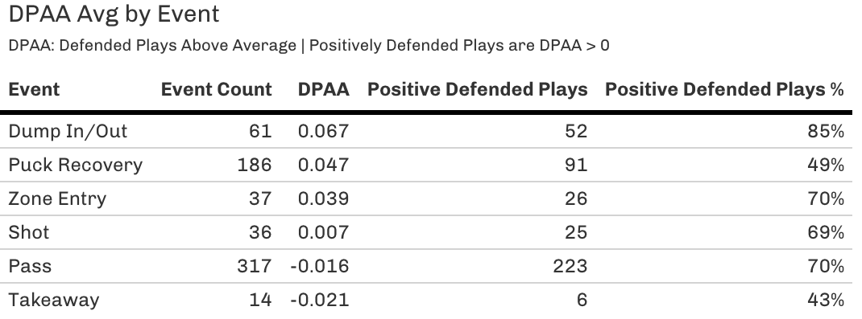
Modelling Results
Pass hardest play to defend
Dump In/Out easiest to defend
Puck Recovery appears to have the highest volatility
Notes:
Aggregate results we see Pass in the power play are negative defended play outcome ~ hardest to defend
Useful sub - metric to evaluate performance
More important than zone entry in power plays to defend well against
Dump Ins & Puck Recovery are easiest
Early bid to initial strategy
Potentially getting aggressive to at the blue line
Secondary metric created is if DPAA > greater than 0, than we can define as a positively defended play
Biggest volatility in overall results is objectively Puck Recovery given low % of puck recovery
Zone Entry is something that varies greatly in Power Plays to what I would compare to even strength situations

Slide 6
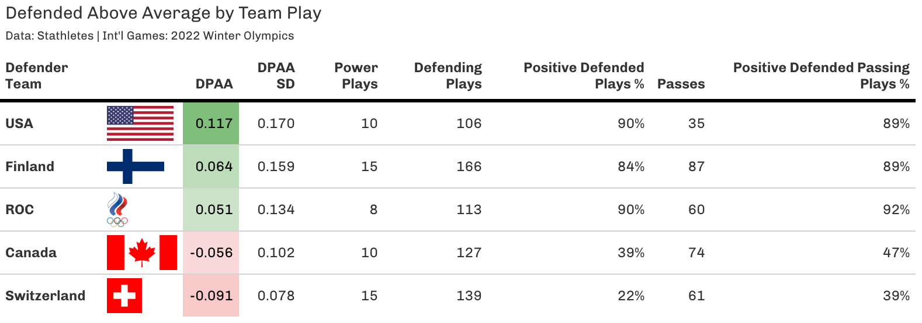
DPAA Use: Team Performance Evaluation
Notes:
Identified USA as top performer and Switzerland as bottom performer
USA is due to reducing amount of overall passes
You can see the positive teams have higher SDs, meaning that individual players could be driving their team success (main point for USA0
Finland had the highest average team separation from players, which led to offensive players being spaced farther from the net.
ROC defended passes well but had the second lowest penalty killing in the tournament, in a small sample size, teams were able to pass within their defensive formation leading to more goals so a call out if any is for a tighter formation for ROC given they could have been a lot higher in DPAA
Canada/Switzerland’s lack of performance is due to inability to prevent passes
50% of Canada’s goals against during the tournament came from power plays.
Teams they were guarding had the highest average pass distance meaning they were able to spread out their defenders
Difference between USA v Canada play was that USA played the top of the formation better than Canada leading to less overall passes

Slide 7
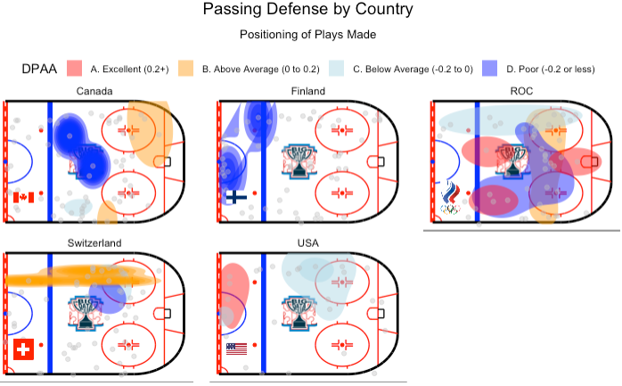
Team Short Handed Passing Defense
Notes:
When we plot passing defense (given hardest play)
Canada:
Not great at defending blue line/good at defending when they need to in front of the goal
Finland:
Not great at defending zone entry/blue line
ROC
Pretty sporadic, which may show us why they were average overall.
Seemed like passes were able to split the defensive formation while positive plays were made on outside of formation
Low stdv give us some insight that their dedication to the formation, may be why there was sporadic play
Switzerland
Only defended well along the boards

Slide 8
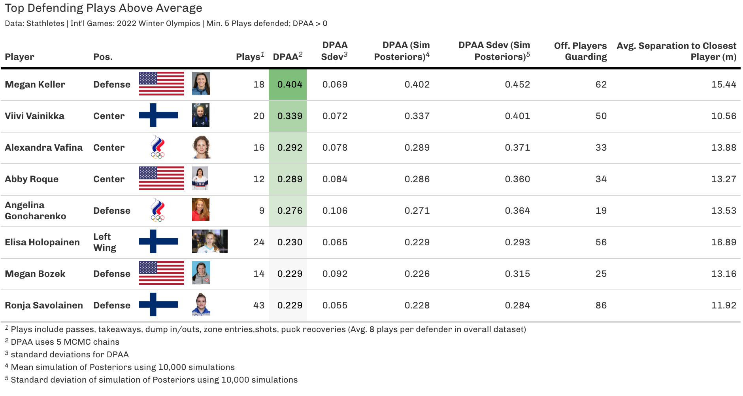
Top Performers
Notes:
Slide 8 - Top Performers
So we can see the total events they are a part of
Megan guarding 3 players on average given her proximity I will dive into her more
One observation of these players is how close the top players play.
Top players are playing less than 15 ft on average, with a few exceptions
Ronja is one of the top defenders for Finland with 43 people guarding
If you were to plot her heat map, she would have top of the diamond formation and near the blue line
Top Canadian player identified was Marie PhilipPoulin
Some regard as one of the best players in Canadian history
Poulin -> separation at 12 ft
Mich Zander Hart -> had lower DPAA (negative) and was stretched to multiple ends of the diamond or box formation;
I think if she was to play to her team formation would have led to more consistent play
To ensure proper scouting and reliance on the MCMC metrics, I simulated the posteriors (using 10k iterations), which is now why you see simulated mean
Utilize German sim technique to build empirical Bayes estimates
Utilize simulate random effects in posterior distributions
Using draws from multivariate normal distribution and multiplies by model’s covriance
Can see standard deviations are a bit all over the place
My guess is these players are the tails of the distribution, which is causing issue in the model
Simulation providing a wider/conservative efforts on the actual uncertainty
Probably consider a non parametric approach; wider distribution probably causing issue in simulation
MCMC results were lot more sensible intervals
Could be due to the covariance penalty I had placed in the model
Another option: Bayesian Boostrapping, which would randomly resample on the posterior distribution and run a penalized likelihood model in for resample

Slide 9
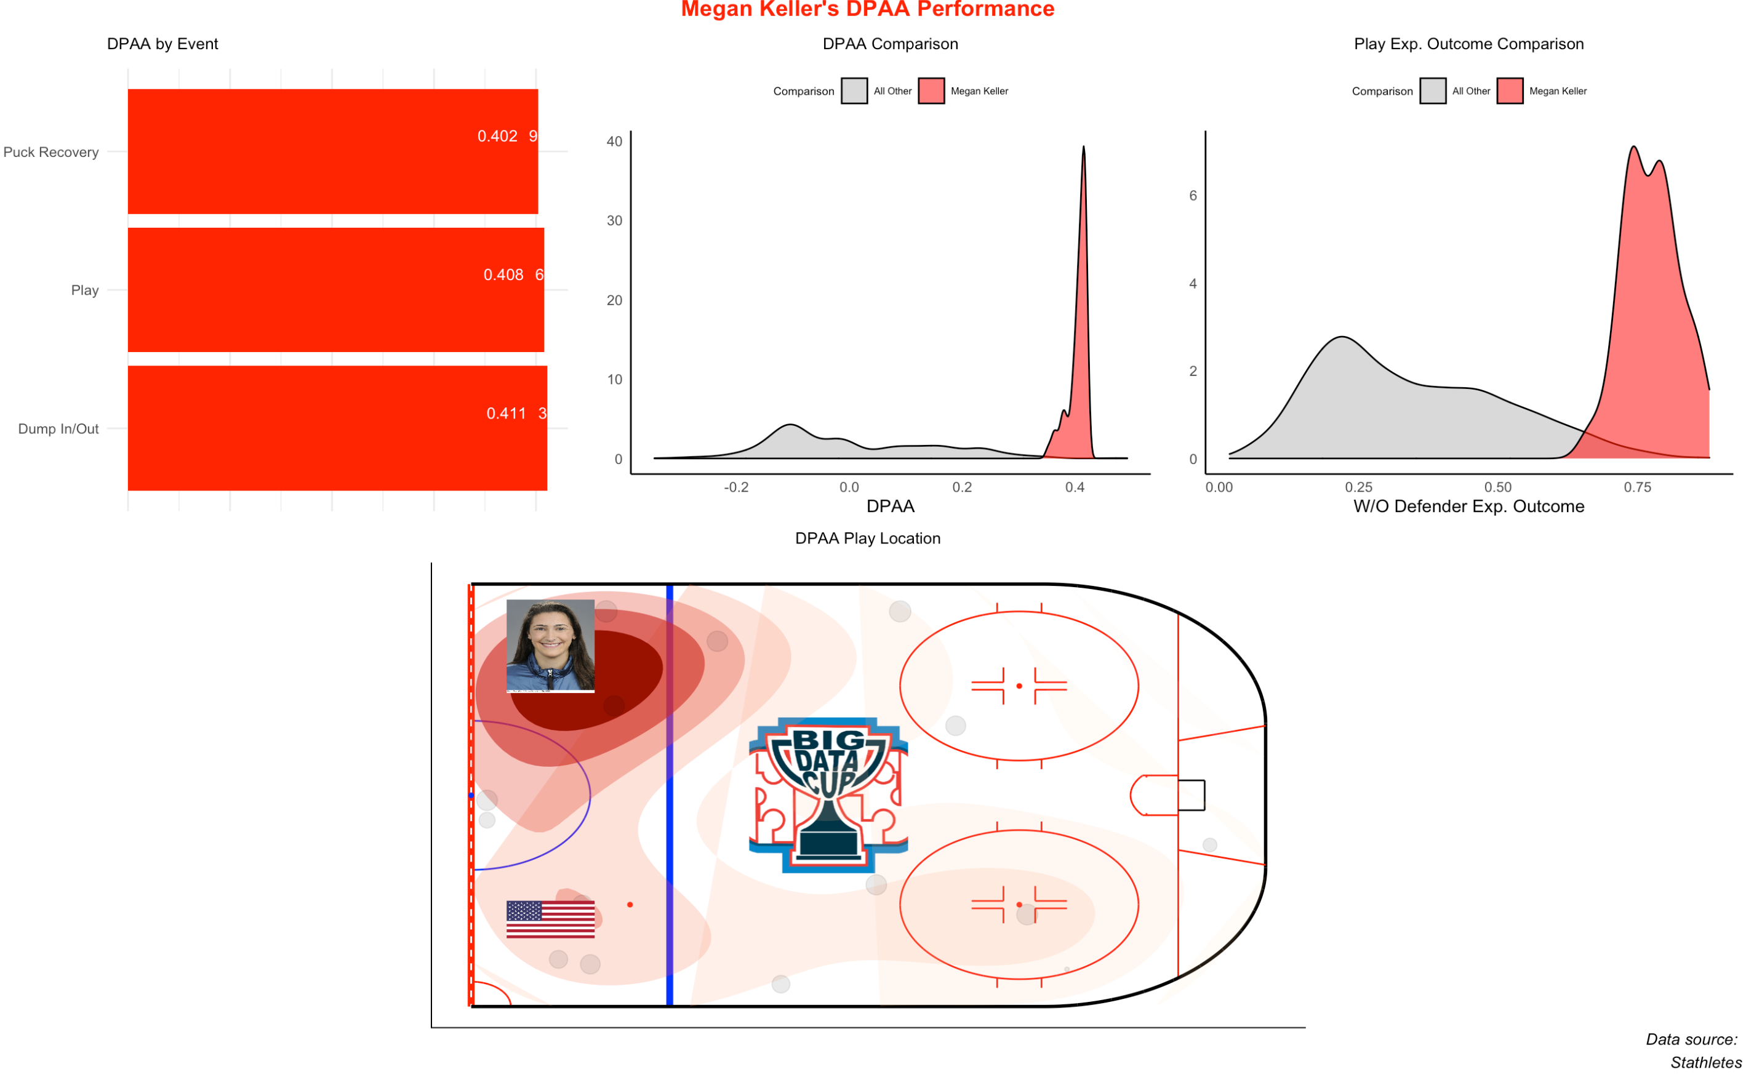
Player Spotlight: Megan Keller
Notes:
The models identified Megan Keller from the US as one of the top performers during the tournament
One difference of Megan versus other top players is that she defended nearly 15 ft+ to her closest defensive which is nearly 4-5 ft more than others top defenders
One advantage that Megan Keller is she has a longer reach (at 5’11) than the average
She also tend to play at the top of the blue line (thus maybe why USA prevent a lot of passes)
On top of that she was one of the best defenders in the tournament against passes in the zone
One knock against Megan Keller is that the expected outcome of plays she was guarding were lot more positive than other players but she played her role well regardless (right chart vs middle chart

Slide 10
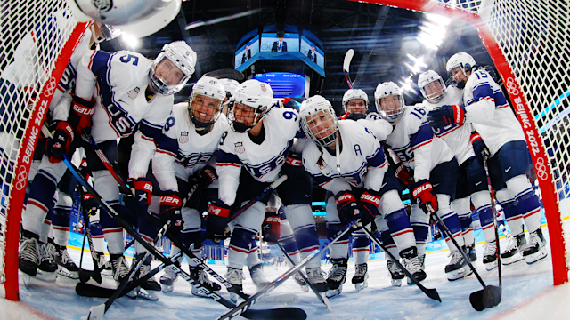
Next Steps
Prevent passing in the zone
DPAA Scouting Reports
Use framework to evaluate EV DPAA
Win the Gold!
Notes:
Following the USA strategy, work to prevent passing in the zone; play the blue line aggressively
Push for Dump In/Outs given that has the highest DPAA average
Play your best defenders near the top of the zone; this could have improved Canada’s play
Install a zone assignment of 15ft or less for effectiveness (top players were at 10 ft of nearest offensive player)
Box/diamond with this spacing should help
Scouting reports (such as Megan Keller example) can help DPAA be used for coaching staff
Could use similar framework for Even strength situations but we’d imagine lack of zone entries and more players would shift results
Hopefully this model can help the USA to win the gold in the next olympics

Slide 11
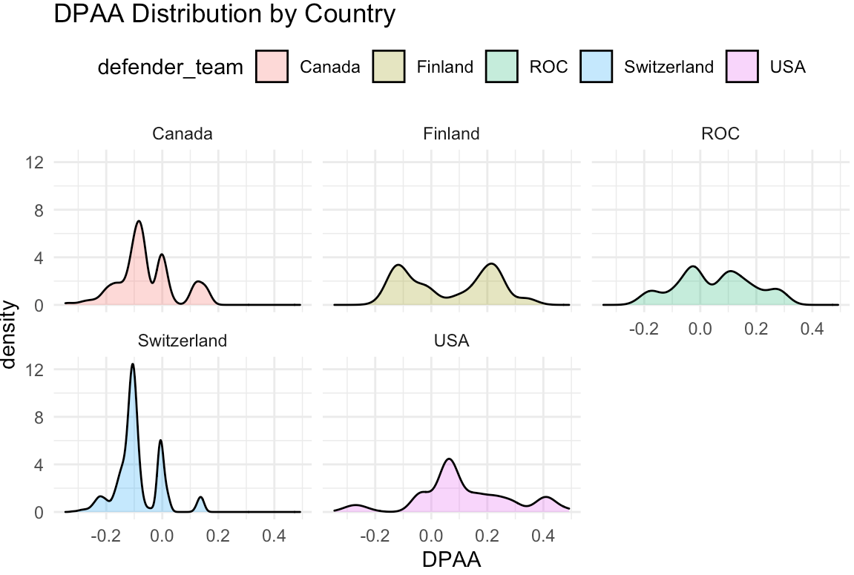
Appendix – DPAA distribution

