Slide 1

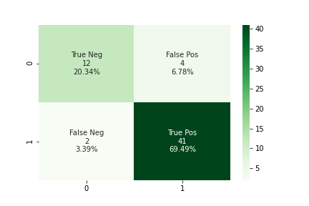
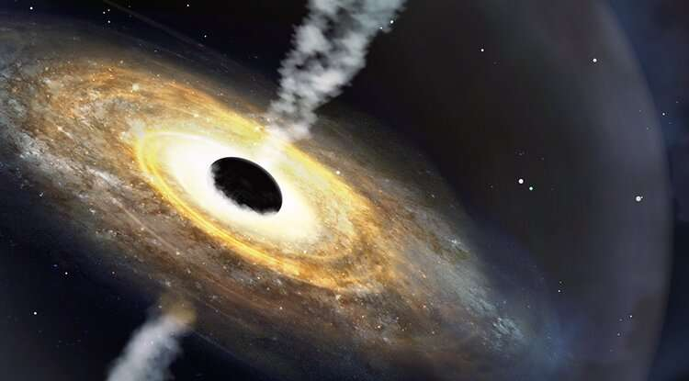

Using the Random Forest Classifier, we can distinguish possible quasars from stars with a 89.83% accuracy.
Using Machine Learning to Improve Efficiency of Quasar Candidates Selection Based On Photometric Data
Qiongwen Mao (Shirley) and Prof. Eilat Glikman
Big Picture
Current Efforts
Quasars are extremely luminous astronomical objects that are empowered by supermassive black holes. Studying quasars is crucial for understanding the makeup of the universe. To identify quasars from other celestial objects, however, requires spectroscopic observations for each objects out of thousands of individual sources, one at a time. Thus, the efficient selection of candidates to be observed is very important.
Quickly explain what the graph shows. Help people think.
an artist’s impression of the quasar Poniua’ena
My projects focuses on using Random Forest Classifier machine learning model to identify quasars prior to pursuing spectroscopic observation, thus improving the efficiency of the selection of quasar candidates.
PHYS 0704: Senior Project
Spring 2022

