Slide 1


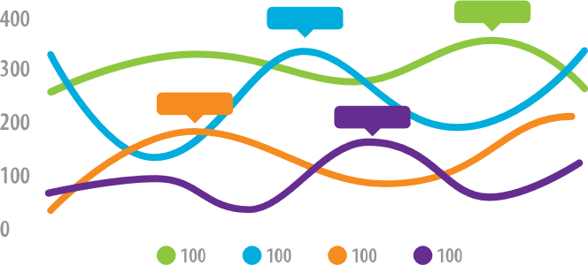
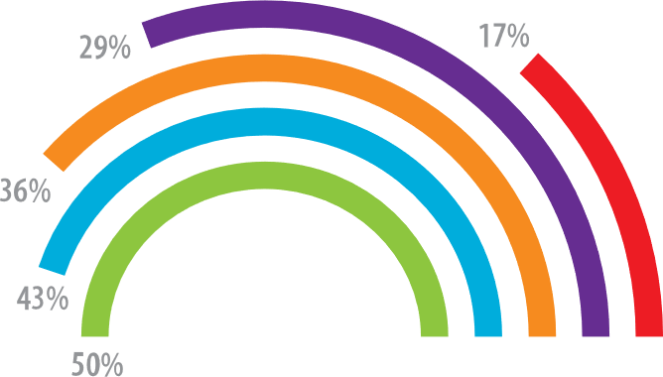
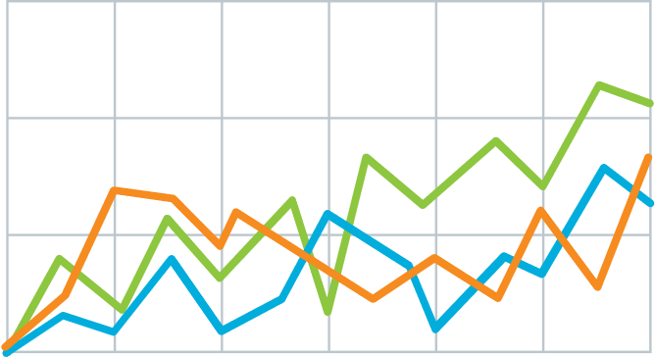
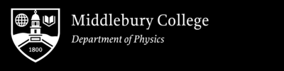
Main finding goes here, translated into plain English. Emphasize the important words.
Predict Quasars and Non-Quasars Astronomical objects Using Random Forest Classifier Model
Qiongwen Mao (Shirley) and Prof. Eilat Glikman
Big Picture
Current Efforts
Who cares? Explain why your study matters in the fastest, most brutal way possible (feel free to add graphics!).
What are you working on? Explain your experiment or simulation briefly. Even better: use a diagram!
Explain what the graph shows. Like, spoilers are good.
Quickly explain what the graph shows. Help people think.
PHYS 0704: Senior Project
Spring 2022

