Slide 1

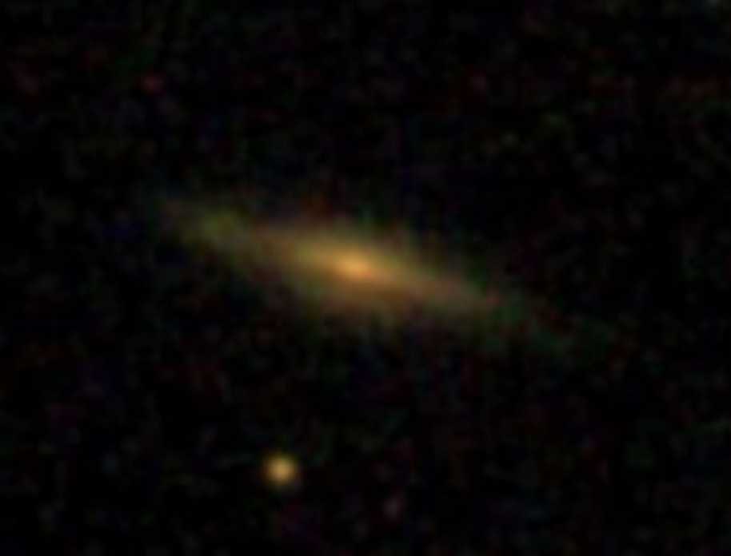
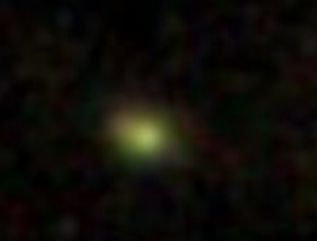
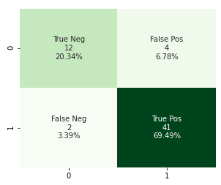
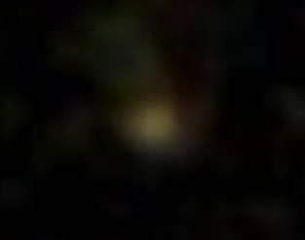
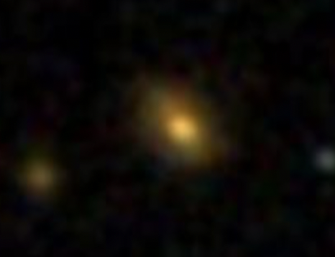

Using the random forest
classifier, we can distinguish possible quasars from stars with a 89.83% accuracy.
Using Machine Learning to Improve Efficiency of Quasar Candidates Selection Based On Photometric Data
Qiongwen Mao (Shirley) and Prof. Eilat Glikman
Big Picture
Current Efforts
Quasars are extremely luminous astronomical objects that are empowered by supermassive black holes. Studying quasars is crucial for understanding the makeup of the universe.
To identify quasars from other celestial objects, however, requires spectroscopic observations for each objects out of thousands of individual sources, one at a time. Thus, the efficient selection of candidates to be observed is very important.
My projects focuses on using Random Forest Classifier machine learning model to identify quasars prior to pursuing spectroscopic observation, thus improving the efficiency of the selection of quasar candidates.
In this project, we collect the luminosity measured at different wavelengths of each celestial object, ranging from ultraviolet to near-infrared, from Solan Digital Sky Survey and measure the luminosity difference. amongst wavelength
We use the luminosity difference, termed as “color,” as the feature inputs for Random Forest Classifier model to classify quasars and non-quasars objects.
The model is currently trained on 194 labelled data points, consisted of each object’s color features.
The confusion matrix below shows the performance of my current trained model. “0” indicates non-quasar objects, and ”1” indicates quasars
Predicted Class
Galaxy
Quasar
Star
Trying to figure out what this is by inputting its color features to the model
True Class
PHYS 0704: Senior Project
Spring 2022

