Slide 1
CO2018
OPERATING SYSTEM LAB: REPORT LAB 1
Vũ Minh Quân - CC02

Slide 2
Q&A
CO2018
OPERATING SYSTEM LAB: REPORT LAB 1
Vũ Minh Quân - CC02
Question 1: List some other popular Linux shells and describe their highlighted features ?
+) Beside Bash, here are some more Linux shells:
-) Zsh (Z Shell):
Interactive Use: Zsh is highly customizable and designed for interactive use. It offers advanced tab completion, spelling correction, and shared command history among other features.
Plugins and Themes: Zsh supports plugins and themes through frameworks like Oh My Zsh, which enhances its usability and appearance.
Extended Globbing: Zsh offers powerful filename globbing capabilities, making it easier to work with files and directories.
-) Fish(Friendly Interactive Shell):
User-Friendly: Fish is designed to be user-friendly with features like syntax highlighting, auto-suggestions, and easy-to-remember commands.
Sane Defaults: Fish has sensible defaults which reduce the need for configuration, making it suitable for beginners.
Scripting Language: Fish uses its own scripting language which is more straightforward than traditional shell scripting languages like Bash.

Slide 3
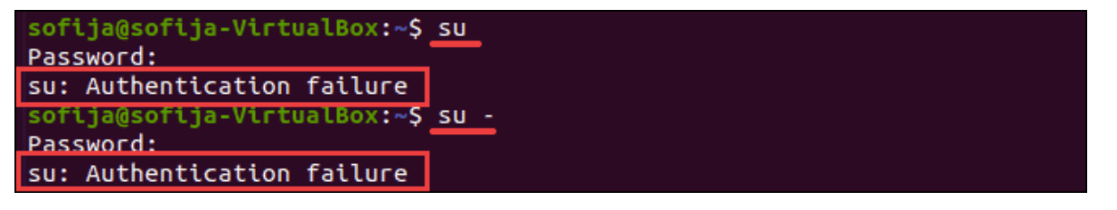
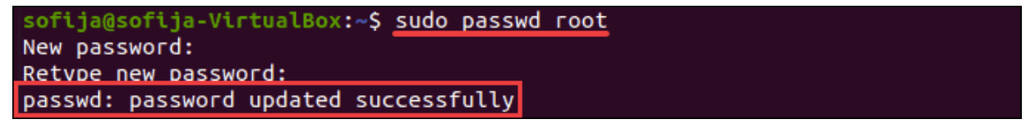
Q&A
Question 3: Compare the sudo and the su command
Su example:
Sudo example:

Slide 4
Q&A
Question 4: Discuss about the 777 permission on critical services (web hostings, sensitive databases,...).
Setting file or directory permissions to 777, which grants full read, write, and execute access to everyone, including the owner, group, and other users, poses significant security risks for critical services such as web hosting and sensitive databases. These risks include unauthorized access, data manipulation, compromised integrity, non-compliance with regulations, vulnerability to attacks, and potential data loss. Instead, it's crucial to follow the principle of least privilege, granting permissions based on necessity and implementing proper access controls to mitigate security threats and maintain the integrity of critical systems.

Slide 5
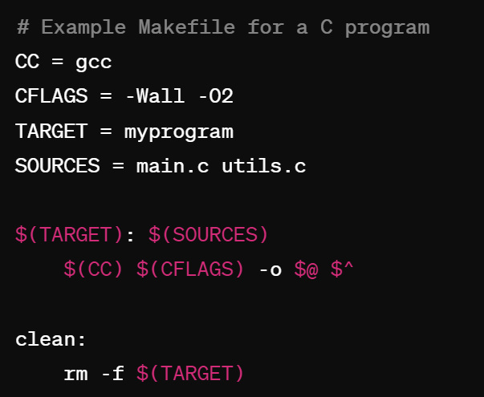
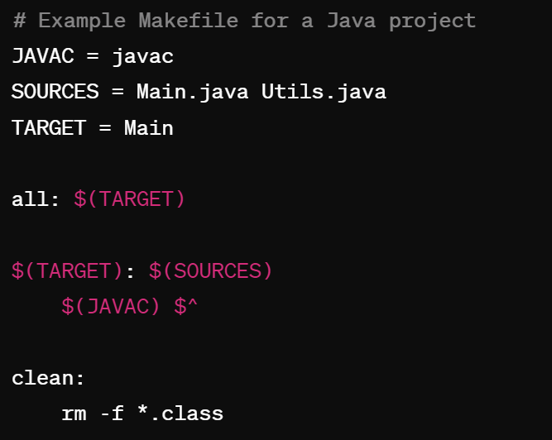
Q&A
b) Makefile Mechanism for Other Programming Languages:
Yes, Makefile mechanisms exist for various programming languages besides C. Makefiles can be adapted to compile projects written in languages like C++, Java, Python, and more. Each language may have its own compiler and specific build requirements, but the concept of Makefiles remains the same - specifying dependencies and rules for building the project.
Question 5:
a) What are the advantages of Makefile? Give examples?
b) Is there any Makefile mechanism for other programming languages? If it has, givean example?
c) Compiling a program in the first time usually takes a longer time in comparisoncwith the next re-compiling. What is the reason?
a) Advantages of Makefile:
Automation: Makefiles automate the compilation process by specifying dependencies and rules for building a project. This saves time and effort, especially in larger projects with multiple source files.
Efficiency: Makefiles only compile files that have changed since the last compilation, avoiding unnecessary recompilation of unchanged files.
Dependency Management: Makefiles manage dependencies between source files and automatically rebuild affected files when dependencies change.
Customization: Makefiles allow for customization of build options, such as compiler flags and build targets.

Slide 6
Q&A
Question 5:
a) What are the advantages of Makefile? Give examples?
b) Is there any Makefile mechanism for other programming languages? If it has, givean example?
c) Compiling a program in the first time usually takes a longer time in comparisoncwith the next re-compiling. What is the reason?
b) Makefile Mechanism for Other Programming Languages:
Yes, Makefile mechanisms exist for various programming languages besides C. Makefiles can be adapted to compile projects written in languages like C++, Java, Python, and more. Each language may have its own compiler and specific build requirements, but the concept of Makefiles remains the same - specifying dependencies and rules for building the project.

Slide 7
Q&A
Question 5:
a) What are the advantages of Makefile? Give examples?
b) Is there any Makefile mechanism for other programming languages? If it has, givean example?
c) Compiling a program in the first time usually takes a longer time in comparisoncwith the next re-compiling. What is the reason?
c) Reason for Longer Compilation Time Initially:
The initial compilation typically takes longer due to the need to compile all source files from scratch and generate object files and executables. Additionally, the compiler may need to perform various optimizations and generate additional metadata during the first compilation. Subsequent re-compilations are faster because Makefiles track dependencies and only recompile files that have changed since the last build, resulting in fewer files needing compilation.

Slide 8

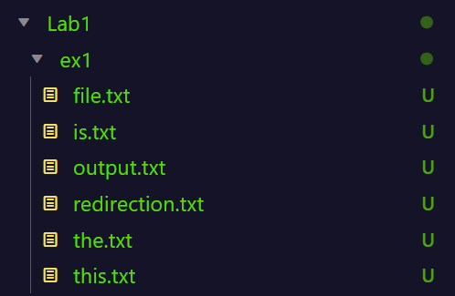
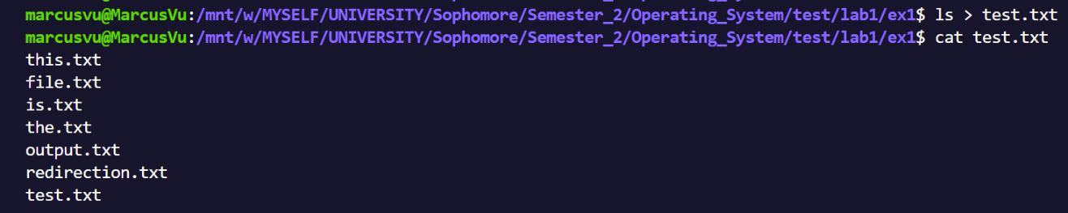
EX-2.4
Question 2 + Ex-2.4: Compare the Output Redirection (>/>>) with the Piping (|) technique :
1. Example of “>” Output Redirection
Redirects standard output (stdout) of a command to a file.
If the file already exists, it will be overwritten.
Here is the path before the command
And here is the content of test.txt after the command

Slide 9

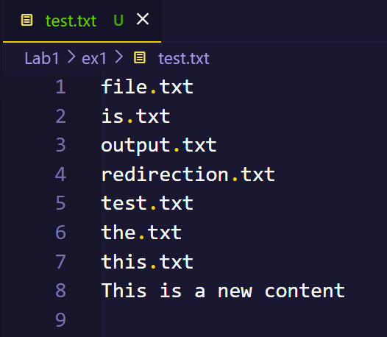
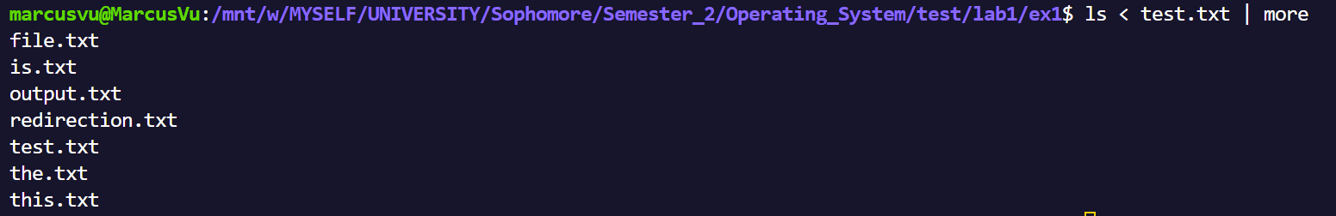
EX-2.4
Compare the Output Redirection (>/>>) with the Piping (|) technique :
2. Example of “>>” Output Redirection
Redirects standard output (stdout) of a command to a file. If the file already exists, the output will be appended to it.
Example, when we type
ls < test.txt | more from the keyboard, the output of the ls command will be converted to the input of the more command and produce the result to the screen.
This is useful when there are many statements that need to be concatenated or have too many results.
Sends the output of one command as input to another command. It connects the standard output (stdout) of the command on the left side of the pipe to the standard input (stdin) of the command on the right side.

Slide 10






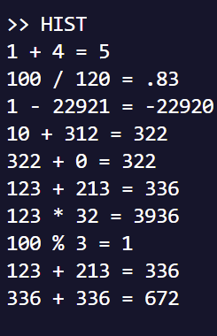
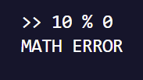
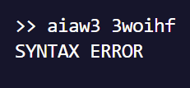
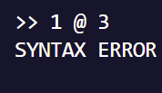
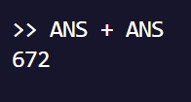
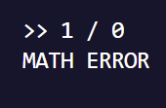
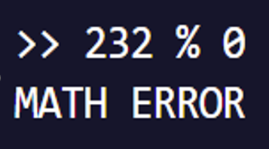
EX-2.4
Compare the Output Redirection (>/>>) with the Piping (|) technique :
3. Example of “|” Piping technique
Example, when we type
ls < test.txt | more from the keyboard, the output of the ls command will be converted to the input of the more command and produce the result to the screen.
This is useful when there are many statements that need to be concatenated or have too many results.
Sends the output of one command as input to another command. It connects the standard output (stdout) of the command on the left side of the pipe to the standard input (stdin) of the command on the right side.
ADD
MINUS
MULTIPLY
DIVIDE
MODULUS
HIST
MATH ERROR
INPUT ERROR
ANS

Slide 11
EX-3.6-5.3
THANKS!
Do you have any questions?
Feel free to ask me
quan.vu2212828@hcmut.edu.vn
Here are just some brief results, more details and demonstrations are directly commented in each file
ADD
MINUS
MULTIPLY
DIVIDE
MODULUS
HIST
MATH ERROR
INPUT ERROR
ANS

Slide 12
THANKS!
Do you have any questions?
Feel free to ask me
quan.vu2212828@hcmut.edu.vn
EX-3.6-5.3
Here are just some brief results, more details and demonstrations are directly commented in each file
ADD
MINUS
MULTIPLY
DIVIDE
MODULUS
HIST
MATH ERROR
INPUT ERROR
ANS

