Slide 1
CO2018
OPERATING SYSTEM LAB: REPORT LAB 1
Vũ Minh Quân - CC02

Slide 2

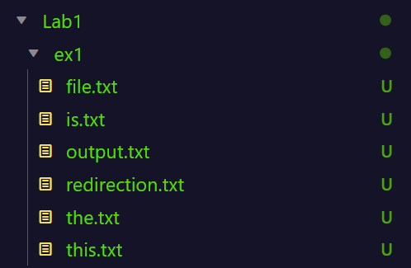
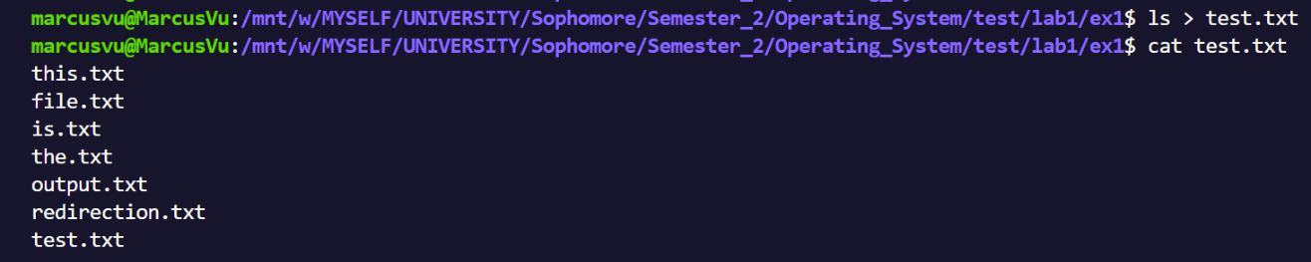
EX-2.4
Compare the Output Redirection (>/>>) with the Piping (|) technique :
1. Example of “>” Output Redirection
Redirects standard output (stdout) of a command to a file.
If the file already exists, it will be overwritten.
Here is the path before the command
And here is the content of test.txt after the command

Slide 3

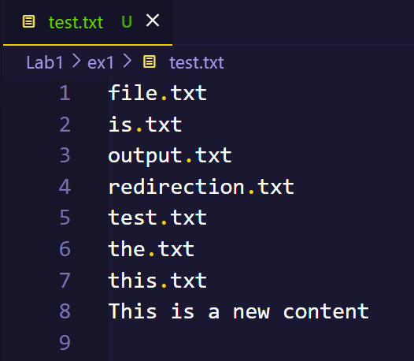
Compare the Output Redirection (>/>>) with the Piping (|) technique :
2. Example of “>>” Output Redirection
Redirects standard output (stdout) of a command to a file. If the file already exists, the output will be appended to it.

Slide 4
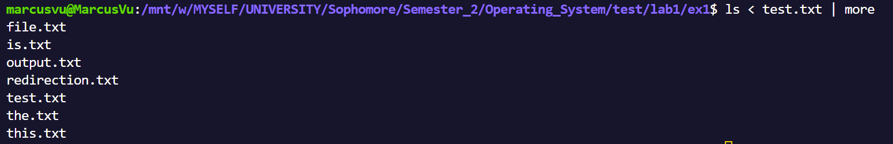
Compare the Output Redirection (>/>>) with the Piping (|) technique :
3. Example of “|” Piping technique
Example, when we type
ls < test.txt | more from the keyboard, the output of the ls command will be converted to the input of the more command and produce the result to the screen.
This is useful when there are many statements that need to be concatenated or have too many results.
Sends the output of one command as input to another command. It connects the standard output (stdout) of the command on the left side of the pipe to the standard input (stdin) of the command on the right side.

Slide 5






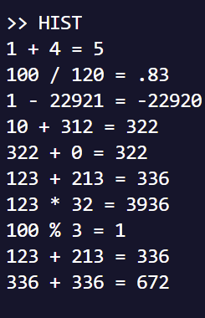

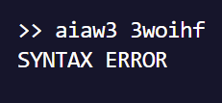
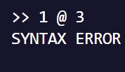
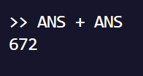
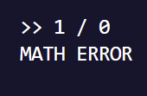

EX-3.6-5.3
Here are just some brief results, more details and demonstrations are directly commented in each file
ADD
MINUS
MULTIPLY
DIVIDE
MODULUS
HIST
MATH ERROR
INPUT ERROR
ANS

