Slide 1
Leveraging network topology for better fake account detection in social networks*
Proposal presentation
Björn Bebensee
bebensee@snu.ac.kr
Nagmat Nazarov
nagmat@snu.ac.kr
*working title

Slide 2
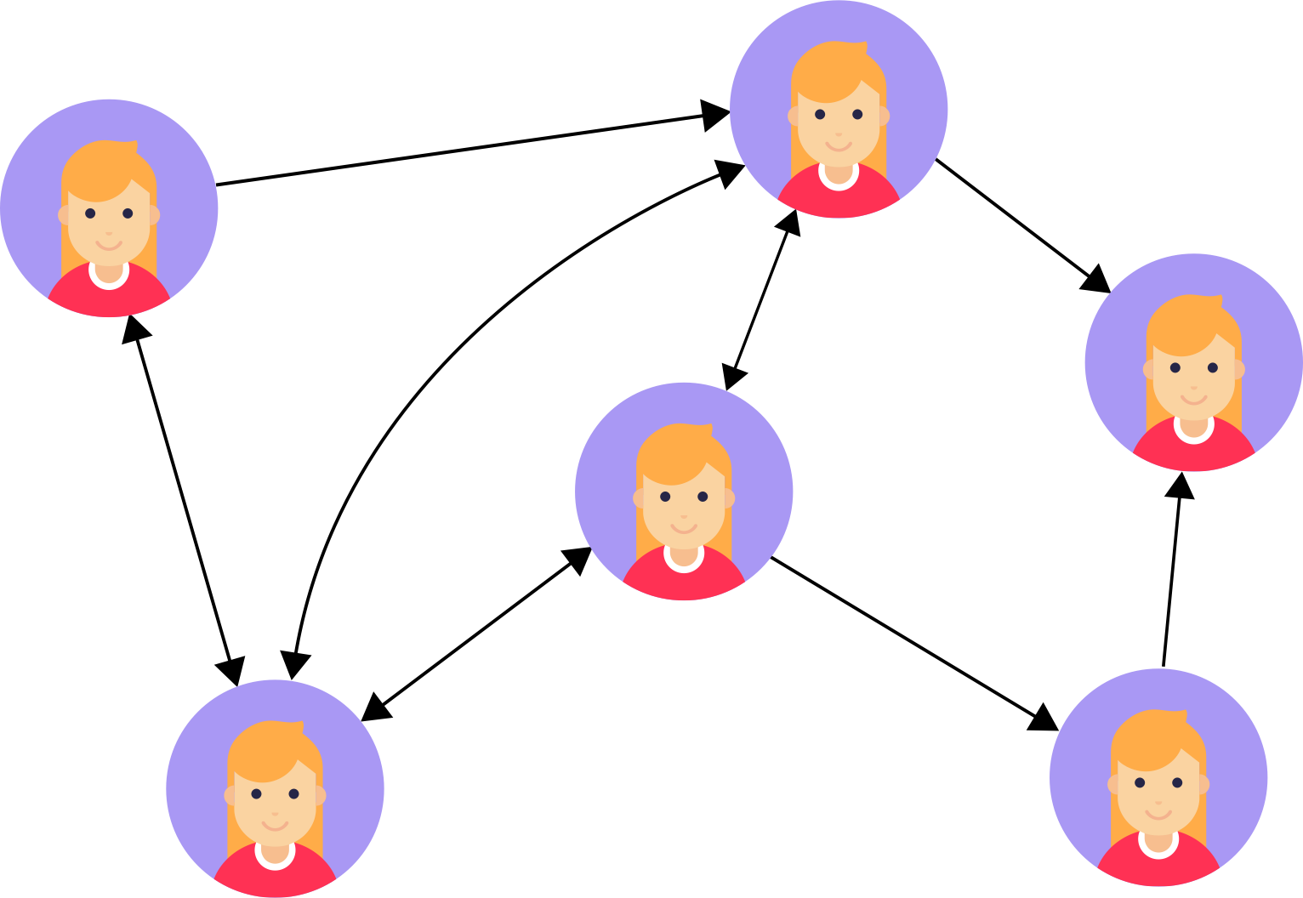
Motivation
High number of fake accounts in social networks
Fake accounts typically serve malicious purposes!

Slide 3
Problem definition
Given: directed graph G=(V,E) of
users and their interactions
Goal: identify all users that are fake accounts

Slide 4
Dataset
Use labelled data by Cresci, 2018.
Total: 25987 accounts, 7479 human, 18508 bots.
However: Twitter does not allow sharing of user data online. Dataset only contains (user_id, label) pairs.

Slide 5
Dataset
Scraped user data from Twitter ourselves.
But: many of the users from original dataset have been deleted (mostly bots).
Scraping challenging due to very low API request limits.

Slide 6
Dataset
Scraped data:
13091 user profiles (~49.6% of accounts less than original dataset, rest has been deleted or is a locked account).
6082 human accounts.
7009 bot accounts.
Dataset became more balanced!

Slide 7
Dataset
Retrieved data for each user:
user_id
label
username
screen_name
number of “followers” (in-degree)
number of “following” (out-degree)
location (if set)
url (if set)
description (if set)
listed_count
favourites_count
status_count
created_at
default_profile
default_profile_image
following_list (up to 5000)
follower_list (up to 5000)

Slide 8
Dataset
Additionally: retrieved all this profile data for each account in following_list and follower_list.
Data for total of 4.6M accounts, ~13,000 labelled accounts.

Slide 9
Problems
90th percentile effective diameter of Twitter: 4.8 (Kwak et al., 2010)
Number of triangles or finding (strongly) connected subgraphs is infeasible for us, requires crawling with depth=3.

Slide 10
Social graph
We created the social graph using collected data. Some statistics:
Vertices: 4,611,170
Edges: 8,514,389
Connected components: 1,244

Slide 11
Social graph

Slide 12
Social graph

Slide 13
Social graph
Real users:
median in-degree 166
median out-degree 202
mean in-degree 576.8
mean out-degree 503.2
Bot accounts:
median in-degree 18
median out-degree 24
mean in-degree 113.7
mean out-degree 163.2

Slide 14
Social graph
Some bot accounts have many followers (and some follow many users).
Also: bot accounts are more likely to be followed by other bots.
Classify accounts by looking their neighbors!

Slide 15
Median indegree of predecessors

Slide 16
Median outdegree of predecessors

Slide 17
Median indegree successors

Slide 18
Reputation predecessors

Slide 19
Reputation successors

Slide 20
Clustering coefficient

Slide 21
Eigenvector centrality

Slide 22
Proposed method
Observation: Fake accounts and bots don’t have the same social structure (and graph structure) as real users.

Slide 23
Proposed method
Idea: we can use
features of neighbors of each node
graph features
general graph topology
to find communities of fake accounts and aid fake account detection.

Slide 24
Proposed method
Features include:
centrality measures
degree
reputation = followers/(following+followers)
density
clustering coefficient
neighborhood-aggregated measures
regular profile features

Slide 25
Proposed method
Next steps:
Run more experiments on the data [Nagmat, 15hrs]
Develop a classification method based on our findings [Both, 20hrs]
Evaluate our method and compare it to other approaches [Both, 30hrs]

