Slide 1

DS 2017 Final Project
Taipei U-bike

Slide 2
期末Project
1~3人一組，可以拆夥，不可併組。
請到下列填寫組員:
https://docs.google.com/spreadsheets/d/1Afr9DeQnUd65qH2bRd-rIeBx0x1NMI6WNITGJLl9r-0/edit?usp=sharing
繳交日期:
期末考完結束後就可以DEMO
6/12~6/19
之後會請大家填寫DEMO時間表。

Slide 3
Rental MRT Station
The Taipei U-bike are set in several MRT station and each has a rental MRT Station. We shall refer to these MRT station by their name.
12 stations:
– They are Danshui(淡水), Hongshulin(紅樹林), Beitou(北投), Shilin(士林), Zhongshan(中山), Xinpu(新埔), Ximen(西門), Liuzhangli(六張犁), Muzha(木柵), Guting(古亭), Gongguan(公館) and Jingmei(景美).

Slide 4


Rental MRT Station
紅樹林
淡⽔
⼠林

Slide 5
Bike information
1.license number 2.mileage 3.class
(Electric, Lady, Road and Hybrid)
4.MRT station

Slide 6
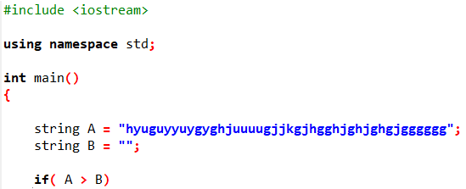
License tag
In order to locate bikes quickly by only providing license tag
(5 alphanumeric characters A..Z and 0..9), a binary search tree is used.
The rule of binary search tree is the following:
Use the ASCII Code to implement the “Lexicographical order”.
e.g. 00000<00001<…<00009<0000A<…<0000Z

Slide 7
License tag
When you need to delete the nodes in the binary search tree, if the node B is a leaf in the tree, then just delete the node B.
Otherwise, if the node B is non-leaf, then there are 2 case.
1.If node A only has right child. Replace A with A->right child.
2.If node A has left child, replace A with the left child which has the largest value.

Slide 8
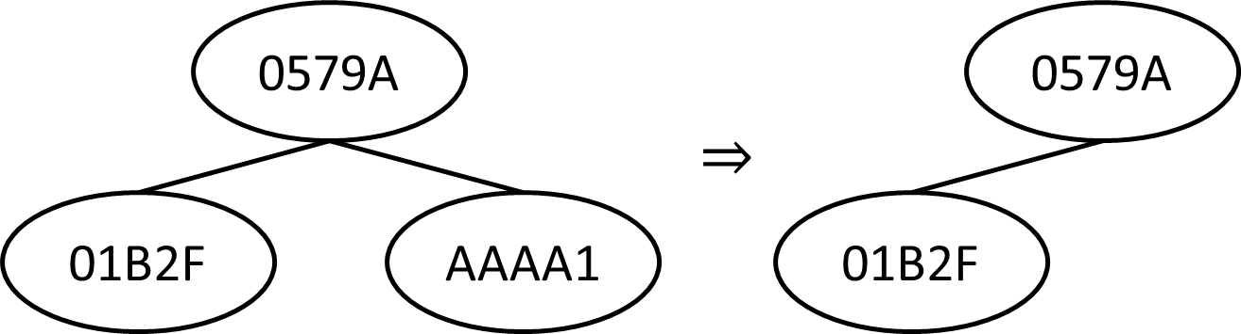
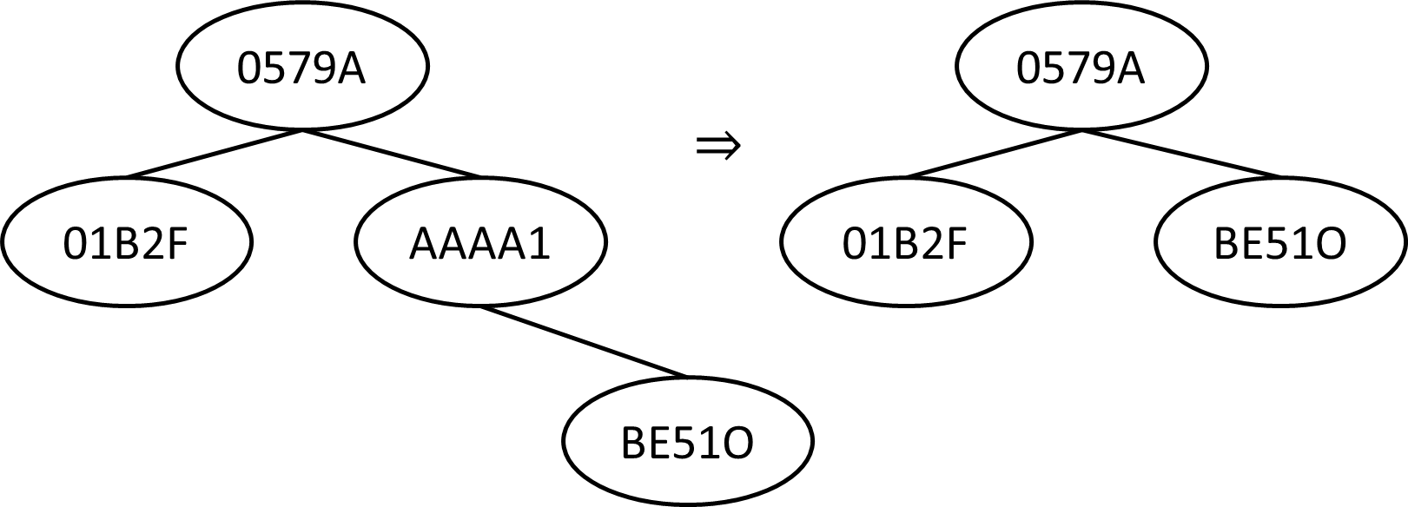
License tag
Leaf case(Delete AAAA1)
Only right child case:

Slide 9
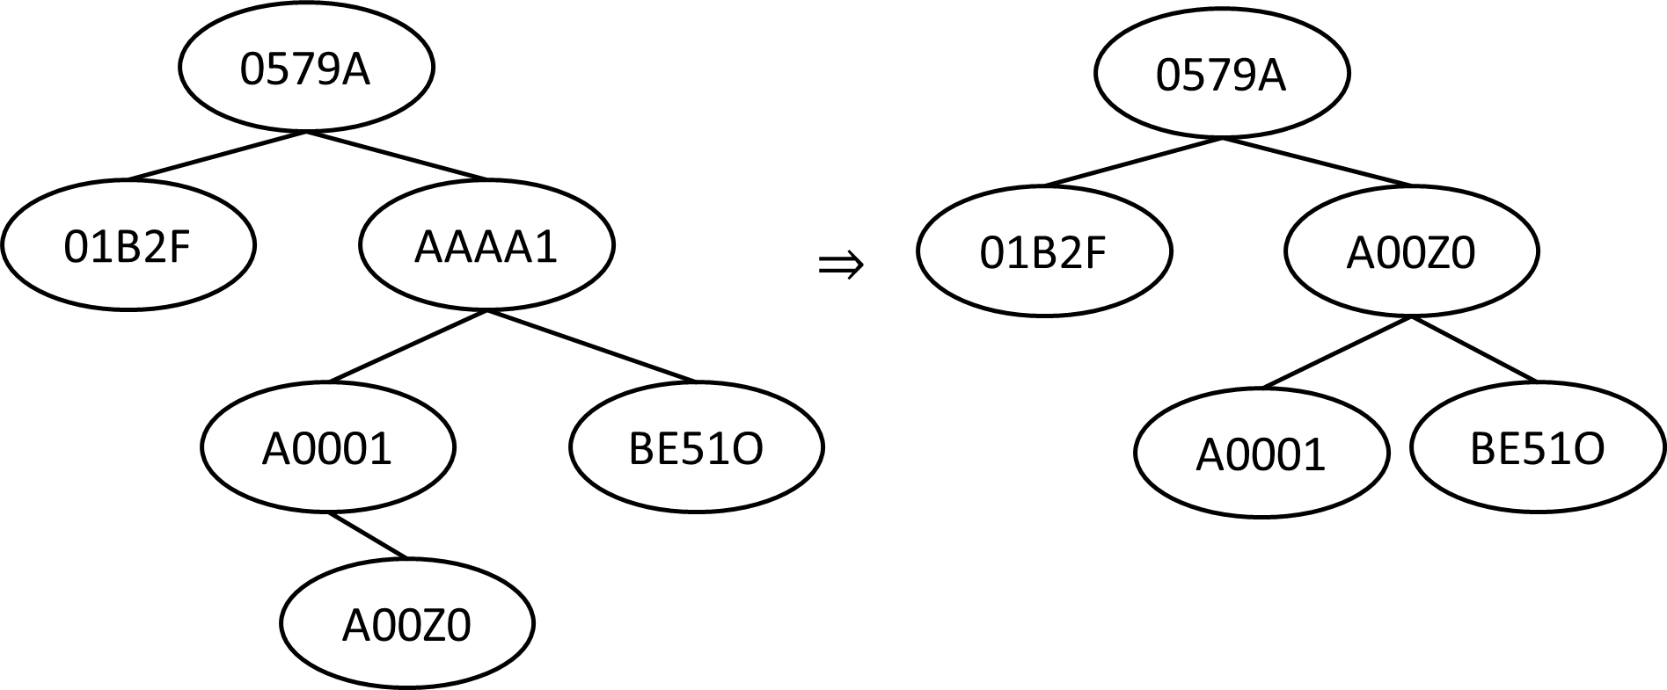
License tag
Replace with the left child which has the largest value case:

Slide 10
Bike class
Heaps
For each MRT Station, we will keep five heaps (HElectric, HLady, HRoad, HHybrid, HRent) for four types (Electric, Lady, Road and Hybrid) of bikes and rented ones.
◆
HElectric
HLady
HRoad
HHybrid
HRent
◆
The ordering in these heaps is determined by the mileage of the bikes (largest value on the top of heap).

Slide 11
Heap deletion
For each deletion, you need to replace the node to delete with the last node and perform following two operations.
bubble-up: check if the parent is smaller than current node or not.
bubble-down: check if the L-child and R-child are bigger than current node or not, if they have equal value and bigger than current node, we exchange L-child with current node.

Slide 12


Example 1 :
bubble-up, parent(9) is smaller than 29 , exchange 29 with 9.
(delete 8)
50
50
50
9
30
9
30
29
30
8
7
29
29
7
9
7

Slide 13
Example 2 : bubble-down, L-child(18) and R-child(19) are bigger than 8, exchange 8 with 19(the bigger one). (Delete 8)
50
50
50
20
30
8
30
19
30
18
19
8
18
19
18
8

Slide 14

Example 3 : bubble-down, if L-child and R-child are bigger than 8, and have equal value, we exchange L-child with 8.
50
50
50
20
30
8
30
19
30
19
19
8
19
19
8
19

Slide 15
Bike class
Five max-heaps
station : Jingmei
Electric
mileage
Lady
Road
9
7
5
Hybrid
Rent
4
2
1

Slide 16
Bike class
EX: Rent Jingmei Electric
station : Jingmei
Electric
Lady
Road
7
5
Hybrid
Rent
4
2
1

Slide 17
Bike class
Electric
Lady
Road
7
4
5
Hybrid
Rent
1
2
9

Slide 18
Bike rental charges
shortest path distance
Bike rental charges are listed in the following table.
Discount and Original
$30/mile and $40/mile
$25/mile and $30/mile
$15/mile and $20/mile
$20/mile and $25/mile
Class Electric - Class Lady - Class Road - Class Hybrid -
We offer a discount to those who drive within shortest path distance between the stations where you rent and return the bike

Slide 19
Rental MRT Station
return
Start
Suppose the shortest path is 8
if (miles > 8)
Original else
Discount

Slide 20
Implement the following C/C++ subroutines:
NewBike
SearchBike
JunkBikePtr
TransBikePtr
RentBikePtr
Returns
Inquire
StationReport
UbikeReport
NetSearch
BReport

Slide 21
The following operation will be in the input.
NewBike Class License Mile StationName
Create a node.
(ii) Put the License in the heap and Binary search tree.
(iii) Print a message ”New bike is received by Station StationName.”
JunkIt License
Search the bike with license number License using Binary search tree.
(ii) Delete the bike in the heap and Binary search tree.
(iii) Print error message if the bike does not exist.
(iv) Print a message ”Bike License is deleted from StationName.”

Slide 22
Rent StationName Class
Find a free bike of bike type Class with the largest mileage in StationName.
If we cannot find such a bike, print an error message ”No free bike is available.”
Perform function RentBikePtr for renting a bike.
(iv) Print a message “A bike is rented from StationName.”

Slide 23
Returns StationName License Mile (total current mileage)
Perform function Returns.
(ii) Print a message “Rental charge for this bike is $$$.”
Trans StationName License
Move the bike with License to StationName.
(ii) Print a message ”Bike License is transferred to StationName.”

Slide 24
Inquire License
Print the information about License.
StationReport StationName
Print the information about StationName.
UbikeReport
Print the information about the Taipei U-bike.
NetSearch StationName
(i) Print the information about StationName Net and each BikeType Net

