Slide 1
Programming

Slide 2

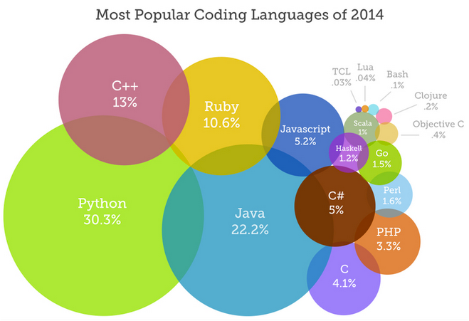
Programming
Basic instructions that tell a computer to do something
Many different languages
  Scripted Languages: C, Java, Ruby, Python
  Block programming: Scratch, Hour of Code
All similar concepts
Fun and rewarding!

Slide 3
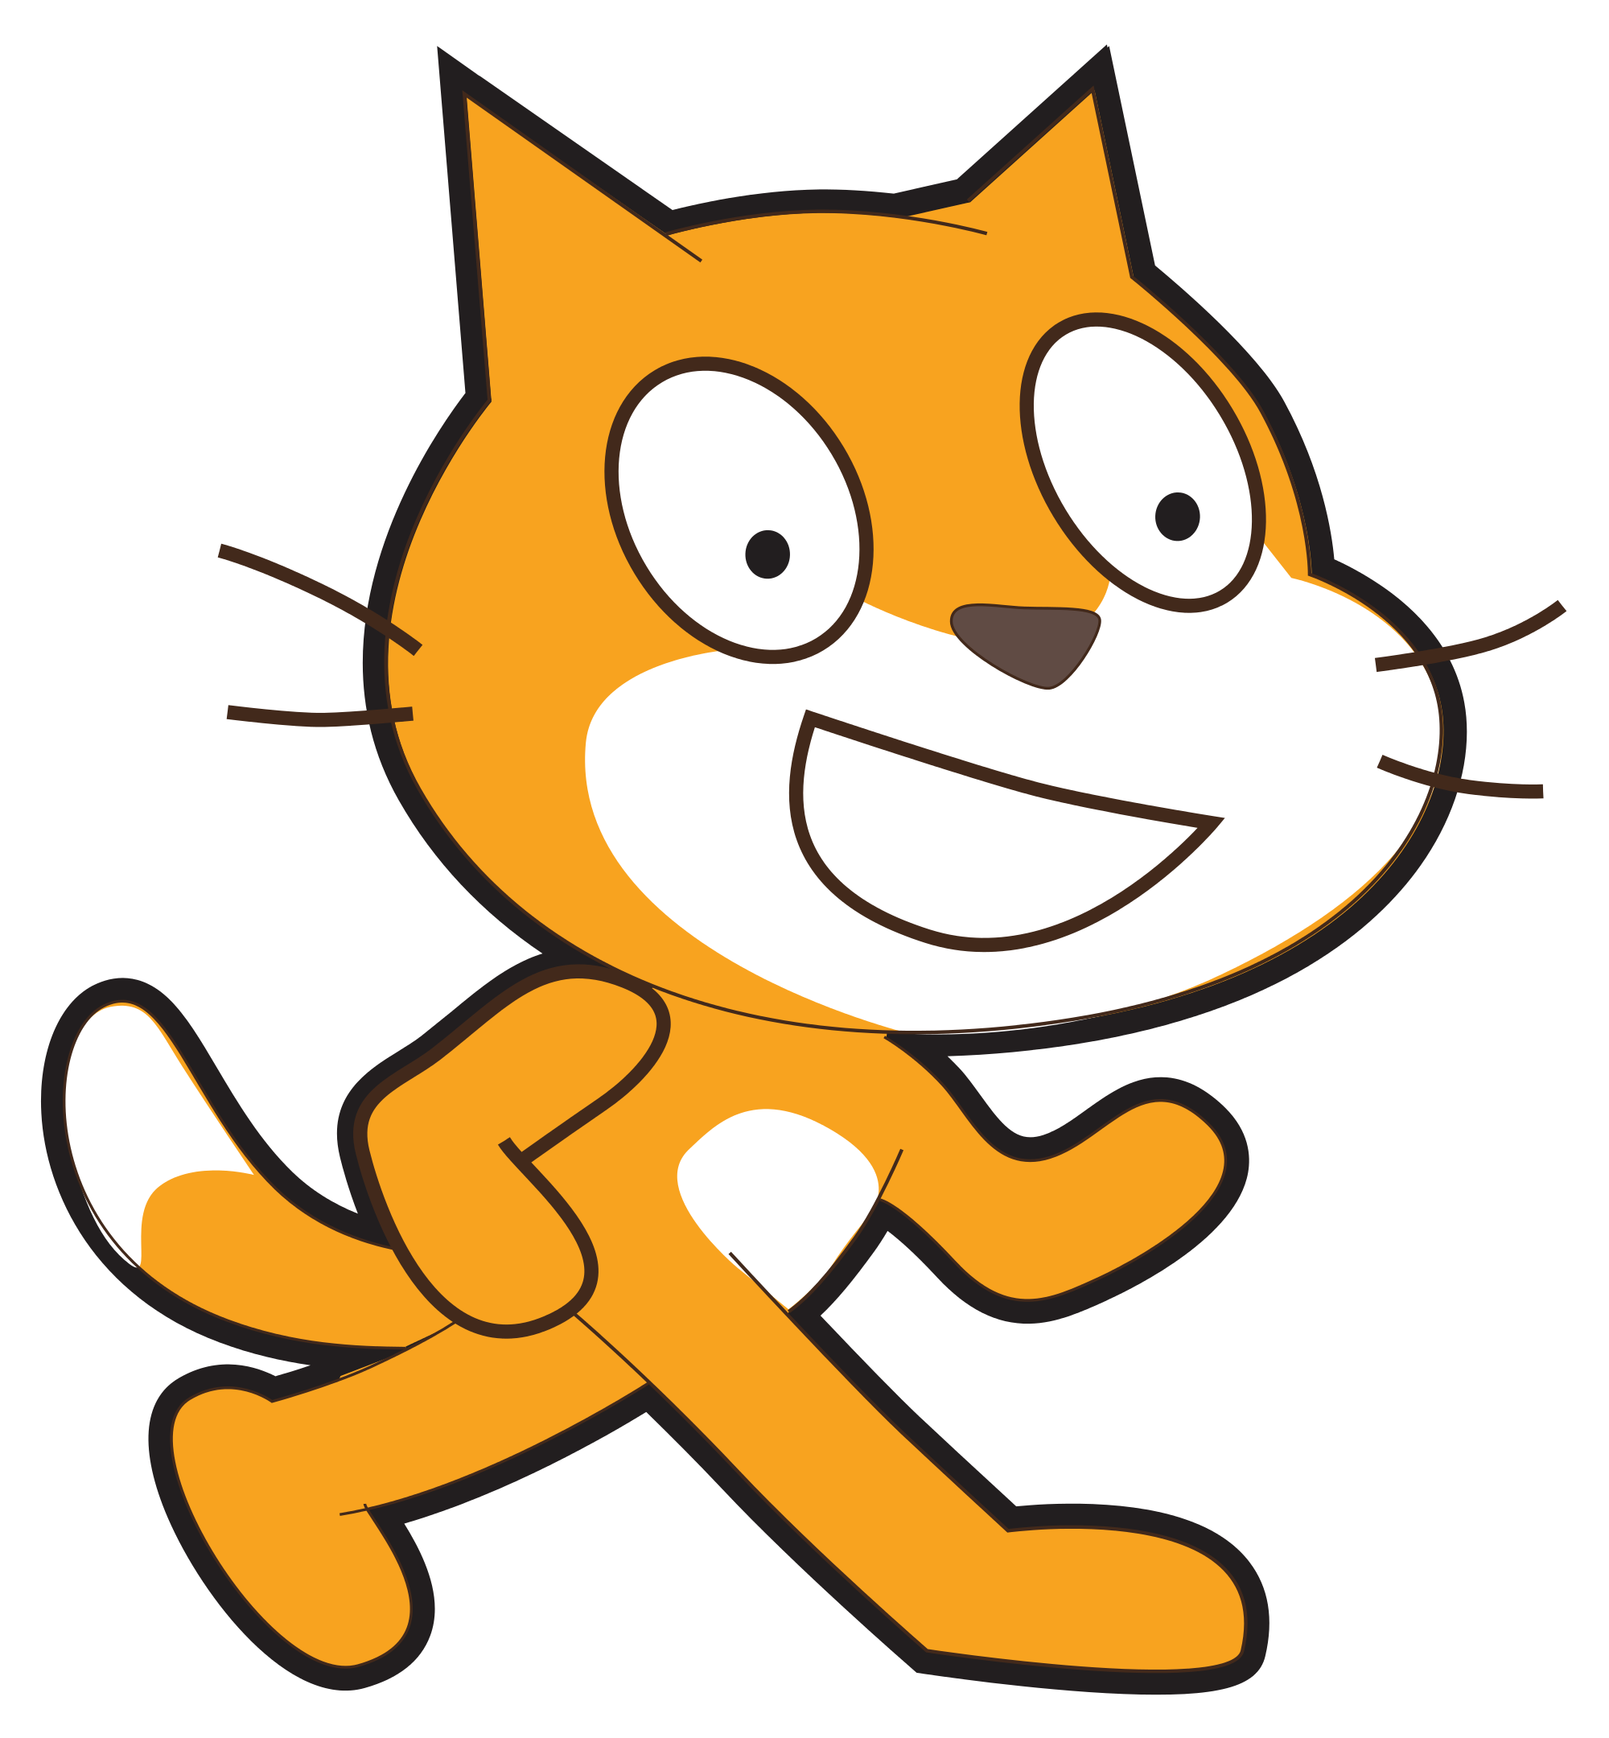
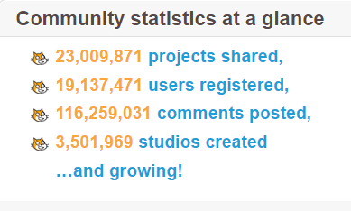
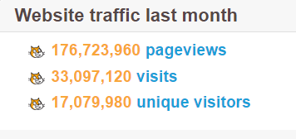

Scratch
Online free programming site created by MIT to help people learn programming basics
Available in 40+ languages
Used in 150+ countries
https://scratch.mit.edu/

Slide 4
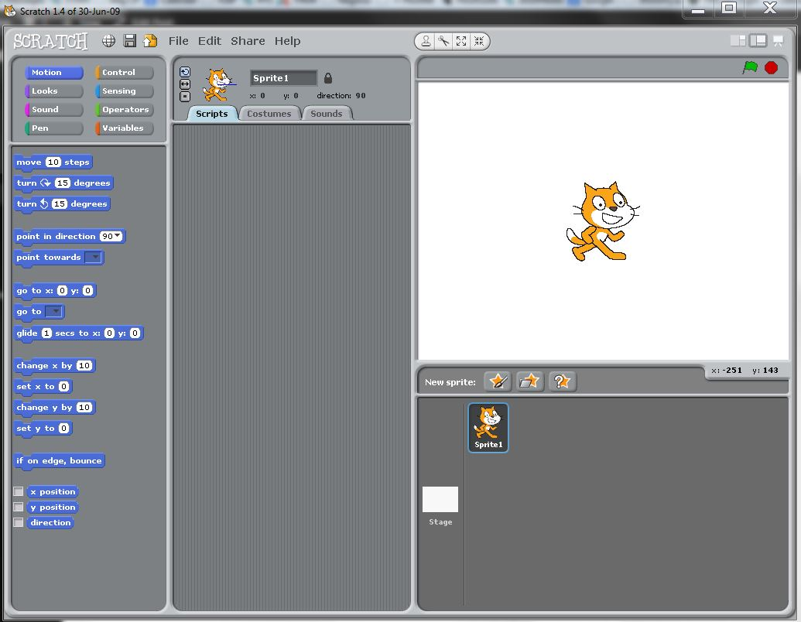
Sprite Editor
Sprite Preview
Sprite Selection and Creation
Tool Box

Slide 5

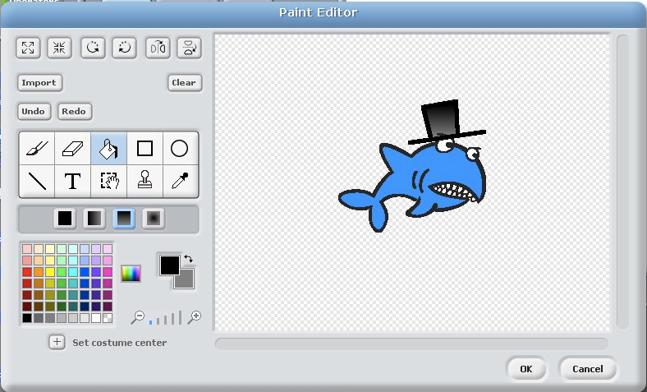
Creating Sprites
Paintbrush
Eraser
Fill Bucket
Rectangle Tool
Ellipse Tool
Text Tool
Select Tool
Line Tool
Stamp Tool
Eyedropper

Slide 6

Challenges
Make a sprite move;
  By itself (autonomous)
  With keyboard input (teleoperated)
  When it touches another Sprite
    Think about adding a costume change
Change Stages (backgrounds)
  When sprite reaches end of screen
  Put a unique sprite on each background
Use a sensing block to ask a question
  Try and incorporate the answer into your program

Slide 7
https://scratch.mit.edu/projects/236783354/

