Slide 1
game
+isClicked:bool -step:int -Score:int -stars:int -first_row:int -first_col:int -second_row:int -second_col:int -secord_R:int
+game(*parent: QWidget) +JudgeTwoStar(R1, C1, R2,C2:int):bool +JudgeOneStar(R1, C1, R2,C2:int) :bool; +Judgestripe2(R1, C1, R2,C2:int) :bool; +JudgeHcrossV (R1, C1, R2,C2:int) :bool; +JudgeStar(R,C:int) :bool +Judge9(R,C:int) :bool +JudgeHorizontal(R,C:int) :bool +JudgeVertical(R,C:int) :bool +JudgeHorizontal3(R,C:int) :bool +JudgeVertical3(R,C:int) :bool; +reNewPicture():void +fillinzero():void +Eliminatepossibility():bool +spawnforzero():void +cannotplay():bool +Judge(first_row,first_col,second_row, second_col:int):bool +done():int +score():void +Step():void +Stars():void +quit(stars,Score:int):void
SquareMap
+number:int +row:int +col:int
+SquareMap(*parent: QWidget, Row,Col:int) +setnumber():void +setpicture():void +operator -(*a:SquareMap):void +Click(int row,int col):void +click():void
Destroy
+Destroy() +condition(*a[10][10],*focus: SquareMap ):virtual int +spawn(*a[10][10],*focus: SquareMap ,mode: int) virtual void +eliminate(a[10][10],*focus: SquareMap ) virtual void

Slide 2
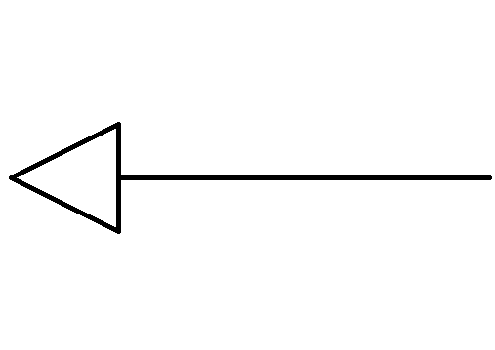
Star
+Star() +condition(*a[10][10],*focus: SquareMap ):virtual int +spawn(*a[10][10],*focus: SquareMap ,mode: int) virtual void +eliminate(a[10][10],*focus: SquareMap ) virtual void
Vertical
+Vertical() +condition(*a[10][10],*focus: SquareMap ):virtual int +spawn(*a[10][10],*focus: SquareMap ,mode: int) virtual void +eliminate(a[10][10],*focus: SquareMap ) virtual void
Nineblock
+Nineblock() +condition(*a[10][10],*focus: SquareMap ):virtual int +spawn(*a[10][10],*focus: SquareMap ,mode: int) virtual void +eliminate(a[10][10],*focus: SquareMap ) virtual void
Destroy
+Destroy() +condition(*a[10][10],*focus: SquareMap ):virtual int +spawn(*a[10][10],*focus: SquareMap ,mode: int) virtual void +eliminate(a[10][10],*focus: SquareMap ) virtual void
Vertical3
+Vertical() +condition(*a[10][10],*focus: SquareMap ):virtual int +spawn(*a[10][10],*focus: SquareMap ,mode: int) virtual void +eliminate(a[10][10],*focus: SquareMap ) virtual void
Horizontal
+Horizontal() +condition(*a[10][10],*focus: SquareMap ):virtual int +spawn(*a[10][10],*focus: SquareMap ,mode: int) virtual void +eliminate(a[10][10],*focus: SquareMap ) virtual void
Horizontal3
+Horizontal3() +condition(*a[10][10],*focus: SquareMap ):virtual int +spawn(*a[10][10],*focus: SquareMap ,mode: int) virtual void +eliminate(a[10][10],*focus: SquareMap ) virtual void

Slide 3
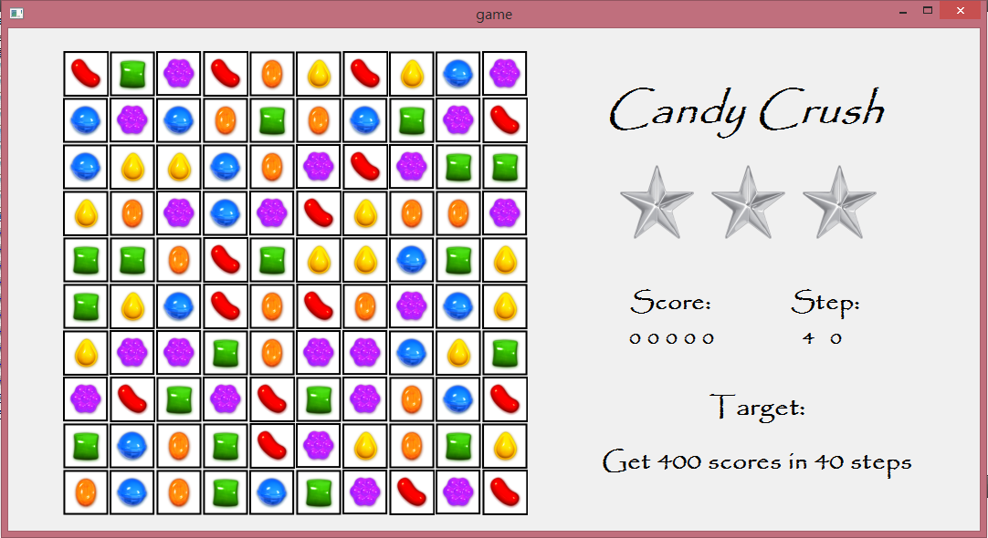

Slide 4
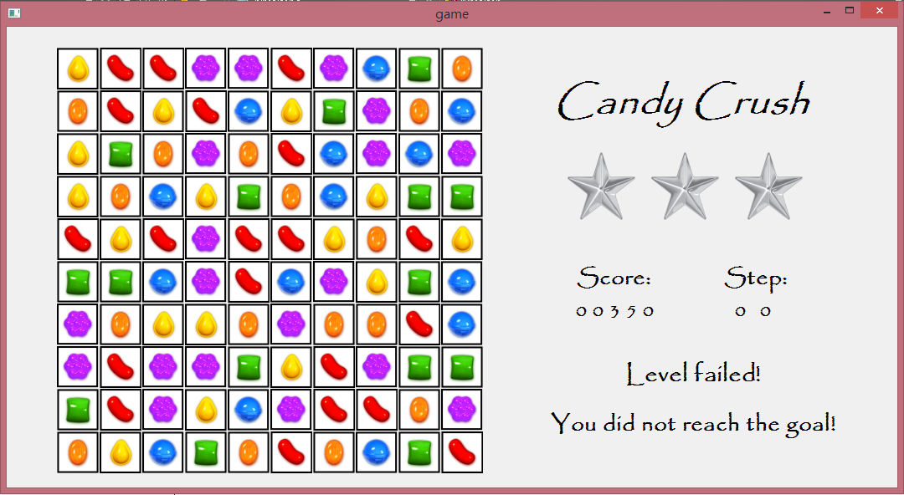

Slide 5
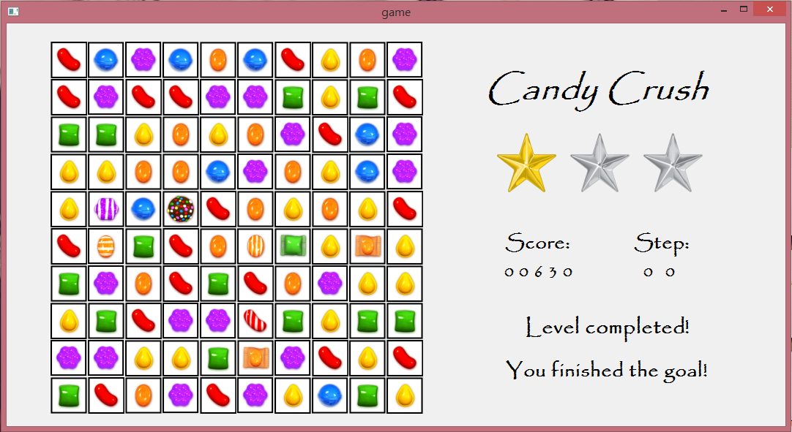

Slide 6
Bonus:
1.星星和星星消掉:整個版面消掉
2.直條紋和橫條紋消掉:消掉十字
3.條紋和炸彈消掉:消掉橫3排和直三排

