Slide 1
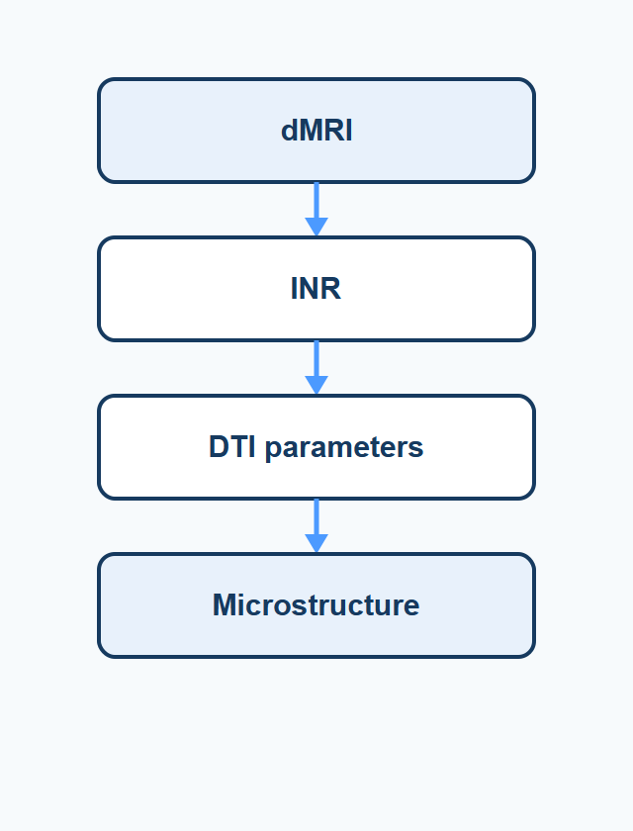
Research Proposal
基于物理自监督隐式神经表示的 多被试DTI参数估计研究
Population-DTI-INR 面向稀疏 dMRI 采样的跨被试 DTI 参数估计方法
Population-DTI-INR · Research Proposal · 1/15

Slide 2
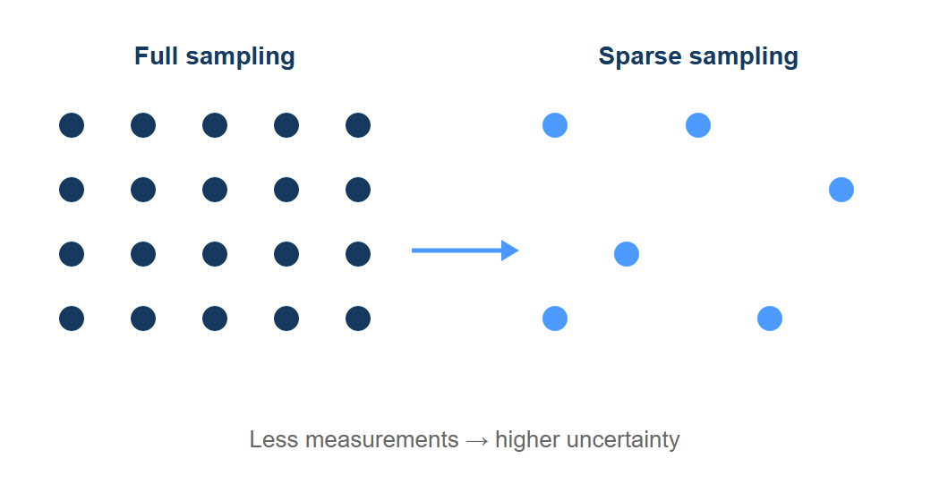
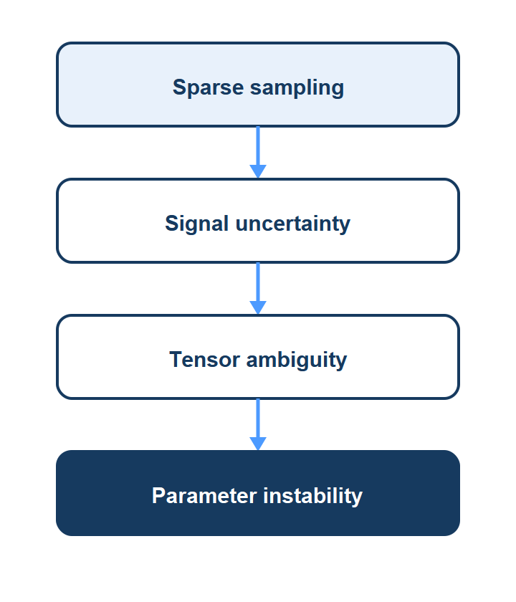
Sparse dMRI acquisition limits reliable DTI estimation
Fewer measurements increase uncertainty and amplify tensor ambiguity.
Population-DTI-INR · Research Proposal · 2/15

Slide 3
Current methods still face limitations under sparse sampling
WLS
Deep Learning
INR
Physics-based
Data-driven
Self-supervised
✓ Interpretable
✓ Powerful mapping
✓ No GT tensors
× Sampling sensitive
× Requires GT labels
× Identifiability gap
Key motivation: Signal fitting ≠ Parameter accuracy
Population-DTI-INR · Research Proposal · 3/15

Slide 4
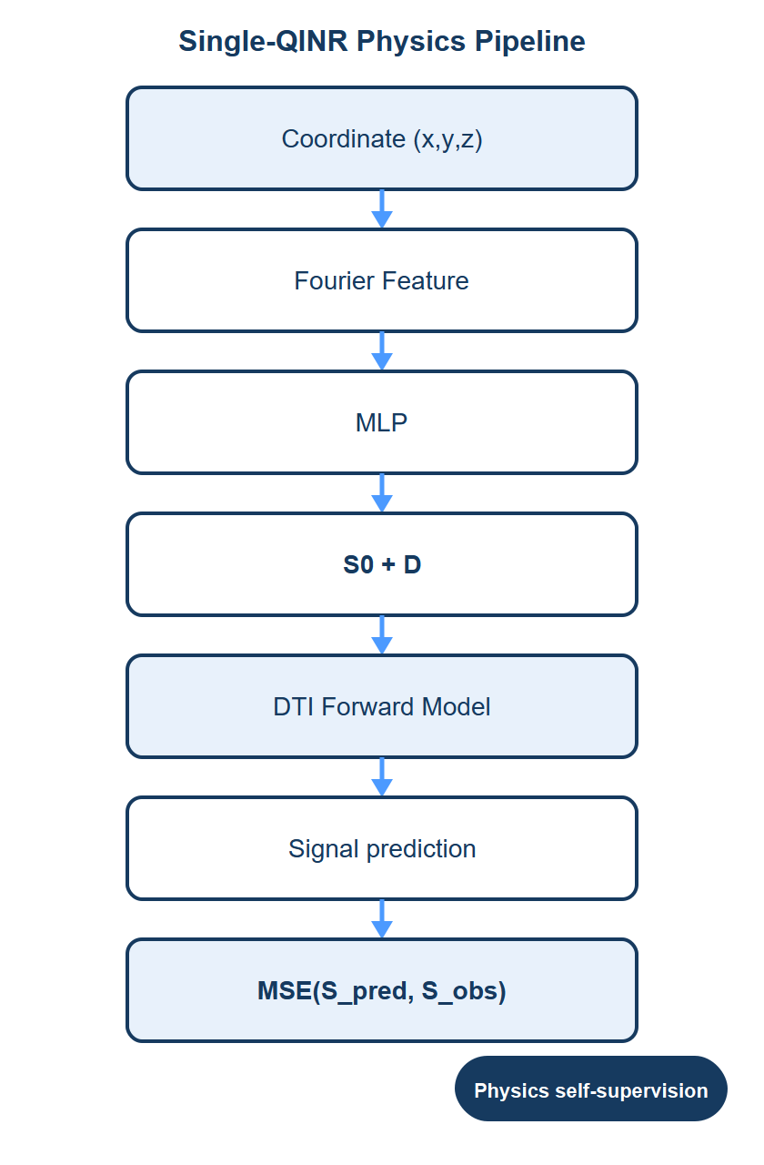
Physics-driven INR enables self-supervised DTI estimation
Population-DTI-INR · Research Proposal · 4/15

Slide 5
Single-QINR preliminary evaluation
Item | Setting
Dataset | HCP-YA
Subjects | 3 focus subjects (106319 / 120717 / 121618)
Sampling | 50% DWI volumes
Shell | b = 1000 (with b0)
Model | Single-QINR (Independent INR)
Objective | Signal reconstruction (physics self-supervision)
Reference | WLS-DTI parameters
Population-DTI-INR · Research Proposal · 5/15

Slide 6
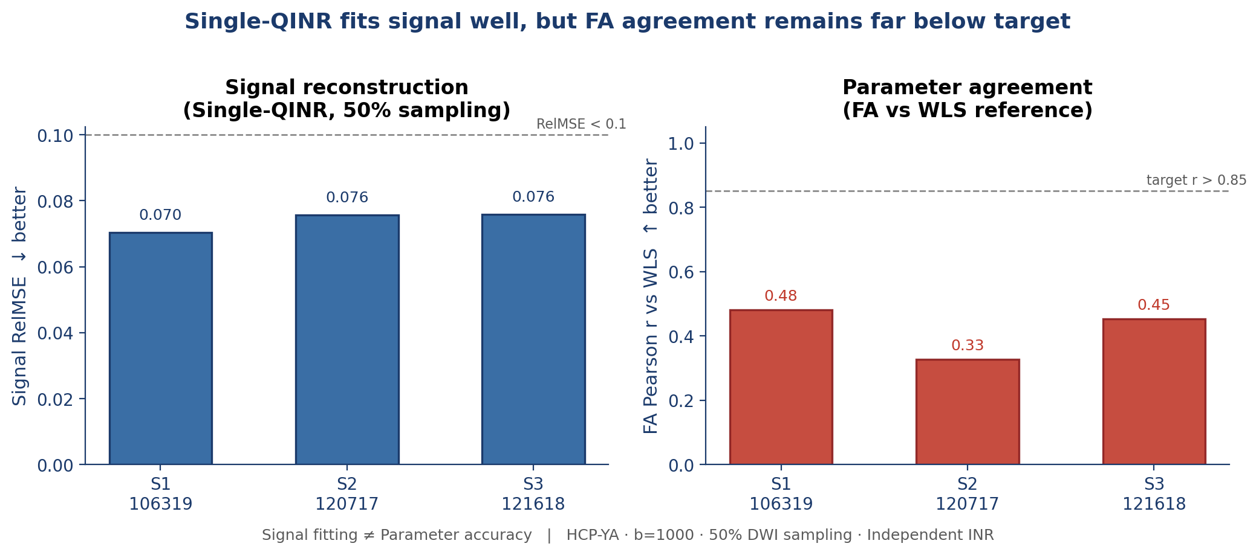
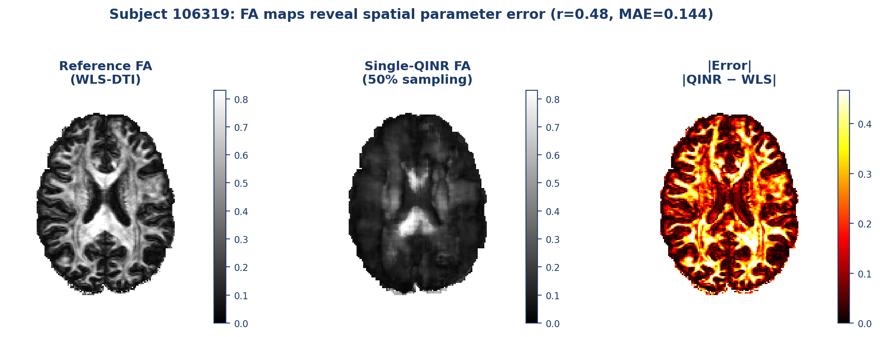
Single-QINR achieves signal reconstruction, but parameter accuracy remains unstable
Preliminary numbers (50% sampling)
Observation Signal fitting does not guarantee parameter identifiability.
Signal RelMSE: 0.070 / 0.076 / 0.076 (3 subjects) FA Pearson r: 0.48 / 0.33 / 0.45 (vs WLS; target > 0.85) FA MAE: 0.144 / 0.142 / 0.152
Population-DTI-INR · Research Proposal · 6/15

Slide 7
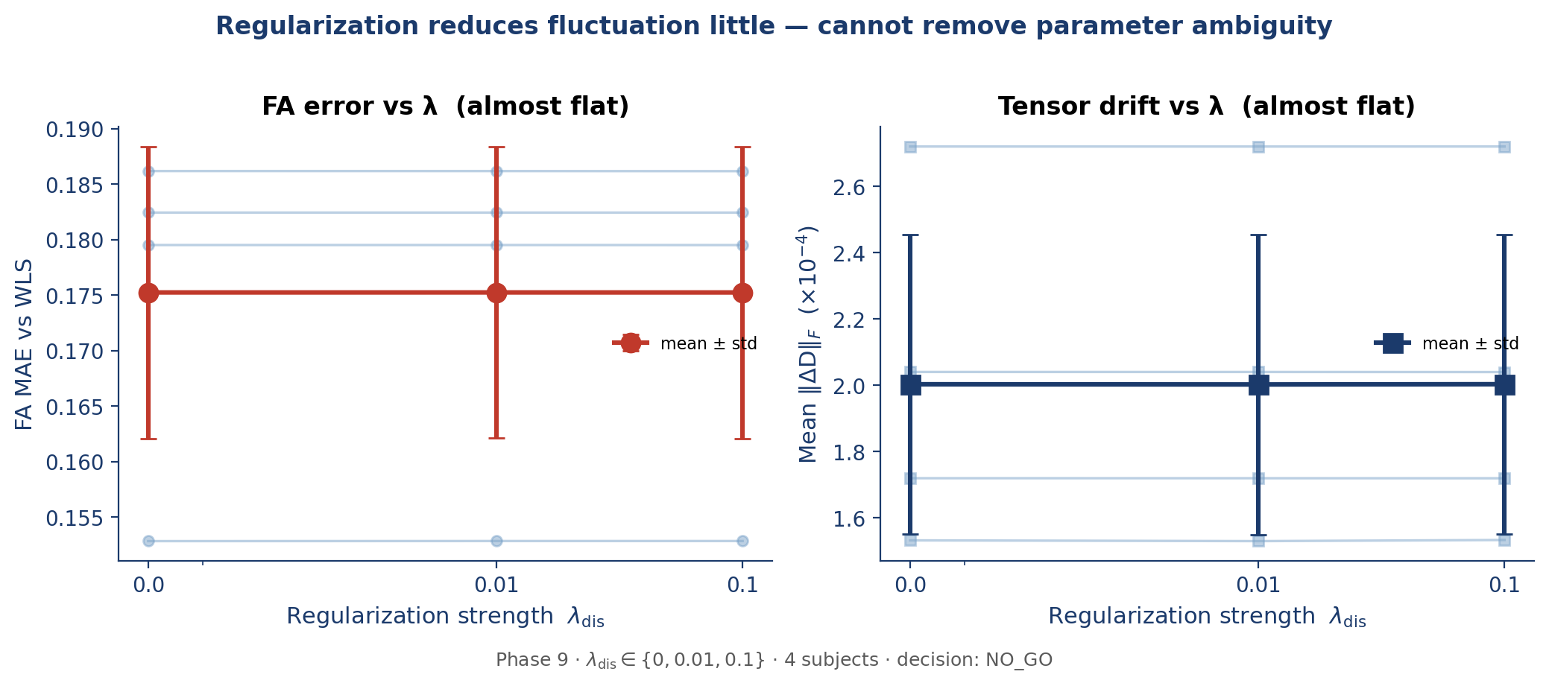
Tensor regularization cannot fully resolve parameter drift
Phase 9 insight
λ_dis ∈ {0, 0.01, 0.1} FA MAE ≈ 0.175 (flat across λ) Mean Δ holdout PSNR ≈ +11 dB but FA does not recover → Ambiguity needs more than local regularization
Population-DTI-INR · Research Proposal · 7/15

Slide 8
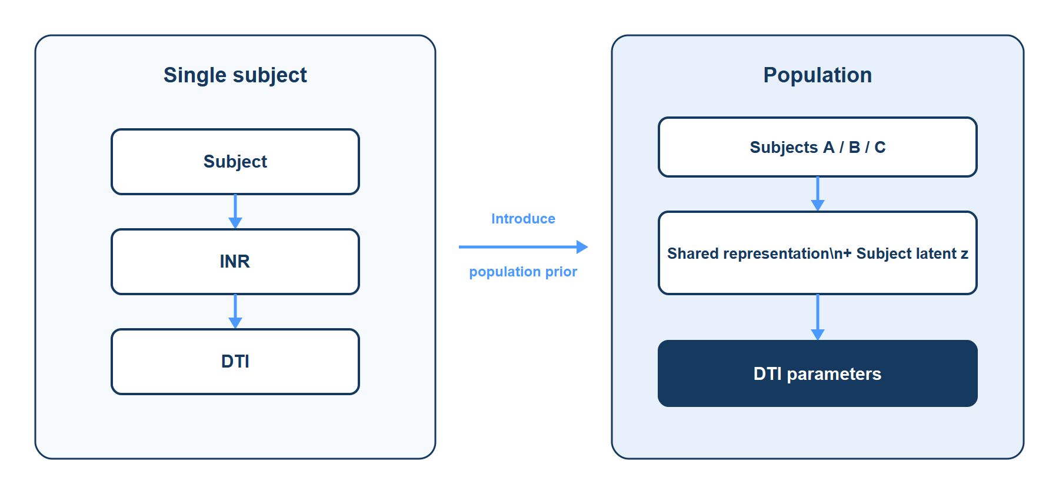
Can population prior improve DTI parameter identifiability?
Population-DTI-INR · Research Proposal · 8/15

Slide 9
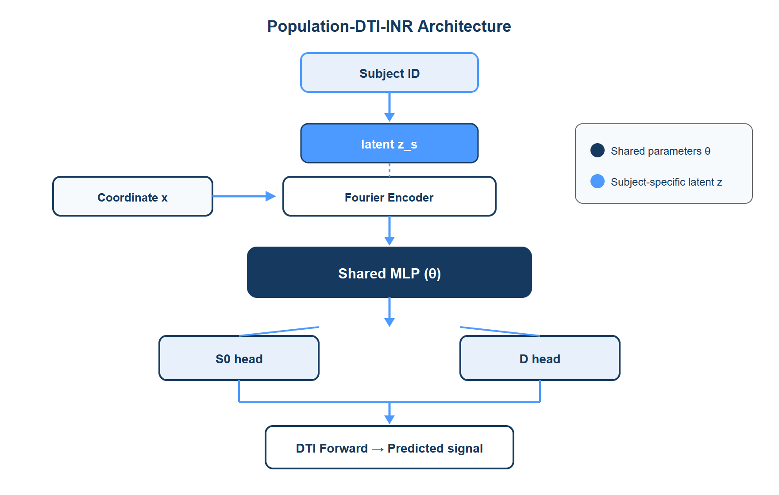
Population-DTI-INR framework
Population-DTI-INR · Research Proposal · 9/15

Slide 10
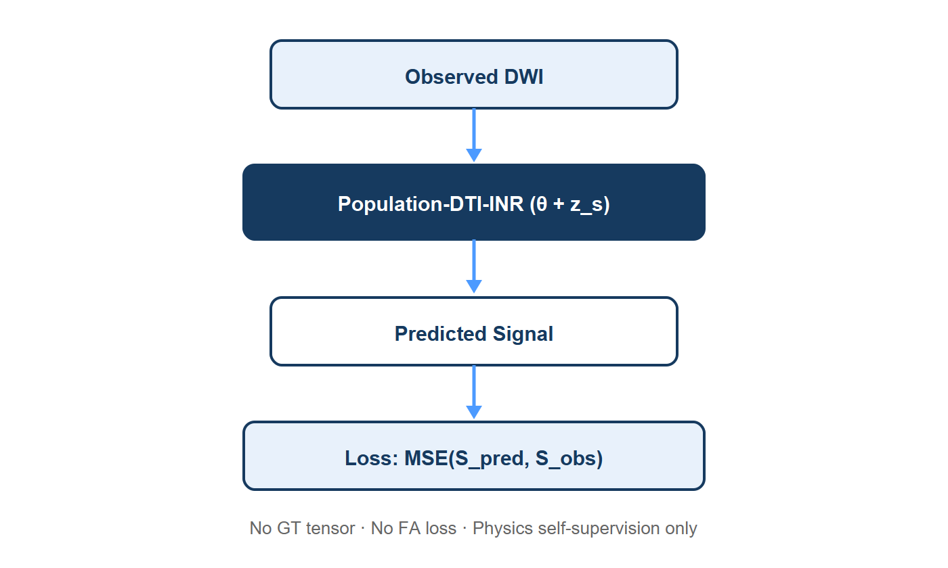
Physics self-supervised population learning
Optimize θ + z_s · No GT tensor supervision · No FA / MD loss
Population-DTI-INR · Research Proposal · 10/15

Slide 11
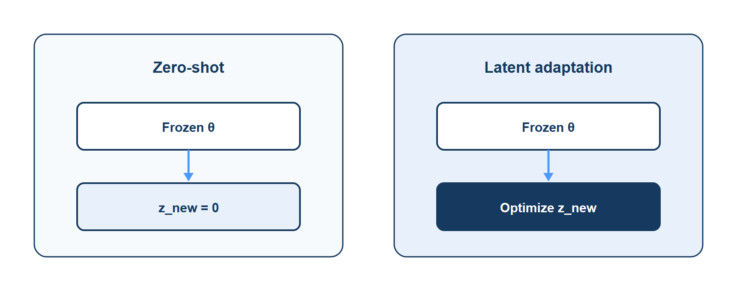
Generalization to unseen subjects
Zero-shot probes population prior; latent adaptation personalizes without retraining θ.
Population-DTI-INR · Research Proposal · 11/15

Slide 12
Evaluation protocol
Item | Setting
Dataset | HCP-YA
Subjects | 5
Split | Train 3 / Val 1 / Test 1
Sampling | 50%
Shell | b0 + b1000
Baselines | Single-QINR · Population zero-shot · Population adaptation
Population-DTI-INR · Research Proposal · 12/15

Slide 13
Comparison between single and population INR
Method | Training / Inference
Single-QINR | Individual subject (per-subject θ)
Population-QINR zero-shot | Shared θ · z_new = 0
Population-QINR adaptation | Shared θ frozen · optimize z_new
Population-DTI-INR · Research Proposal · 13/15

Slide 14
Preliminary numbers vs pending Population evaluation
Available now (evidence for the research problem)
Pending (Population-DTI-INR full comparison)
Single-QINR · 50% sampling · 3 subjects • Signal RelMSE ≈ 0.070 – 0.076 • FA Pearson r ≈ 0.33 – 0.48 (target > 0.85) • FA MAE ≈ 0.14 – 0.15 Phase 9 · λ ablation · 4 subjects • FA MAE ≈ 0.175 across λ_dis • Holdout ΔPSNR ≈ +11 dB (mean) • Tensor drift persists under signal adaptation Metric families already in use: Signal (RelMSE / PSNR) · Parameter (FA/MD) · Stability (ΔD)
Unified table to complete next: • Single-QINR • Population zero-shot • Population latent adaptation Reported with aligned metrics: • Signal: RMSE / PSNR / RelMSE • Parameter: FA / MD / AD / RD • Stability: tensor drift, ΔFA Same 50% sampling · HCP-YA split 3/1/1 Pilot exists, but full multi-subject comparison is reserved for validation.
Population-DTI-INR · Research Proposal · 14/15

Slide 15
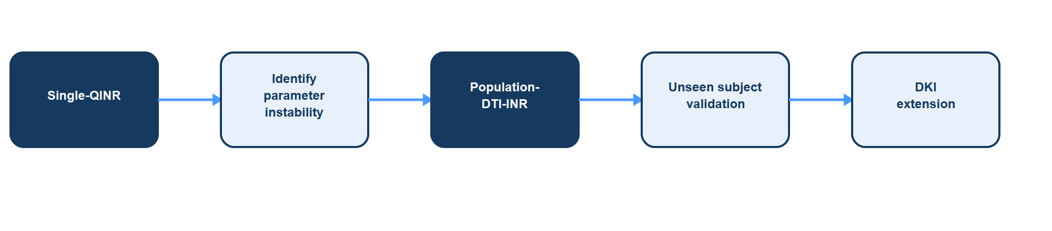
Research roadmap
Population prior may improve parameter identifiability under sparse dMRI acquisition.
Population-DTI-INR · Research Proposal · 15/15

