Slide 1
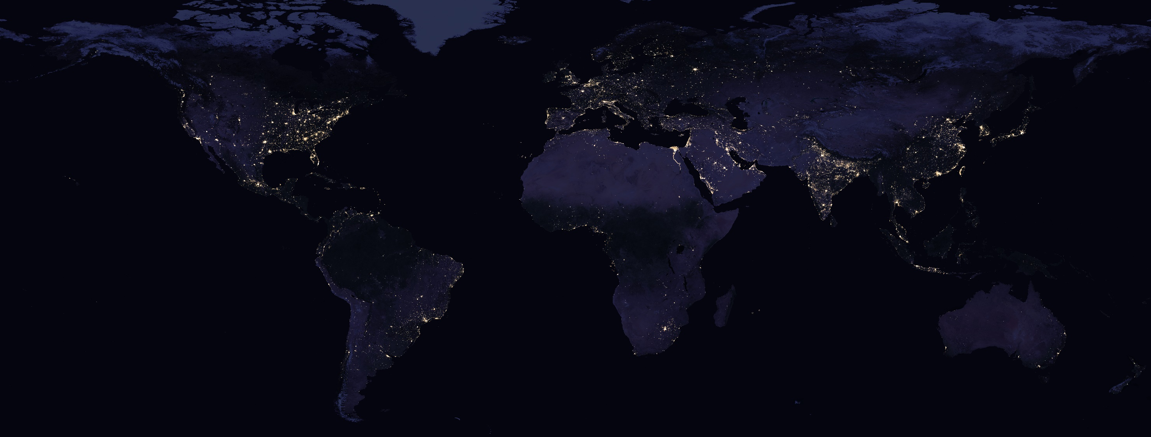
Nasa’s Black Marble VIIRS product -Tips, Tricks and Codes
Source: NASA
Qiming Zheng, PhD
National University of Singapore
qmzheng@nus.edu.sg

Slide 2
Ep.3 Layer info

Slide 3
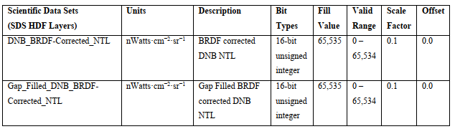
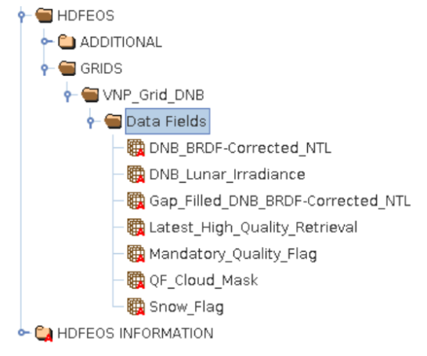
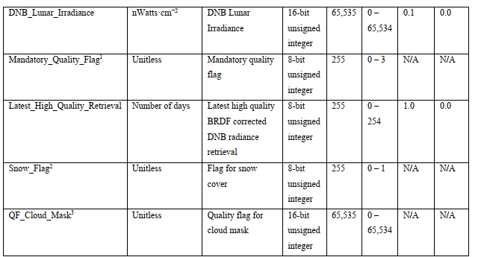
SDS HDF layers

Slide 4
10 | 9 | 8 | 7 | 6 | 5 | 4 | 3 | 2 | 1 | 0 | Dec
0 | 0 | 0 | 0 | 0 | 1 | 0 | 0 | 0 | 1 | 0 | 34
0 | 0 | 0 | 0 | 0 | 1 | 0 | 1 | 0 | 1 | 0 | 42
0 | 0 | 0 | 1 | 1 | 1 | 0 | 0 | 0 | 1 | 0 | 226
0 | 1 | 0 | 1 | 1 | 1 | 0 | 0 | 0 | 1 | 0 | 738

Slide 5


What’s Next
Ep.4 Preprocessing .
Dr. Qiming Zheng
qmzheng@nus.edu.sg

