Slide 1
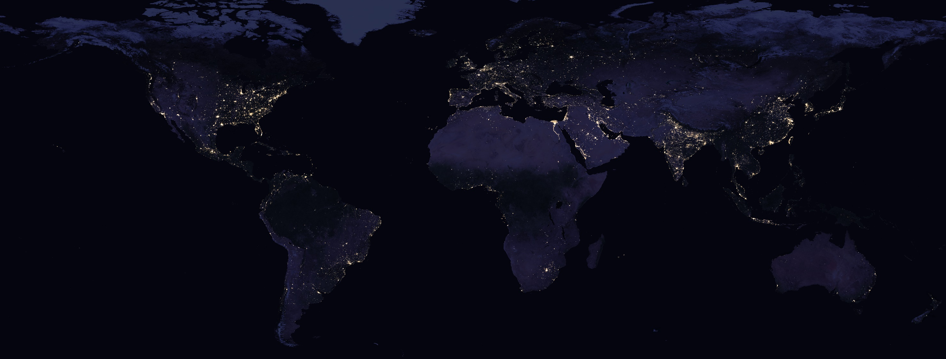
Nasa’s Black Marble VIIRS product -Tips, Tricks and Codes
Source: NASA
Qiming Zheng, PhD
National University of Singapore
qmzheng@nus.edu.sg

Slide 2
Before we start
- Objective
To share tips/tricks/codes for NASA’s Black Marble VIIRS nighttime light product (VNP46)
- Suitable for
Current nighttime light data users
Potential users with RS/GIS/spatial analysis backgrounds

Slide 3
Ep.1 intro

Slide 4
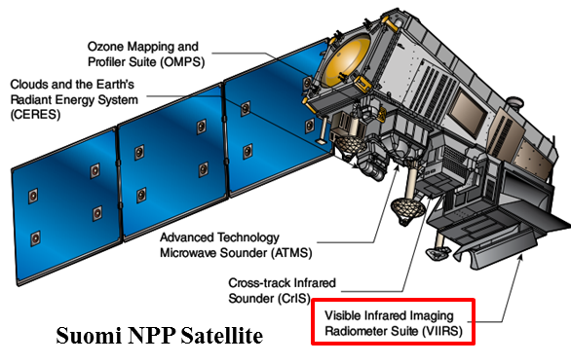




Black Marble VIIRS Product
Suomi NPP VIIRS/DNB
(2012-present)
DMSP/OLS
(1992-2013)
Stable light product
Radiance calibrated product
V1 monthly/annual composite
Old products
New products (released after 2018- )
Daily/Monthly/Annual
Black Marble Product
Daily/Monthly/Annual
HD/NRT (hourly)

Slide 5
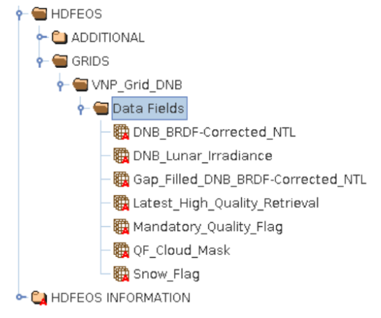
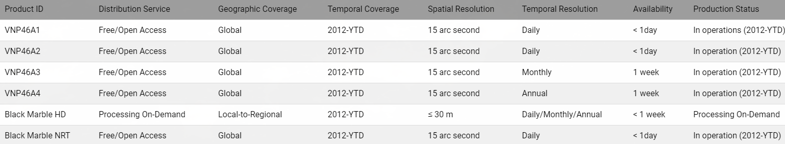
Black Marble VIIRS Product
SDS HDF layers of VNP46A2
- Improvements (compare with old VIIRS products)
Higher temporal resolution (monthly/yearly → daily)
Better quality (atmospheric-, terrain-, vegetation-, snow-, lunar-, and stray light-corrected)
More information in Scientific Data Set (SDS) layers (quality control flags, etc.)
TOA
Moonlight and Atmosphere corrected

Slide 6
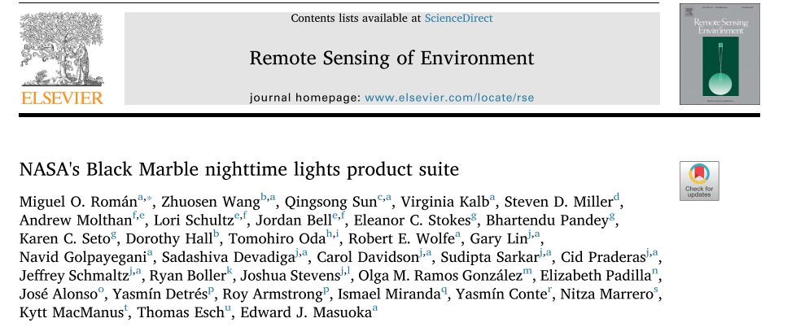
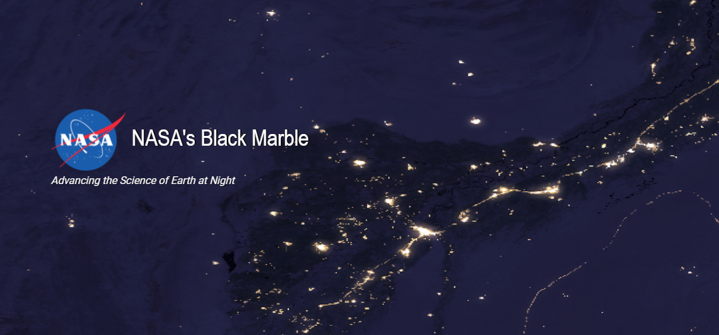
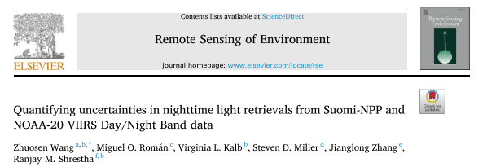
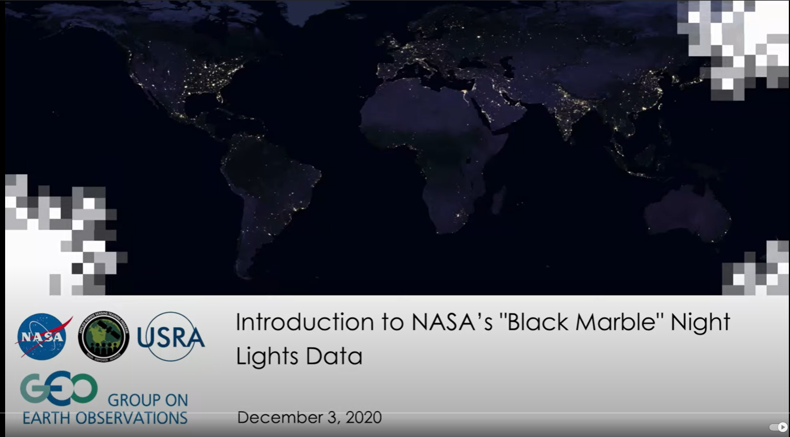
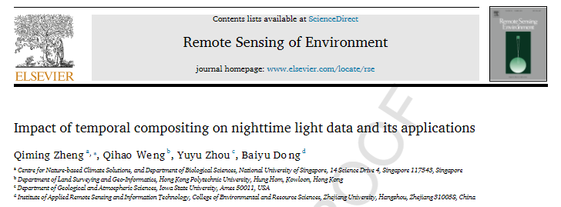
More info. & potential applications
Homepage & users doc.
An intro. video made by NASA

Slide 7

What’s Next
Ep.2 Download
thousands of tiles
tips & tricks
Dr. Qiming Zheng
qmzheng@nus.edu.sg

