Slide 1
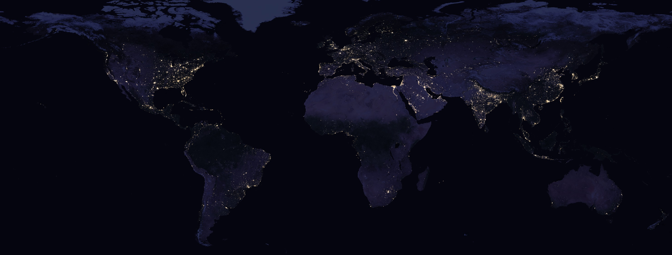
Nasa’s Black Marble VIIRS product -Tips, Tricks and Codes
Source: NASA
Qiming Zheng, PhD
National University of Singapore
qmzheng@nus.edu.sg

Slide 2
Ep.5 Pre-processing 2

Slide 3
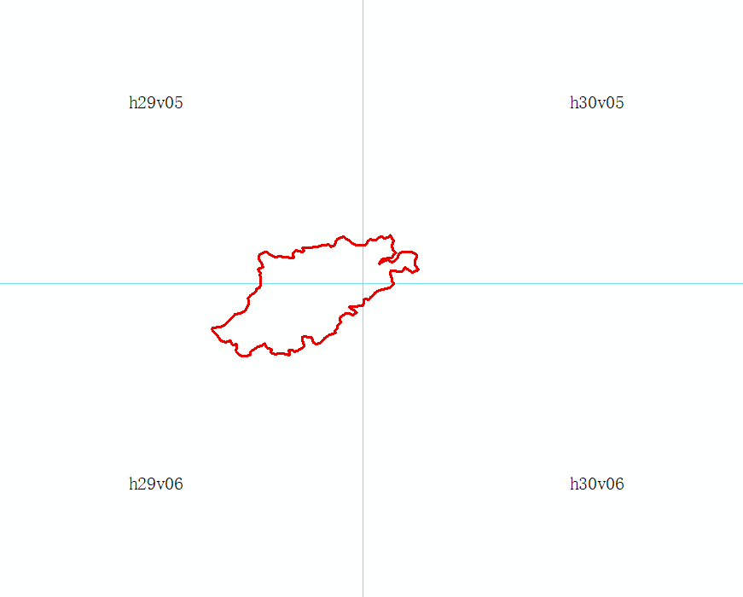
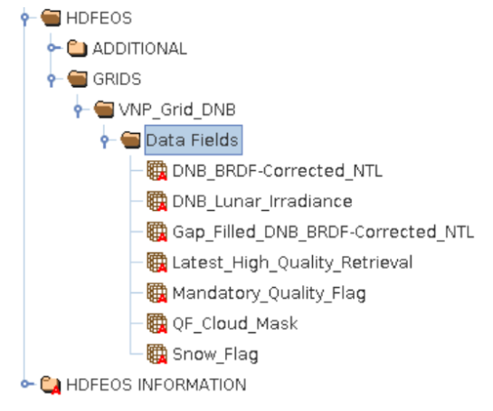
Pre-processing
HDF to geotiff
geotiff of city
Identify tiles intersect with city
Select layer
Add buffer
Mosaic all tiles (of the same YearDOY) of a city into one single image
Clip to city (ROI)
City (ROI)
Tile
(h__v__)
Layer
(L1-L7)
YearDOY
(2013001)
Tiles for city
VNP46A2.A2012220.h25v03.001.2020079042047.h5

Slide 4
Pre-processing
? How to identify tiles intersect with city
Solution 1: tile coordinates x city coordinates
Solution 2: create a tile-city shapefile
Create tile-city shapefile
(Arcmap)
HDF to geotiff
(python)
geotiff of city
(python)

Slide 5
Preparation
Shapefile
Black Marble tile @BM website
ROI
Raster
Raw Black Marble tiles (.h5)
Software
ArcGIS/QGIS
Python (gdal package)

Slide 6
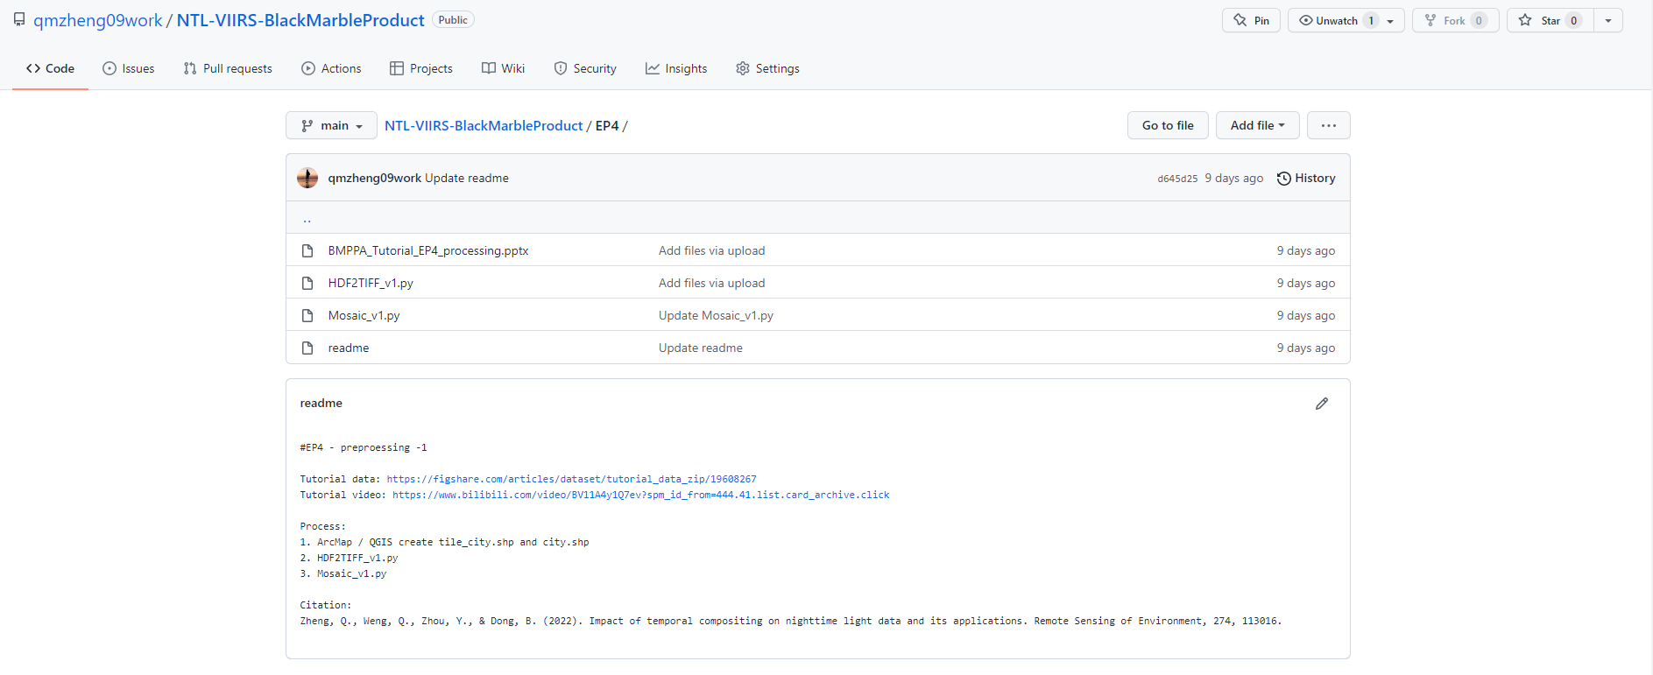
Pre-processing -2

Slide 7
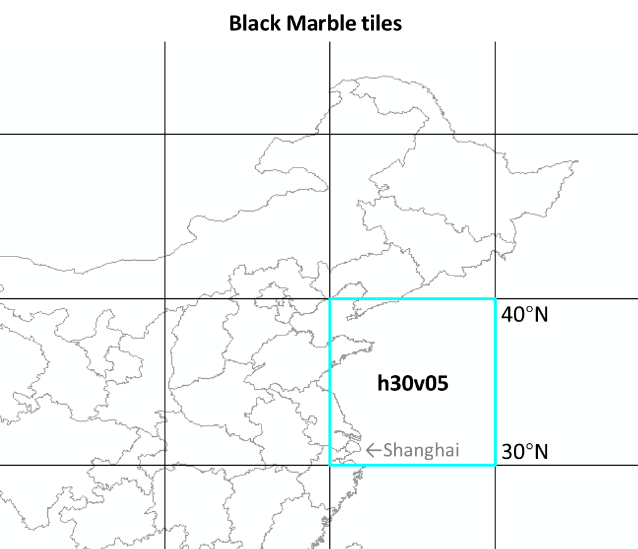
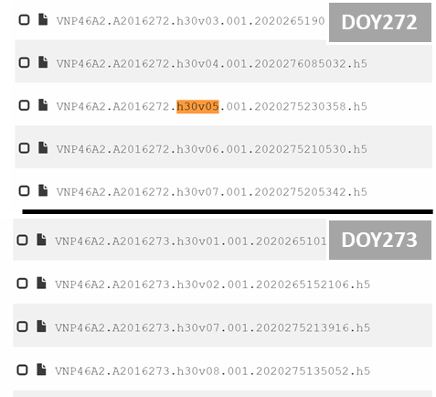
Pre-processing -2 : Missing tile

Slide 8
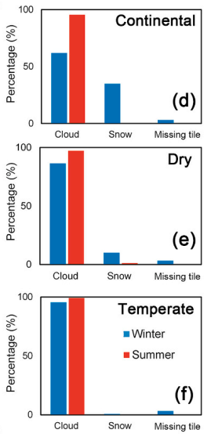
Pre-processing -2 : Missing tile
1. How to identify – code
2. Impact ?
3. How to address this issue ?

Slide 9

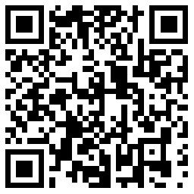
What’s Next
Ep.6
Other Black Marble products
Dr. Qiming Zheng
qmzheng@nus.edu.sg

