Slide 1
KEM-WireGuard
Equip WireGuard with post quantum resistance and mutual authentication
Presenter/s Name
Date 00/00/00

Slide 2
Overview
Background
Design
Implementation Issues
Demo of Artefact
Evaluation
Conclusions

Slide 3
Background & Related Work
WireGuard is a fast and secure VPN protocol using classic but not post-quantum cryptography algorithm
KEM-WireGuard does not only aim for pq conﬁdentiality, but also target mutual pq authentication.
Andreas et al¹ added PQ security to WireGuard’s using Key Encapsulation Mechanism(KEM).
Hülsing et al² introduce KEMTLS, a novel approach to implement handshake protocol that make full of KEMs as a new way of authentication instead of signatures.

Slide 4
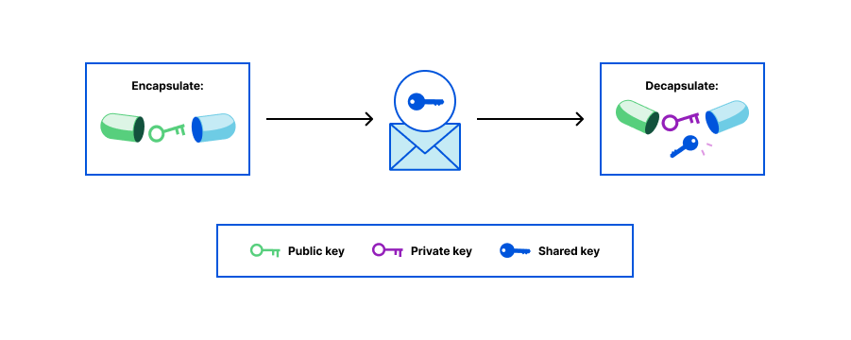
Building blocks
Cryptographic primitives
Key Encapsulation Mechanisms (KEMs)
Notes:
When using a KEM, Receiver would run Generate and publish the public key. Sender takes this public key, runs Encapsulate, keeps the generated secret to herself, and sends the encapsulation (the ciphertext) to Receiver. Receiver then runs Decapsulate on this encapsulation and, with it, arrives at the same shared secret that Sender holds.

Slide 5
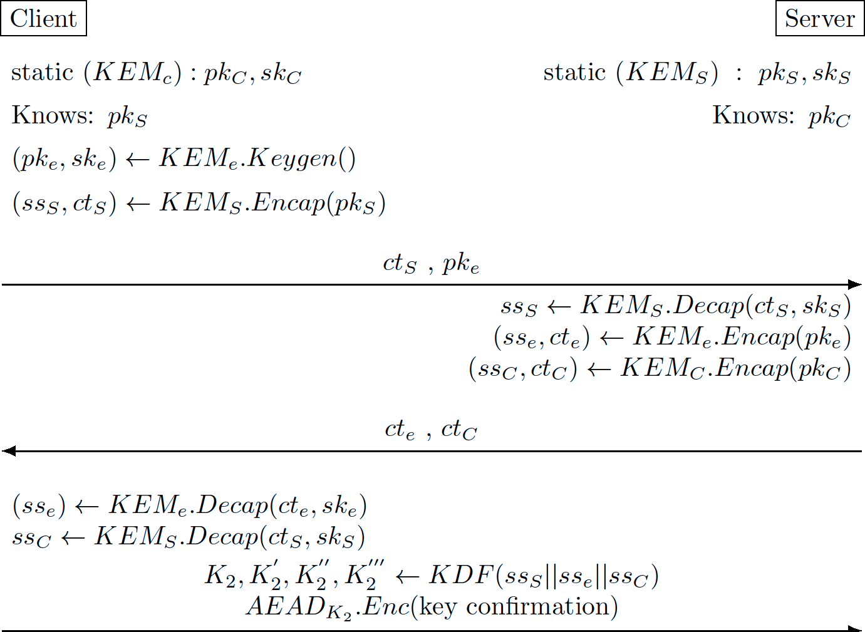
Design
Generic KEM construction
Notes:
Static key pairs exchanged out-of-band

Slide 6
Implementation Issues
The post quantum cost: Either computational or communicational
As we can see from the genetic design, the whole handshake requires 3 independent KEMs. So, all the design choices are boiled down to the question of priorities:
Should we prefer the on-wire size other than total runtime?
Should we care about more conservative security margin instead of performance?

Slide 7
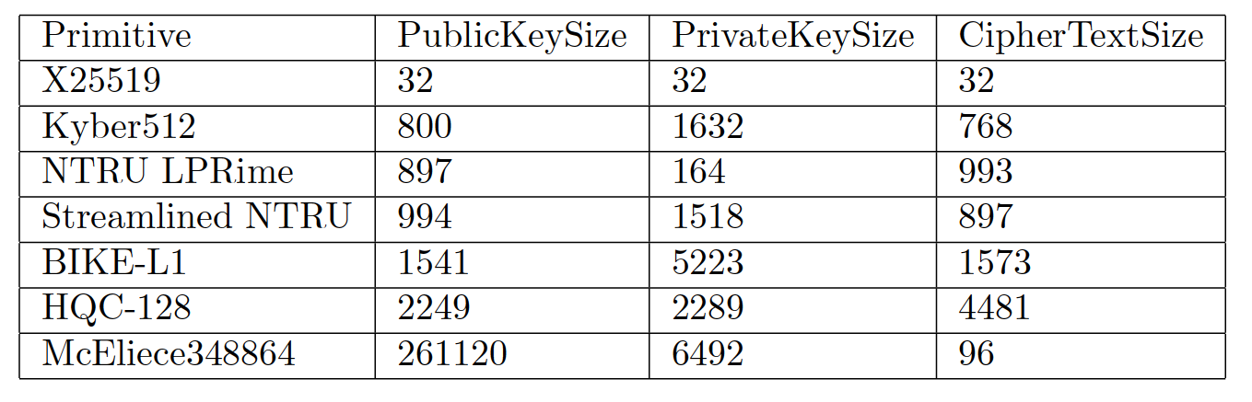
Evaluation
Tab 1. The size in bytes parameter of different KEM schemes

Slide 8
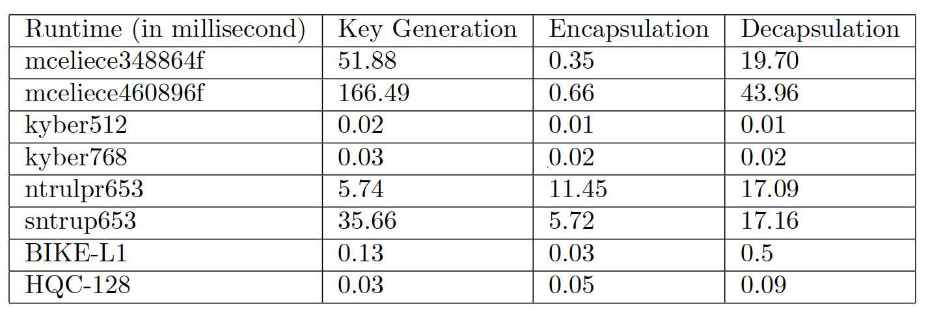
Evaluation
Tab 2. The time parameter of different KEM schemes

Slide 9
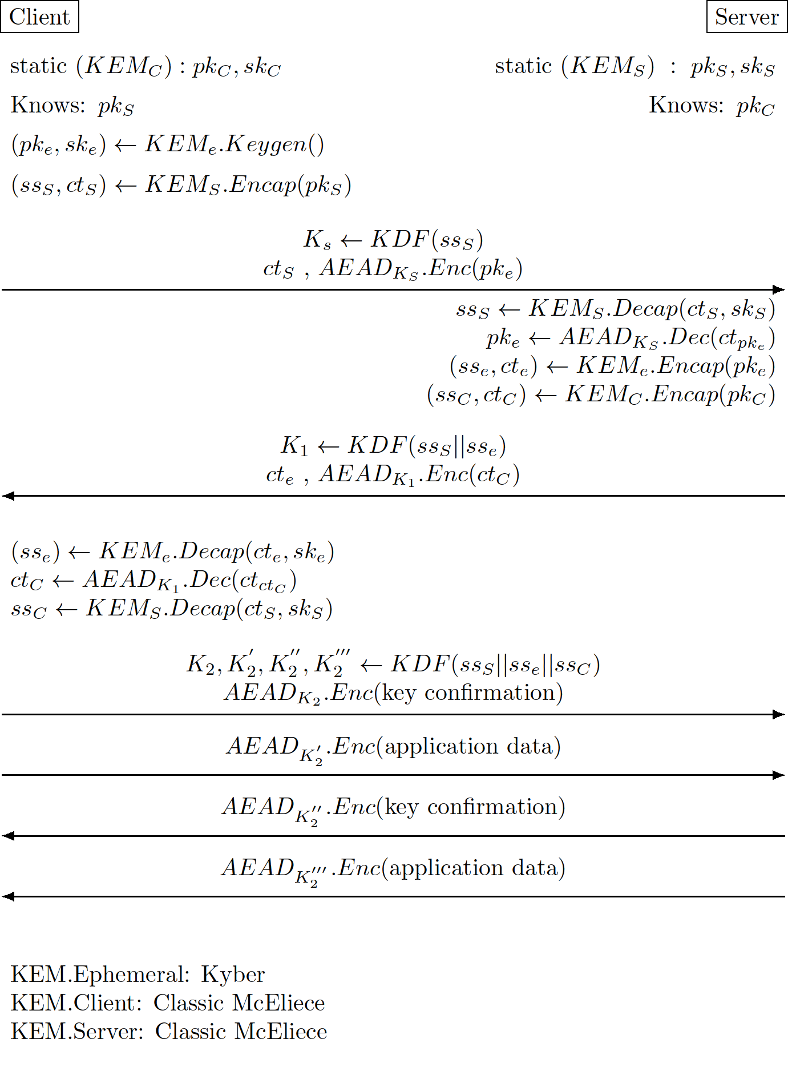
Design after evaluation
KEM scheme choice:
Server/Client: Classic McEliece
mceliece348864
Ephemeral: Kyber512

Slide 10
Questions ?

Slide 11
Thank You

