Slide 1

Project: G2M Insight for Cab Investment Firm
LISUM 15
12/06/2022

Slide 2
Agenda
Business Background
Data Properties
Hypothesis
EDA
EDA Summary
Recommendations

Slide 3
Business Background
XYZ is a private firm in US. Due to remarkable growth in the Cab Industry in last few years and multiple key players in the market, it is planning for an investment in Cab industry and as per their Go-to-Market(G2M) strategy they want to understand the market before taking final decision.
There are 4 datasets that are provided for marketing analysis:
Cab_Data.csv
Customer_ID.csv
Transaction_ID.csv
City.csv

Slide 4
Datasets
Cab_Data.csv contains information about transactions from 2 cab companies from 01/31/2016 to 12/31/2018.
Customer_ID.csv contains information about the customers from 2 companies and their demorgraphic details.
Transaction_ID.csv contains information about the customers’ transaction and payment mode
City.csv contains information about the US cities, their populations, and numbers of cab users.

Slide 5
Hypothesis
Is there any different in profit from 2 different companies in different years? Annually?
Is there any different in amount of customers and profit in different cities?
Is there any pattern for the spatial profits from 2 different companies?
Is there any factors affect the profit making for 2 companies, such as gender, payment mode, age, and income level?

Slide 6
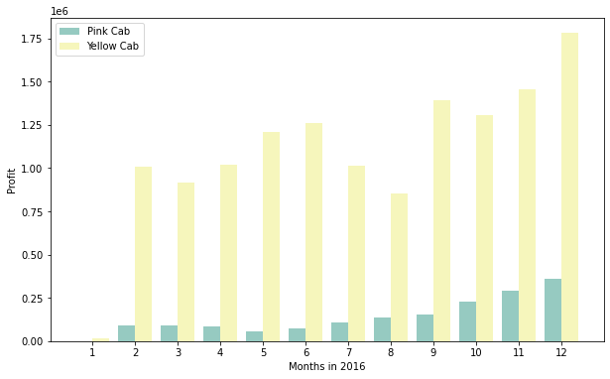
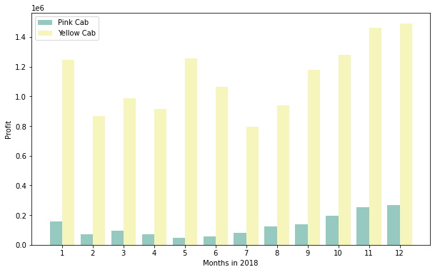
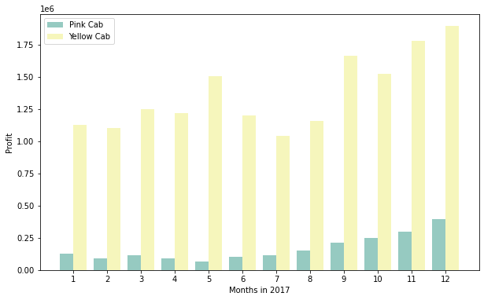
Hypothesis 1: Different in monthly and annually profit
These graphs illustrate the monthly profits from 2 companies, Pink Cab and Yellow Cab, between 2016 and 2018.
From those graphs, we can see that the Yellow Cab made much more profit than Pink Cab for every month in every year.
The Pink Cab tended to make more profit in the last quarter of the year and less profit in the second quarter of the year.
The Yellow cab tended to make most profits at the end of the year, and least profit in the third quarter of the year

Slide 7
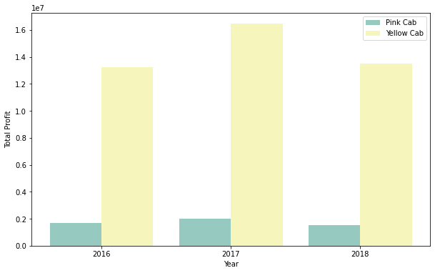
Hypothesis 1: Different in monthly and annually profit
Since the monthly profit of Yellow Cab outweighed Pink Cab, the yearly profit here confirmed the same thing
It seems like for both of the companies, they had the most profit in 2017 and least profit in 2018.

Slide 8
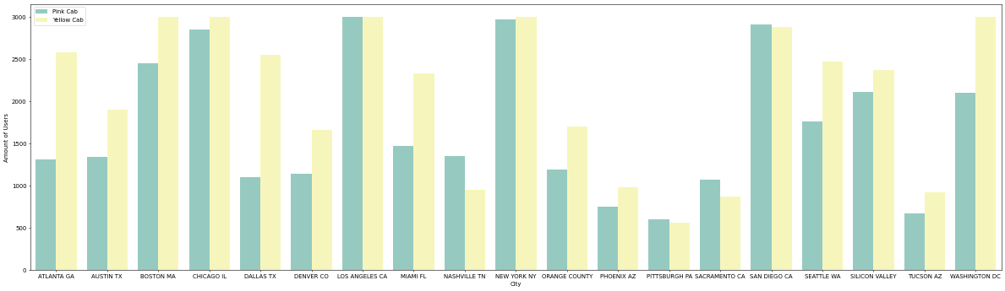
Hypothesis 2: Different in customers and profits in different cities
We can see that there are more customers using Yellow Cab than Pink Cab as they have more customers in 11 out of 19 cities in total. Moreover, the different in amounts of customers in these cities are noticeable.
For Pink Cab, they have the most of their customers in New York (NY), and Los Angeles (CA) and least customers in Pittsburgh (PA)
For Yellow Cab, they have the most customers in New York(NY), Los Angeles (CA), Chicago (IL) and Washington DC, and least customers in Pittsburgh (PA), which even less than the Pink Cab.

Slide 9
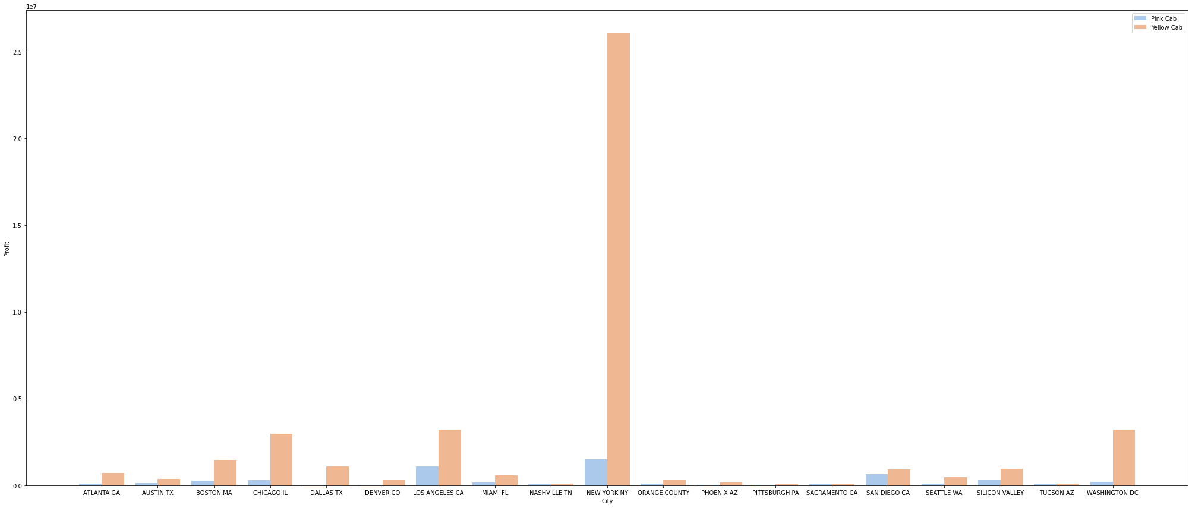
Hypothesis 2: Different in customers and profits in different cities
Since they both have the most customers in New York (NY), they also have the most profit in this city for both companies.
In every cities, Yellow Cab always had more profit than Pink Cab

Slide 10
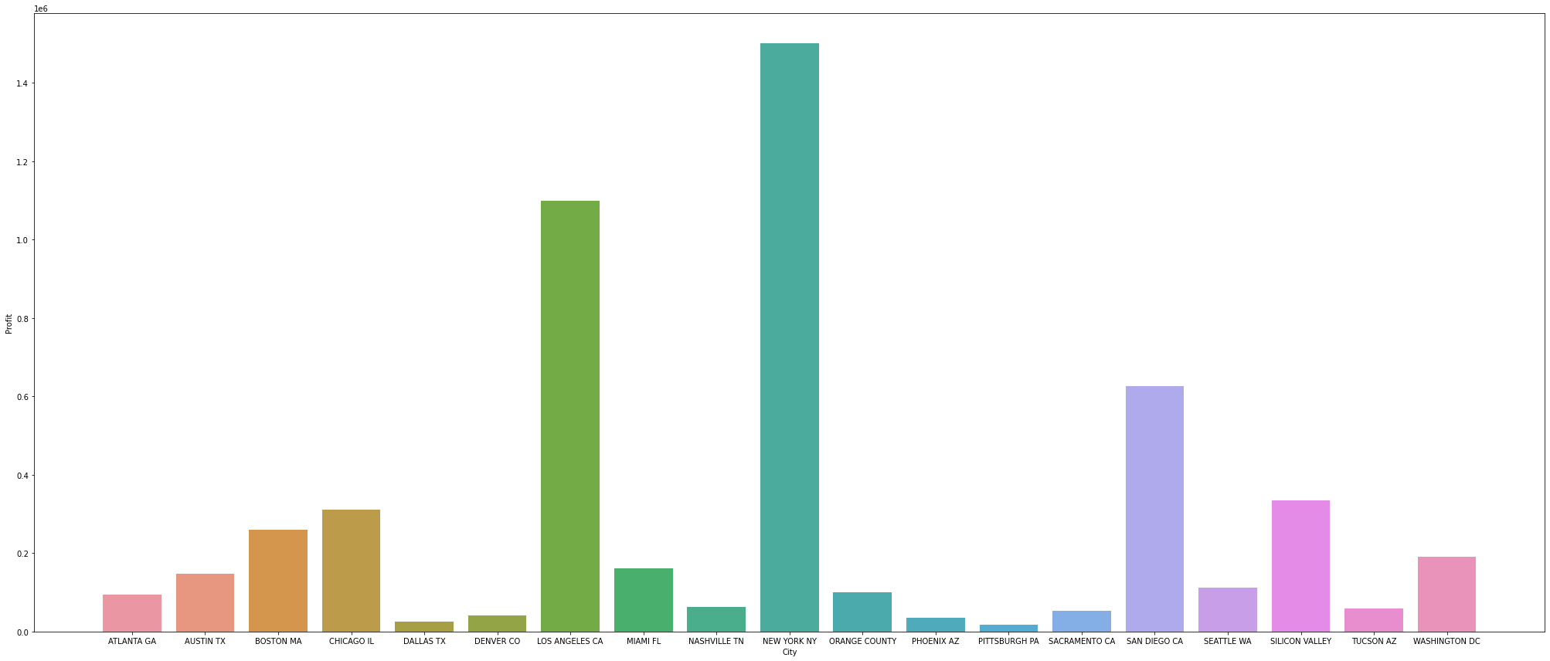
Hypothesis 3: Pattern in spatial profit of Pink Cab
As discussed above, they have most profits in New York (NY), following in Los Angles (LA) where they also have the most customers.
They have least profits in Pittsburgh (PA), where they have the least customers.

Slide 11
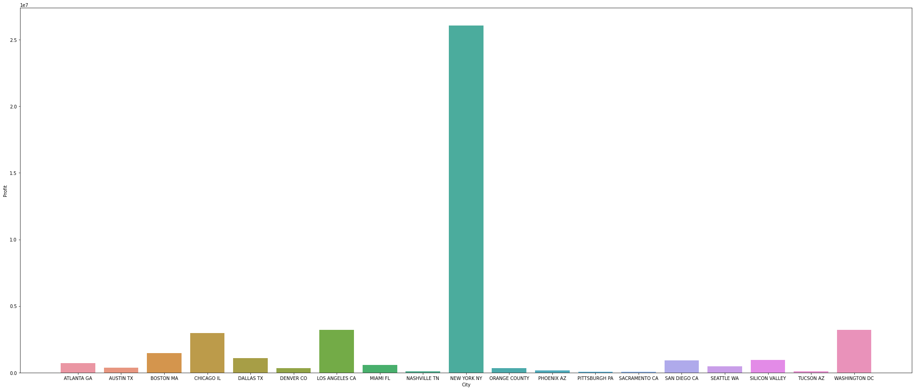
Hypothesis 3: Pattern in spatial profit of Yellow Cab
As discussed above, they have most profits in New York (NY), following in Los Angles (LA) where they also have the most customers.
They have least profits in Pittsburgh (PA), where they have the least customers. Other than that, they seemed not to have much profit in Sacramento (CA) and Tucson (AZ) either

Slide 12
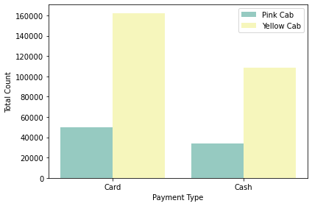
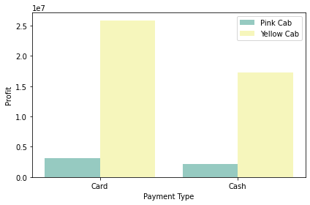
Hypothesis 4: Factors Affect Profits in two companies
For both companies, they have more customers using card as payment mode then cash.
Because of this, card gives them more profit than cash
However, in Pink Cab company, the difference is not a big gap comparing to the Yellow Cab.

Slide 13
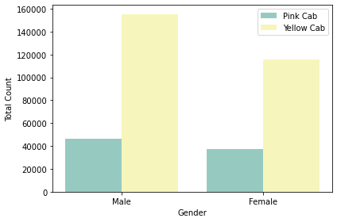
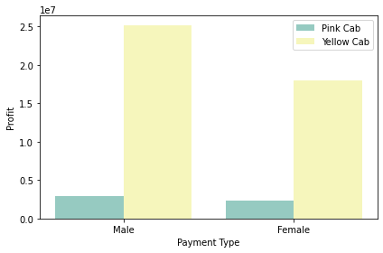
Hypothesis 4: Factors Affect Profits in two companies
For both companies, they have more male customers than female customers.
However, in Pink Cab, the difference are not noticeable comparing to Yellow Cab. This makes the contributions to the profits from both genders are similar to each other
In Yellow Cab, there are a big difference in the customers’ genders. This makes the male customers contribute more profits comparing to Female customers.

Slide 14
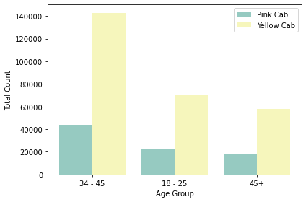
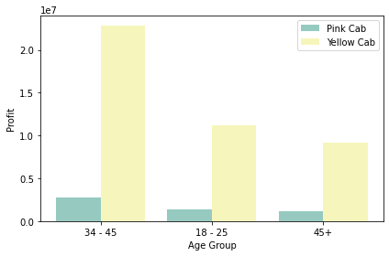
Hypothesis 4: Factors Affect Profits in two companies
For both company, they have the most customers between 34 – 45 years old, following by 18– 25 age group, and 45+ age group
Because of this, the most profit is coming from people in 34 – 45 age group.

Slide 15
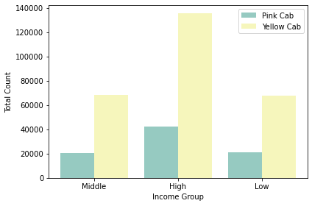
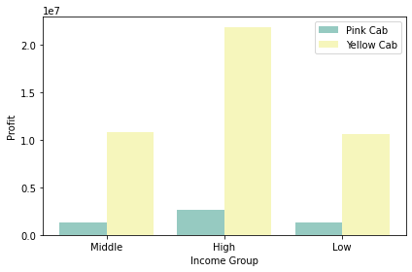
Hypothesis 4: Factors Affect Profits in two companies
For both companies, the have the most customers coming from the high-income group. The middle and low-income group seems to have the same amount of the customers.

Slide 16
Conclusion
Based on the EDA, we can see that Yellow Cab has more customers comparing to the Pink Cab for every factors, such as income level, gender, age group, and payment type.
In some cities, the Pink Cab may have more customers than Yellow Cab. However, these differences are not significant as they outweighed the numbers of customers in other 11 cities
This makes the Yellow Cab gained more profits than the Yellow Cab.

Slide 17
Thank You

